Slide 1

Childcare Providers
Information and communications toolkit
2022

Slide 2

Contents
Introduction
How you can help
Steps to take
Ofsted registration- Eligibility criteria
Guide to Ofsted registration
Guide to activating your Tax-Free Childcare account
Sample social media posts
Editable text for digital channels
Additional resources
Thank you and evaluation
Annex A: Guide to government childcare support offers

Slide 3

Introduction
Over a million families in the UK are entitled to support with the cost of childcare from the government, but many are missing out because childcare providers in their area haven’t signed up to accept the various offers.
This also means that many childcare providers are missing out on boosting their businesses by increasing demand as they aren’t accessible to families who use government childcare support.
With the school summer holidays approaching, it is more important than ever that parents and carers are able to access the financial aid they qualify for. It can reduce their costs, help them to stay in work, or help them work more hours.
This toolkit provides a step by step guide to making sure you have correct elements in place to make your services accessible to families who use government childcare support, boosting your business in the process.

Slide 4
How can you help
By making sure you have the correct elements in place for your services to be accessible to families using the different types of government childcare support.
By advertising the fact that your services are available to parents who are using government childcare support (resources on pages 10 and 11), boosting your potential client base in the process.
Reminding families using your services to search Childcare Choices to check what government financial support they could be entitled to.

Slide 5
Steps to take
If you are a childcare provider or childminder, we ask that you take the following steps to make sure families can access government support when using your services:
1) Check that you are registered with the relevant regulatory service. This means:
If you’re in England: Signing up to Ofsted’s Voluntary Childcare Register if you’re an unregistered childcare provider (guide on page 6), or if you’re a unregistered childminder, registering with Ofsted or a childminder agency.
If you’re in Wales: Making sure you’re on the Care and Social Services Inspectorate for Wales (CSSIW) Childcare and Play Service register whether you’re a childcare provider or childminder.
If you’re in Northern Ireland: Making sure you’re registered with your relevant Early Years Team within Health and Social Care (HSC) Trust whether you’re a childcare provider or childminder.
This will enable parents to access Universal Credit support when using your services.
If you’re in Scotland: It is already a legal requirement for all childcare providers to be on the Care Inspectorate’s Care Service register and for all childminders to be on the Care Inspectorate’s Childminder register, therefore you should automatically be able to accept parents using Universal Credit.
2) Check that you have activated your Tax-Free Childcare account (guide on page 7).
This will enable parents to access Tax-Free Childcare support when using your services.

Slide 6
Ofsted registration- Eligibility criteria *England only
In England, most childcare providers who look after children aged under eight will already be registered with Ofsted or a childminder agency.
However, those providing care to children aged eight or over, or who have an exemption from compulsory registration (e.g. activity providers, some home-based carers), will need to join the voluntary part of the Ofsted General Childcare register for parents to access Universal Credit or Tax-Free Childcare when paying for their services.
Providing they give care to the same child for two or more hours a day or provide wraparound care*, a large variety of childcare providers are eligible to register with Ofsted. Such as:
Playgroups and Nurseries
Wraparound care; Before or after school club
Home child carers/ nannies
Open-access youth providers, for example, centre-based and detached youth work
Complementary schools; those offering support or education in addition to the mainstream, learning, operating after school hours or at the weekend
Private tuition or learning centres
Holiday activity clubs
Private language schools, including those for children coming from abroad
Extracurricular clubs or settings, for example:
- Ballet classes
- Sports tuition
- Instrumental music tuition
- Martial arts training
- Drama classes
Religious settings offering education in their own faith, culture. For example:
  - Jewish yeshivas and chedarim
  - Muslim madrassahs
  Christian Sunday schools
  Hindu settings
  Sikh settings
For more information on eligibility, please visit: Qualifying for the voluntary part of the Childcare Register - GOV.UK (www.gov.uk)
* Wraparound care is care that either ends when the school day begins or begins when the school day ends and there is no two hour requirement

Slide 7
Guide to Ofsted registration *England only
As a childcare provider or childminder registered with a regulator, you could boost your business by accepting payments from families using Universal Credit or Tax-Free Childcare. If you are in England, this means joining the voluntary part of the Ofsted General Childcare register or a childminder agency.
For those who choose to join the Ofsted register, please note the following information:
To register your childcare on the Childcare Register, you must be either the:
sole owner
nominated individual of an organisation, such as a company or partnership
You will need a Disclosure and Barring Service (DBS) check. Please read this guidance on what DBS check you will need.
You must have first aid training for the age range you look after.
How much it costs
It usually costs £114 for a provider to apply to register with Ofsted, and £35 for childminders.
Providers can start the registration process here: Apply to join the Childcare Register (CR1) - GOV.UK (www.gov.uk)
Childminders can start the registration process here: Become a childminder or nanny (England): Register as a childminder - GOV.UK
Once you are Ofsted or childminder agency registered, you are automatically able to accept payments from parents who are using Universal Credit childcare support. Please see Annex A for more information on how parents become eligible for Universal Credit childcare support.

Slide 8
Guide to activating your Tax-Free Childcare account
Once registered with a regulator in the UK, you can boost your business and help reduce cost for working families by activating your Tax-Free Childcare (TFC) account. Setting it up is free and only takes around ten minutes.
After the registration process with the regulator has been completed, you should receive an invitation letter containing your unique 11 digit user ID, along with instructions on how to sign-up online to TFC. If you are already registered and haven’t received your invitation letter, you should contact the Childcare Service helpline.
Activating your TFC account:
You’ll find everything you need on the GOV.UK Tax-Free Childcare if you’re a childcare provider page.
To sign up you’ll need your:
• unique 11-digit user ID
• business bank account details, so you can receive payments
• business postcode (the one registered with your regulator)
Once you’ve signed up, you can:
• Accept Tax-Free Childcare payments and get a childcare provider account which you can use to keep your details up to date
• Manage payments online 24/7 (using your provider account)
• Promote the financial benefits to your customers
• Still accept payments from parents using childcare vouchers and other methods
Visit the Childcare Choices information for providers page to learn more about Tax-Free Childcare and how it can help your business, and see Annex A to find out which parents are eligible.

Slide 9



Sample social media posts
Once you have registered with the relevant regulator and activated your TFC account, why not boost your business by letting parents in your area know that they can access government support when using your services? Social media networks are a great way to do this, which is why we have produced some suggested posts and graphics that you can use across your channels:
Some families may not realise that they’re eligible for government childcare support.
Here at “enter name”, we have everything in place for you to access all the different offers when using our services.
Visit https://www.childcarechoices.gov.uk/ to find out what you’re entitled to.
Want your child make the most of their summer? ☀
The Universal Credit childcare offer can help eligible families with up to 85% of their childcare costs.
Visit 👉 https://www.childcarechoices.gov.uk/ to see which offer works for you.
Over a million families are entitled to some form of government childcare support.
Here at “enter name of business” we are set up so our families can access all the different offers.
Visit 👉 https://www.childcarechoices.gov.uk/ today to find the support that works for you.
Tax Free Childcare gives support to working parents earning up to £100,000.
If you are eligible, the government will pay up to 20% of your childcare costs.
Access all the types of support whilst your children are at “enter name of business”.
Visit👉 https://www.childcarechoices.gov.uk/
Download the graphics for Twitter, Facebook, Instagram and LinkedIn here

Slide 10
Editable text for digital channels
Alternative digital channels such as websites, email networks and newsletters are also great ways of reminding parents that they could be entitled to government childcare support. Please find some suggested text below that you could use across your channels to help your families reduce their costs:
‘Could you do with some help with your childcare costs? Over a million families are entitled to government-funded childcare support that could be worth thousands of pounds.
Whether you have toddlers or school kids, you could get support with your childcare payments.
Here at “enter name”, we are set up to accept parents using all the different types of government childcare support.
It’s easy to find out about all the offers online, just visit ChildcareChoices.gov.uk for more information on what support you could receive.
Don’t miss out on the help you could be entitled to.’

Slide 11
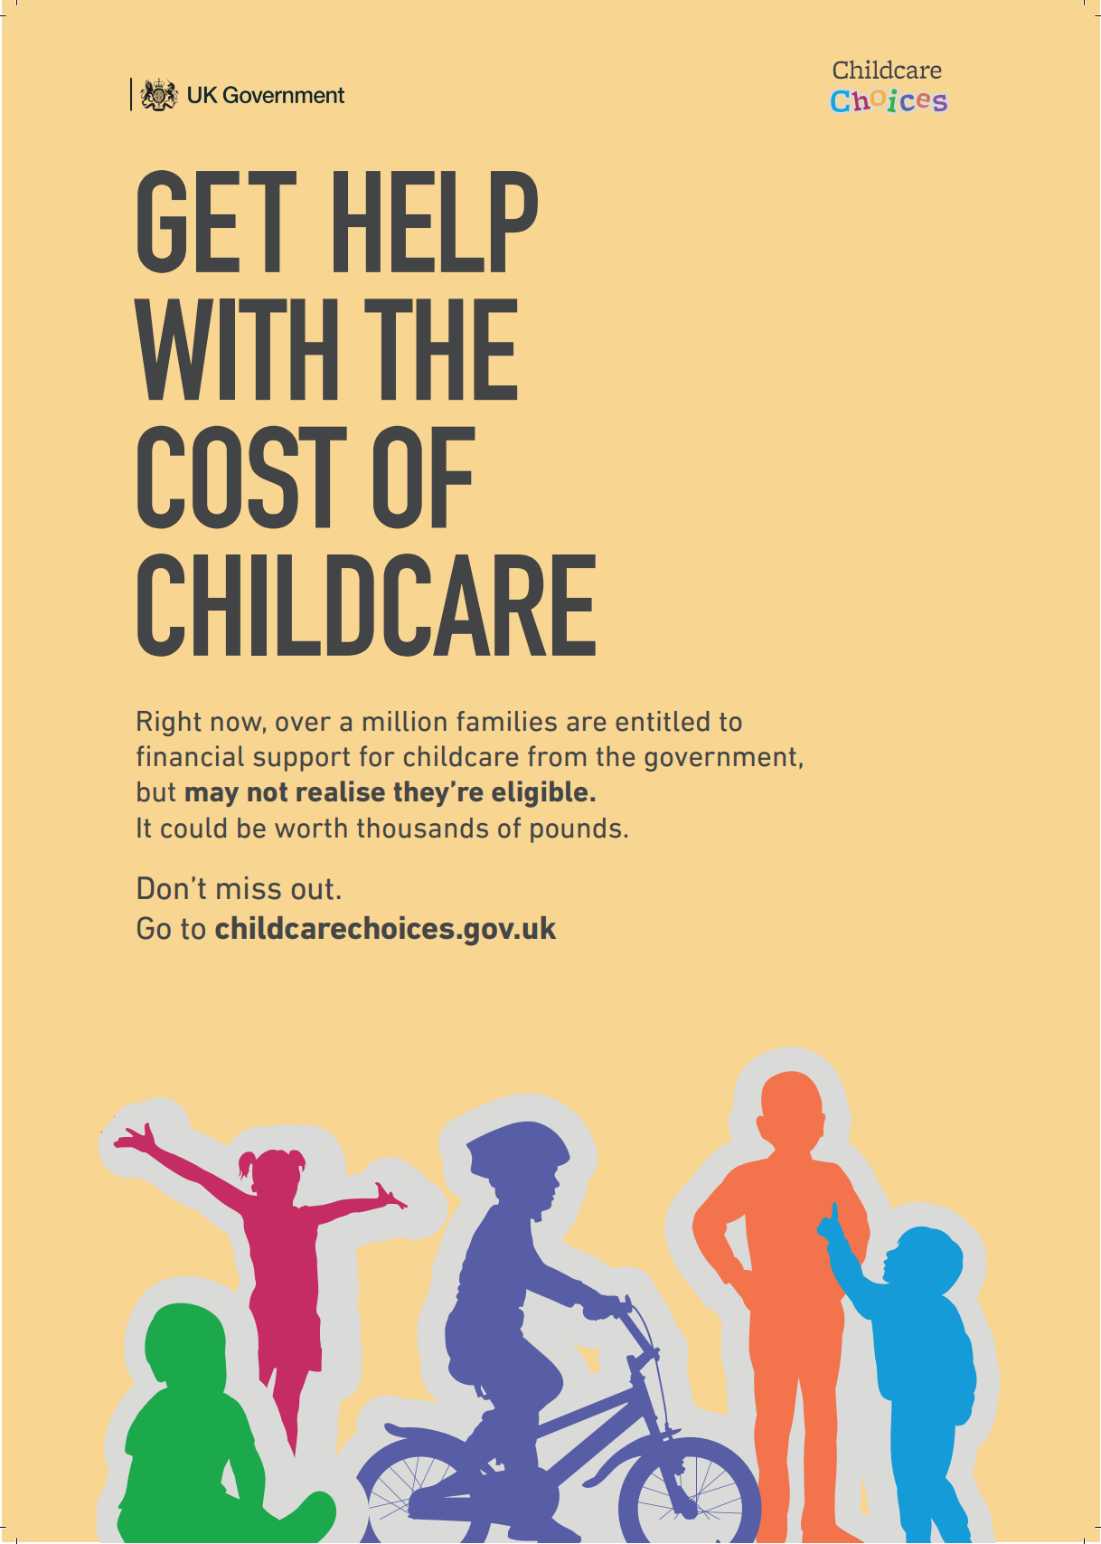
Additional resources
Click here to download a printable Childcare Choices A4 poster that you can display on-site.
Other helpful links:
Link to Childcare Choices: Childcare Choices | 30 Hours Free Childcare, Tax-Free Childcare and More | Help with Costs | GOV.UK
Link to information page on how parents can use more that one government support offer together: Using childcare schemes together | Childcare choices
Link to Childcare Choices provider information page: Information for Childcare providers | Childcare choices
Link to Childcare Choices marketing toolkit, containing more resources to promote and explain the childcare support offers to parents: Communications toolkit | Childcare choices
Once childcare providers are registered with Ofsted, they will be supplied with an Ofsted logo to be displayed on your marketing materials.

Slide 12
Thank you
We appreciate the time you have taken to read and utilise this toolkit.
Please note: We will be circulating a short follow-up survey at the beginning of August to receive feedback on how useful you found this resource.

Slide 13
Annex A: Guide to childcare support offers (UK wide offers)
The eligibility criterial of the different forms of government childcare support packages that parents can access are as follows:
Tax –Free Childcare
Universal Credit support
For working families, including the self-employed, in the UK
Each parents in the household can earn up to £100k, or at least £152 per week (equal to 16 hours at the National Minimum or Living Wage) each to be eligible.
Who aren't receiving Tax Credits, Universal Credit or childcare vouchers
With children aged 0-11 (or 0-16 if disabled)
Government will pay 20% of the childcare costs, up to £2,000 per child per year
Can be accessed through regulator registered providers and childminders who have activated their Tax-Free Childcare accounts.
If parents live and pay tax in Northern Ireland but use a childcare provider in the Republic of Ireland, please advise them to call 0300 123 4097 to check their eligibility.
If they live in Northern Ireland but work in the Republic of Ireland, they’re eligible for Tax-Free Childcare if they or their partner pay UK tax and complete an annual Self-Assessment tax return.
For working families claiming Universal Credit, in England, Scotland, Northern Ireland and Wales
With children under 17*
Up to 85% of eligible childcare costs
Who aren't receiving Tax-Free Childcare
Parents can claim for childcare provided by those registered with a regulator.

Slide 14
England only offers:
15 hours free childcare- Age 2
15 hours free childcare- Ages 3 & 4
30 hours free childcare
For families in England, receiving some forms of support
With 2-year-old children
15 hours of free childcare or early education for 38 weeks
A total of 570 hours per year, that they can use flexibly with one or more childcare provider
By already being Ofsted registered, all early years settings are set-up to offer 15 hours free childcare
For all families in England with 3 and 4-year-old children
15 hours of free childcare or early education for 38 weeks
A total of 570 hours per year, that they can use flexibly with one or more childcare provider
By already being Ofsted registered, all early years settings are set-up to offer 15 hours free childcare
For working families in England with 3 and 4-year-old children
30 hours of free childcare or early education for 38 weeks
A total of 1,140 hours per year, that they can use flexibly with one or more
childcare provider
By already being Ofsted registered, all early years settings are set-up to offer 30 hours free childcare

Slide 15
Wales only offers:
Childcare for 3 &4 year olds
Flying start
The childcare offer for Wales’ provides working parents or in education and training with a mixture of childcare and early education for children aged 3 or 4. Families could get up to 30 hours a week of early education and childcare.
Childcare eligible to be paid for by the Childcare Offer for Wales includes:
nurseries
child minders
playgroups
crèche
out of school child care
They can choose your own childcare provider that meets your child’s needs.
Eligibility
The child must be aged 3 or 4 years old
Each parent must earn at least the equivalent of 16 hours at the National Minimum Wage or living Wage for 16 hours per week on average and less than £100,000 per year
Parents of lone parent families need to be working or in education or training
Parents of two parent families must both be working or in education and training
Parents who are self-employed or on a zero hours contract need prove their status and provide relevant documents
Parents who are employed or self- employed but are on statutory leave for example, maternity leave
Foster carers, kinship carers and parents on adoption leave may also be eligible
Parents in education need to prove their status with evidence of a formal offer or enrolment on a course
Check eligibility for the Childcare Offer for Wales.
Help is available for parents and carers of under 4s in disadvantaged areas of Wales.
Help available includes:
  part-time childcare for 2 to 3 year olds
  an enhanced Health Visiting service
  access to parenting programmes
  support for children to learn to talk and communicate
Contact your local Family Information Service to find out if you live in a Flying Start area and what help may be available.

Slide 16
Scotland only offers:
1,140 hours
In Scotland all 3 and 4 years olds and eligible 2 year olds are entitled to up to 1,140 hours of funded early learning and childcare (ELC) a year.
This works out as around 30 hours a week if families take it during school term time or around 22 hours a week is taken year round.
For information on who is eligible please go to: Funded early learning and childcare - mygov.scot
Each local council area manages this for children and families in their areas. For more information on their local offer, families should contact their local council
Funded ELC in Scotland is provider neutral, so families can access high quality funded ELC with the provider of their choice- in the public, private, or third sector or a child minder- if that provider meets the criteria in the National Standard, wishes to deliver the funded entitlement, has a space available, is able to offer the funded hours in-line with their local authority’s ELC plan and is in contract with their local authority to deliver the funded hours
For more information on funded ELC visit: Funded early learning and childcare - mygov.scot

Slide 17
Northern Ireland only offers:
Sure Start
Funded pre-school education places
Help with upfront childcare costs
The Sure Start programme supports parents with children aged under four years old, living in disadvantaged areas in Northern Ireland. The programme can help a parent from pregnancy until their child starts school.
A project can support a child's:
learning skills
health and well-being
social and emotional development
Sure Start projects complement the work of local services and give young families advice on where to go and who to speak to, if they have specialised needs or problems.
Click here for more information, and to find
out what services are available in your area, contact the local Sure Start project:
Sure Start partnerships
The Pre-School Education Programme funds education for children in the year before they start primary school. Pre-school education is available to every child but it's not essential. If parents want their child to have pre-school education, they need to apply for a place.
Funded pre-school education places are provided in:
nursery schools
primary schools with nursery units
voluntary and private pre-school education settings with government-funded places
For more information, visit: Pre-school education places | nidirect
Eligible parents may be able to receive help with upfront childcare costs through the Adviser Discretion Fund (ADF). To qualify:
- They need to be in receipt of, or moving onto, Universal Credit, or are in receipt of other income-based benefits.
- Facing upfront childcare costs that are a barrier to moving into work, recommencing employment (such as following a period of parental leave), or are significantly increasing their hours.
• This is a non-repayable grant for upfront childcare costs of up to £1,500
• The money will be paid directly to a registered childcare provider only
• A receipt for the upfront childcare costs paid through the ADF can also be submitted for the purposes of calculating the parent’s Universal Credit entitlement.
Check eligibility via Universal Credit Work Coach or the local Jobs & Benefits office: https://www.nidirect.gov.uk/adf

