Slide 1

Implementing Continuity of Care across Greater Manchester Maternity services Catherine Owens (MSc;BSc,RGN,RM,PGCAP) Clinical Project Lead for Continuity of Carer
July 2023
July 2023

Slide 2

Recent findings
Insights gained from past experiences
Adopting a new approach
Hosts:
Catherine Owens & Sarah West
GMEC Integrated Care Board

Slide 3




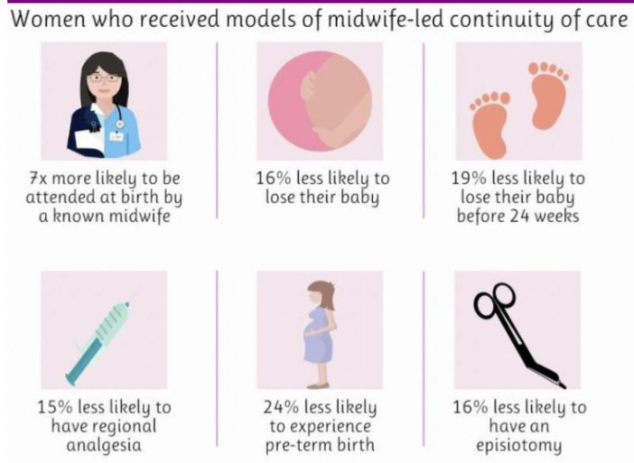


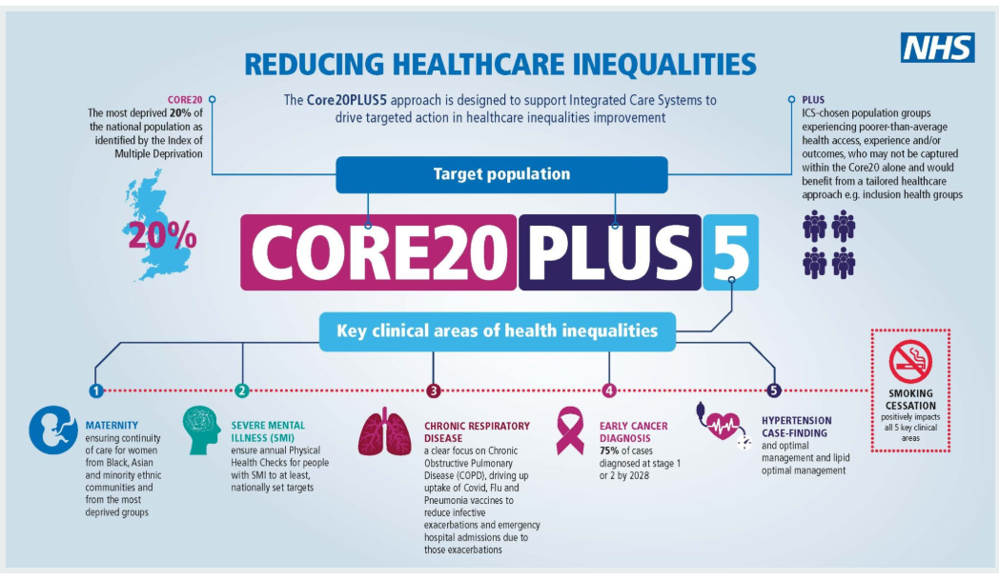
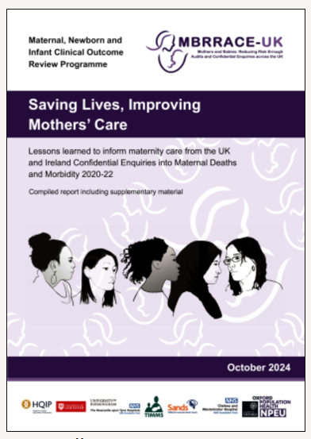

The Findings
1993
2007
2016
2022
2023
2024
The Marmite years
2023

Slide 4
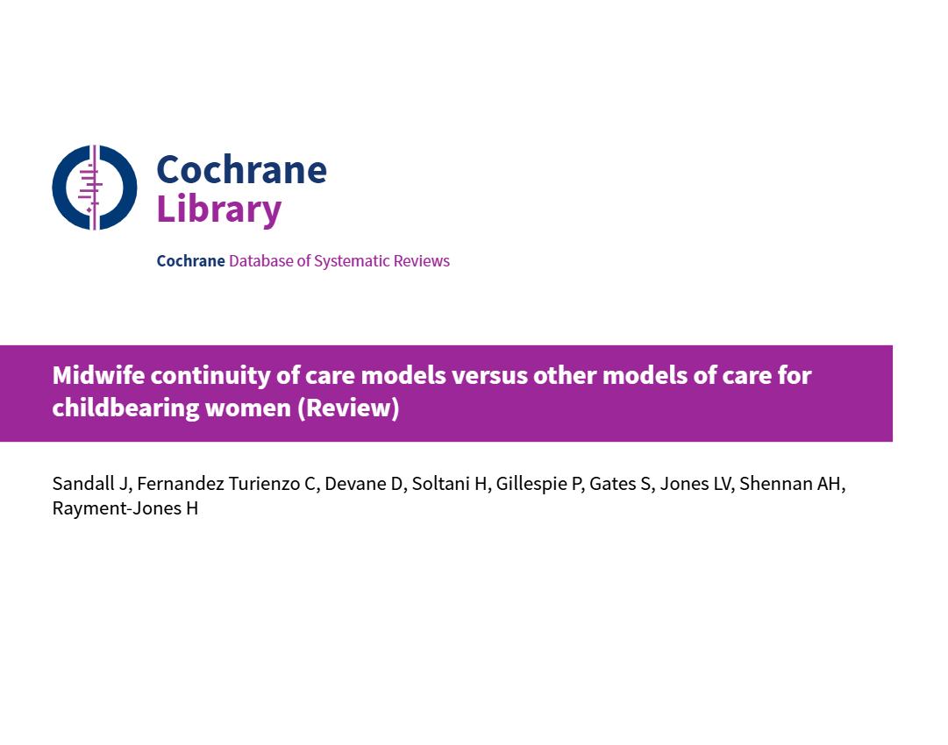
The Findings
18,533 women classified as low risk found:
Women or babies receiving midwife continuity of care models less likely to experience a caesarean section or instrumental birth and may be less likely to experience an episiotomy
More likely to experience spontaneous vaginal birth.
More positive experiences during pregnancy, labour, and postpartum.
The review concluded uncertainty about the effect of midwife continuity of care models on regional anaesthesia, fetal loss after 24 weeks' gestation, and neonatal death.
Findings were noted as limited and need for further studies required particularly in relation to women at high risk of complications and social risk factors
May 2024
https://www.cochrane.org/CD004667/PREG_are-midwife-continuity-care-models-versus-other-models-care-childbearing-women-better-women-and

Slide 5



The Findings
Evaluation of the enhanced midwifery continuity of carer model (EMCoC)
Independent, formative evaluation Jan 2023 to August 2024
Inequalities in maternal mortality: targeted EMCoC to women in deprived areas, ethnic minority groups & increased social risks
58 local community-midwifery teams located in areas of highest deprivation with high proportions of ethnic minority women supporting AN &PN care and mental health wellbeing
Research focused on 17 enhanced teams

Slide 6
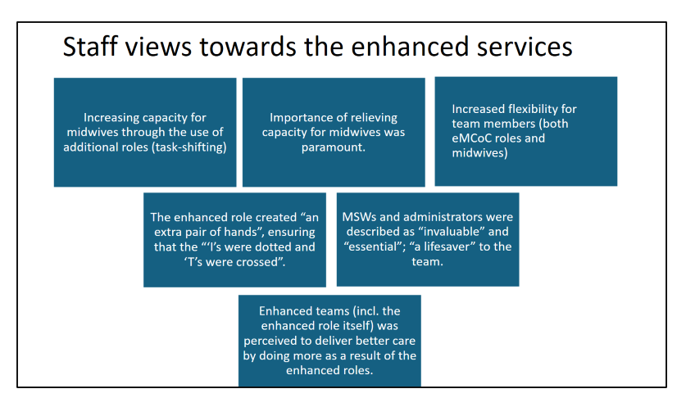
Insights gained from the past
Staffing Levels & Midwifery infrastructure
paramount
Value of relationship - based care
Local and regional team approach required
Lost the digital intelligence re CoC data

Slide 7

Adopting a new approach
Collaborative Partnership with
all maternity providers in Greater
Manchester
Implementation of EMCoC
teams reflective of local needs
Implementing national Building
Blocks to underpin sustainable pathways
Introduction of Pregnancy Circles

Slide 8
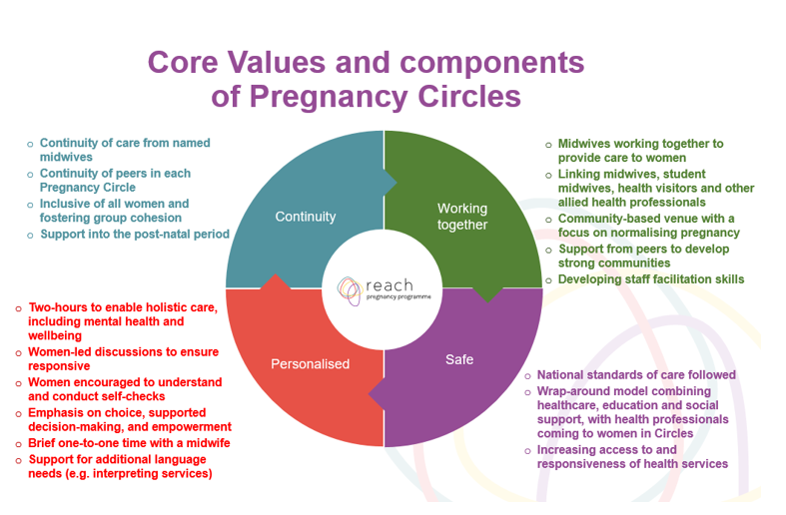
Group Ante Natal Care: How the Model Works

Slide 9
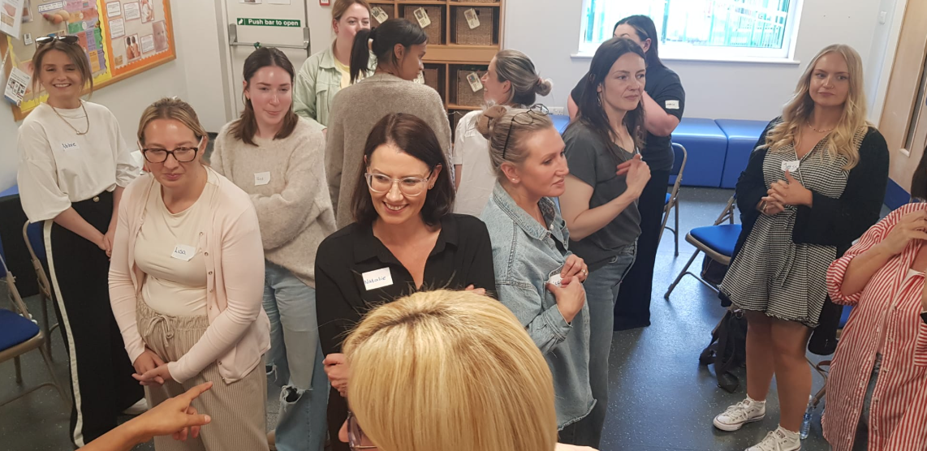
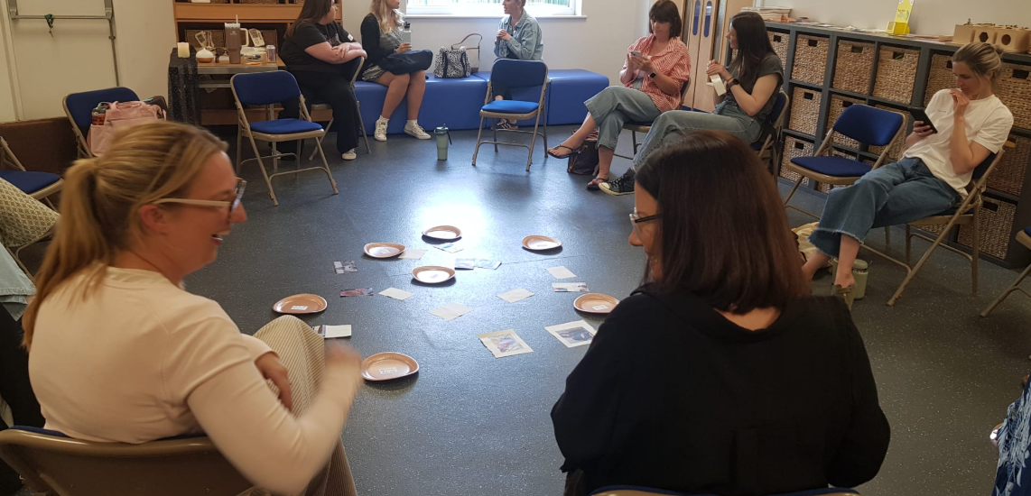
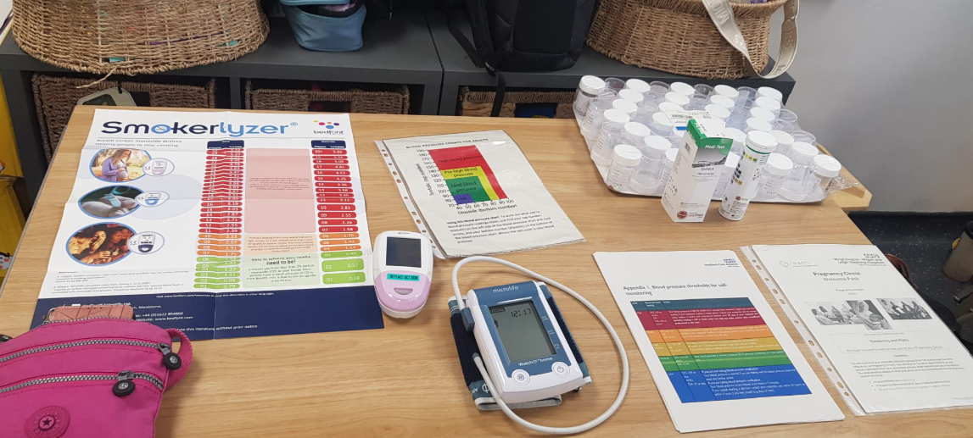
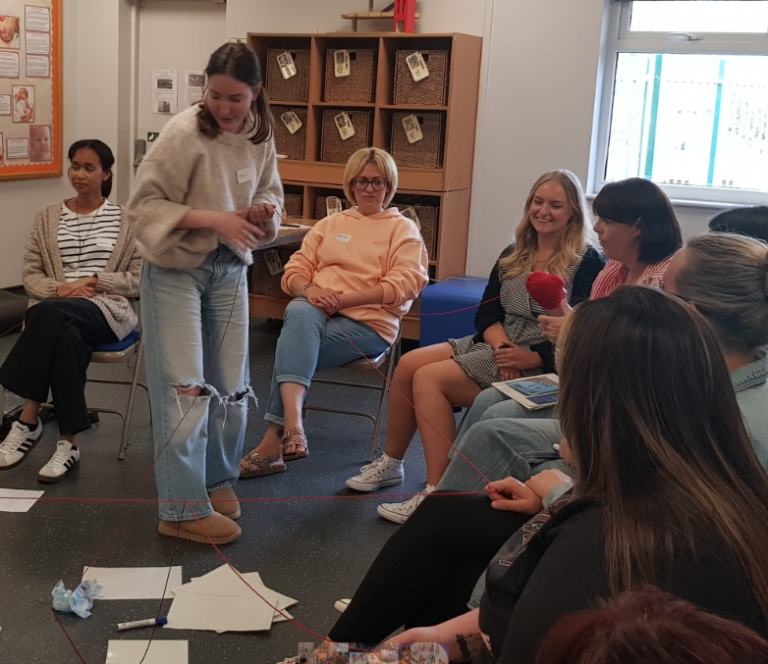
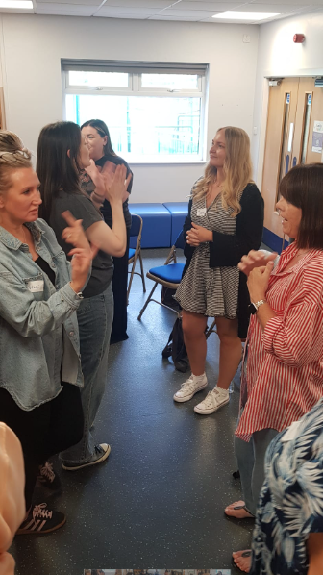
Pregnancy Circles Midwifery feedback
Inspiring
Fun and interactive
Fabulous experience
Re inspired midwifery passion to be with women
So many positive benefits to women and midwives
Can not wait to start delivering this model
It was such a positive experience for NES group and myself
No powerpoint
Feel well prepared to undertake
Great follow up support to share experiences

Slide 10

Continue the excellent progress being made in Greater Manchester by: Wide scale implementation of pregnancy circles across Greater Manchester Build digital intelligence around EMCoC to underpin practice and identify future needs and priorities of women and their families Embed a sustainable EMCoC approach which will meet the needs of women and families and also maternity workforce

Slide 11
Summary
Providing Continuity of Carer has witnessed a challenging journey
The need and benefits of continuity is not going away
This time we have adopted a building blocks approach encompassing collaborative partnerships with women, maternity workforce and LMNS
Greater Manchester has made great steps into improving the offer of EMCoC to the most vulnerable women and families
We are excited about the future of continuity and the opportunities which lie ahead

Slide 12


