Slide 1




Diabetes in Children: Don’t EVER FORGET GLUCOSE
This presentation has been developed by the Children and Young People’s National Diabetes Network and is aimed at health professionals in primary care.
It should take no more than 5 minutes to read and may help save a life.

Slide 2
Diabetes in Children
Most diabetes in children is type 1 diabetes
It is caused by immune destruction of the islet cells in the pancreas, leading to insulin deficiency
Diabetes in children progresses
Sometimes there are only a few days between symptoms developing and the child developing Diabetic Ketoacidosis (DKA)
FAST

Slide 3
Facts and Figures
2019-20: In England and Wales, 2799 children under 16 were diagnosed with type 1 diabetes
What percentage do you think were in DKA at diagnosis?
Source: National Paediatric Diabetes Audit
The answer is 38.5%
That is 1078 children who could have avoided DKA if diagnosed earlier

Slide 4
Impact of DKA
Diabetic Ketoacidosis is
Many children will be admitted to HDU – some will go to ITU
Complications of DKA include:
Cerebral oedema
Permanent brain injury
Renal failure
Limb ischaemia and amputation
Death
Long term impacts:
Anxiety, post-traumatic stress symptoms
Association with poorer longer term glycaemic control
May affect long term cognitive scores/brain growth
DANGEROUS

Slide 5
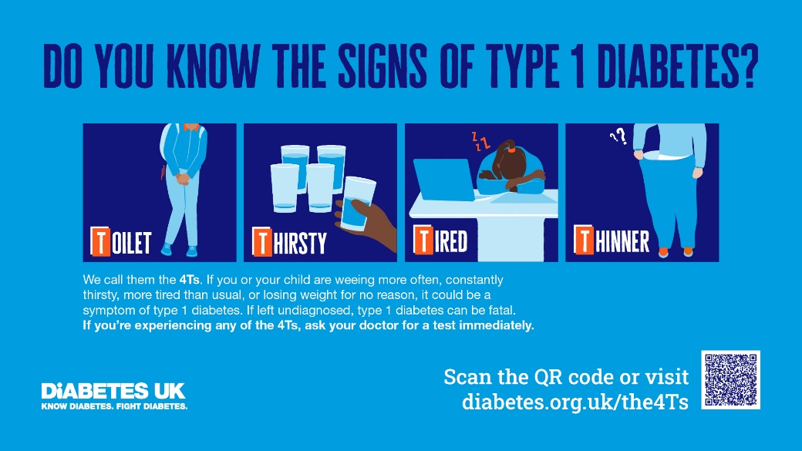
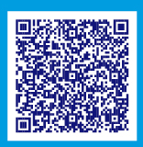
The Key Symptoms of Type 1 Diabetes
The Diabetes UK 4Ts campaign promotes awareness of the four key symptoms of Type 1 Diabetes. Do you know what they are?
Toilet
Passing urine more than normal
May present with new onset bedwetting
In babies may note very heavy nappies
Thirsty
Drinking more than normal
Tired
Thinner
Parents often don’t notice their child is losing weight – they think they are growing. Ask if they are getting thinner instead.
Also think about diabetes in children with:
Recurrent oral thrush
Persistent nappy rash

Slide 6
SPOTTING DKA
Children who have developed DKA may show the following additional symptoms:
Tired, sleepy or confused
Deep sighing breathing
Abdominal pain – may present as acute abdomen
Vomiting
Breath that smells fruity (like pear drop sweets or nail polish remover)
Be careful not to mistake the deep sighing breathing pattern of DKA for pneumonia or asthma.

Slide 7
Making The Diagnosis
Children with suspected diabetes should have an immediate finger prick blood glucose tested on a blood glucose meter
Urine dipstick for glucose may show glycosuria but is less sensitive
All GP practices should ensure they have a blood glucose meter available
Ensure equipment is calibrated and that strips are available and in date

Slide 8
Why Might The Diagnosis of Diabetes Be Missed By Clinicians?
Don’t think about diabetes
This is particularly common in children with isolated weight loss who haven’t developed thirst/urination symptoms.
Don’t believe it’s diabetes
Children can still look really well despite very high blood glucose levels. Children can’t be “too young” to have diabetes, it can present in infants and toddlers.
Think diabetes is rare
Most GPs/nurses will only diagnose diabetes in a child a few times in their career – but make sure you don’t miss it!
Testing is delayed
Children with diabetes can go into DKA very quickly. If they have any one of the symptoms of diabetes make sure you do a test the same day:
Do: Finger prick blood glucose
Don’t: Send for outpatient HbA1c - this will delay diagnosis

Slide 9
Case 1
8 year old boy consults with 2 months of weight loss
Bloods tests are normal but diabetes is not considered and not tested
Consults again with 4 day history of excessive thirst and going to toilet 2 times a night
Diabetes is considered and blood test for HbA1c booked for next week
While awaiting blood tests child develops vomiting and drowsiness – admitted in DKA
pH 6.9 on admission, acute kidney injury with creatinine of 200, requires 48 hour admission to HDU

Slide 10
Case 1 – Learning Points
Always think about diabetes in a child with unexplained weight loss
When suspecting diabetes do a test the SAME DAY:
Finger prick blood glucose
Don’t send for outpatient HbA1c – this will delay diagnosis

Slide 11
Case 2
2 year old boy consults with increased thirst
Clinician considers diabetes but child looks very well, running around the room
Increased thirst attributed to hot weather
3 days later child deteriorates – vomiting, pale, quiet
Admitted in DKA
Early into treatment develops severe headache – CT shows cerebral oedema
GCS deteriorates despite IV mannitol – intubated and transferred to PICU

Slide 12
Case 2 – learning points
Children with diabetes can look very well
If there is a symptom of diabetes then do a test the SAME DAY:
Finger prick blood glucose
Don’t attribute symptoms to another cause without ruling out diabetes first

Slide 13
Case 3
6 year old child brought to GP with breathlessness
GP notes deep sighing breathing pattern not typical of chest infection – considers diabetes
Further history – 2 weeks of increased thirst and bedwetting
Finger prick blood glucose test – 30 mmol/L
Transferred urgently to ED – DKA confirmed
IV access very difficult and has multiple cannulation attempts
Develops anxiety after discharge, flashback to time in HDU, referred to team psychologist

Slide 14
Case 3 – learning points
Always consider DKA in a breathless child
Asthma and pneumonia do not typically present with deep, sighing respiration – think DKA
The smell of ketones may be a clue to DKA but be aware not all people can smell these
Think about diabetes in children with new onset bedwetting

Slide 15
In summary
In children with one of the 4Ts:
Toilet, Thirsty, Tired, Thinner
Don’t Ever Forget Glucose
Test for diabetes:
Finger prick blood glucose
Blood glucose above 11 mmol/L indicates diabetes:
Transfer to hospital for further assessment
Blood glucose 7-11 mmol/L or glycosuria with diabetes symptoms:
Discuss with paediatric team
ANY
SAME DAY
IMMEDIATELY
SAME DAY

Slide 16
Further information
National Children & Young People’s Diabetes Network
www.cypdiabetesnetwork.nhs.uk/national-network/dka-prevention-at-diagnosis/
Diabetes UK
www.diabetes.org.uk/The4Ts
Diagnosing type 1 diabetes - Pathway HCPs - Diabetes UK Shop
NICE: Diabetes (type 1 and type 2) in Children and Young People: Diagnosis and Management
www.nice.org.uk/guidance/ng18
You are welcome to copy sections of this work to include in your own presentations, but please do not edit this slide set when distributing.

