Slide 1
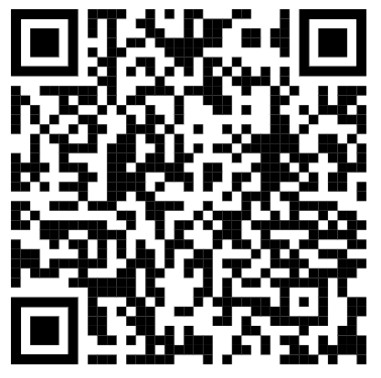
Spring FREE SEND CPD
1 hour online sessions, 4-5pm, no limit to places
Course title | Date | Course provider
Supporting students with hearing impairment | Monday 15th January | Sandwell Inclusion Support
Exploring challenging behaviour | Thursday 1st February | Sycamore Short Stay School
Autistic Girls Network | Monday 5th February | Autistic Girls Network
Supporting students with SLD | Monday19th February | The Orchard School
Exploring the SENCo role in different settings | Thursday 7th March | Albright Education Centre
Supporting students with dyslexia | Monday 18th March | Albright Education Centre
Day time sessions, refreshments included, limited places
Course title | Date | Course provider
Experience alternative provision | 13th March | Cherry Tree Learning Centre
Access our booking page on Eventbrite using the QR code

