Slide 1
Origin Maths Hub Coventry Spring Term Updates and Opportunities
Notes:
Good Morning and Happy New Year all

Slide 2
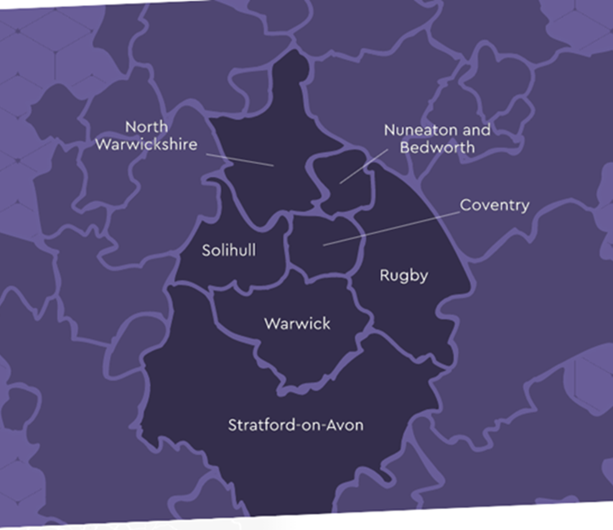

Origin Maths Hub
Government DfE-funded Maths Curriculum Hub (one of 40 in England).
Offers free and funded maths CPD and school development opportunities to teachers, teaching assistants, and leadership in Solihull, Coventry, and Warwickshire.
Whole department approaches such as the Teaching for Mastery Programme.
Specific, targeted Specialist Maths Knowledge CPD for individual teachers.
Leadership CPD Development opportunities.
Notes:
Just a little bit about the Maths Hub and what we are. We provide maths subject specific CPD funded by the DfE, every single school in the UK comes under their own regionally specific maths hub. We serve Warwickshire, Coventry, and Solihull.
Today I am going to share some programmes that are starting this half term and also towards the end I will share some free SEND resources we have available to schools.

Slide 3
2025-2028 Origin Local Priorities (OLP) – 3-year plan
Origin Maths Hub is a community of teachers, schools and other education professionals/ organisations. We work collaboratively to make sustainable and lasting changes that improve learners’ life chances by enhancing their experiences, attitudes and outcomes in learning mathematics.
1 Engage – Increase and deepen lasting partnerships by knowing and addressing community needs:
promote teaching for mastery as values and pedagogy for equity, supporting all children to be aspirational, thrive, enjoy and achieve in maths (no matter their background, circumstances, prior attainment or educational needs)
work with all levels of teaching staff/assistants and leadership in schools and trusts
foster collaboration and partnerships between schools
support continuity between phases
explore and act on schools’ barriers in order to implement and sustain teaching for mastery with fidelity
2 Unite - Create sustainable and lasting change in schools:
use effective professional development models and implementation processes within our projects, and encourage these in participant schools
develop all participants as leaders, agents of change, and as process/impact evaluators in their schools
focus on fidelity to the principles and approaches of teaching for mastery, and consistency of implementation across the school
3 Reflect - Understand our collective impact and make it visible so that we can further work towards sustainability and equity:
monitor progress according to intended outcomes, and adapt next steps as needed
research and evaluate impact using internal research evidence, case studies and stakeholder voice (including pupils), and draw on external research evidence
explore and share how fidelity to teaching for mastery strengthens equity and supports all children to be aspirational, thrive, enjoy and achieve in maths (no matter their background, circumstances, prior attainment or educational needs)
Notes:
These are the Origin Local Priorities moving forward over the next few years. As we are funded by the Department for Education, our responsibility is to ensure the best possible opportunities for schools, no matter the development needs or situation. Focusing on 3c – exploring and sharing how teaching for mastery strengthens equity and supports all children – I will just share a slide that you can read in detail when they are sent out but just highlight some key points

Slide 4
A pedagogy for equity
While some subjects have actually recovered to pre-pandemic levels, mathematics has not. The negative impact on maths has been deeper and more persistent.
Although overall standards in maths have increased slightly this year for both disadvantaged and non-disadvantaged pupils, they remain below 2019 levels and, crucially, the attainment gap remains significantly wider now than it was in 2015/16.
Research has shown that pupils from the least deprived backgrounds were 2.6 times more likely than their peers from the most deprived backgrounds to be high achievers at KS1.
At Secondary, looking at high-performing students at the end of Key Stage 2:
Only 52.1% of those from the poorest backgrounds manage to convert that potential into Grades 7–9 at GCSE.
This is compared to 73.5% of their peers with the wealthiest backgrounds.
What can we do about this?
Teaching for Mastery is recognised as a pedagogy for equity.
In Teaching for Mastery:
Everyone can learn and enjoy mathematics
A focus on building self confidence in all children’s ability to do mathematics is fostered
Cognitive strategies such as physical gestures and representations are used to support learning.
There is a strong focus on disciplinary literacy (the specific ways of reading, writing, and thinking used in mathematics), vocabulary, and focused talk.
Attention is drawn to the crucial and most efficient approaches to the mathematics.
Pupils' schemas are extended by making connections between different parts of the mathematics curriculum.
Notes:
The gap between the attainment for disadvantaged and non-disadvantaged pupils in maths is significantly wider now than it was a decade ago. In Primary pupils from the least deprives backgrounds are 2.6 times more likely than their peers from the most deprived backgrounds to be high achievers in KS1 and at Secondary If you look at high-performing students at KS2, only 52% from the poorest backgrounds will convert this to a grade 7-9 at GCSE. Teaching for Mastery is a pedagogy for equity where everyone can learn and enjoy mathematics together with a strong focus on disciplinary literacy, vocabulary and focused talk. This focus on equity runs through all of our programmes.

Slide 5
Current Coventry Engagement with Origin Maths Hub
Primary: 73 Coventry schools working with Origin Maths Hub (85%)
Secondary: 16 Coventry schools working with Origin Maths Hub (73%)
Special/Alternative Provision: 8 Coventry schools working with Origin Maths Hub (67%)
Across all of Solihull, Coventry and Warwickshire – 357 schools are working with Origin Maths Hub (79%)
 | Total number of schools | Number involved in any project | % Involved in any project
Coventry | 120 | 97 | 80.8%
Notes:
When we look specifically at the current engagement in Solihull, 86% of primaries, 73% of Secondary’s and 80% of Special Schools are engaged with us. You can also see the engagement of North, East and West Solihull. The vast majority are working with us but the reason I am speaking to you today is that we want to ensure all schools are informed about the best and newest opportunities we have coming up.

Slide 6
What is the Origin offer? – EYFS and Primary
Teaching for Mastery Focus Themes
Oracy
SEND in Mainstream
Mixed Age
New to Leadership
Implementing Curriculum Prioritisation Materials
New Teachers (ECT)
Collaborative Planning
Open Lessons
Mastering Number at KS1 (including Year 3)
Mastering Number at KS2
Mathematical Habits for Problem Solving
Teaching for Mastery in Nursery
EYFS and Primary
Primary Teaching for Mastery Programme (Including Focus Themes)
Primary Teaching for Mastery Introductory Programme
Mastering Number at Reception and KS1
Mastering Number Reception and KS1 Embedding the Impact
Mastering Number (KS2)
Specialist Knowledge for Teaching Mathematics – Early Years Programme – Number and Shape Pathways
Specialist Knowledge for Teaching Mathematics – Primary Teacher Programme – Number and Shape Pathways
Specialist Knowledge for Teaching Mathematics – Teaching Assistant (Primary) Programme
Primary Maths Early Career Community
Year 5 – 8 Continuity
Notes:
This is the full list of programmes for EYFS and Primary this year. If there is anything you are interested in then there will be contact details at the end so please get in touch with us as we have waitlists open for next year.

Slide 7
What is the Origin offer? Secondary and Post 16
Secondary and Post 16
Secondary Subject Leadership
Mathematical Thinking
Collaborative Planning and Lesson Observation
Teaching for Mastery Support
Mastering Number (KS3) - Securing Foundations in Year 7 and Multiplicative Reasoning in Year 7/8
A Level Pedagogy
Core Maths Pedagogy
Higher-level Maths Achievement
Post 16 GCSE Resit cross-phase – Supporting lower attainers to achieve in GCSE
Secondary Maths Early Career Community
Secondary Maths Non-specialist Teacher Programme
Secondary Maths TA Programme
Year 5 – 8 Continuity
Notes:
This is the full list of programmes available at Secondary and Post-16 and again please contact us if you are interested in any of these or would like to be added to the waitlist.

Slide 8
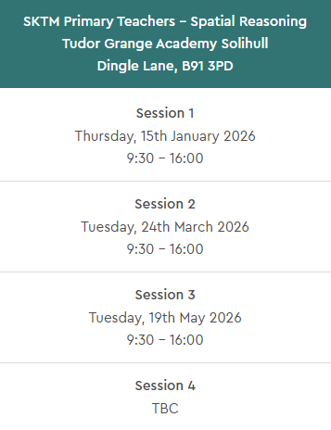
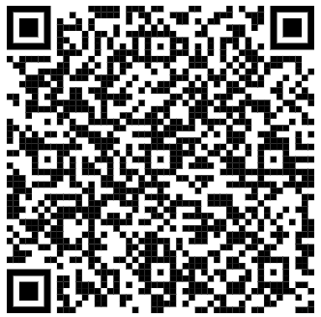
SKTM Primary Spatial Reasoning
This pathway focuses on exploring and identifying the progression in the curriculum for shape, position, direction and movement and how to deepen understanding in these areas. Teachers will identify why spatial reasoning skills are important, how they support the development of number sense and how they contribute to mathematics learning and understanding for all.
Sign up here –
https://originmathshub.tgacademy.org.uk/opportunities/specialist-knowledge-for-teaching-mathematics-primary-teachers-spatial-reasoning-pathway/
Notes:
These next slides are the programmes we have starting this term. I don’t want to take up too much time but if there is something you would like more detail on then the slides will be sent out and you can find out more information by clicking the links or using the QR code. The first two programmes are for primaries, this one is our SKTM Primary Spatial Reasoning pathway which focuses on progression in the curriculum for shape, position, direction and movement and how to deepens children’s understanding in these areas.

Slide 9
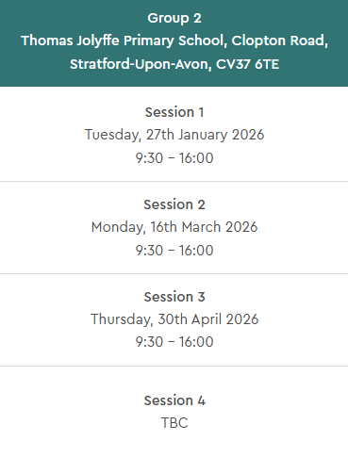
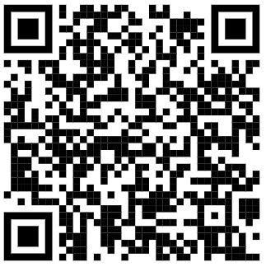
SKTM Primary Teaching Assistants
This programme supports primary teaching assistants who are supporting maths to develop specialist knowledge for teaching maths, to build on the primary maths National Curriculum, and to develop distinct pedagogical decision-making which will impact on their practice when supporting maths.
Sign up here –
https://originmathshub.tgacademy.org.uk/opportunities/specialist-knowledge-for-teaching-mathematics-teaching-assistant-programmes/
Notes:
This programme is specifically for Primary Teaching Assistants which builds on knowledge of the National Curriculum and looks to develop pedagogical decision-making.

Slide 10
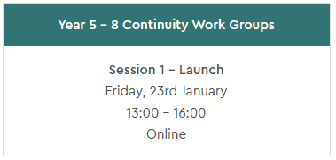
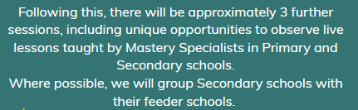
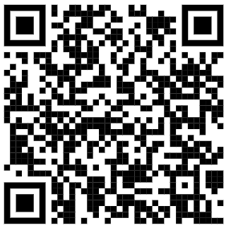
Year 5-8 Continuity Work Group
Transition from KS2 to KS3 has been repeatedly identified in recent research as a hiatus point for many students, particularly disadvantaged students. Data shows that of high-performing students at the end of Key Stage 2, only 52.1% of those from the poorest backgrounds achieve Grades 7-9 at GCSE, compared to 73.5% of those from the wealthiest backgrounds.
This engaging and thought-provoking Work Group aims to address this issue through collaboration across the KS2 to KS3 boundary to ensure consistency in the pupil experience.
Sign up here –
https://originmathshub.tgacademy.org.uk/opportunities/year-5-8-continuity/
Notes:
Year 5-8 continuity is for both primary and secondary schools. As part of this Work Group primary and secondary colleagues will develop shared understandings of mathematics curriculum, teaching and learning – and be able to implement changes that support all pupils in their transition from primary to secondary.​

Slide 11
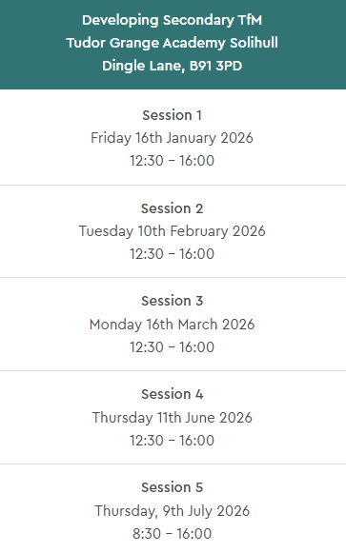
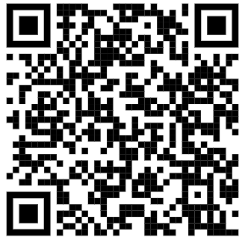
Developing Secondary Teaching for Mastery
Participants work with a small group of local schools, led by a Mastery Specialist, to embed teaching for mastery approaches across their department.
You will strengthen students’ understanding, reasoning and fluency
You will deepen your understanding of teaching for mastery and how to embed it consistently
You will improve collaborative approaches to planning, teaching and curriculum development
You will build a culture of sustained professional learning through collaboration
You will choose a focus area that aligns with your department’s priorities with resources to support it
Sign up here –
https://originmathshub.tgacademy.org.uk/opportunities/developing-secondary-tfm/
Notes:
These next two programmes are for Secondary schools. On ‘Developing Secondary Teaching for Mastery’ participants will work to embed teaching for mastery approaches across their mathematics department.

Slide 12
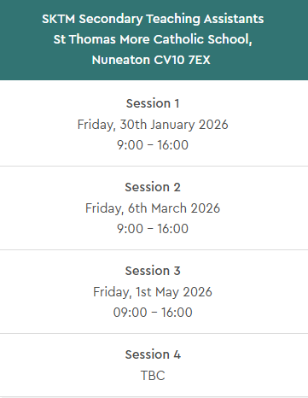
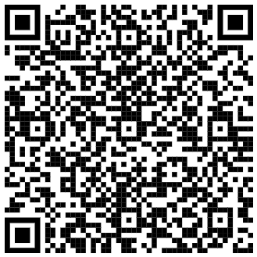
SKTM Secondary Teaching Assistants
This is a new programme to support teaching assistants develop the specialist knowledge for working within the maths classroom.
Participants will develop their specialist knowledge with a focus on using precise mathematical language, representations, and reasoning within each of the topics: addition and subtraction; multiplication and division; ratio; and fractions.
Sign up here - https://originmathshub.tgacademy.org.uk/opportunities/specialist-knowledge-for-teaching-mathematics-secondary-teaching-assistants/
Notes:
This final programme is specifically for Teaching Assistants in Secondary settings. It will look to develop their specialist knowledge of maths with a focus on mathematical language, representations and reasoning.

Slide 13
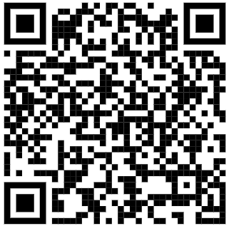
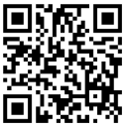
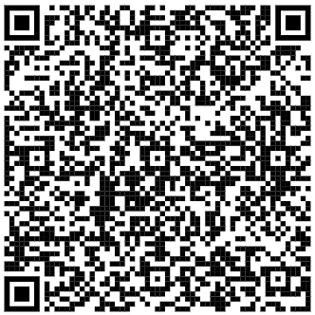
SEND Support
Do you want further support with SEND in your school in relation to mathematics?​ ​ We offer free bespoke support for schools to support them with areas of need they have identified. If you are looking for SEND support, we have access to a wide range of SEND specialists and can allocate appropriate support to your school. This support is fully funded by the Maths Hubs Programme. ​ ​ Fill in this form and we will get in touch with you to discuss how we can help.​
We provide opportunities for teachers of mathematics from mainstream, Special Schools, and Alternative Provisions to collaborate and explore ways to support children with SEND to engage, overcome barriers and make progress in mathematics.
You can join sessions on specific areas of need. There are also recordings and resources in the ‘SEND Resources’ section of our website which you can access here:
https://originmathshub.tgacademy.org.uk/opportunities/send-support/
These cover topics such as:
If you are interested, then please email office@originmathshub.tgacademy.org.uk or use this QR code and we will get in touch.
https://forms.office.com/e/T0xCYpxpbS
Notes:
Finally, back at the beginning I mentioned some free SEND resources we have available. We have a web page dedicated to SEND resources including videos of previous online sessions that have taken place on a variety of topics. We also have shared dates of upcoming online sessions that we will be running and we will be adding to these throughout the year. If you are interested in these then please email us using the address on screen. We are also able to offer bespoke support to support with SEND in schools in relation to mathematics. If this is something you may be interested in then please complete the form using the link or QR code on the left.

Slide 14

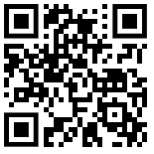
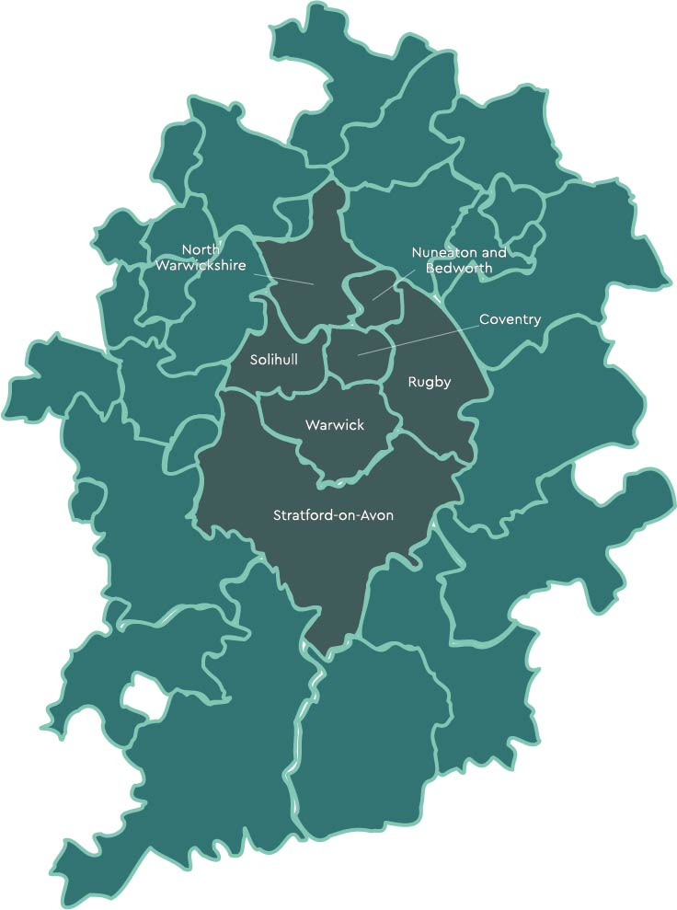



If you are interested in working with the Hub on any of these opportunities, please get in touch using the details below:
Sign Up to our Newsletter here
Look out for opportunities on our website here
https://originmathshub.tgacademy.org.uk/opportunities/
office@originmathshub.tgacademy.org.uk
Origin Maths Hub originmathshub.bsky.social
@OriginMathsHub
Notes:
As promised, our contact details are on screen. Thank you very much for your time and if you have any questions, please let us know. I will put our email address in the chat for ease.

