Slide 1

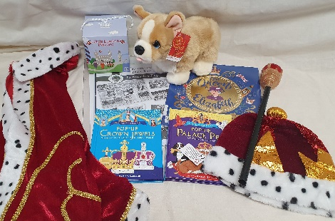
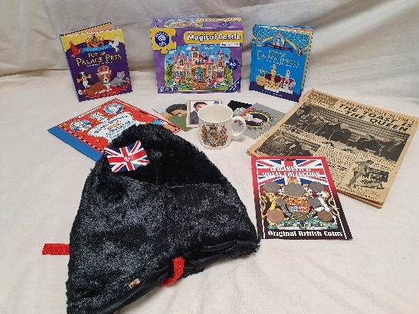
Coventry Schools Library Service Newsletter : Primary Schools
Issue: SLA Edition 2022
Special SLA 2022 Edition
How Coventry SLS can help your school
For every £100 that you spend with SLS you receive over £400 worth of resources
Give your school a boost for a fraction of the cost by using the School Library Service. We provide high quality books and artefacts to support curriculum teaching as well as reading for pleasure.
Introductory Package
If your school hasn’t subscribed to SLS recently and you are not sure how it would work in your school then this is a great way to find out. See first hand how it can enhance the teaching and learning in your school for 1 year at a special low cost. For only £800 the school receives 5 project boxes, unlimited artefact loans and a 100 high quality fiction books. This gives you £2950 worth of resources and a chance to try our 3 most popular loan services. If you then convert to a subscription the next year you will receive an additional 10% of the price.
Subscription Plus
Our subscription Plus service has gained in popularity over the years, so much so that we now have more schools who buy this than the standard subscription! As well as getting the termly project loans, annual loan for your library or classrooms and unlimited artefact loans you also receive support for reading for enjoyment through CPD for teachers, Book Awards sets and practical help in managing your SLS loans (selection, cataloguing etc.). If you would also like to have the Reading for Pleasure package you can add this on at the discounted price of £500
Celebrating the Jubilee?
Check out our new artefact collections. Our Jubilee collection (left) is perfect for KS1 role play and the Coronation collection (right) gives a historical context to the event.
Reading for Pleasure Package
Want help with getting more pupils reading for enjoyment? This is the ideal solution, as it includes a subscription to our Reading Update service which provides reviews of the best fiction and non-fiction books. PLUS 25 new books for the school to keep (not loans) delivered each term (75 in total), selected by our librarians to keep your fiction up to date, relevant and diverse. A great way to ensure that your school reading books are updated regularly while saving you time and money. The cost to the school is £600 saving over £100.
02476 97 5485 sls@coventry.gov.uk www.coventry.gov.uk/sls
Schools Library and Resource Service, Central Library, Smithford Way, Coventry, CV1 1FY

Slide 2




Issue: SLA Edition 2022
Representative Reading Spine for KS1
Looking to update your literacy spine? Check out the new Representative Reading Spine created by experts from Coventry School Library Service and Primary English Education Consultancy Limited.
A spine of 12 picture books selected for the quality of their writing, illustration and ability to represent the lives and experiences of all children regardless of their gender, ethnicity or social class.
supports a holistic approach to reading. Helping children to understand the world around them, to process emotions and experiences, and importantly to provide them with “mirrors, windows and sliding glass doors”¹ through using up-to-date modern texts from a diverse range of authors and illustrators.
Each book is accompanied by a range of reading activities. These focus on making links between the book and the children’s existing knowledge, identifying themes, emotional literacy and expressing opinions about what is read.
¹ Rudine Sims Bishop Professor at the College of Education and Human Ecology, Ohio State University. (1990) https://ehe.osu.edu/news/listing/rudine-sims-bishop-diverse-childrens-books/
Library Refresh
Testimonials
Does your school library need a makeover and a reboot? Many school libraries were closed during the pandemic and are in need of revitalisation. For a set cost of only £1500 we will provide the following.
Librarian (and library assistant) in school for 2 days to weed library stock, tidy shelves (put in order), change of layout to make best use of space, furniture and display areas
£1000 RRP’s worth of new books added to your library, chosen by SLS Librarians based on their review of the current stock in the library after the weed
“SLS has been invaluable in fostering a love of reading for our children. They provide a wealth of knowledge when it comes to children's literature and provide us with support and resources to ensure the children in our school have access to a wide range of reading materials.” Mrs Gemma Spence
Acting Deputy Headteacher, John Shelton Primary School
“We subscribe to Coventry Schools Library Service, which is an invaluable resource in providing us with ever-changing, high-quality texts for our library, for units of work across the curriculum and for classroom reading corners.” St Anne’s Primary School
Other SLS initiatives
As well as our traditional loan services SLS provide many other opportunities to schools to support reading. We run the Coventry Inspiration Book Awards which have now being going for 15 years as well as the Year 5/6 Library Quiz. We also have various training courses running this term and are always available to provide advice and guidance.
How to order
Most of our services are available to order from SLS’s page on the new Education Traded Services online ordering portal. If you would like to discuss your school’s needs and how SLS can best support your students then please contact Isobel.Powell@coventry.gov.uk

