Slide 1
Supporting Approved Mental Health Professional trainees' good practice.
The challenges of teaching the tension that exists when upholding people's human rights when applying powerful legislation: A Practice Educator's perspective.

Slide 2
Who we are and what we do
Matt Graham – Senior Lecturer, University of Central Lancashire
Jonathan Ashworth – Mental Health Team Manager, Social Worker, and Approved Mental Health Professional (AMHP), Cumbria County Council
Lesley Farragher – Mental Health Social Worker and AMHP, Cumbria County Council
Che McGarvey-Gill – Mental Health Social Worker and AMHP, Cumbria County Council
Steve Nellist – Urgent Care Team Social Worker and AMHP, Cumbria County Council
Becky Squires – Mental Health Professional Practice Co-ordinator, Social Worker, and AMHP, Cumbria County Council
Alla Stoica – Mental Health Social Worker and AMHP, Cumbria County Council

Slide 3
Introduction
Cumbria County Council – a large rural county in North West England – has collaborated with the University of Central Lancashire to explore ways of teaching AMHP practice with social worker AMHP trainees on placement
We have drawn on themes from social work practice education literature and research
AMHP practice education also has unique qualities, tensions and autonomy that arise from the complex role of the AMHP, requiring specialist consideration for the educator and trainee

Slide 4
Introduction
Approved Mental Health Professionals – 95% of whom are Social Workers – bring a social perspective to assessments under the Mental Health Act 1983 (amended 2007), for people experiencing significant mental disorder and distress
In deciding whether or not to apply for a person’s compulsory detention in hospital, AMHPs balance complex human rights; liberty, safety, autonomy

Slide 5
What we will be doing today
We will present the key points and highlights from each of the 3 papers that we have produced:
Modelling Good AMHP Practice
Direct Observation of the AMHP Trainee’s practice
Supervision: Pedagogical Perspectives
Opportunity for discussion on the key issues will follow each paper

Slide 6
Modelling Good Practice – Key Points
The Practice Educator Professional Standards
The continuing professional development of the educator and application of knowledge to the assessment process.
The use of authority and power, including own prejudices and personal values.
Respect for the individual needs and preferences of students.
Anti-oppressive practice within the assessment process.
(Field, et al, 2014)

Slide 7
Modelling Good Practice – Discussion area
How do AMHPs act anti-oppressively when applying a piece of legislation which is deemed by many to be highly oppressive?
How are good values modelled within this complex process?

Slide 8
Direct Observation – Key Points
Democratic process
Support is a democratic and reciprocal process
Acknowledge the tension with supporting trainees
Understanding the complex eco system of mental health
Discourage atomised and decontextualized approach

Slide 9
Direct Observation – Key Points
Unearthing the tensions
Acknowledge that as practice educators we are not purveyors to absolute truth
The importance of safe space
The importance of reflection
Overwhelming experience

Slide 10
Direct Observation – Discussion area
Is there a safer way to expose trainee AMHPs to situations that are “utterly unacceptable” or is real experience required to support learning?
Do you feel there is a better way to manage the tensions/anxieties trainee AMHPs can experience during their training?

Slide 11
Supervision: Pedagogy – Key Points
The connection between the AMHP role and social work
Practitioners simultaneously carry out the following roles:
Competent practitioners (applying skills in their work)
Professionals (applying values)
Social scientists (applying knowledge)
Croisdale-Appleby (2014)

Slide 12
Supervision: Pedagogy – Key Points
Segments of competence - Stone (2016)
Skills
Values
Knowledge
Resilience
Emotional Intelligence
Approach to Learning

Slide 13
Supervision: Pedagogy – Key Points
Functions of supervision - Kadushin
Managerial (or administrative) function – Case load management/ timescales/ policy
Educational function – Developing knowledge/skills/ values
Supportive function – Psychological/ interpersonal support

Slide 14
Supervision: Pedagogy – Key Points
Why is the supportive element so important for AMHPs?
Decisions made by AMHPs - impacts on human rights
Reflection is usually after an event, rather than before
Emotional labour
Coercive support – ‘dirty work’

Slide 15
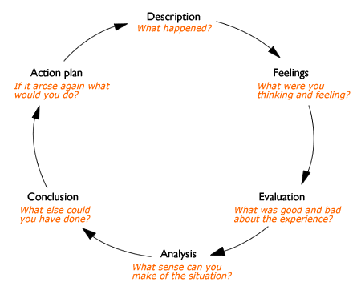
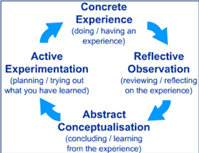
Supervision: Pedagogy – Key Points
Reflective learning models

Slide 16
Supervision: Pedagogy – Discussion area
How do AMHP Practice Educators enable reflective practice?
When providing supervision to AMHP trainees how do practice educators ensure that the supportive function of supervision is not overshadowed by the managerial or educational functions?

Slide 17
Supporting Approved Mental Health Professional trainees' good practice.
The challenges of teaching the tension that exists when upholding people's human rights when applying powerful legislation: A Practice Educator's perspective.
Any further comments?
Thank you for listening and for your presence today.

