Slide 1

COVID-19 Weekly Briefing Report
Enquiries to: PHI@essex.gov.uk
Created: 10/11/2020
Based on validated data for the period 30/10/20 - 05/11/20 (unless otherwise stated)
Strategy, Insight & Engagement
Essex County Council

Slide 2
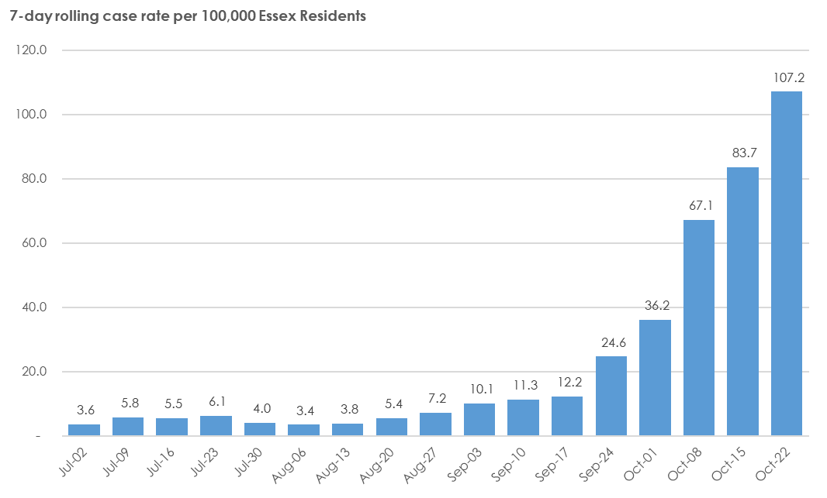
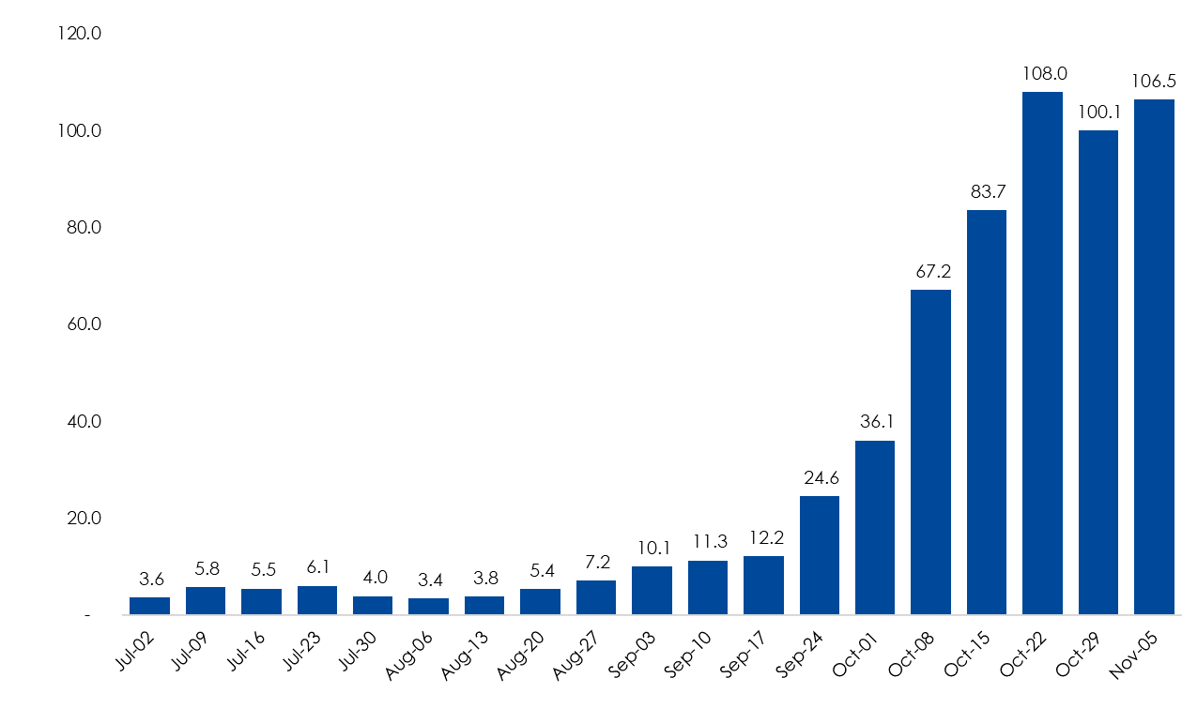
Cases
Public Health England report on weekly case rates. The weekly case rate is based on the number of cases recorded in the preceding seven days per 100,000 population.
This allows for comparison between areas, and it gives a clear indication of the trend in COVID-19 cases, removing day-to-day volatility in recorded case numbers.
As at 05/11/20, the weekly case rate for Essex is 106.5. This is the latest date for which complete data is available.
Source: PHE Test Data

Slide 3
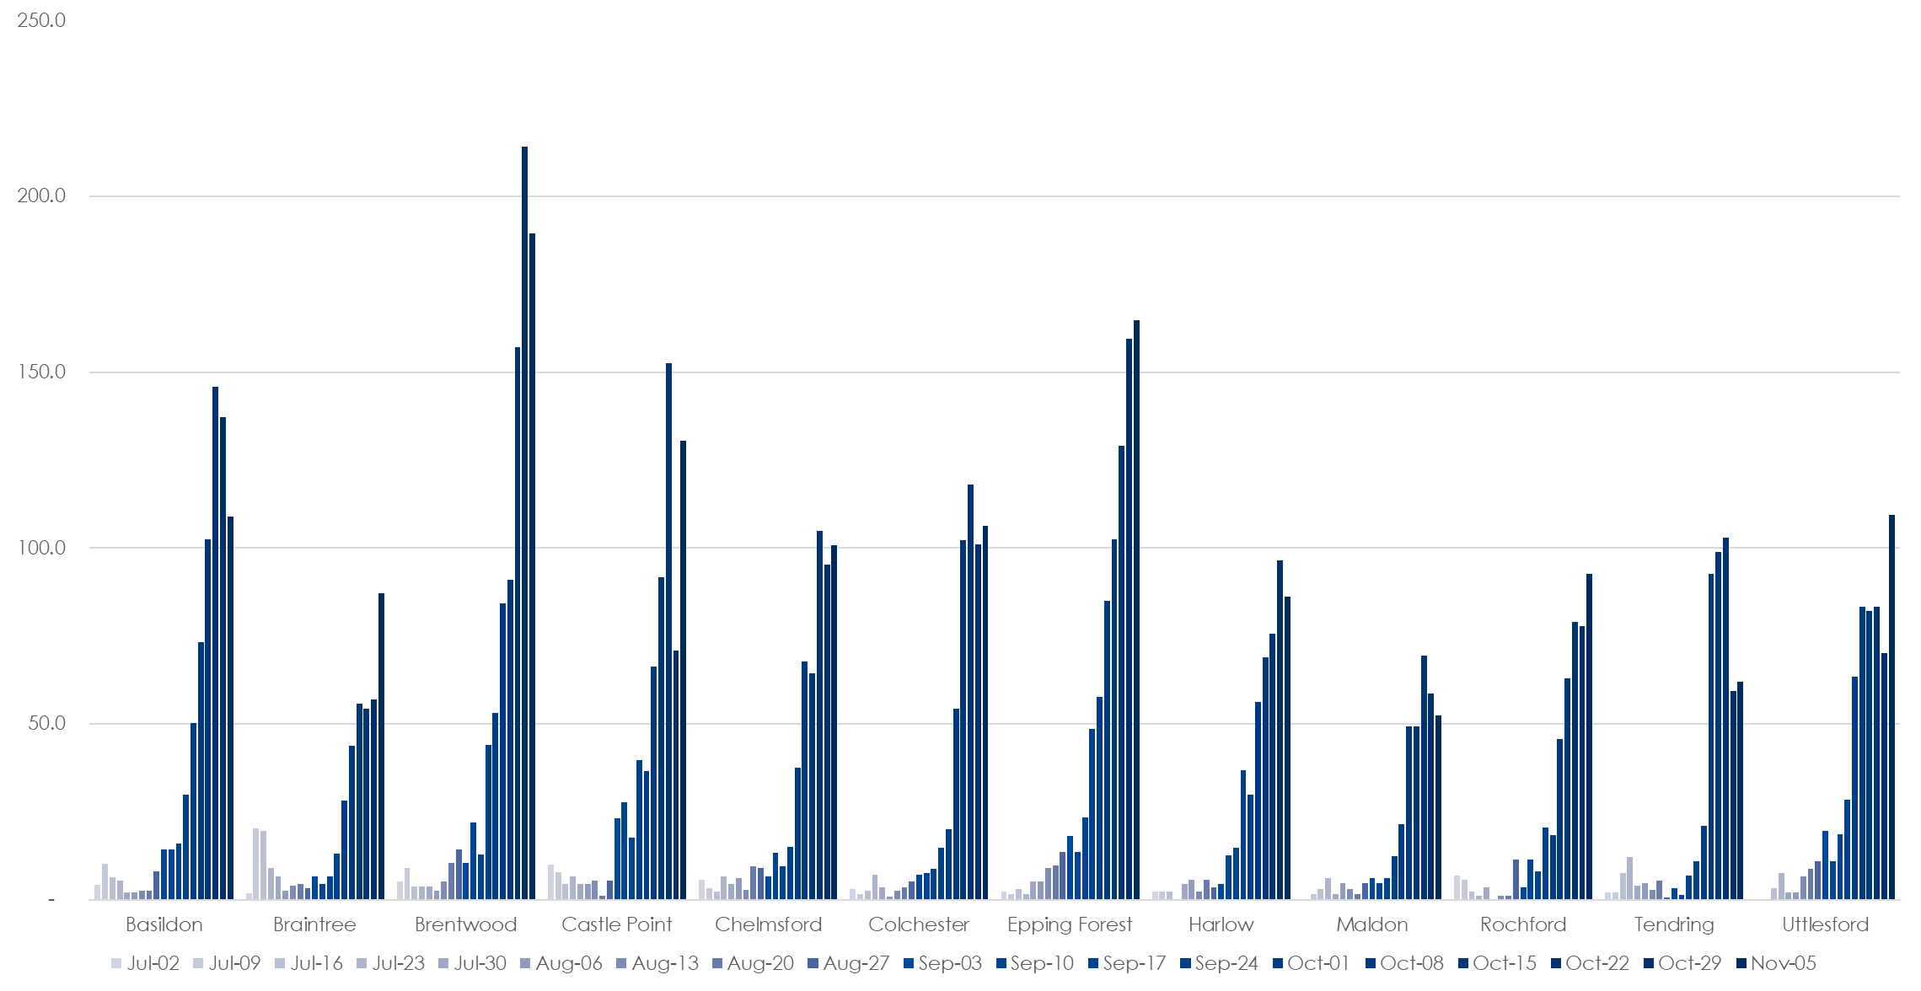
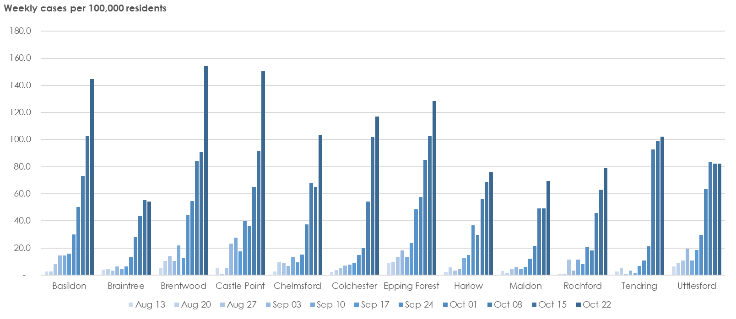
Cases continued
Public Health England report on weekly case rates. This is based on the number of cases recorded in the preceding seven days per 100,000 population.
Case rates allow for comparison between areas, and give a clearer indication of the trend in COVID-19 cases, removing day-to-day volatility in daily case numbers.
The chart opposite shows weekly case rate by Essex District. As at 05/11/20, the highest weekly case rates were in Brentwood and Epping Forest, with rates of 189.6 and 164.8, respectively.
The table below shows the weekly case rate figures per 100,000 population by Essex district.

Slide 4
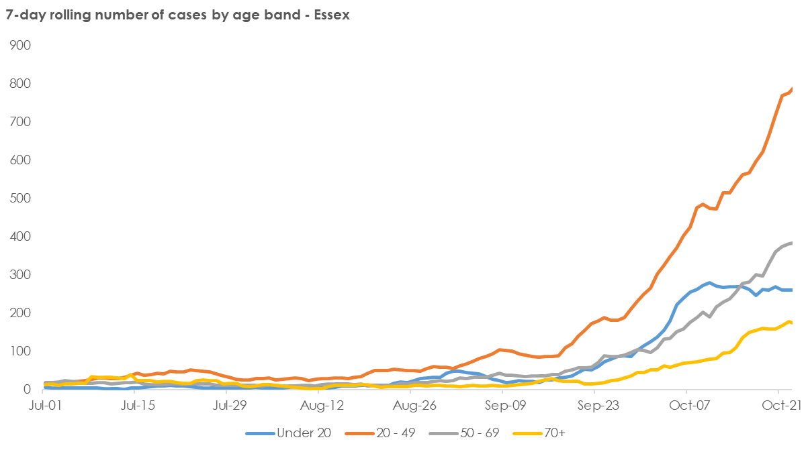
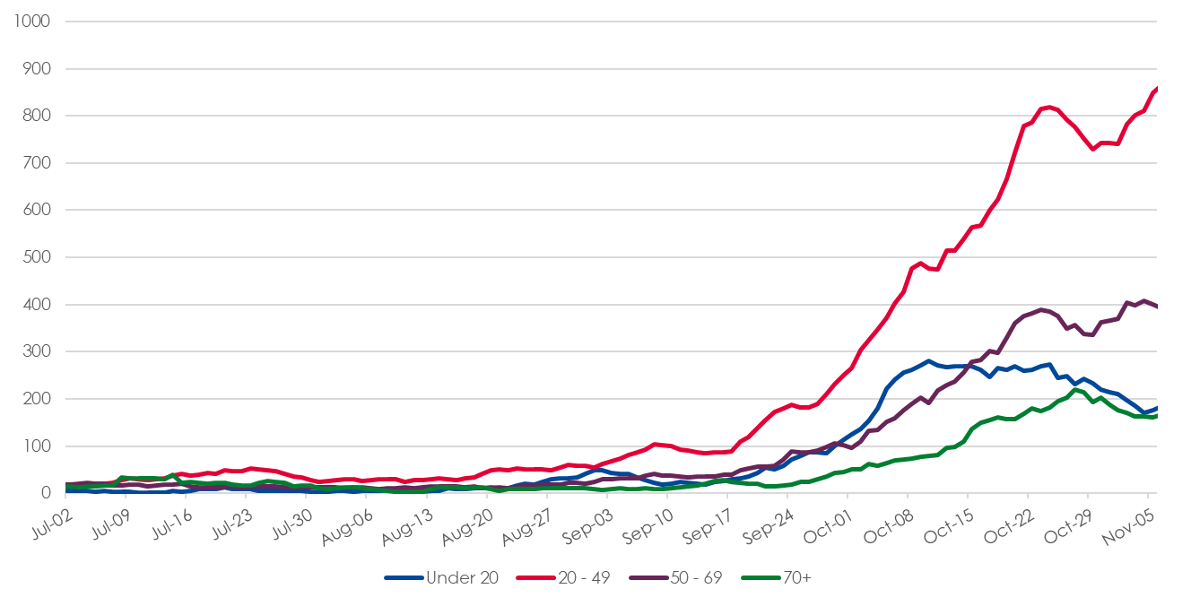
Cases
The chart opposite provides a breakdown of new COVID-19 cases by age group up to 05/11/2020. This is the latest date for which complete data are available.
For each date, the chart shows the number of confirmed COVID-19 cases in the preceding seven days.

Slide 5
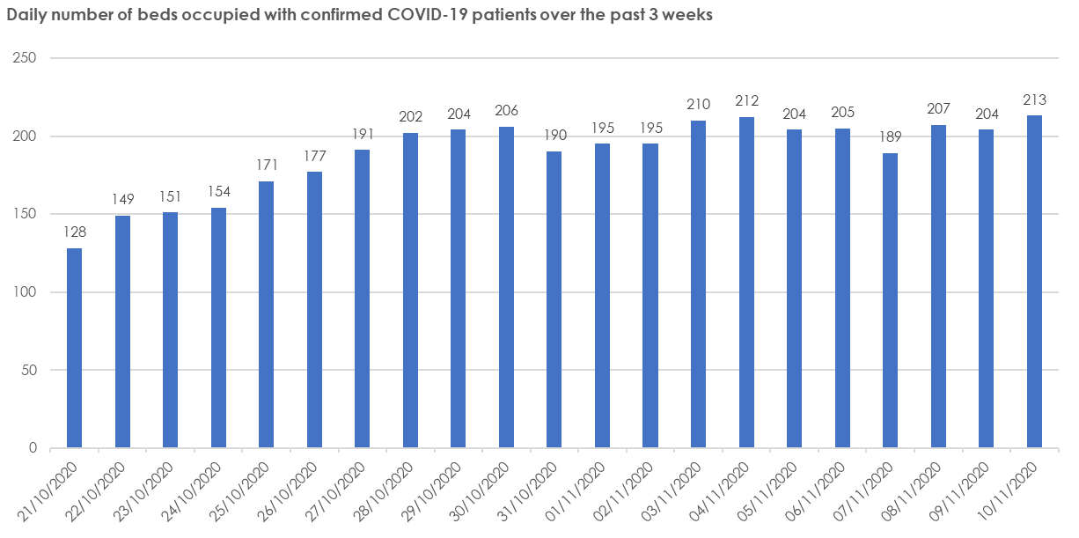

Essex NHS Trusts – Occupancy
As at 10/11/20 there were 213 beds occupied by confirmed COVID-19 patients in Essex hospital trusts. This equates to 7.6% of trust capacity and is relatively stable compared to bed occupancy one week previous (03/11/20).
A further 92 beds were occupied by patients with suspected COVID-19 (3.3% trust capacity).
We would expect hospital admissions, diagnosis and occupancy to lag behind community cases by a period of four to eight weeks.
Source: NHSI Sitrep Dashboard.

