Slide 1



POST- BREXIT
TRANSITION PERIOD
ACTIONS FOR
BUSINESSES
NEW RULES FOR BUSINESSi
iWITH EUROPE ARE HEREi
ACT NOW AT
iGOV.UK/TRANSITIONi

Slide 2
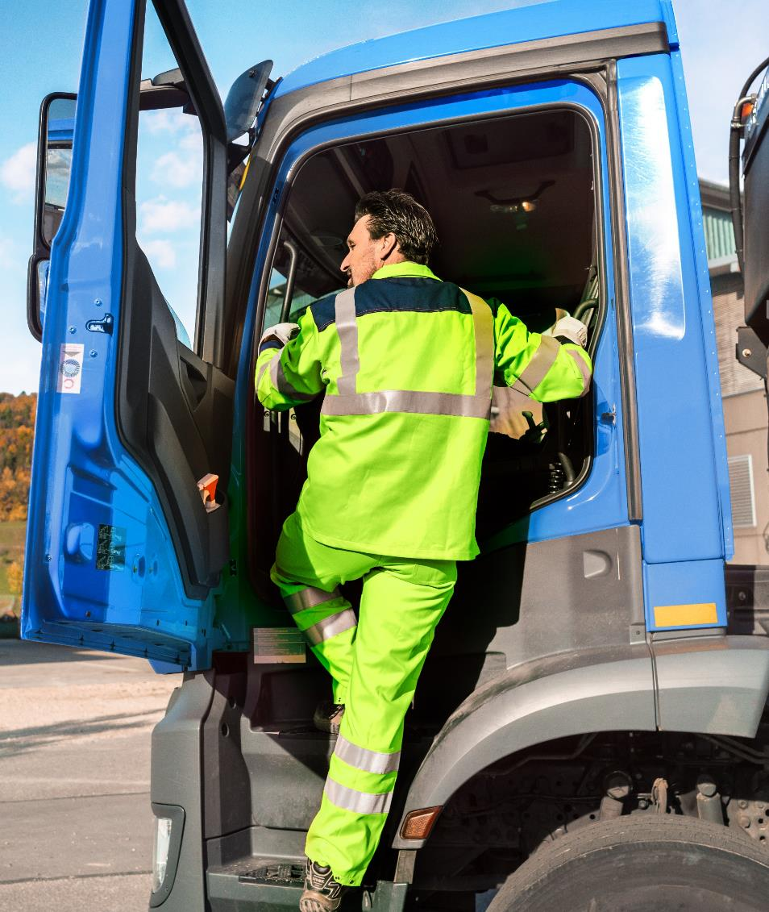
ICONTEXTiAND AIMSI
Context
The UK has left the EU and now has a free trade agreement based on zero tariffs and zero quotas where goods meet the EU-UK preferential rules of origin. Businesses should continue to make the necessary changes to operate in an independent trading nation. ​
All businesses should understand that there are changes to key areas and must check to see if they need to take action now.
Aims
Provide information on areas of change and identify the key actions to take.
Show available support, including gov.uk/transition

Slide 3
INEW RULESiARE HEREI
The UK has left the EU. Businesses need to take the actions required to adapt to the new rules.
This is the beginning of a new relationship with the EU and a chance for the UK to set its own rules that benefit UK businesses.
The UK agreed a Free Trade Deal with the EU on 24 December 2020. The UK/EU trade agreement is based on zero tariffs and zero quotas where goods meet the UK-EU preferential rules of origin. An explainer document is available here.
The UK has also signed agreements with key trading partners including Ukraine, Switzerland, South Korea, Japan, Chile, Morocco, Vietnam and Canada. Negotiations are progressing including with the US, Australia and New Zealand. Further details on all agreements can be found on GOV.UK.
Businesses need to understand how changes affect them and adjust accordingly to ensure they can continue trading. Advice on what actions businesses should take is available on gov.uk/transition.

Slide 4

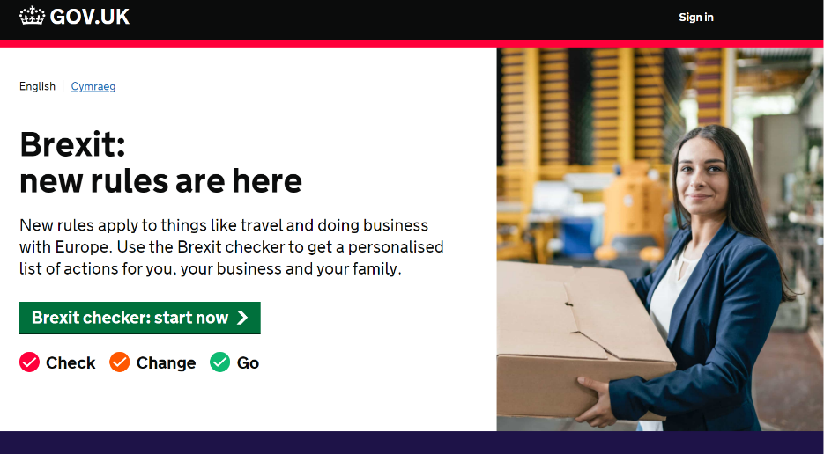
ICHECK WHAT ACTIONS AREiNEEDEDI
Businesses need to find out what changes apply to their organisation, by using the Brexit checker tool for tailored advice:
Visit gov.uk/transition.
Answer a few questions to get a personalised list of
Sign up for the Business Transition Bulletin.

Slide 5








iWHAT’S CHANGED?I
There are a number of changes that have taken place. This presentation covers changes to:
Importing and exporting (inc. Trading with NI)
Customs, taxes and duties, export and import declarations
Placing goods on the market
Certification and labelling of products and materials
Tariffs
Taxes levied on imported goods and services
Rules of Origin
Determining economic nationality and compliance
Hiring staff outside and inside the UK
Immigration and employment
Providing services to EU markets
Travel, business and qualification recognition
Using personal data
Transfer of personal data between the UK, EU
and select third countries
There are different rules for Northern Ireland – check the latest guidance on gov.uk/transition
BEIS has launched a new video explainer package on
doing business with Europe. These are on demand
videos. To watch the videos please register here

Slide 6
IIMPORTING AND EXPORTING HAS CHANGEDi
What do businesses need to know?
Businsses will not be able to import or export goods if they fail to comply with new customs procedures. Changes are introduced in three stages in 2021:
1 January
1 April
1 July
Full controls in place for exports.
Full controls in place for staged imports of controlled goods.
Optional deferred declarations in place for imports of standard goods.
Full controls in place for:
  Animals and Products of Animal Origin; i.e. meat, honey, milk or egg products.
  Plants and plant products.
Full controls in place for all goods.

Slide 7
iCHANGES TO IMPORTING AND EXPORTINGI
What do businesses need to do?
Businesses will need to take a range of actions, but as immediate steps should:
    Make sure they have an EORI number starting with GB.
    Consider using a customs intermediary to make declarations.
    Check if goods need an import or export licence e.g. for chemicals or food and, if so, apply for what is needed.
    Make sure businesses understand VAT responsibilities and what they have to pay.
    Consider the use of deferred declarations if importing goods.
    Look at grant funding availability, search ‘Customs Grants’ on GOV.UK.

Slide 8
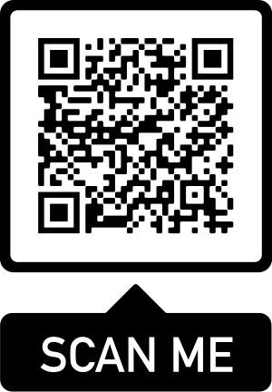
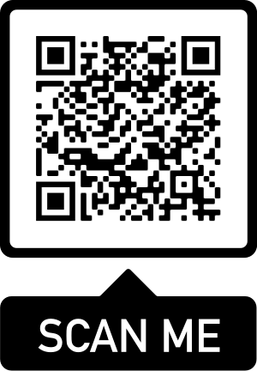
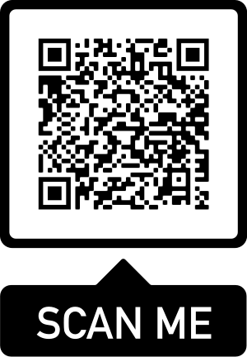
iFURTHER INFORMATIONI
SCAN NOW FOR INFO ON:
IMPORTING GOODS
SCAN NOW FOR INFO ON:
EXPORTING GOODS
SCAN NOW FOR INFO ON:
CUSTOMS GRANTS

Slide 9
iTRADING WITH NORTHERN IRELANDI
What do businesses need to know?
The Northern Ireland Protocol is now in effect. There are some changes for goods movements into Northern Ireland from Great Britain.
The Protocol entails some new administrative processes for traders, notably new digital import declaration requirements, and digital safety and security information, for goods entering Northern Ireland from the rest of the UK.
The UK Government has established a new, free service, the Trader Support Service (TSS). The TSS provides an end-to-end service guiding businesses through all import processes and can also be used to complete digital declarations at no additional cost. The TSS ensures that there are no new tariffs for businesses and consumers on internal UK trade, and will maintain the UK’s VAT area.
The new declarations need to be made on the new Customs Declaration Service (CDS). The TSS has access to the CDS and will be able to complete declarations on traders’ behalf.
There is a three-month grace period, ending April 2021, for supermarket supplies to aid businesses in adapting to the new regulations within the Northern Ireland Protocol.

Slide 10
iTRADING WITH NORTHERN IRELANDI
What do businesses need to know?
Direct trade from Northern Ireland to Great Britain continues. The only exceptions to these arrangements are goods falling within the extremely limited number of procedures relating to specific international obligations binding on the UK and the EU. i.e. wild animals and already restricted items, such as uncut diamonds.
The smooth flow of trade from Great Britain to Northern Ireland will be maintained - with critical flexibilities to maintain the flow of food supplies and medicines and avoid the need for any new physical customs infrastructure.
The Movement Assistance Scheme (MAS) complement the existing Trader Support Service. The MAS provides assistance for traders moving food or agricultural products for which specific Sanitary and Phytosanitary (SPS) controls apply - meaning the Government will cover, for example, reasonable costs for obtaining Export Health Certificates.

Slide 11
iTRADING WITH NORTHERN IRELANDI
What do businesses need to do?
Check the latest Northern Ireland Protocol guidance.
If businesses move goods to or from NI, they will need an EORI number that starts with XI under certain circumstances. To get an XI EORI number, businesses must already have a GB EORI number. Further information is available at https://www.gov.uk/eori/ni.
Sign up for the free Trader Support Service for guidance through any changes to the way goods move between Great Britain and Northern Ireland.
Contact the Movement Assistance Scheme (MAS) for support. The MAS provides a dedicated helpline to guide businesses through the new requirements for moving goods; and are ready to support businesses in meeting new certification costs that arise.
The Movement Assistance Scheme’s helpline number is 0330 0416 580.

Slide 12
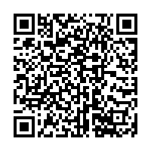
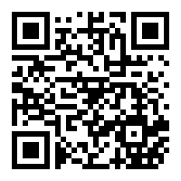
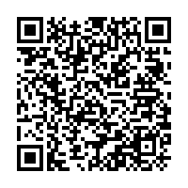
iFURTHER INFORMATIONI
SCAN NOW FOR INFO ON:
MOVING GOODS UNDER NI PROTOCOL
SCAN NOW FOR INFO ON:
TRADER SUPPORT SERVICE
SCAN NOW FOR INFO ON:
MOVEMENT ASSISTANCE SCHEME

Slide 13




iPLACING GOODS ON THE MARKETI
What do businesses need to know?​
Check which regulations apply to products. The following slides focus on New Approach goods. Guidance for other products can be found on gov.uk/transition.
New Approach
      Goods with a CE marking may be placed on the GB market until 1 January 2022 e.g. Toys, PPE, machinery.
      It is longer in some cases e.g. medical devices. Different rules apply to NI.
Old Approach
      Rules under standalone regulation models depend on specific goods, e.g. Chemicals, Vehicles, Aerospace.
Non-Harmonised Goods
      Mutual recognition no longer applies to non-harmonised goods, e.g. Furniture.
Other Goods
      There are now special rules for some goods including medical devices, cosmetics, construction products, civil explosives, and products requiring eco-design and energy labelling.
There are different rules for Northern Ireland – check the latest guidance on gov.uk/transition

Slide 14

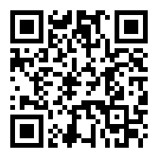
iENSURE NEW APPROACH GOODS ARE LABELLED iCORRECTLYI
What do businesses need to know?​
CE Marking
If business self-declare or use an EU Notified Body, they can still use the CE marking until 1 January 2022 for goods placed on the GB market (more in some cases). In this case, EU Declarations of Conformity can be used until 1 January 2022.
The CE marking is still required for products placed on the EU market.​
Businesses can place the UKCA and CE marking on the same product if it is destined for both the GB and EU markets so long as the product meets the rules for both markets.​
UKCA Marking
New Approach goods assessed against GB rules by a GB ‘Approved Body’ need the UKCA (UK Conformity Assessed) marking and a UK Declaration of Conformity. ​
Businesses can self-declare for the UKCA marking, as with the CE marking.​
On 31 December 2020, the essential legal requirements that businesses must meet did not change. All harmonised standards became ‘designated standards’. ​
SCAN NOW FOR INFO ON:
DESIGNATED STANDARDS

Slide 15
iPLACING NEW APPROACH GOODS ON THE MARKETI
CE marked goods already placed on the EU or UK market before January 2021 do not require any actions to be taken. Placing on the market refers to individual goods, not types of goods.
Placing CE marked goods on the GB market
Businesses should ensure they comply with changes to the new domestic regime if they are placing CE marked goods on the GB market, for instance using the UKCA marking where necessary.
CE marked goods that meet EU and GB requirements can continue to be placed on the GB market in most cases until 1 January 2022.
For most new approach goods, businesses should affix the UKCA marking on a label affixed to the product or on accompanying documentation until 1 January 2023.
Placing CE marked goods on the EU market
If businesses are placing manufactured goods on the EU market, they must take steps to ensure compliance with EU requirements.

Slide 16

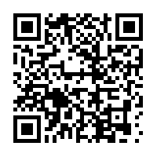

iCONFORMITY ASSESSMENT BODIES FOR NEW iAPPROACH GOODSI
GB market
All UK-based ‘Notified Bodies’ became UK ‘Approved Bodies’ on 1 January 2021. Details of UK bodies can be found on the UKMCAB database.
If a businesses product requires third-party conformity assessment, this will need to be completed by a UK-recognised body from 1 January 2022 (in most cases).
EU market
Mandatory conformity assessments by UK bodies are no longer recognised by the EU. Businesses should speak to their existing conformity assessment body to discuss options.
SCAN NOW FOR INFO ON:
UKMCAB DATABASE

Slide 17


ILEGAL RESPONSIBILITIES FOR NEW APPROACH iGOODSI
What do businesses need to know?​
The responsibilities of ‘economic operators’ who deal with CE or UKCA marked goods changed on 1 January 2021. Economic operators include manufacturers, importers, distributors and authorised representatives. ​
        UK-based distributors of EU goods may become 'importers' - and vice-versa. Compared to distributors, importers have additional duties to ensure products are compliant with product standards and must ensure their address is on a product.
        Authorised Representatives must be based in GB or NI for the GB market. GB-based Authorised Representatives aren't recognised in the EU.
On 16 July 2021, Regulation (EU) 2019/1020 – Market Surveillance and Compliance of Products Regulation – comes into effect, which means businesses may need to appoint an EU representative if there is no other economic operator in place (when exporting or moving goods to the EU and NI).

Slide 18

iPLACING GOODS ON THE NI MARKETI
What do businesses need to know?​
The Northern Ireland Protocol is now in effect. For as long as it applies, goods placed on the market in NI need to meet relevant EU rules.
The CE marking will continue to be relevant marking for most goods. If a business self-declares for CE, they can continue to do this when placing goods on the NI market.
The CE marking will need to be accompanied by the UKNI marking if a business uses a UK Notified Body to assess against EU rules. This is now the case, and this rule applies to existing stock that was not already placed on the market, by the end of the 2020 (if that existing stock was assessed against relevant EU rules by a UK Notified Body). Goods with the ‘CE UKNI’ marking are not valid for the EU market.​
A business will never apply the UKNI marking on its own. It always accompanies the relevant EU conformity marking.​
If a business uses an EU Notified Body, they will only need to use the CE marking.
The UKCA marking alone will not be valid for the NI market.

Slide 19
iPLACING QUALIFYING NI GOODS ON THE GB MARKETI
What do businesses need to know?​
The Northern Ireland Protocol provides Northern Ireland businesses with unfettered access* to the rest of the UK market.​
This means that qualifying Northern Ireland goods marked with the CE marking or CE plus UKNI marking can be placed on the GB market, even if EU and GB rules diverge. ​
For highly regulated goods (e.g. chemicals and medicines), which pose a particular risk to the consumer, some basic information will need to be provided to the GB market regulator to place that good on the GB market. There is detailed guidance for these goods on gov.uk. ​
Guidance is also available on gov.uk on how to check whether goods qualify for the arrangements in place to support NI’s unfettered access to the rest of the UK market.
* There will be only extremely limited exceptions to this for certain controlled products, for example the movement of radioactive waste.

Slide 20


iIMPORTER RESPONSIBILITIES AND NII
Have responsibilities changed?
There are now changes to the responsibilities of businesses importing goods within the UK.
      Bringing goods into NI - A business is an importer if they import goods from the EU or another non-EU country and place them on the NI market, or move goods from GB to NI. This is due to the rules that apply in NI under the Protocol. Importers need to make sure goods are labelled with their details, among other responsibilities. The measure on providing address details on e.g. an accompanying document, does not apply to goods from GB, due to the Protocol. ​
      Placing goods on the GB market from outside the UK – A business is an importer if they are an NI business placing goods from outside the UK on the GB market. This includes where they have come from, e.g. the EU via NI, and means they will need to be labelled with their details, e.g. NI businesses benefit from unfettered access, meaning qualifying goods can use the CE or CE UKNI marking, even if EU and GB rules diverge.

Slide 21
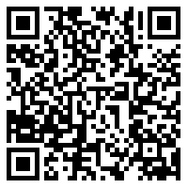
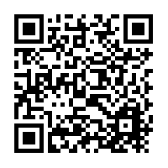
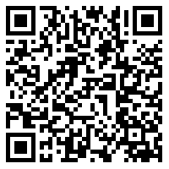
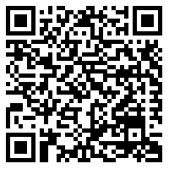
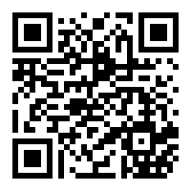
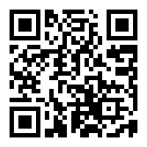

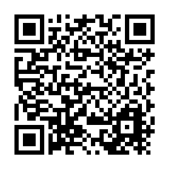
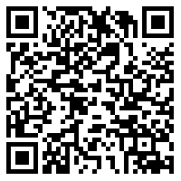
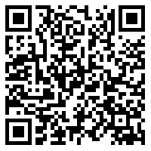
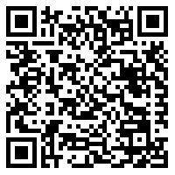
iFURTHER INFORMATIONI
For queries on this guidance, please email goodsregulation@beis.gov.uk
SCAN NOW FOR INFO ON:
PLACING GOODS ON THE GB MARKET
SCAN NOW FOR INFO ON:
PLACING GOODS ON THE EU MARKET
SCAN NOW FOR INFO ON:
PLACING GOODS ON THE NI MARKET
SCAN NOW FOR INFO ON:
MOVING GOODS BETWEEN NI AND GB
SCAN NOW FOR INFO ON:
USING THE UKNI MARKING
SCAN NOW FOR INFO ON:
USING THE UKCA MARKING
SCAN NOW FOR INFO ON:
DESIGNATED STANDARDS
SCAN NOW FOR INFO ON:
UKMCAB DATABASE
SCAN NOW FOR INFO ON:
CONFORMITY ASSESSMENT AND ACCREDITATION
SCAN NOW FOR INFO ON:
APPLYING TO BE A UK CONFORMITY ASSESSMENT BODY
SCAN NOW FOR INFO ON:
HOW TO CHECK IF YOU QUALIFY FOR UNFETTERED ACCESS
SCAN NOW FOR INFO ON:
SPECIFIC PRODUCT SAFETY AND METROLOGY REGULATIONS

Slide 22
iTHE UK GLOBAL TARIFF (UKGT)I
What do businesses need to know?
The UK is no longer part of the EU Customs Union and Single Market. The EU Common External Tariff (EU’s CET) no longer applies for UK businesses trading internationally.
The UK now has its own tariff schedule, the UK Global Tariff (UKGT). The UKGT applies to goods imported into the UK.
The UK Global Tariff applies to all goods imported into the UK unless:
  the country being imported from has a trade agreement with the UK, and a business can meet the rules of origin requirements, to trade under lower, or zero tariffs in that agreement;
  an exception applies - such as a relief or tariff suspension; or
  the goods come from developing countries - covered by the Generalised Scheme of Preferences (known as GSP’s).
The UKGT introduces two distinct changes to the current EU’s CET tariffs:
  Liberalisation - removing tariffs on products which are used in UK production, not made in the UK or are a nuisance tariff of below 2%.
  Simplification - rounding tariffs down (to the nearest 2% below 20%, 5% between 20-50%, and 10% for tariffs over 50%) and moving complex agricultural tariffs to a single percentage.

Slide 23
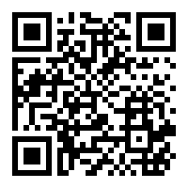
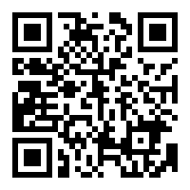
iTHE UK GLOBAL TARIFF (UKGT)I
Trade Tariff
What do businesses need to do?
The 'Trade Tariff' tool provides information about what tariffs apply to goods imported into the UK.
The ‘Check How to Export Goods’ tool, provides information for UK exporters about duties, rules of origin and customs procedures for over 160 markets around the world. It also provides detailed information about the UK border.
Check How to Export Goods

Slide 24
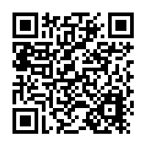
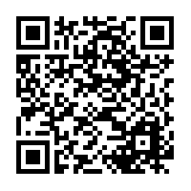
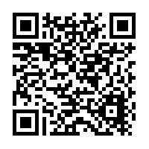
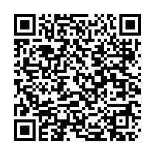
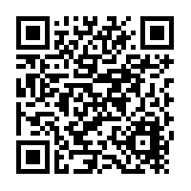
iFURTHER INFORMATIONI
SCAN NOW FOR INFO:
THE UK’S TRADE AGREEMENTS
SCAN NOW FOR INFO:
DUTY SUSPENSIONS AND TARIFF QUOTAS
SCAN NOW FOR INFO:
TRADING WITH DEVELOPING NATIONS
SCAN NOW FOR HELP ON:
IMPORTING AND EXPORTING, CONTACT HMRC USING GUIDANCE
SCAN NOW FOR INFO:
STAGED CUSTOMS WHEN IMPORTING INTO THE UK

Slide 25
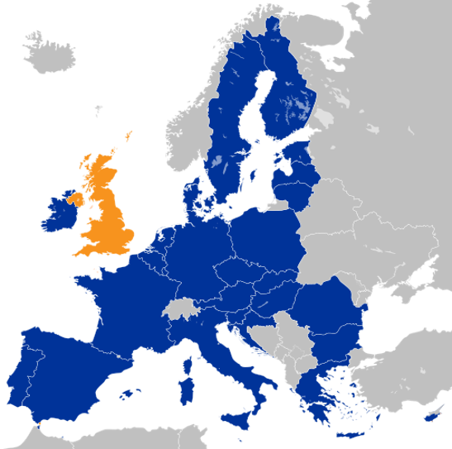

iRULES OF ORIGIN – TRADING WITH THE EUI
The UK is no longer part of the EU Customs Union. Trade is now governed by the UK-EU Trade and Cooperation Agreement (TCA). The Northern Ireland Protocol applies to Northern Ireland.
As of 1 January 2021, UK goods exported to the EU are eligible for zero tariffs if the goods meet the Rules of Origin requirements set out in the TCA. If not, the goods may be subject to EU tariffs.
The same applies for EU goods imported into the UK.

Slide 26
iRULES OF ORIGINI
What do businesses need to know?
Rules of Origin determine the ‘economic nationality’ of a good, a standard part of trade agreements.
The UK is no longer part of the EU Customs Union. Trade is now governed by the UK-EU Trade and Cooperation Agreement (TCA). Rules of Origin in the TCA ensure that only goods produced in the UK or EU benefit from the zero-tariff agreement.
Different goods must comply with different rules. The following slides set out the types of rules products may need to comply with.
Goods imported into GB cannot move freely between GB and EU Member States or vice versa. To be eligible for zero tariff export to the EU, these goods must still comply with rules of origin.
This means there must be a qualifying level of production in the UK. This applies to EU origin goods as well as to goods from the rest of world.
If traders move goods through GB from one EU Member State to another without the goods entering UK customs territory (i.e. without entering free circulation in GB) the goods may not need to meet rules of origin.

Slide 27
iRULES OF ORIGIN - EXPORTINGI
What do businesses need to do?
If a business is a UK exporter and the EU importer wants to claim zero tariffs on their goods, there are 3 key steps to work out whether the goods comply with rules of origin:
  Classify the goods
  Understand whether goods meet the applicable rule of origin
  Understand how to demonstrate origin to the customs authorities.
Businesses may choose to use a customs agent to help with rules of origin. There is guidance available on GOV.UK on how to find a customs agent. Businesses may still need to provide supporting evidence to customs agents.

Slide 28
iSTEP 1 – CLASSIFY THE GOODSI
What do businesses need to do?
For the purposes of international trade, all goods are classified under the Harmonised System, an internationally standardised system of descriptions and numbers to identify goods. Businesses need to know the classification of their goods to find the applicable rule of origin.
The Harmonised System forms the first 6 digits of the 10-digit classification (commodity) code when importing goods into the UK or the EU.
Goods are categorised into chapters (first 2 digits), headings (next 2 digits), and subheadings (next 2 digits)
Use the trade tariff look-up tool to classify goods.
For example, household dishwashers are classified under:
Chapter 84 - Nuclear reactors, boilers, machinery and mechanical appliances
Heading 8422 - Dishwashing machines; machinery for cleaning or drying bottles or other containers…
Subheading 842211 - Household dishwashing machines
SCAN NOW TO ACCESS:
TRADE TARIFF TOOL TO CLASSIFY GOODS

Slide 29
iSTEP 2 – DETERMINE WHETHER GOODS MEET RoOI
What do businesses need to do?
Understand supply chains to know where businesses’ materials or inputs come from – whether they originate in the UK or EU, or whether they come from rest of world (non-originating).
Count EU origin materials and processing when considering whether UK exports to the EU meet rules of origin requirements, if there is a qualifying level of production in the UK – this is called 'cumulation'.
If the exported goods incorporate non-originating material, businesses need to comply with the relevant Product Specific Rule.
There are rules for different goods. Businesses will need to understand whether their goods comply with the applicable rule for that good.
Refer to the list of Product Specific Rules in the TCA to find the applicable rule for specific goods.

Slide 30
iPRODUCT SPECIFIC RULESI
Wholly Obtained (WO)
  If a good is fully grown, born or extracted from the UK, it is eligible for preferential treatment. This mainly applies to agricultural products e.g. vegetables grown in the UK, but could also apply to e.g. mineral products extracted within the UK.
Change in Tariff Code (CTC)
  Some rules of origin require that non-originating inputs used in production of a good must be classified in a different chapter, heading or subheading of the Harmonised System.
Value Added or ‘maximum non-originating material’
  If a rule requires a “maximum level of non-originating material” (MaxNOM), a certain proportion of the value of the final good must be generated in the UK or the EU. This can include UK-originating parts or value added in production, such as labour and manufacturing costs.
Specific Processing Rule (SPR)
  Some rules require a specific operation or set of operations to take place in the UK, in order for that good to be classed as UK-originating. For example, for certain chemicals, a chemical reaction must take place in the UK.

Slide 31
ISTEP 3 - DEMONSTRATE ORIGIN AND iQUALIFICATION TO CUSTOMS AUTHORITIESI
What do businesses need to do?
Have evidence to prove goods meet rules of origin.
Businesses may also require evidence of origin from suppliers, such as a supplier declaration.
Businesses can:
  Self-declare that goods meet the rules by making out a statement on origin and sending this to customers with the export.
  or,
  importers can claim for zero tariffs based on importer’s knowledge without providing the customer with a statement of origin, though they may ask businesses to provide other information about the goods to support their claim for zero tariffs.
Until 31 December 2021, UK and EU exporters do not need supplier’s declarations in place when the goods are exported, but they must be confident that the exported goods meet the rules of origin requirements. Businesses may be asked to retrospectively provide a supplier’s declaration after this date.
SCAN NOW TO ACCESS:
ONLINE TOOL TO CHECK WHICH RULES OF ORIGIN APPLY TO YOUR EXPORTS

Slide 32
iRULES OF ORIGIN - IMPORTINGI
What do businesses need to do?
To access zero tariffs when importing into the UK from the EU, businesses will need to claim preference on customs declaration. They need to hold proof that the goods being imported meet the Rules of Origin.
Under the UK’s deal with the EU, businesses can self-declare that goods meet the rules by making out a statement on origin. Alternatively, the importer can use importer’s knowledge, and businesses may need to provide other information. Businesses can choose which option to use and should look at the origin procedures in the text of the Agreement here.
To use importer’s knowledge, businesses will need to obtain sufficient evidence that the goods meet Rules of Origin. This may involve the exporter providing a range of supporting documentation.
The UK is taking a staged approach to customs controls (see slide 7). This allows traders to make a record in their own commercial records at the point of entry of goods into GB and submit a customs declaration and any claim for preference to HMRC within six months, until 1 July 2021, of the point of import. This easement is only for UK companies importing from the EU.

Slide 33
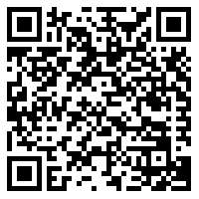
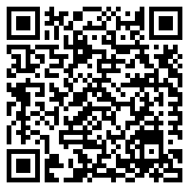

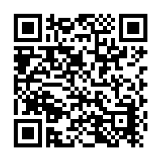
iFURTHER INFORMATIONI
SCAN NOW FOR INFO ON:
HOW TO CLAIM PREFERENTIAL (ZERO) TARIFFS WHEN TRADING WITH THE EU
SCAN NOW TO ACCESS:
FULL GUIDANCE ON RULES OF ORIGIN
WHEN TRADING WITH
THE EU
SCAN NOW TO ACCESS:
TRADE TARIFF TOOL TO CLASSIFY GOODS
SCAN NOW TO ACCESS:
ONLINE TOOL TO CHECK WHICH RULES OF ORIGIN APPLY TO YOUR EXPORTS
SCAN NOW TO ACCESS: ONLINE TOOL TO CHECK WHICH RULES OF ORIGIN APPLY TO YOUR IMPORTS
SCAN NOW FOR INFO:
STAGED CUSTOMS WHEN IMPORTING INTO THE UK
SCAN NOW FOR HELP ON:
IMPORTING AND EXPORTING, CONTACT HMRC USING GUIDANCE

Slide 34



iHIRING STAFF FROM OUTSIDE THE UKI
What do businesses need to know?
Free movement has ended and the UK has introduced a points-based immigration system.
The new system introduces job, salary and language requirements that may impact the ability to hire from the EU.
This system enables UK employers to recruit skilled workers from around the world. Businesses need to be a licensed sponsor to hire most eligible workers from outside the UK.

Slide 35
iHIRING STAFF FROM OUTSIDE THE UKI
What do businesses need to do?
If businesses want to recruit workers from outside the UK (excluding Ireland), they now need to ensure:
  They are a Home Office licensed visa sponsor.
  The job on offer is at the required skill level – RQF 3 or above (A Level and equivalent).
  The job on offer is above the required minimum salary level.
  The candidate speaks English to the required standard.
When does this need to be completed?
If a business is not already a licensed sponsor and they want to sponsor migrants through the skilled worker route, they must apply now.
An application to become a licensed sponsor usually takes 8 weeks and fees apply.

Slide 36


iHIRING EU CITIZENS WHO ALREADY LIVE IN THE UKI
What do businesses need to know?
Free movement has ended and the UK has introduced a points-based immigration system
They can apply to the
EU Settlement Scheme before 30 June 2021.
The new system does not apply to EU citizens living in the UK before 31 December 2020.
Search for ‘EU Settlement Scheme: employer toolkit’ on GOV.UK to find out more.

Slide 37

iHIRING EU CITIZENS WHO ALREADY LIVE IN THE UKI
What do businesses need to do?​
Businesses should direct employees to the EU Settlement Scheme to help secure their immigration status.
Businesses cannot discriminate against EU citizens as a prospective or current employer. There will be no change to right to work checks until after 30 June 2021.
EU citizens coming to the UK to live, work and study will need to apply under the new points-based immigration system.
When does this need to be completed?​
EU citizens living in the UK by 31 December 2020 are eligible to apply to the EU Settlement Scheme.
EU citizens and their family members (including non-EU citizens) need to apply to the EU Settlement Scheme to continue to live, work and study in the UK beyond 30 June 2021.
The application deadline is 30 June 2021.
SCAN NOW TO ACCESS:
EMPLOYING EU CITIZENS
IN THE UK

Slide 38
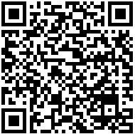
iPROVIDING SERVICES TO EU MARKETSI
What do businesses need to know?
There are changes to be made if businesses operate in the service sector in the EU or in EFTA countries (Norway, Liechtenstein, Iceland and Switzerland) and one of the following applies:​
  They are a UK-based supplier providing services to customers based in EU or EFTA countries​.
  They own, manage or direct a company based in EU or EFTA countries​.
  They travel to the EU or EFTA countries for business​.
  They need a professional qualification to provide services in the EU or EFTA countries​.
As the UK is no longer a member of the EU single market, businesses should make adjustments according to the new rules in order to continue exchanging, delivering and receiving services with the EU.
The agreement guarantees that UK investors and service suppliers will be able to access the EU’s markets and sets the terms for that access.
UK service suppliers travelling to the EU for short-term business trips of up to 90 days in any 180 days, for some specific purposes such as conferences, will not need visas or work permits. Service exporters can continue to move across borders to supply their services, but in some cases may require visas or work permits. ​
SCAN NOW FOR:
INDIVIDUAL COUNTRY
GUIDES IN THE EU/EFTA

Slide 39
iCROSS-BORDER TRADE IN SERVICES & INVESTMENTI
What do businesses need to know?
The UK is no longer operating under the European Economic Area (EEA) regulations for cross-border trade in services and investment and now trades under the terms of the Trade and Cooperation Agreement.
UK businesses and citizens no longer have the freedom to establish a business in the EU or in EFTA countries.
UK businesses are no longer treated as if they were local businesses. Services provided by UK businesses and professionals are regarded as originating from a ‘third country’.
Businesses registered in the UK and a UK citizens might face restrictions on their ability to own, manage or direct a company registered in the EU. ​
There could be different requirements on the nationality or residency of senior managers or directors, as well as limits on the amount of equity that can be held, depending on the sector or country they are operating in.
If businesses are registered in the EU, there may be changes to registration requirements for businesses in some Member States. ​

Slide 40
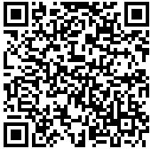
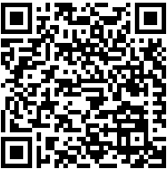
iCROSS-BORDER TRADE IN SERVICES & INVESTMENTI
What do businesses need to do?
Check now for any regulatory changes in the EU, EEA, or Switzerland as soon as possible. More information can be found on the GOV.UK website, or through scanning the relevant QR codes below.
If businesses provide services to the EU, they will need to check the national regulations of the country they are doing business in to understand how best to operate.
SCAN FOR:
SELLING SERVICES TO
THE EU/EFTA
SCAN FOR:
INFO ON CORPORATE STRUCTURING
AND MERGERS

Slide 41
iTRAVELLING TO EUROPEAN MARKETS FOR BUSINESSI
What do businesses need to know?
Travel for work and business purposes to and within the EU/EFTA have now changed for UK nationals.
If professionals are carrying out any of the following activities for any length of time, they may need a visa, work permit or other documentation:​
  Transferring to a subsidiary/branch of the same company in a different country (intra-corporate transfer)​.
  Carrying out a contract to supply a service to a client in another country in which the supplying business has no presence (contractual service supplier).​
  Carrying out services in another country as a self-employed person (independent professional).​
  Moving temporarily to invest independently or on behalf of a company.
If delivering a contract lasting up to 90 days per year in Switzerland, professionls will be able to continue to do so without requiring a permit, as set out in the UK-Switzerland Citizens’ Rights Agreement, but only if the contract was signed and had started before 1 January 2021.

Slide 42
iTRAVELLING TO EUROPEAN MARKETS FOR BUSINESSI
What do businesses need to do?
Business travellers should check whether they need to apply for a visa, work permit or other documentation before travelling to the EU/EFTA. If necessary, apply in sufficient time in advance of travel.
Why do businesses need to take action?
If action is not taken to check and acquire a visa, work permit or other documentation required, businesses may face additional costs, administrative barriers and delays as a result.
Travellers may be denied entry if they do not have the correct visa/work permit when travelling to the EU/EFTA.

Slide 43
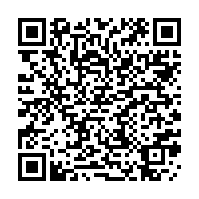
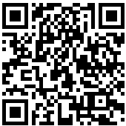
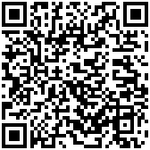
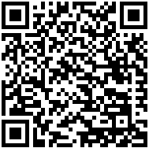
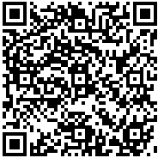
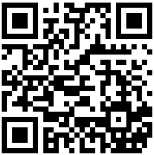
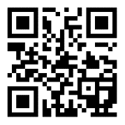
iSUB SECTOR-SPECIFIC FURTHER INFORMATIONI
SCAN FOR: CHANGES TO LEGAL PRACTICE: GUIDANCE FOR LEGAL PROFESSIONALS
SCAN FOR: ACCOUNTING FOR UK COMPANIES
SCAN FOR:
AUDITING FOR UK AUDITORS OPERATING IN THE EEA
SCAN FOR:
THE SYSTEM FOR RECOGNISING EU QUALIFIED ARCHITECTS IN THE UK
SCAN FOR:
THE UK-EU TRADE AND COOPERATION AGREEMENT
SCAN FOR: INFORMATION ON VISITING THE EU FROM 1 JANUARY 2021
SCAN FOR: FOREIGN TRAVEL ADVICE

Slide 44
iPROVIDING REGULATED SERVICES IN EU MARKETSI
What do businesses need to know?​
There may be a need to have a UK professional qualification officially recognised if intending to work in a profession that is regulated in the EU, Norway, Iceland, Liechtenstein or Switzerland. Professionals may need to do this even if providing only temporary or occasional professional services.
If living and working in the EU, Norway, Switzerland, Iceland or Liechtenstein and the qualification has already been recognised by the relevant regulator in that country, professionals should make sure they understand the terms of the recognition decision by checking in with that regulator.
The agreement includes a process to agree routes for UK qualifications to be recognised in the EU and vice versa. The agreement includes a framework under which the EU and the UK can bring together professional bodies and regulators for the mutual recognition of professional qualifications.
Authorities responsible for professional qualifications in the UK and EU member states can submit joint recommendations to the UK-EU Partnership Council for profession-specific arrangements.​
In future, professionals will be able to take advantage of any profession-specific EU-wide arrangement agreed under this new framework.

Slide 45
iINTERNAL MARKET FORI iPROFESSIONAL QUALIFICATIONSI
What do businesses need to know?​
The UK has established new arrangements to allow professionals qualified in the UK to access the same profession in a different part of the UK without needing to requalify. These apply only to professionals regulated in law, and in relation to new requirements, or where existing ones are changed.
The UK has introduced two systems by which professionals will be able to have their qualifications recognised in other parts of the UK when necessary. These systems are the automatic system and the alternative system.
The automatic recognition system will apply by default unless a decision is made by the relevant authority to replace it with the alternative system.
The alternative recognition system will ensure that professionals and their qualifications are treated fairly when applying for recognition whilst protecting the relevant authorities' ability to set and maintain their own standards.

Slide 46
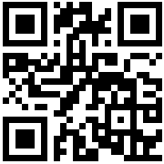
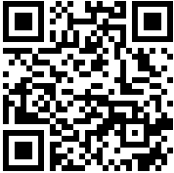
iPROFESSIONAL QUALIFICATIONSI
What do businesses need to do?
Check the European Commission’s Regulated Professions Database to find out which professions are regulated in which Member States.
Contact the single point of contact for the country in which they work to find out how to get professional qualifications recognised.
Get their qualifications recognised by the appropriate authority or regulator in each country where they intend to work.
SCAN FOR:
THE UK CENTRE FOR PROFESSIONAL QUALIFICATIONS (UK NARIC)
SCAN FOR:
CHANGES TO LEGAL PRACTICE: GUIDANCE FOR LEGAL PROFESSIONALS
SCAN FOR:
THE EUROPEAN COMMISSION’S REGULATED PROFESSIONS DATABASE

Slide 47
iDATA SHARING AND DATA ADEQUACYI
What do businesses need to know?
The UK/EU trade agreement contains a bridging mechanism that allows the continued free flow of personal data from the EU/EEA to the UK after the transition period until adequacy decisions come into effect, for up to 6 months.
EU adequacy decisions for the UK would allow for the ongoing free flow of data from the EEA to the UK.
As a sensible precaution, during the bridging mechanism, check how you can legally continue to receive personal data such as names, addresses or payroll details from organisations in the EU or EEA.
Your business may not be able to lawfully receive personal data from the EEA if you have not put in place alternative safeguards to cover EU-UK personal data flows and the bridging mechanism ends without an adequacy decision.

Slide 48



iDATA SHARING AND DATA ADEQUACYI
What do businesses need to do?
Businesses should take stock of the data being held, be aware of the (up to) 6 month bridging mechanism in place and monitor Data Adequacy decisions.
If businesses receive data from the EU/EEA, they should prepare alternative transfer mechanisms as a precaution.
Businesses can put in place safeguards by incorporating standard contractual clauses. Search ‘keep data flowing’ on the ICO’s website for more help.

Slide 49
iUSEFUL LINKSI
Click each topic below to find information about the new rules on:
  Importing and Exporting
  Moving goods to and from Northern Ireland including the Trader Support Service
  Placing goods on the market
  Tariffs
  Travelling abroad for work
  Hiring staff from the EU
  Personal Data Transfers. Visit keep data flowing on the ICO’s website for further information
BEIS has launched a new video explainer package on doing business with Europe. These are on demand videos. To watch the videos please register here.
To access a wide range of topical on demand webinars from other Government departments click here.
Government has announced a new £20 million SME Brexit Support Fund, which offers support to help small businesses adjust to the new trading rules. SMEs who trade only with the EU can apply for grants of up to £2000 to pay for practical support, including training and professional advice. For further details, including eligibility, click here.
The weekly Business Readiness Transition Bulletin provides information on major announcements and recently published guidance for businesses on what they can do to adjust to the new rules. Sign up to the Bulletin here, to receive these updates directly.

Slide 50
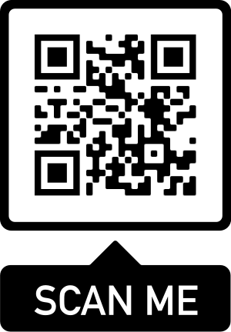
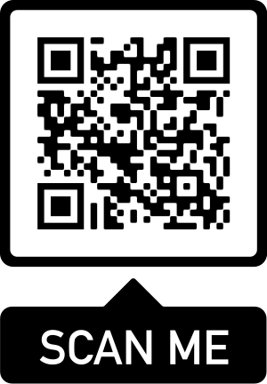
iFIND MORE INFORMATIONI
Brexit Transition Period Guidance:
Coronavirus support:

Slide 51


THANK YOU
QUESTIONS?
NEW RULES ARE HERE
iKEEP YOUR BUSINESS iMOVING
ACT NOW AT
iGOV.UK/TRANSITIONi

