Slide 1
Welcome to Office Hours! January 21, 2025
Please put your district name next to your username
In the chat: Favorite Podcast
Notes:
JEN

Slide 2

Agenda for Today’s Session: Federal Updates
The Road so Far
New Administration
The future of U.S. Department of Ed and Funding
The Journey Ahead
Understanding the Allocation Process
Communicating
Questions

Slide 3
The Road So Far
Answers We Have
To Be Determined
U.S. Department of Education Leadership
What the Law Says (Process, Procedures)
Federal Funding Pathway
Census Data that will be used to determine state allocations
Federal Education Appropriations for SY 2025-26
Amount of Federal education funds heading to Oregon for 2025-26
Overall Funding Levels
Updated January 21, 2025
Notes:
We know who will likely be leading the U.S. Department of Education: Linda McMahon
We know what ESEA and ESSA says about having a U.S. Department of Education and the programs it must run. This is current law and requires very specific things to happen to be rescinded/shut down.
We know the federal funding pathway and the steps needed to reach the point where we have federal funding amounts.
We do NOT know:
- National Federal Education Spending that will impact the 2025-26 School Year
- How much money Oregon districts can expect

Slide 4
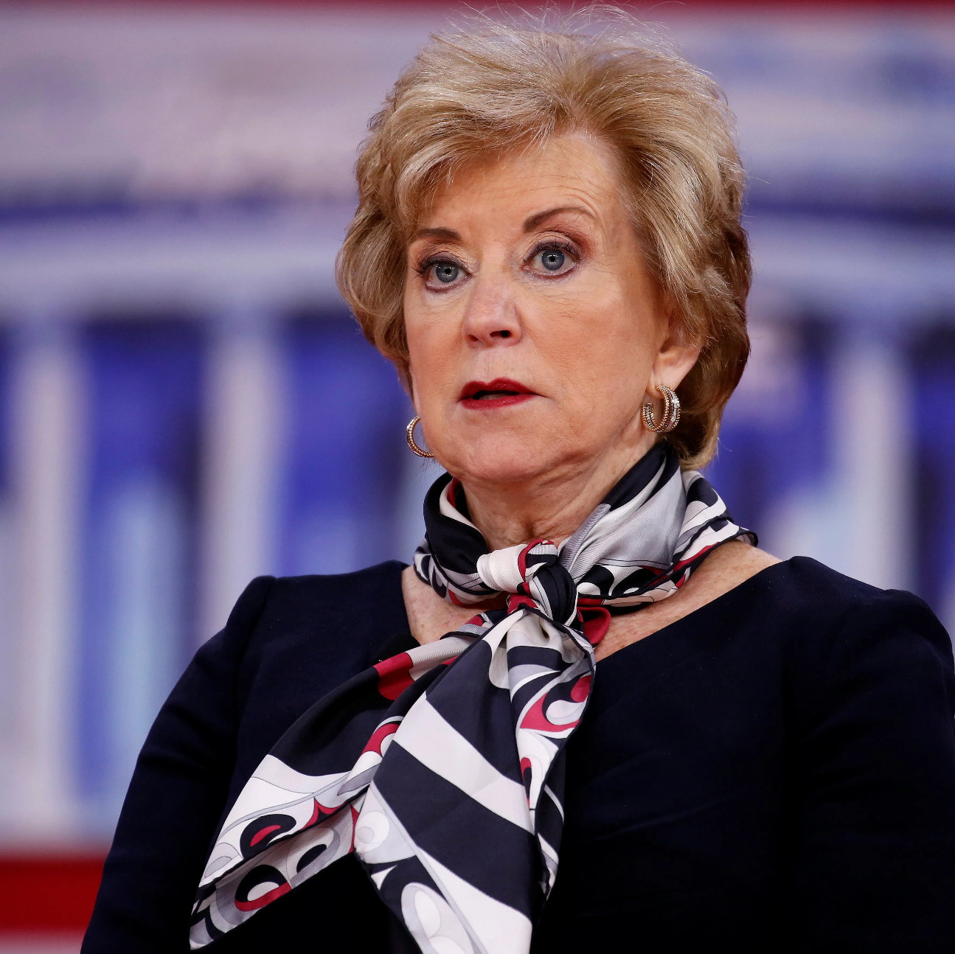
Federal Updates: New Administration
Chaired the Small Business Association
Served on the CT Board of Education
Priorities:
School Voucher/Choice
Eliminate DEI in Higher Education
Promote Workforce Training with Employer Involvement
Linda McMahon
Notes:
President Trump has nominated Linda McMahon for the U.S. Secretary of Education.

Slide 5
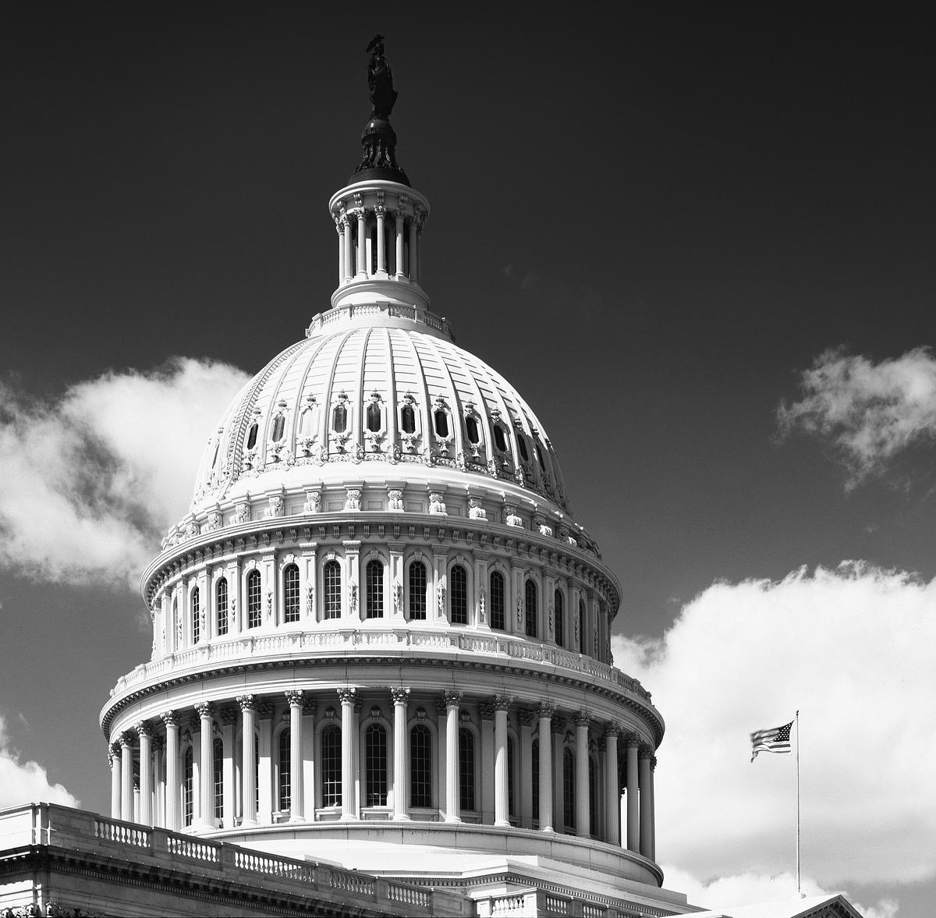
Future of the U.S. Department of Education: A Literal Act of Congress
Department of Education is codified into law
Congress would have to pass legislation to dismantle USDE
Votes needed:
House: Simple Majority (50%)
Senate: 60 Votes
Policy Priorities and Public Perception
Notes:
The incoming administration has messaged a desire to “Shutdown” the department of education, “saving money” and sending education back to the states. This is a huge talking point with a lot feelings around it. But can it happen? What would it take?
Eliminating the Department of Education would require an act of congress.
Legislation eliminating the department of education would need to be passed.
60 votes are required to pass legislation in the senate. That would require a 10 seat majority, convincing all members of one party.
There are policy priorities from all parties that require a federal agency to support

Slide 6








Federal Appropriations Road Map
President’s Budget
Subcommittees set funding for programs through appropriations bills
House and Senate resolve differences in appropriations bills
Submitted to Congress by the first Monday in February
Signed into Law
President signs the bill (budget) into law.
Congress
Overall spending levels set through Budget Resolutions (not a law)
Appropriations bill goes to House and Senate floors for final vote.
Notes:
Step 1: The President initiates the process by submitted his budget to Congress. This is due the first Monday in February.
Step 2: Congress sets overall spending levels through Budget Resolutions
Step 3: Subcommittees set funding for programs through appropriation bills
Step 4: The House and Senate resolve differences in their appropriation bills
Step 5: The agreed upon appropriation bill goes to the House and Senate floors for the final vote.
Step 6: The Presidents sigs the bill into law.
Once this is complete, the U.S. Department of Education issues allocations to the states based on census poverty data and specific formulas in ESSA.
As of January 21, 2025, the president has not submitted his budget to congress.
We anticipate preliminary allocations to districts to be in late winter/early spring and will communicate these numbers as soon as accurately possible.

Slide 7
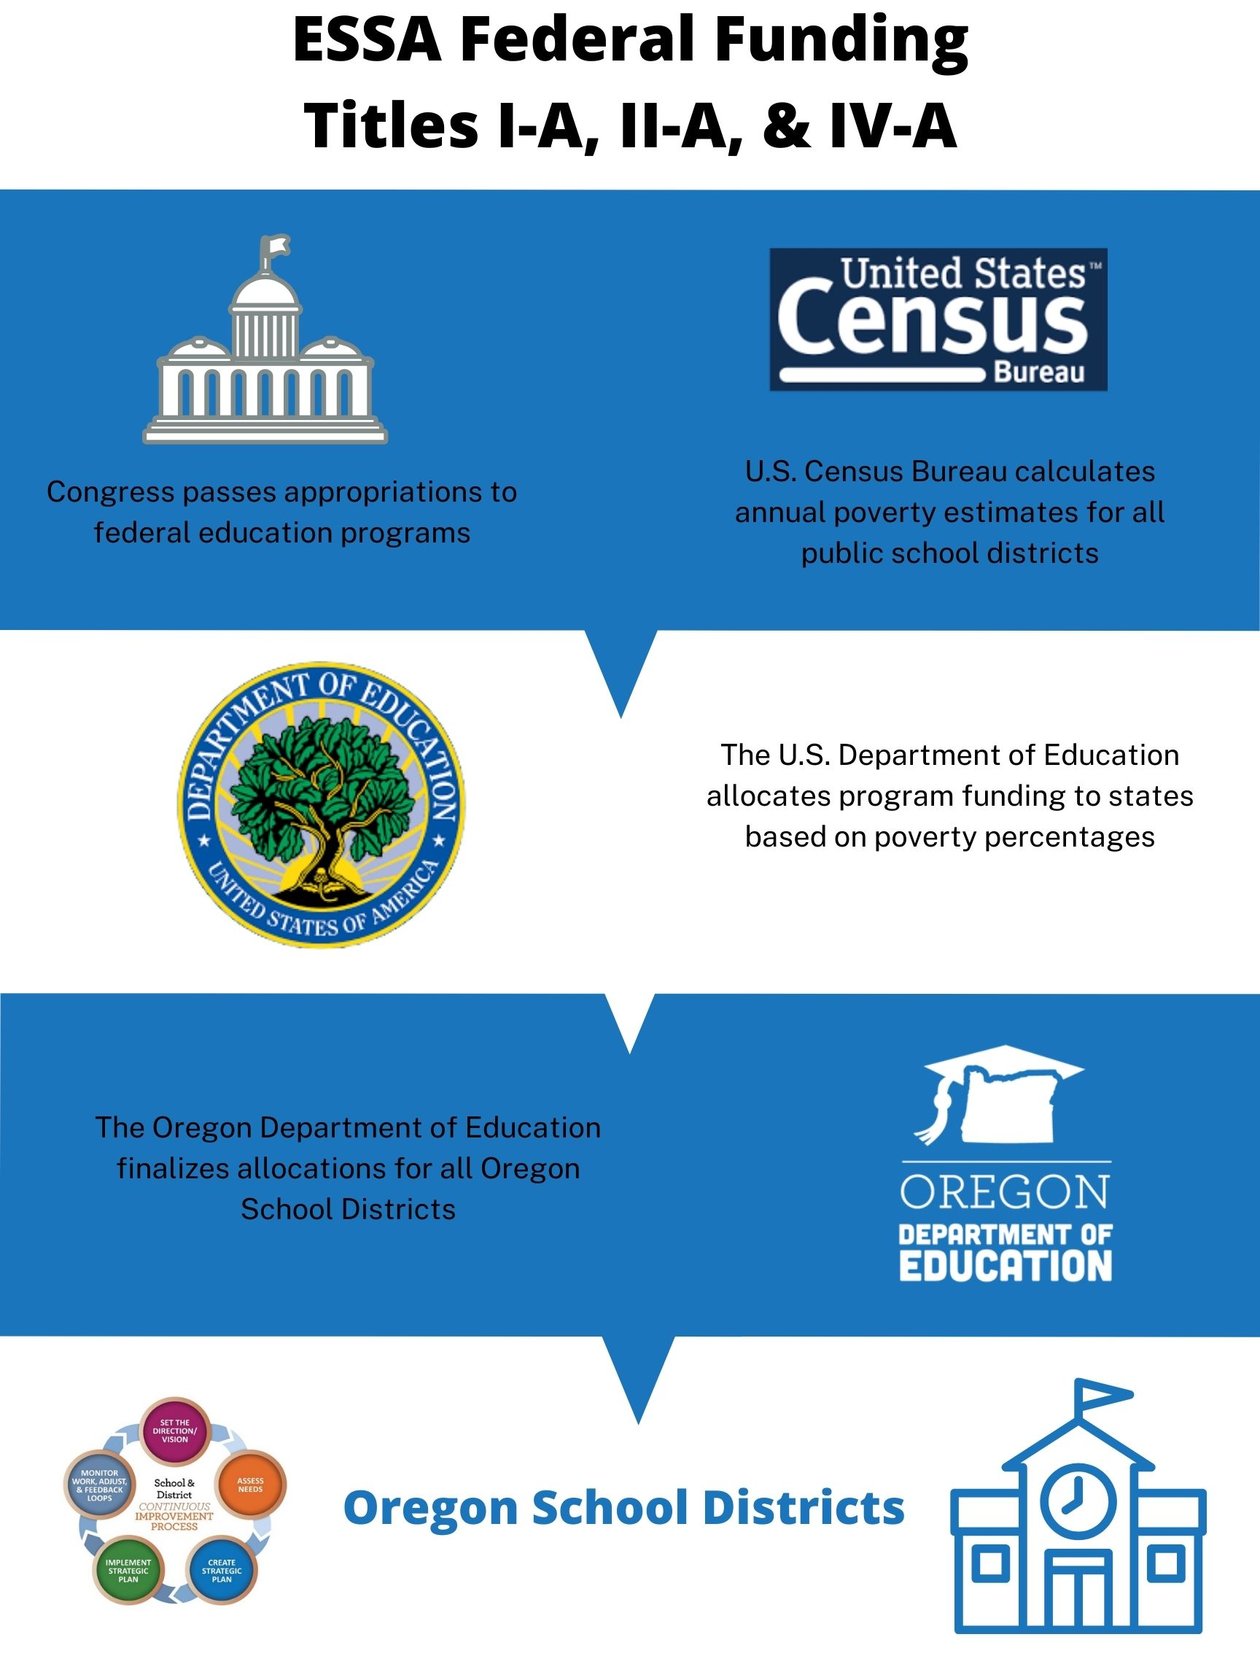
Federal Funding Step by Step
First: Federal funds originate in Congress
Second: The U.S. Department of Education calculates state level allocations
Third: ODE calculates each district’s allocation
Notes:
USDE
Census poverty, and overall education budget
To
Oregon
State gets a share based on census poverty in comparison to other states
To
Districts
Districts receive allocations based on census poverty in comparison to district after state level set asides
To
School (if applicable)
Title I-A

Slide 8

Federal Level Procedures
Congress annually appropriates funds for programs administered by the U.S. Department of Education.
The U.S. Census Bureau annually calculates poverty estimates for every public school district in the country.
The U.S. Department of Education allocates funds for each Title program based on each state’s census poverty information.
Notes:
Congress passes appropriations of a budget for all federal education programs (IDEA, Title, CTE, etc).
Meanwhile, the U.S. Census Bureau compiles poverty estimates for all public school districts in the country.
This data is called Small Area Income Poverty Estimates (SAIPE) and can be found on the website. (We will get that website to you at the end).
These estimates are based on the 2010 census, plus information about accessing of government programs. (TANF, Foster Care, Neglected & Delinquent)
2020 Census Data will be used NEXT year.
The U.S. Department of Education takes the money they have been appropriated and awards it to states and programs by census poverty information.

Slide 9

What is SAIPE Data?
Small Area Income Poverty Estimates (SAIPE)
Annual estimates of income and poverty for school districts, counties, and states
Things to Remember:
Based on residents in school district boundaries
Lower threshold than Free and Reduced Lunch
Virtual charter schools are not included
Data is two years behind the current school year
Notes:
SAIPE annually provides the most current school-age poverty estimates available for all school districts and counties in the U.S. regardless of population size.
According to data received in December 2024, Oregon’s percentage of students experiencing poverty has increased slightly, though individual districts may have decreased.
Communication from ODE is coming soon.

Slide 10

Now we wait
Budget Conservatively
Plan for reduced federal funds
Be Patient
Preliminary allocations will likely be much later, as the incoming administration and new Congress create and pass their own spending bills
Use Carryover Funds First and Plan Strategically

Slide 11

This Week’s Key Takeaways & Hot Topics
There is a lot we don’t know
Allocations anticipated for spring
Plan Conservatively: Funding cuts are likely
More ODE Communication Coming!
January 17th: CIP Budget Narrative Carryovers due

