Slide 1
Menstrual Dignity Act
K-2 Talking Points
(Less Info)

Slide 2
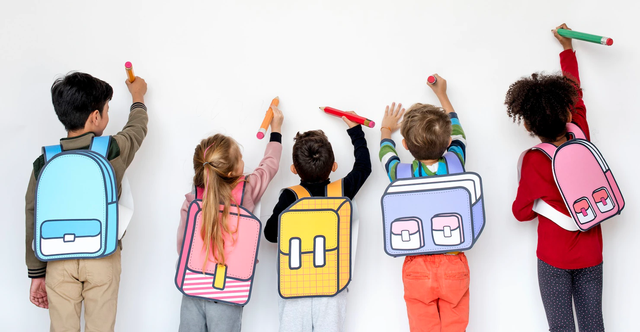
Our school is a special place.
There are lots of kids here. Some are younger - like you - and some are older.
Raise your hand if you know one of the big kids at our school!

Slide 3
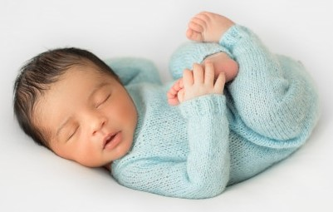
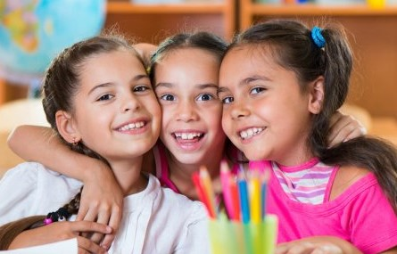
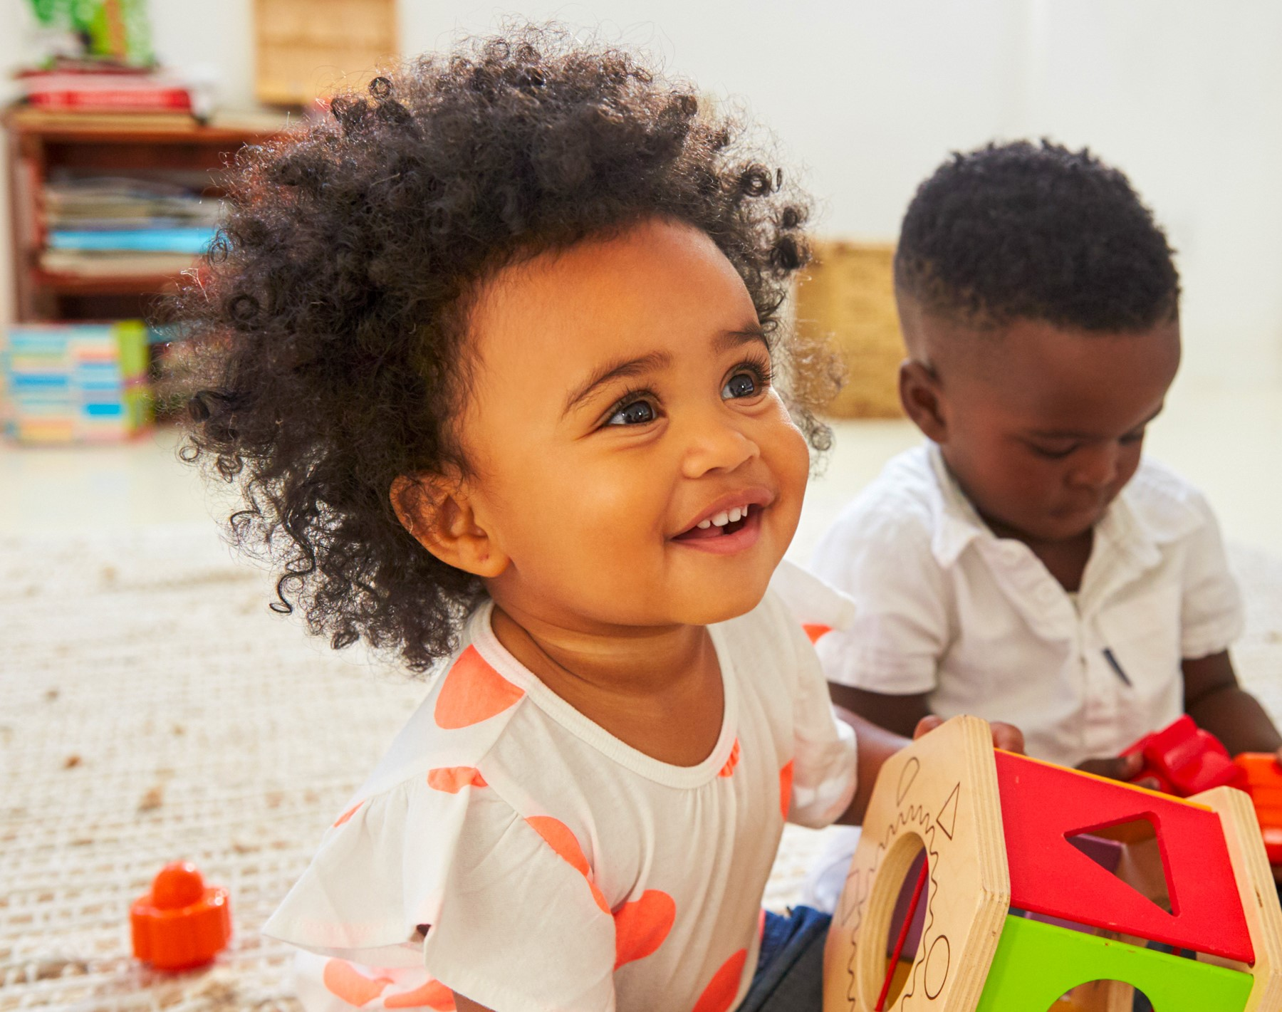
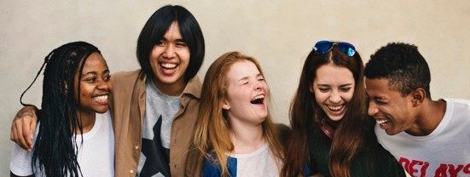
Our friends in 3rd, 4th, and 5th grade are growing up!
Their bodies are changing. They are still kids, but they are slowly becoming teenagers.
It’s exciting!
infants/babies
kids
1
3
2
toddlers
4
tweens and teens

Slide 4
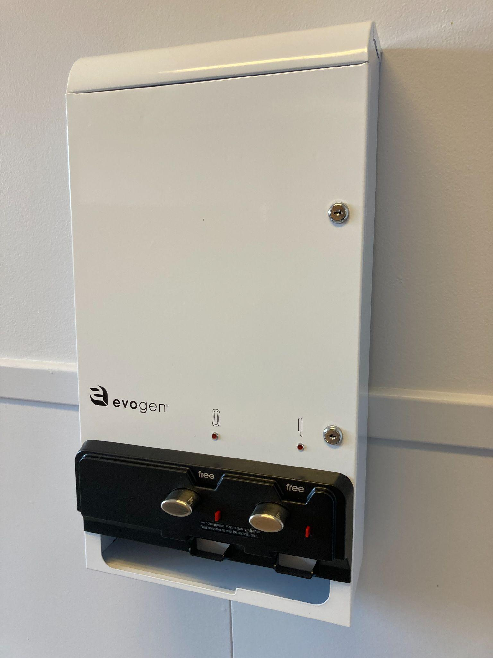
Our bathrooms got some new machines.
You may have seen them!
What are they?
What do you notice about them?

Slide 5
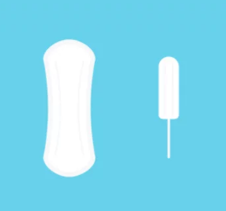
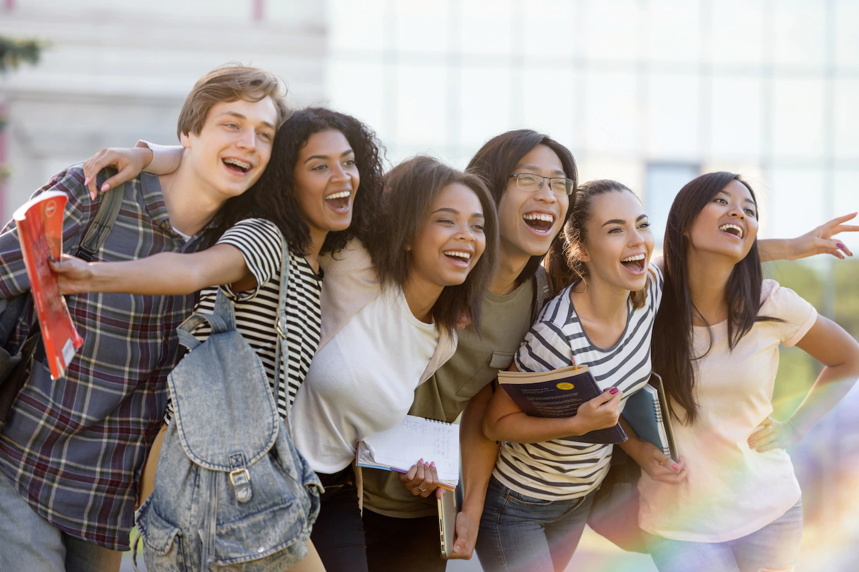
The machines are there for the older kids at our school.
Inside the machines are tools that help many of our big kids take care of their bodies.

Slide 6
We need to leave the machines alone so that our older friends have the tools they need.
What are some norms we can create about taking care of our bathrooms?

Slide 7
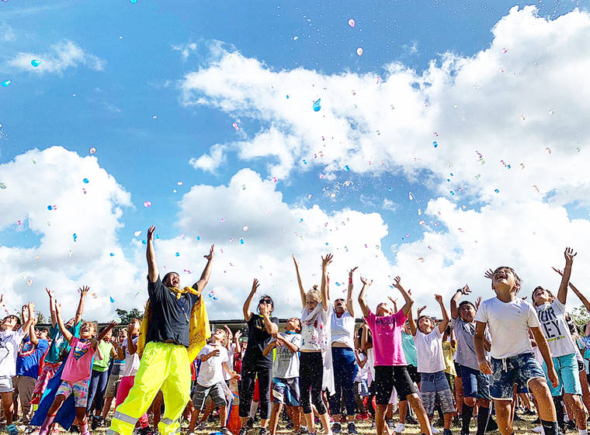
You rock!
Thanks for being a good friend to our 3rd, 4th, and 5th graders.
We can all help take care of each other and our school!

