Slide 1
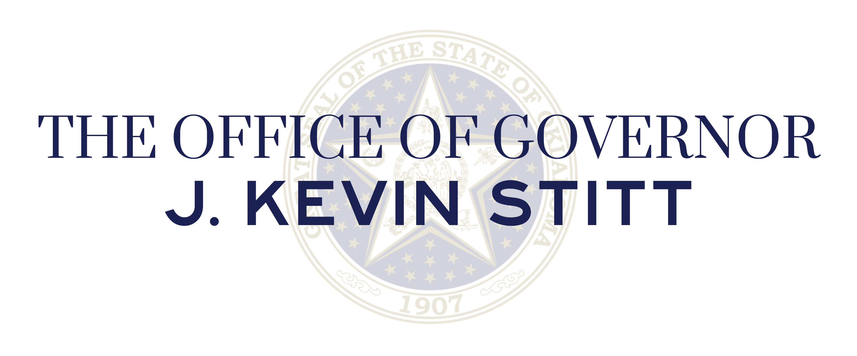

Secure Oklahoma N.O.W.
Governor J. Kevin Stitt
Commissioner Tim Tipton

Slide 2
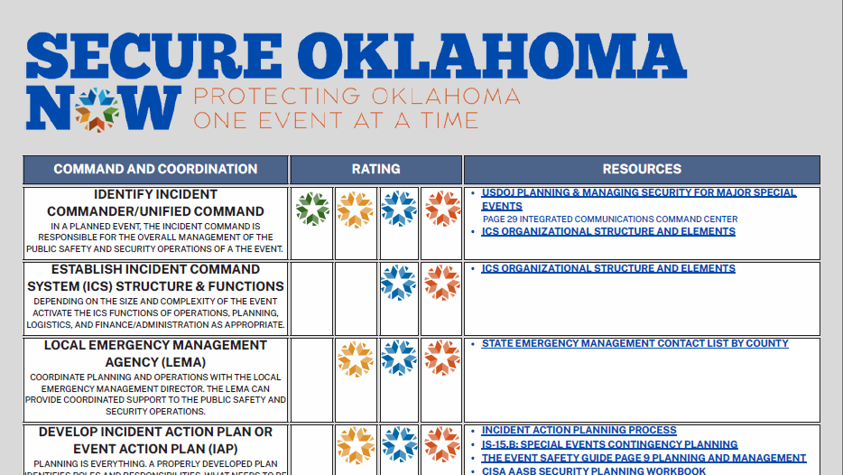

Slide 3
Secure Oklahoma N.O.W. Advisory Council
Tricia Everest, Cabinet Secretary of Public Safety
Tim Tipton, Commissioner of Public Safety
Rohit Rai, Director of the Oklahoma Office of Homeland Security
Tommie Johnson, Oklahoma County Sheriff
Michael Merritt, Comanche County Sheriff
Ron Bacy, Chief of Oklahoma City Police Department
JD Younger, Chief of Edmond Police Department
Nate Tarver, Chief of University of Oklahoma Police Department
Michael Baker, Chief of the Tulsa Fire Department
Annie Vest, Director of the Oklahoma Department of Emergency Management
Allan Young, Director of the Oklahoma Counter Terrorism Intelligence Center
Laurel Roberts, Tulsa Commissioner of Public Safety

Slide 4
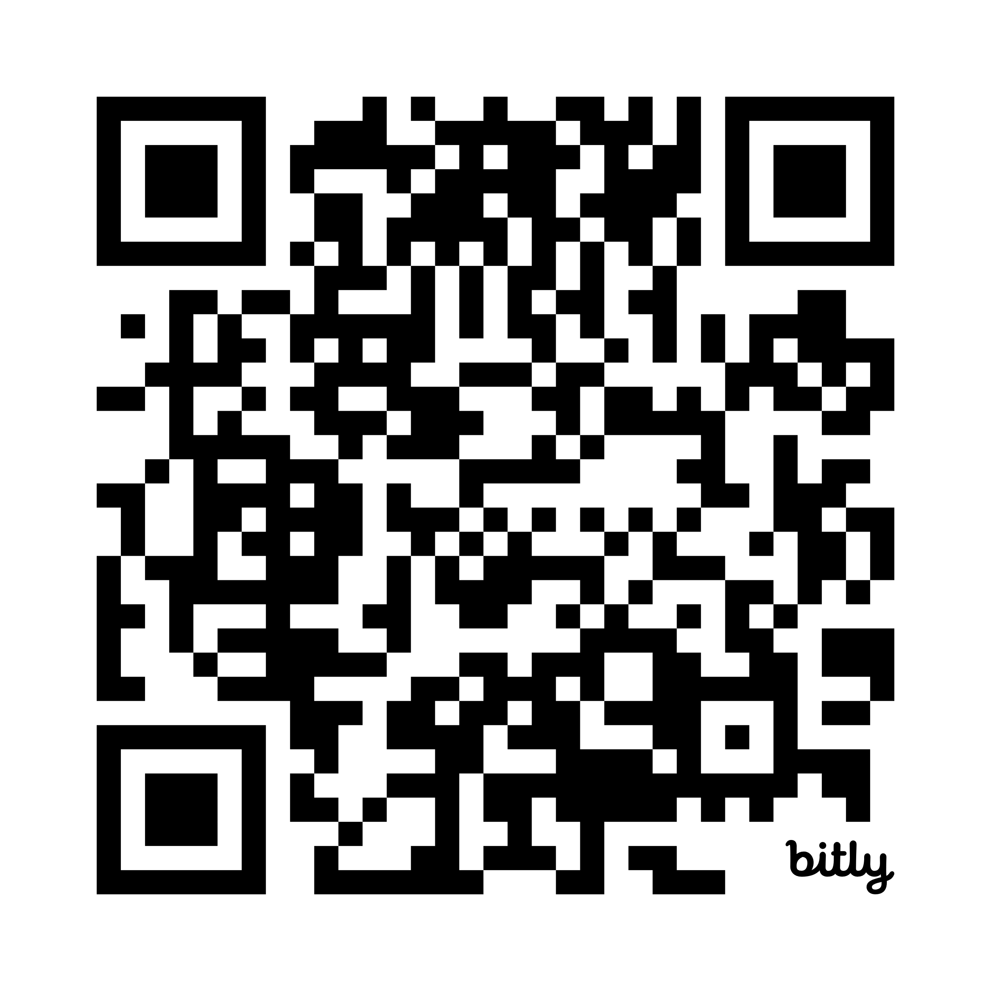


Slide 5
Secure Oklahoma N.O.W.
Governor J. Kevin Stitt
Commissioner Tim Tipton

