Slide 1


Aligning Registered Apprenticeships to Transform Classrooms in North Dakota
Laurie Matzke
Assistant Superintendent
North Dakota Department of Public Instruction
Jeff McCanna
Officer of Human Capital
Fargo Public School District
Jennifer Soupir-Fremstad
Assistant Human Capital Director
Fargo Public School District
Lennon Audrain
Research Assistant Professor,
MLF Teachers College
Arizona State University

Slide 2
Session Focus
This session will highlight North Dakota’s Registered Apprenticeship Program for Teachers (RAP-T), our plans to infuse ASU’s Next Generation Workforce in our schools, specifically within the Fargo Public School District, and how we are aligning this work.

Slide 3
NDDPI Registered Teacher Apprenticeship
Structure:
Sponsor: North Dakota Department of Public Instruction (NDDPI)
Training providers: State Approved EPPs
Employer: ND LEAs

Slide 4
The North Dakota Model
Our model uses a grow-your-own approach, which allows the apprentices to remain in their community and continue to work in the school district and support themselves while they pursue their degree.

Slide 5
Registered Teacher Apprenticeships
Registered Teacher Apprenticeship application
Approved in December 2022
SAEF grant funding awarded in June 2023
$700,999 base funding
$3.7 million in competitive funding
RFA released
Awardees announced
Round One – January 2024, (49)
Round Two – April 2024 (15)
Round Three – July 2024 (42)
Implementation – spring and fall 2024

Slide 6
A Collaborative Effort
Small SEA
North Dakota’s Team:
NDDPI – Laurie Matzke, Assistant Superintendent
Education Standards and Practices Board – Dr. Rebecca Pitkin, Executive Director
Career and Technical Education – Wayde Sick, State Director
Office of Apprenticeship – Barry Dutton, State Director
Contracted Liaison – Dr. Lynn Hammonds, Program Administrator
NCGYO – David Donaldson, Founder and Managing Partner
Northern Cass Public School District
Fargo Public School District
Arizona State University (ASU)

Slide 7
How We Leverage Multiple Funding Sources
Currently, in North Dakota, we are planning to utilize the following funding sources in our GYO programming:
IDEA – Special Education
Title I
ESSER
SAEF Grant through USDOL
State General Funds
WIOA – Job Service ND
Philanthropic Funding

Slide 8
Strategic School Staffing Models
Conventional one-teacher, one-classroom model of staffing schools is increasingly unsustainable.
Next Education Workforce Initiative has been at the forefront of pioneering work focused on strategic school staffing models.
The model reimagines how educators collaborate and deliver instruction to students by emphasizing team-based staffing.
North Dakota, is advancing education and innovation within our college teacher preparation programs and North Dakota’s school systems.

Slide 9
Lead Teacher Pilot to Statewide Scale-up Efforts
Teams comprised of ND Legislators and educators from ND visited the Next Education Workforce staffing model in Arizona.
ND recognized a unique opportunity to blend team-based staffing models with the Registered Apprenticeship work.
Lead Teacher Apprenticeship program being pursued.
Secured a $140,000 grant from the Burgum Foundation for this work.
Pilot initiative in the Northern Cass and Fargo Public School Districts.
ND would then be in a position to replicate this work across the state.

Slide 10






A Typical Set of 3rd Grade Classrooms
1 teacher
25 students
1 teacher
25 students
1 teacher
25 students
1 para-educator
Shared across all four classrooms

Slide 11
What Do You Do in This Situation?
1 teacher
25 students
1 teacher
25 students
1 teacher
25 students
No teacher
25 students

Slide 12






Short-term Solutions
1 teacher
33 students
Sub covers
25 students
1 teacher
33 students
1 teacher
33 students
Distribute students
No teacher
25 students
Teachers cover on preps
25 students
Admin covers
25 students
Resident covers
25 students

Slide 13
What if we don’t just have a teacher shortage problem, but also, a workforce design problem?

Slide 14
A plausible solution...

Slide 15
The Next Education Workforce is a paradigm shift in school staffing from “teachers of record” to “teams of record”.

Slide 16



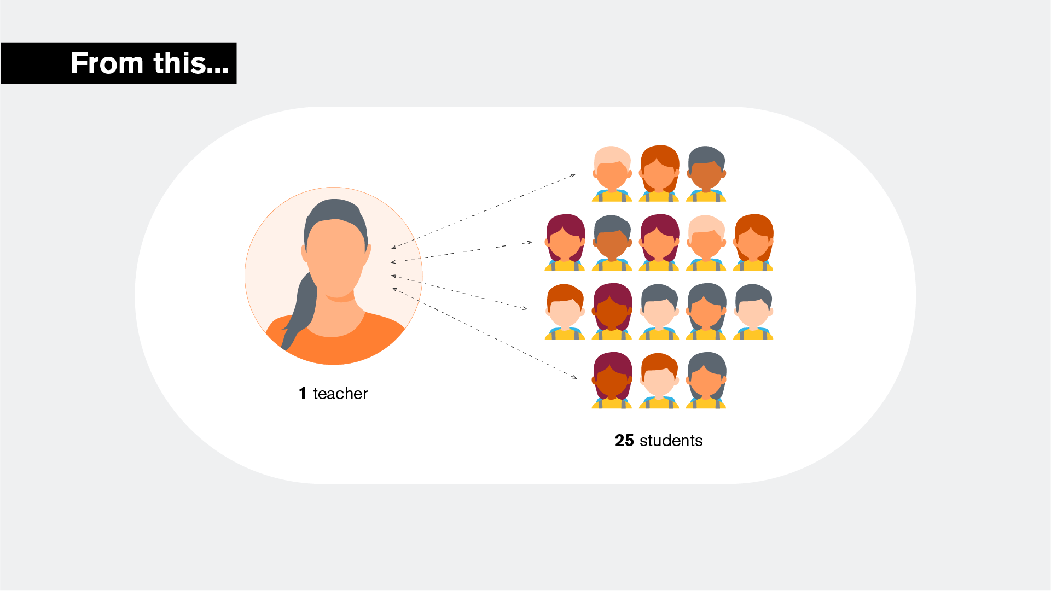









3rd Grade Educator Team
Cross-Team Data Analyst
Teacher B
Teacher C
Paid Teacher
Resident
ELA Planner
Social Studies Planner
Family Communications
AI
Science Planner
Tech / AI Integration
Small-Group Instruction
ELA + Math Tutoring
Special
Educator
Community Educator Coordinator
Lead Teacher
Math Planner
Team Management
Educator Coaching
IEP Services
UDL Supports
Shared roster of 100 learners
Student Success Coaches
Digital Learning Facilitator
Project-Based Mentors
MTSS Check-in & Check-out
Work with 15 learners each
Content Experts + Authentic Audience
Motivator + Tech Help
for online learning
Therapy dog

Slide 17

Early Outcomes
Educators in team-based models
Have lower turnover rates
Receive higher evaluation scores
Are more likely to recommend the teaching profession
Are more satisfied (75% vs. 66%)
Collaborate more (planning & implementation)
Believe they have better teacher-student interactions
Feel more supported and less lonely
Take fewer sick days and request fewer substitutes
* All of these educator differences between team-based models and traditional 1T:1C models are statistically significant p<0.05.

Slide 18

Students in Team-based Models
Observed higher levels of support and opportunities for collaboration
Increase in 3rd-grade reading growth (+1.5 months of growth)
Increases in Algebra I passing rates
“
[There] are more teachers to help you when you need it.”
– Elementary student
I like how there are a lot of teachers to support you.”
– Elementary student

Slide 19
The WHY - We Had a Problem!
Statewide Teacher Shortage: All areas of teaching were in critical shortage. In 2022, Fargo Public Schools had over 100 vacancies to fill.
Decline in Educator Preparation Programs student enrollment: Fargo has three institutions of higher education that have teacher prep programs, and all have experienced significant declines in enrollment.
Increase in hiring of educators that had not completed traditional teacher preparation programs: multiple pathways for licensure that did not require classroom practice.

Slide 20
So, What Do We Do?
Seek possible Solutions:
Enhanced Partnerships with University Partners
Increased focus on Retention
Research options - what is out there that we are not aware?

Slide 21
The Opportunities - What we found
Collaboration with the North Dakota Department of Public Instruction and other stakeholders to create opportunities for future teachers
RAP-T
Next Education Workforce
FPS Grow Your Own

Slide 22
The Process
FPS surveyed current employees to gauge interest in pursuing a teaching degree.
We tried and failed. We learned and tried again. This time with WGU. Information meeting held.
Vetting process for those interested in pursuing a teaching degree.
2-3 years of successful school-based experience
Diversity in experience in the school setting (general education/special education/multiple grade levels/content-specific experiences)
Recommendations from building leaders
Review of personnel files and performance evaluations
Alignment of the employee’s teaching degree with district high-needs areas

Slide 23
The Process
After a thorough review of employee information, FPS identified candidates most likely to succeed in the teaching degree program.
FPS collaborated with Western Governors University (WGU) and secured grant funding through two application rounds.
Currently, 30 FPS employees are enrolled at WGU, pursuing teaching degrees in Elementary Education, Special Education, Math Education, and Science Education.

Slide 24
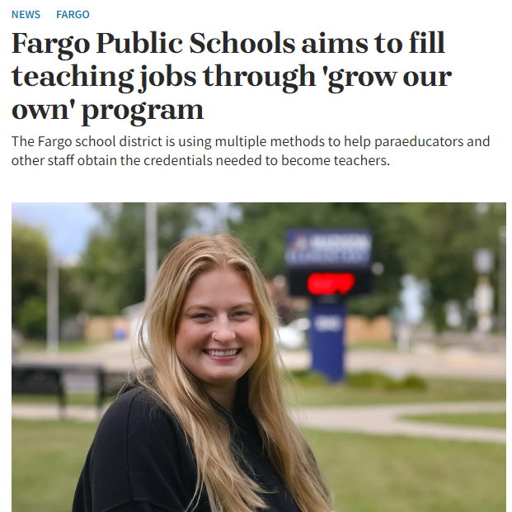
Earning & Learning
FPS Grow Your Own.

Slide 25
FPS Self-Directed Academy: Teacher Team
Purpose of the Self-Directed Academy
Alternative Educational Pathway – students were struggling with the return to traditional learning (post-COVID)
Diverse Learning Needs –offers personalized learning opportunities, flexibility in time and space, and provides student autonomy
Middle-Level Focus – addressed a need to engage students before high school to promote on-time graduation.

Slide 26
The Design: Team - Purpose - Possibilities
Core Team: ELA – Math – Social Studies – Special Ed.
Support Positions: Principal, Campus Coordinator, District Curriculum Facilitators, Para Educator, and student teachers
Authentic, project-based learning opportunities that increased engagement, aligned to standards, and allowed for individualized instruction.
Teacher Teams will increase collaboration, increase peer mentorship, build collegial relationships, and help retain and grow great teachers.

Slide 27
Impact That We Anticipate
Filling Local Teacher Shortages: Our program addresses teacher shortages by creating a reliable local pipeline of future teachers.
Retention of Experienced Educators: Paraprofessionals transitioning to teaching roles bring valuable classroom experience and demonstrate strong commitment. The team concept in the strategic staffing model helps with teacher retention.
Diversity and Community Connection: These programs increase workforce diversity, better reflecting our student demographics and strengthening cultural connections.
Cost-Effective Teacher Preparation: Our approach allows paraprofessionals to earn their certification while working, reducing financial strain.
Personalized Learning: This model uses a teaming approach and allows for more personalized instruction.

Slide 28
Next Steps
Secure Additional Philanthropic Funding.
Seek approval from USDOL on Lead Teacher Apprenticeship.
Work with ASU on Lead Teacher training modules.
Pilot in Fargo Public School District – school year 2024-2025.
Scale across North Dakota – 2025 and beyond.

Slide 29

Laurie Matzke
Assistant Superintendent
North Dakota Department of Public Instruction
lmatzke@nd.gov
Jeff McCanna
Officer of Human Capital
Fargo Public School District
mccannj1@fargo.k12.nd.us
Jennifer Soupir-Fremstad
Assistant Human Capital Director
Fargo Public School District
soupirj@fargo.k12.nd.us
Lennon Audrain
Research Assistant Professor,
MLF Teachers College
Arizona State University
lennon.audrain@asu.edu

