Slide 1
Back-to-school Drilldown for School Leaders August 7, 2024
Laurie Matzke, Assistant Superintendent
North Dakota Department of Public Instruction

Slide 2
Purpose of Presentation
The education landscape is continuously changing. This session will share key updates on state and federal programming, including updates on ESSER funding, Title funding, school accountability, Choice Ready, and state and national priorities.

Slide 3
ESSER Funding
Name | ND Allocation | Date Awarded | Deadline to Spend
ARP – ESSER III | $305.3 million | March 2021 | September 30, 2024
Current Status
$30.7 million is unspent from LEAs
98 LEAs have spent all of their funds
65 LEAs have funds remaining

Slide 4
Limited Extended Liquidation
ALL obligations signed by September 30, 2024
Normal liquidation by December 30, 2024
Extended liquidation – February 2026
Must complete the initial request form by September 15, 2024
Final documentation submitted by: October 30, 2024
Requires NDDPI approval based on the following criteria:
District is in good standing with all federal reporting requirements
Necessary based on extenuating circumstances
All liquidation will be completed by February 2026

Slide 5
Disposal of Equipment & Supplies
Equipment
Tangible property (including information technology systems) having a useful life of more than one year and a per-unit purchase cost of $5,000 or more.
When no longer need to meet the program goals.
Fair Market Value $5K or less:
May retain, sell, or dispose of with no further requirements.
Fair Market value of more than $5K or more:
Retain or sell- refund portion of the money to the US Dept of Education.
Supplies
All tangible personal property that is not equipment.
When no longer need to meet the program goals.
Aggregate Value $5K or less:
May retain, sell, or dispose of with no further requirements.
Aggregate Value of more than $5K:
Must make a good faith effort to sell unneeded supplies and document its efforts.
Cannot find a buyer no further obligation to the Department.
Sold- refund portion of the money to the US Dept of Education.

Slide 6
Spending Progress
Impacts
Increased
School Staffing, Mental Health Resources, Extended Learning Opportunities
Challenges
Timely expenditure claims
Within 120 days
Accurate & timely reporting
Learning Loss
$ 83.2 M spent directly addressing student learning

Slide 7
Remaining Reports
US Department of Education ESSER Annual Report
Focus | Specific and detailed spending of ESSER funds Specific and detailed program participation by the student sub-group
Audience | US Department of Education & ESF Transparency Portal
Participants | School districts with expenditures reimbursed during reporting period
Reporting Periods & Due Dates | FY23 Revise | July 1, 2022- June 30, 2023 | Due August ‘24
 | FY24 | July 1, 2023- June 30, 2024 | Due April ‘25
 | FY25 | July 1, 2024- June 30, 2025 | Due April ‘26
 | FY26 (Ext ONLY) | July 1, 2025- March 2026 | Due April ‘27
ND Legislative Learning Loss Report
Focus | Specific Student Gains (Academics, SEL, Choice Ready) General spending categories
Audience | ND Legislatures
Reporting Period | December 2023- November 2024
Due Date | January 2025
Participants | All ND public school districts accepting ANY ESSER funds (shorter form for districts with no expenditures after December 2023)

Slide 8
ESSER Questions
All ESSER-related questions, programmatic and fiscal, should be directed to:
Anne Butterworth
ESSER Program Manager
abutterworth@nd.gov
(701) 328-4051

Slide 9
Final Title Allocations & Consolidated Applications
Final allocations have been posted: Final 2024-2025 Federal Title Allocations.
NDDPI staff have reviewed and approved almost all of the Consolidated Application narrative sections.
Within 5-7 business days of the Consolidated Application narrative's approval, NDDPI staff will create a budget(s) for the associated federal Title program(s), with all funds represented in the unobligated object code (950).
Budgets are due by August 29, 2024.
Guidance and training videos are available here:
Consolidated Application Budget Training
Title IV Creating an Initial Budget Micro Training
Funding Your Plan: Best Practices to Sustain Investments
Return on Investment Planning Tool Instructions
Return on Investment Planning Tool Worksheet

Slide 10
Consolidated Application Approval Process
NDDPI personnel approve Con App narratives and use approved applications to determine allowable uses of funds, budget approvals, and future contract amendments.
Budgets are created in WebGrants based on intent to comingle (schoolwide process) and transferability requests after the Con App narrative is approved and final allocations are released by the USED.
Once budgets are submitted and approved by NDDPI staff, districts receive Contracts (i.e., grant awards) via WebGrants, and the Authorized Representative must sign before any claims can be paid.
Updated information on the Consolidated Application can always be found on the NDDPI website: Consolidated Application | North Dakota Department of Public Instruction (nd.gov/dpi)

Slide 11
Funding Your Plan: Best Practices for Sustaining Effective Investments
Released January 2024
Guidance and examples for districts
ESSER inspired, but applicable to many more situations
https://www.nd.gov/dpi/districtsschools/finance-operations/funding-your-plan
Funding Your Plan Workshops: Preparing for the ESSER Cliff
Visit the CREA Website for future offerings

Slide 12
Upcoming Training Opportunities
EL Crash Course – August 28-29, 2024, Register here
Accountability Report Review-Data Overview – ​ September 3, 2024
Click here to join the meeting
TSI/CSI Training for Identified Schools – September 17-18
Foster Care/Homeless/N&D Meeting – September 25, 2024​
Title I Schoolwide and Targeted Assistance Training – September 26, 2024​

Slide 13
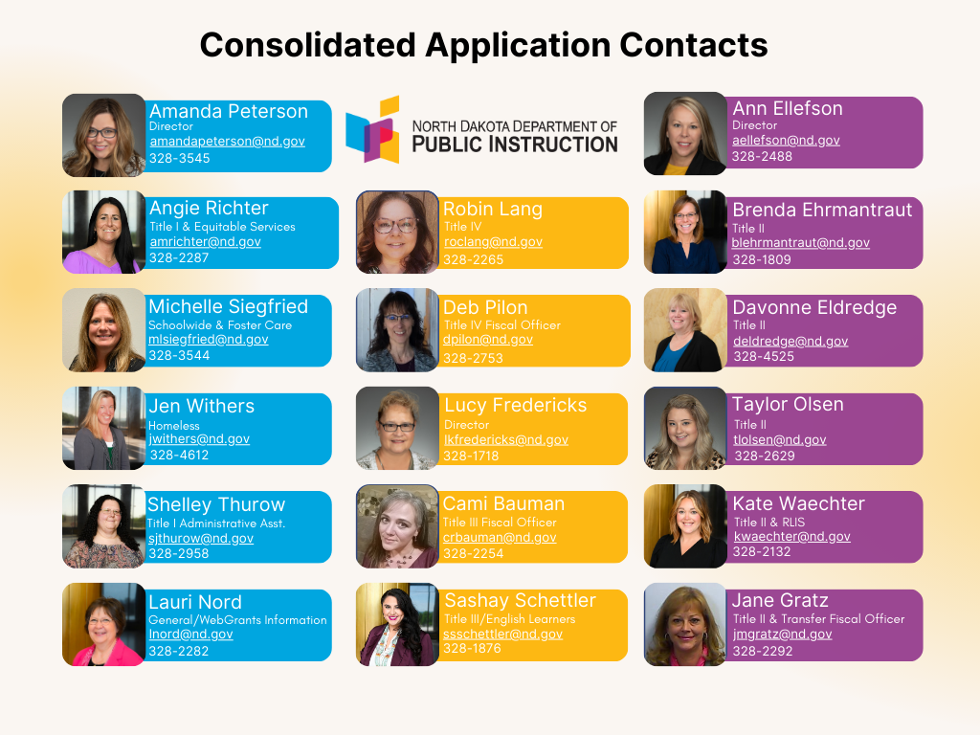

Slide 14
ESSA Updates
Although technically, the Every Student Succeeds Act (ESSA) law has expired, there is no current discussion of reauthorization.
The NDDPI continues to meet annually with our ESSA Implementation Committee to discuss the need for changes or updates to our plan. We will meet with this committee on September 12, 2024.
Topics of discussion for the September 2024 meeting:
Accountability
Student Engagement
Choice Ready
Teacher Shortage

Slide 15
School Accountability Reports
Under the ESSA federal law, state education departments, such as the NDDPI, are required to create an accountability report annually for every public school in the state.
The school accountability reports outline how schools are performing on the accountability elements North Dakota selected within its ESSA plan.
The subsequent slide outlines the accountability elements at both the elementary and high school grade spans in North Dakota.

Slide 16
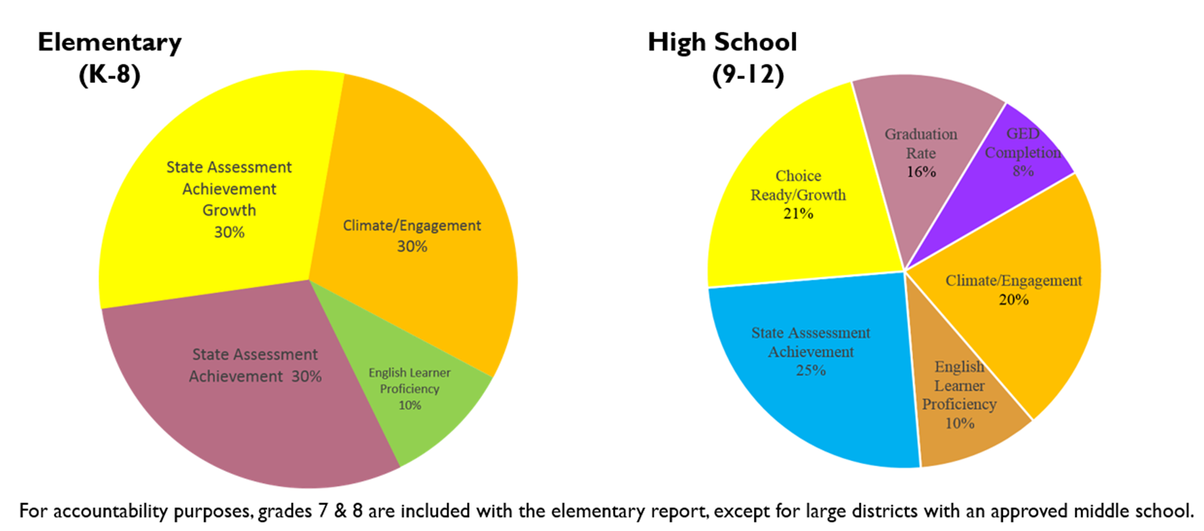
Elementary/High School Accountability System

Slide 17
How and What Information Will Be Disseminated
The 2023-2024 school accountability reports under ESSA will be released in mid-August 2024. Listed below is a timeline showing the rollout of this process:
July – August | School accountability reports created
Mid-August | Correspondence disseminated for review of school accountability reports in STARS
Mid-August – early September | Accountability report question and answer period
September 3, 2024 | Accountability report review and data overview TEAMS meeting
Mid-September | Final school accountability reports made public on Insights dashboard

Slide 18
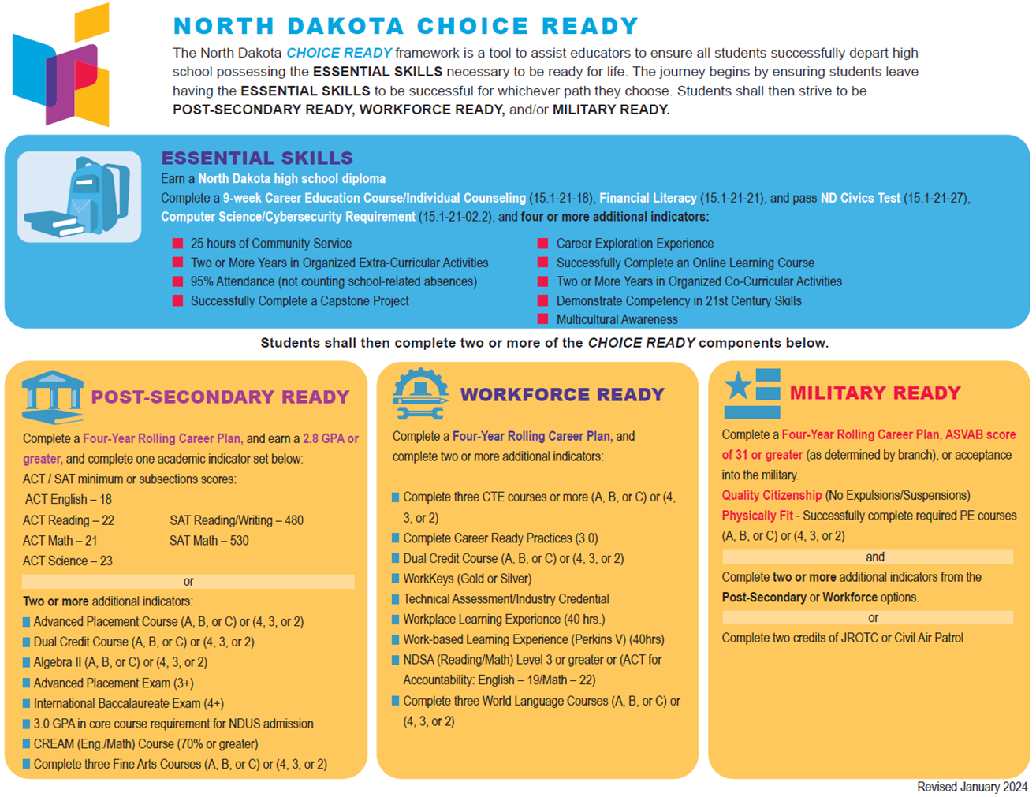
Choice Ready
Choice Ready is a key component in our state accountability system and our PK-12 strategic vision.

Slide 19
SB 2289: State Scholarship and Choice Ready
Redefines the requirements for the state scholarship program and aligns the requirements to Choice Ready.
Aligns to Choice Ready but has higher expectations for students.
3-year overlap (classes of 2022-2024) in which students can use either the old or new requirements.
Starting with the Class of 2025, only the new requirements can be used.

Slide 20
Choice Ready Report
The final due date to submit a Choice Ready report each year is June 30. We are pleased to announce that 100% of our high schools completed and submitted this critical report by June 30, 2024.
It was crucial that every public high school in North Dakota complete and submit a Choice Ready report to secure these points in the accountability system. The Choice Ready report is 21% of your accountability report and is worth 129 points.

Slide 21
Choice Ready Results
The department is now compiling the data for inclusion of Choice Ready results on the school accountability report, which will be represented by a graphic showing growth, as indicated below:
Choice Ready Visualizations:
The Choice Ready measure is calculated based on year-over-year growth. High schools must improve year after year to maintain the Choice Ready goals.

Slide 22
Choice Ready Regional Workshops
The NDDPI, in collaboration with the North Dakota Department of Career and Technical Education (CTE), EduTech, and the North Dakota Regional Education Association (REA), will be hosting two regional Choice Ready workshops.
August 12, 2024 – Fargo
August 14, 2024 – Bismarck
At the workshops, the NDDPI will share information on a unique opportunity for high school students to get services in the following three areas for the 2024-2025 school year:
ACT Tutoring
Dual Credit Courses
Online Courses
The applications will be time-stamped, and we will fund them on a first-come basis until the funding runs out.

Slide 23
Grow Your Own (GYO) Programming
The teacher shortage is a pervasive problem affecting all states nationwide. Some initiatives the NDDPI is working on to address the shortage include:
SB 2032
Registered Teacher Apprenticeship Program
Registered Principal Apprenticeship Program

Slide 24
SB 2032
Senate Bill 2032 appropriates $3 million over two years to the NDDPI for grants to universities to help paraprofessionals become qualified teachers.
North Dakota is using a “follow the student” approach.
Information was disseminated to schools on September 8, 2023.
Funding was depleted by early December 2023.
The program is funding 230 paras across 60 districts.
Part of NDDPI’s base budget, so we will have funding for the foreseeable future.

Slide 25
Registered Apprenticeship Program for Teachers (RAP-T)
Tennessee's approval spurs nationwide interest.
A partnership develops.
David Donaldson – National Center for Grow Your Own (NCGYO) (August 2022)
Registered Teacher Apprenticeship Application.
Approved in December 2022
SAEF Grant funding was awarded in June 2023.
$311,388 base funding
$3.7 million in competitive funding
RFA released – due November 20, 2023.
First awardees announced in early January 2024 for round one.
Implementation – Fall 2024.

Slide 26
Registered Principal Apprenticeship Program
Round | Educator Preparation Provider (EPP) | Grant Amount | Participants
Round 1 | Valley City State University Mayville State University University of Mary Certification Central | $100,000 $100,000 $555,000 $100,000 | 12 5 27 5
Round 2 | Western Governors University | $300,000 | 15
Round 3 | Certification Central Dickinson State University Mayville State University Valley City State University Western Governors University | $200,000 $140,000 $100,000 $200,000 $300,000 | 10 14 5 13 15
Round 4 | RFA released in the fall of 2024

Slide 27
Registered Principal Apprenticeship Program
ND becomes first in the nation to receive approval on a Registered Principal Apprenticeship – July 2023.
Year one grant – NDSU had 11 apprentices with 3 districts.
Year two grant – awarded to UND in June 2024.
New Principal Playbook developed by NCGYO.

Slide 28
Lead Teacher Pilot / Strategic Staffing Models
Teams comprised of ND Legislators and educators from ND visited the Next Education Workforce staffing model in Arizona.
ND recognized a unique opportunity to blend team-based staffing models with their Registered Apprenticeship work.
Seek Lead Teacher Apprenticeship program approval from USDOL.
Pilot the initiative in Northern Cass and Fargo Public School Districts.
Secured a $140,000 grant from the Burgum Foundation for this work.

Slide 29
Convening to Support Education Professions
In June 2024, the Hunt Institute and USED sponsored three regional convenings designed to support state action to advance the education professions.
A team from ND attended, including staff from NDDPI, Career and Technical Education, the Education Standards and Practices Board, and the University of North Dakota.
North Dakota created the following two plans:
Youth Plan: We decided we would like the state to focus on pathways into the profession, by encouraging middle and high school students to pursue education careers. An outline of the plan is available here.
Multicultural Plan: The purpose of this plan will be to create a more multicultural teaching pipeline in ND. A workgroup is being established to formulate our plan going forward.

Slide 30
In Summary – Key Takeaways
Ensure all ESSER III funding is spent by September 30, 2024.
Review draft school accountability report: mid-August to mid-September.
Register for a Choice Ready Workshop.

Slide 31
How to Stay Informed
The NDDPI disseminates the Weekly Blast to share key information and updates with the field.
The NDDPI utilizes the communications suite, GovDelivery. The NDDPI GovDelivery communications will deliver critical and essential information for the 2024-2025 school year to all North Dakota school districts so be sure to watch for these important emails.

Slide 32
Laurie Matzke, Assistant Superintendent
North Dakota Department of Public Instruction
(701) 328-2284
lmatzke@nd.gov

