Slide 1
School Performance Grade Redesign
Catherine Truitt, NC State Superintendent
Dr. Michael Maher, Deputy State Superintendent
Dr. Andrew Smith, Assistant State Superintendent
House K–12 Education Committee
May 30, 2023

Slide 3
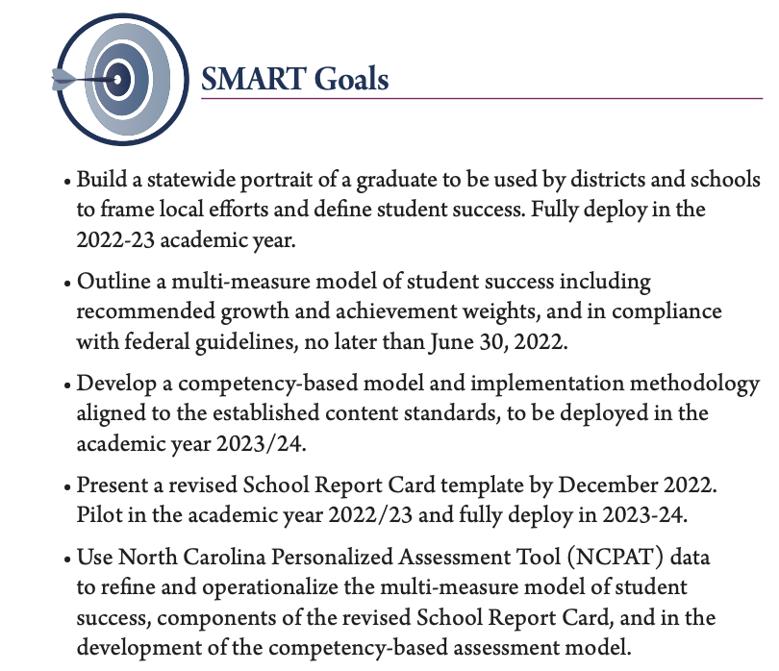
Testing and Accountability Goals

Slide 4
School Performance Grade Redesign
Goal: Develop a multi-measure model of school performance that moves beyond compliance with federal guidelines and represents NC educational values.
Pandemic shed light on inadequacy of current school accountability model
Reduce reliance on test scores & growth by adding valuable school quality indicators
Indicators of school performance (i.e., school climate scores, Portrait of a Graduate (POG) competency attainment, school safety, parent engagement, career/college readiness, etc.)
Federal requirements would continue to be met

Slide 5
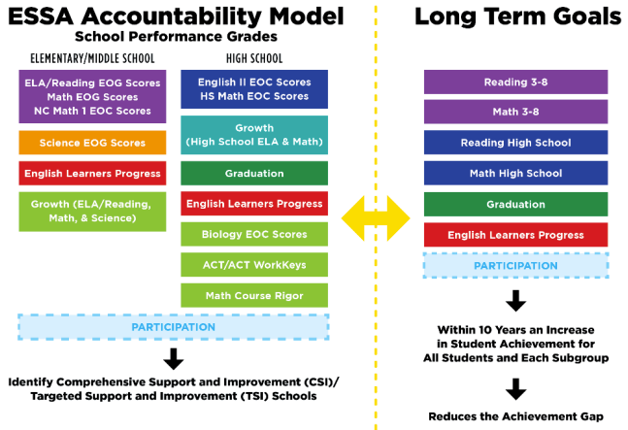
North Carolina’s Current Accountability System
Notes:
NC Consolidated State Plan (p. 33): https://www.dpi.nc.gov/media/8459/download
Academic Achievement: EOG/EOC
ELP: WIDA
Other: EOG Science; (high school EVAAS)
SQSS:
ES/MS: EVAAS Reading and Math
HS: EVAAS Reading and Math (Math I, Math III) + (1) ACT/ACT Workkeys, (2) Math course rigor, and (3) Biology performance
High School growth: https://www.publicschoolsfirstnc.org/wp-content/uploads/2022/03/3.18.22_FACTS-A-F-School-Performance-Grades_F.pdf

Slide 6
North Carolina’s SPG Background
First reported in February 2015 based on 2013–14 school year data.
The model is weighted 80% achievement and 20% growth
A = 100–85
B = 84–70
C = 69–55
D = 54–40
F = 39 and below

Slide 7
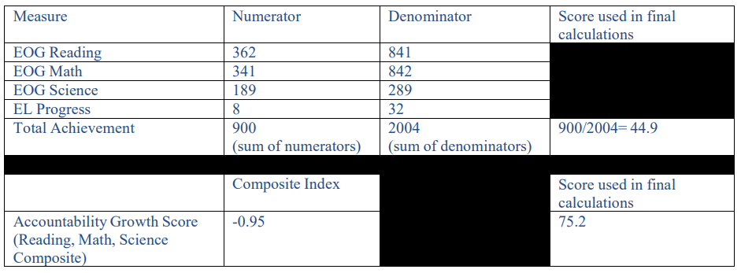
Scoring Example: Annual Measurable Differentiation (AMD)
Elementary/Middle School
School Score = 44.9 (.8) + 75.2(.2) = 51.0
NC Consolidated State Plan, p. 46: https://www.dpi.nc.gov/media/8459/download

Slide 8
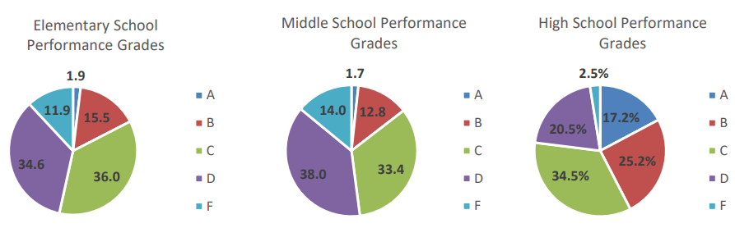
NC Grades by School Type (2021–22)
D and F Schools:
46.5% Elementary (N=1,267)
52% Middle School (N=694)
23% High School (N=634)
Note: In high school, fewer D & F schools is a function of the accountability model. K–8 school grades are limited to test score results.

Slide 9
SPG - State Analysis
School performance grade (A–F) state comparisons for the 2021–22 school year
State | A Schools N (%) | B Schools N (%) | C Schools N (%) | D Schools N (%) | F Schools N (%) | Total Schools
North Carolina | 145 ( 5.6) | 446 (17.2) | 907 (35.0) | 833 (32.1) | 264 (10.2) | 2,595
Arizona | 485 (27.3) | 767 (43.2) | 403 (22.7) | 89 (5.0) | 30 (1.6) | 1,774
Florida | 1,069 (32.1) | 842 (25.1) | 1,229 (36.7) | 182 (5.4) | 26 (0.7) | 3,348
Louisiana | 192 (15.9) | 362 (29.9) | 350 (29.0) | 178 (14.7) | 124 (10.3) | 1,206
Mississippi | 258 (29.8) | 273 (31.5) | 172 (19.8) | 122 (14.1) | 41 (4.7) | 866
Texas | 2,356 (27.9) | 3,895 (46.1) | 1,636 (19.4) | 376 (4.4) | 188 (2.2) | 8,451
Notes:
Of the states shown in Table 1, North Carolina had the highest number and percentage of D or F schools (1,097 schools for 42.3%) in the 2021-22 school year. Three of the comparison states have less than 10% of schools identified as D or F, and two states (Louisiana and Mississippi), though higher than 10%, are significantly lower than North Carolina. These comparisons are based on accountability reports for the 2021-22 school year, noted as a year during the COVID pandemic with the associated impacts on schools and communities.

Slide 10
SPG - State Analysis
NAEP 2019 State Comparisons Mean Scale Score
State | Math Grade 4 | Math Grade 8 | Reading Grade 4 | Reading Grade 8
North Carolina | 241 | 284 | 221 | 263
Arizona | 238 | 280 | 216 | 259
Florida | 246 | 279 | 225 | 263
Louisiana | 231 | 272 | 210 | 257
Mississippi | 241 | 274 | 219 | 256
Texas | 244 | 280 | 216 | 256
National Average | 240 | 281 | 219 | 262
Blue: Statistically Higher than North Carolina
Green: Not Statistically Different than North Carolina
Yellow: Statistically Lower than North Carolina
10

Slide 11
SPG - State Analysis
NAEP 2022 State Comparisons Mean Scale Score
State | Math Grade 4 | Math Grade 8 | Reading Grade 4 | Reading Grade 8
North Carolina | 236 | 274 | 216 | 256
Arizona | 232 | 271 | 215 | 259
Florida | 241 | 271 | 225 | 260
Louisiana | 229 | 266 | 212 | 257
Mississippi | 234 | 266 | 217 | 253
Texas | 239 | 273 | 214 | 255
National Average | 235 | 273 | 216 | 259
Blue: Statistically Higher than North Carolina
Green: Not Statistically Different than North Carolina
Yellow: Statistically Lower than North Carolina
11

Slide 12
SPG - State Analysis
NAEP data affirms North Carolina schools are performing considerably better than their state performance grades otherwise suggest. The disproportionally large numbers of D and F schools in North Carolina, as compared to other states, prompts two questions:
How can North Carolina strengthen the validity of its accountability system for assigning school performance grades?
And how might evolving values and priorities of North Carolina stakeholders influence revisions to the current system and its intended uses?

Slide 13
School Performance Grade Redesign Process

Slide 14
Advisory Group Members
Catherine Truitt, NC State Superintendent of Public Instruction
Amy Galey, NC Senator
Ashton Clemmons, NC Representative
Brenda Berg, President & CEO - Best NC
Bruce Mack, Vice President - NC Community Colleges
David Willis, NC Representative
Debra Derr, Director Gov. Affairs - NC Chamber
Diana Lys, Assistant Dean - UNC Chapel Hill
Don Phipps, Superintendent - Caldwell County Schools
Edward McFarland, CAO - Wake County Public Schools
Frank Barnes, Deputy Superintendent - Charlotte Meck.
Geoff Coltrane, Senior Education Advisor - Office of the Governor
Jessica Swencki, Deputy Director - MyFutureNC
Jill Camnitz, NC State Board of Education Member
John Marshall, Head of School - Union Academy Charter School
Jordan Whichard, Chief Deputy Sec. - NC Department of Commerce
Leah Carper, NC Teacher of the Year - Guilford County Schools
Levy Brown, Senior VP/CAO – NC Community College System
Lynn Moody, Strategic Advisor, SparkNC
Michael Sasscer, Superintendent - Edenton-Chowan Schools
Nick King, CAO - Johnston County Schools
Patrick Greene, NC Principal of the Year - Greene County Schools
Phil Kirk, NC Independent Colleges & Universities
Travis Reeves, Superintendent - Surry County Schools
External Members
Michael Maher, Deputy Superintendent
Andrew Smith, Innovation
Angie Mullennix, Innovative Practices & Programs
Ashley Baquero, Charter Schools
Jeni Corn, Research and Evaluation
Jeremy Gibbs, Regional Director
Kristi Day, Academic Standards
Kristie VanAuken, Workforce Engagement
Maria Pitre-Martin, State Board of Education
Shelby Armentrout, Chief of Staff
Sherry Thomas, Exceptional Children
Sneha Shah Coltrane, Advanced Learning
Tammy Howard, Testing & Accountability
Tom Tomberlin, District Human Capital
Trey Michael, Career & Technical Education
DPI Members

Slide 16
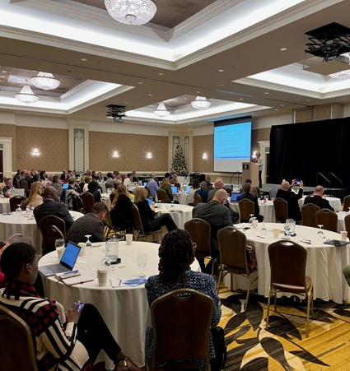
Statewide Stakeholder Engagement
NC School Board Association
Superintendent Quarterly Meeting
Public Information Officers
NCPAPA
RESA Meetings – Superintendents
Charter School Leadership
Chief Academic Officers
AIM Conference
Testing and Growth Advisory
AIG Regional Leadership
Teacher Leadership Council
Governors’ Teacher Advisory Council

Slide 17
SPG | Potential Indicators
Extended High School Graduation Rate
Improving Student Group Performance
Postsecondary Outcomes – Employed, Enlisted, Enrolled
Postsecondary Preparation Inputs
Academic
Indicators
Extra/Intra-Curricular Activities
Durable Skills
Chronic Absenteeism
School Climate
School Quality
Indicators

Slide 18
Extended High School Graduation Rate
Applicable Grade Span
Definition: This indicator refers to the percentage of students who complete graduation requirements within five years on entering ninth grade.
Existing Data System: Yes
State or Federal Model: Possibly Both
Note: This is in addition to the adjusted 4-year cohort rate.
Elementary
School
Middle
School
High
School
Academic Indicator

Slide 19
Improving Student Group Performance
Applicable Grade Span
Definition: Increase in student group achievement from previous year.
Existing Data System: Yes
State or Federal Model: Possibly Both
Elementary
School
Middle
School
High
School
Academic Indicator

Slide 20
Postsecondary Preparation Inputs
Definition:
Elementary: Percentage of students who participate in a career exploration activity.
Middle: Percentage of students who have a career development plan.
High: Percentage of students who fulfill at least one of a defined list of post-secondary preparation programs, classes, or certifications.
Existing Data System: Yes
State or Federal Model: Possibly Both
Applicable Grade Span
Elementary
School
Middle
School
High
School
Academic Indicator

Slide 21
Postsecondary Outcomes – Employed, Enlisted, Enrolled
Applicable Grade Span
Definition: Percentage of graduates who either have confirmed acceptance in a post-secondary institution, enlisted in the military, or are employed.
Existing Data System: No
State or Federal Model: Possibly Both
Elementary
School
Middle
School
High
School
Academic Indicator

Slide 22
Extra/Intra-Curricular Activities
Applicable Grade Span
Definition: Percentage of students who participate in at least one extracurricular or intra-curricular activity.
Existing Data System: No
State or Federal Model: State
Elementary
School
Middle
School
High
School
School Quality Indicator

Slide 23
Durable Skills
Applicable Grade Span
Definition: Percentage of students who demonstrate the seven durable skills defined in the NC Portrait of a Graduate.
Existing Data System: No
State or Federal Model: State
Elementary
School
Middle
School
High
School
School Quality Indicator

Slide 24
Chronic Student Absenteeism
Applicable Grade Span
Definition: The percentage of students whose absences exceed 10% of days in membership.
Existing Data System: Yes
State or Federal Model: State
Elementary
School
Middle
School
High
School
School Quality Indicator

Slide 25
School Climate
Applicable Grade Span
Definition: Percentage of students and teachers who affirm the qualities of a school related to engagement and environment.
Existing Data System: No
State or Federal Model: State
Elementary
School
Middle
School
High
School
School Quality Indicator

Slide 26
Next Steps: Exploring Indicators in Great Depth

Slide 28
Plan
The indicator needs to be established; requiring discussion and research to determine how to measure and collect from authoritative sources.
Develop
Some information for the indicator is available, but business rules need to be established.
Implement
Indicators have sufficient data. Model simulations are created and business rules are adjusted as needed.
Finalize
The indicator is final, leadership will determine to include or exclude from the school performance grade model.
Research
and Evaluate

Slide 29
Current Indicators Status
Plan | Develop | Implement | Finalize
School Climate Survey Durable Skills Extra-Curricular or Intra-Curricular Activities Improving Student Group Performance Postsecondary Outcomes Postsecondary Inputs (Middle School) Postsecondary Inputs (Elementary School) | Chronic Absenteeism Postsecondary Inputs (High School) | 5-Year Cohort Graduation Rate

Slide 30
Questions

