Slide 1
$10,000 High School Scholarship Program - 2023

Slide 2
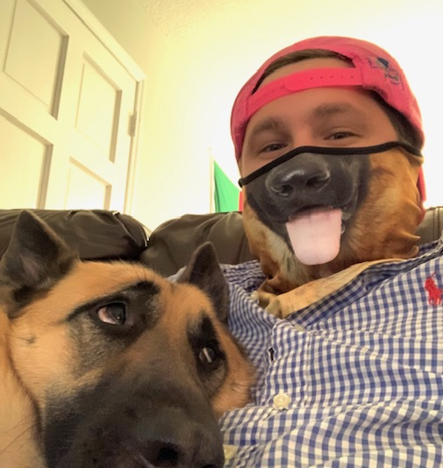
Grant Kennedy
SECU Foundation Program Officer
Notes:
*Brief introduction to Grant Kennedy
*Explanation of SECU Foundation
*Created in 2004
*Power of a Dollar
*$7+ million/year in scholarships
*$10-$12 million/year in grants

Slide 3
The SECU People Helping People Scholarship is valued at $10,000 and awarded over [up to] eight consecutive semesters to pay for tuition and fees
Scholarship is only available to graduating public high school seniors who are either current members of SECU or the child of a parent/guardian who is a member of SECU
Students must have a 2.5 GPA (on a 4.0 scale) or higher, plan on attending one of the 16 UNC System universities, demonstrate leadership, excellence of character, integrity, and community involvement
LEA Scholarship Selection Committees will make final decision on recipient(s) from the school district
Scholarship Overview & Eligibility Criteria
Notes:
435 scholarships total. Each LEA is allotted at least 1; the rest are allotted based upon ADM per DPI. The email each facilitator received on November 3rd had all 2023 materials and also mentioned how many scholarships your LEA was allotted.
The People Helping People Eligibility Criteria outlines our requirements for all recipients selected for the scholarship. The first and most significant criteria is that the People Helping People Scholarship is only available to graduating public high school seniors who are either current members of State Employees’ Credit Union (“SECU”) or the child of a parent/guardian who is a member of SECU at the time of application. Membership eligibility does not include Local Government Federal Credit Union or NC Press Association Credit Union members. ***MENTION NEW POLICY ABOUT VERIFYING MEMBERSHIP***

Slide 4
Scholarship Overview & Eligibility Criteria
Notes:
*Same information as last slide; this is the flyer that everyone should have received on November 3rd. This flyer should be posted at schools, on school websites, social media, etc.

Slide 5
Scholarship Program
Role of Facilitator:
Communicate program changes with all high schools in your LEA
Ensure each high school is sharing scholarship information with students and their parents
Establish LEA selection committee to determine final selection of scholarship winner(s) for your district
Communicate final selection(s) with SECU Foundation as indicated in operating procedures
Serve as the point of contact for scholarship related questions for the high schools in your district
Notes:
So, what is your role as the facilitator throughout this process? The SECU Foundation People Helping People Scholarship administrator role for which you have been chosen includes the following responsibilities:
Communicating all updated selection processes and 2023 materials with all high schools in your LEA. As a reminder, we ask that you ensure each high school in your district is represented in your selection process, to ensure equity in distribution of the scholarships.
Ensuring each high school is sharing scholarship information with students and their parents, for example making sure the scholarship information is posted on each high school website, sent through email, posted on social media, and announced at senior class events.
Establishing a Scholarship Selection Committee to determine final selection of a scholarship winner or winners for your district.
The LEAs will be required to create their own Scholarship Selection Committee that must consist of three or more members to make the final decisions on the recipient or recipients from their school district. We do ask that the LEAs who have more than one high school in their district ensure they are representing the entire district in their final recipient selections. The decision of the Scholarship Selection Committee is final, if all requirements have been met. LEAs must communicate their processes to both principals and guidance counselors at each school in their district to ensure proper administration of the scholarship.
****ASK WEBINAR ATTENDEES TO TYPE OUT WHO THEY INCLUDE IN THEIR LEA SELECTION COMMITTEE****
Communicating final selection(s) with SECU Foundation as indicated in the Operating Procedures.
Serving as the point of contact for scholarship related questions for the high schools in your district. SECU Foundation will direct students back to their high schools for questions about process or deadlines, and direct any questions from the high schools directly to you at the LEA.

Slide 6
LEAs should set a deadline for the high school to submit applications to the LEA
High schools should set a deadline for students to submit an application to the high school
Student applications and all accompanying paperwork will be turned into school counselors, who will verify the application is complete and submit to the facilitator at the LEA
Notes:
Each LEA should set a deadline for their high schools to submit the student applications to them and based on that date, high schools should set a deadline for students to turn in the application at the high school level. Please ensure the students, counselors, principals, and LEA staff are all aware of every deadline. Should students or their parents contact SECU Foundation with questions about deadlines, we will refer them back to their high school to confirm their specific dates.
Student’s applications and all accompanying paperwork must be submitted to school counselors, who will verify the application is complete and then submit the packet to the designated facilitator at the LEA. SECU Foundation requires filled out, signed, and dated 2023 SECU Consent Forms, SECU Application and Essay, Photo of student, and University Acceptance Letter. These are the student provided materials that must be turned in to SECU Foundation if a student is selected by the LEA.

Slide 7
Scholarship Program
Timeline:
November-January– Establish LEA Selection Committee and process for choosing recipient(s) *Scholarship can go live as early as December 16th
No later than end of January– Communicate process and give information to Counselors and Principals
January-March– High Schools receive applications
April 3, 2023– Deadline for recipient submission by LEA to SECU Foundation
April-June – SECU Foundation confirms nominees; LEAs and SECU Foundation notify recipients; SECU Foundation coordinates award ceremony attendance with local SECU Branches
December - January - March - May
Notes:
November-January – Each LEA should establish a Selection Committee and create a process for choosing the recipient or recipients in your LEA. If your LEA has not already begun this process, please do so as soon as possible. You can refer to the Helpful Hints and Operating Procedures for assistance in creating and implementing that process.
Beginning in December, but no later than the end of January– LEAs will communicate their process with their district’s high school counselors and principals. Please make sure you’ve shared with your high schools the Eligibility Criteria, Application, Consent Form, Frequently Asked Questions, and $10,000 Scholarship Flyer. Please make sure your counselors know that all of this material must be shared with interested applicants.
January - March– High Schools will receive scholarship applications from students. As mentioned previously, each high school should have a date by which all student applications must be received in order to submit to the LEA by their designated deadline.
March 2023—Scholarship Selection Committees at each LEA will make their selections of their recipients and alternates. LEAs should have both their recipient and alternates decided before the April 3, 2023 deadline. As a reminder, LEAs should ensure they have an alternate for each recipient ready to submit to SECU Foundation in the instance the chosen recipient no longer qualifies for the award. Please include all alternates names on the committee selection letter in the order of approval. SECU Foundation should not receive any alternate scholarship materials until such time that an alternate needs to step in for the original recipient. Please have all alternate recipient scholarship materials ready to submit should they be needed.
April 3, 2023 is the deadline for recipient submission from the LEA to SECU Foundation. The LEA must submit the recipient’s full scholarship packet to SECU Foundation, where we will then verify SECU membership eligibility for each recipient provided and will notify the LEA when eligibility has been confirmed so the school district can announce the selections. Please do not announce any recipient until SECU Foundation has confirmed SECU membership eligibility. As a recap, the full scholarship packet must include a completed application and essay, copy of recipient’s acceptance letter, signed consent form, student photo, and signed LEA Selection Committee statement verifying their choice of recipients.
June 2023 – SECU Foundation will send an award letter to all recipients. This award letter will include information on how the scholarship will be paid and provide some frequently asked questions for the recipients. This letter will be sent to all recipient’s mailing addresses listed on their application. ***This year, we ask that the LEAs, once SECU Foundation has confirmed the recipients, notify students of their scholarship (ie. don’t wait until the student’s award ceremony); SECU Foundation will also be reaching out to the students shortly after confirmation). *

Slide 8
When submitting scholarship recipient packets to the Foundation, please be sure the packet includes the following items:
Completed student application and essay
Copy of the recipient’s university acceptance letter
Written LEA Scholarship Selection Committee Statement signed by all members on LEA Letterhead (NOT high school/school board foundation letterhead)
Signed and dated Consent Form
Membership Confirmation Document
*Please note, we are not requesting a photo with the 2023 application materials
Notes:
When submitting scholarship recipient packets to the Foundation the LEA should be sure to include all of the following:
2) A copy of recipient’s University Acceptance Letter. We only need the acceptance letter for the university the student has indicated they will be attending on their student application.
*Note that we are not requesting a photo this year---this requirement often delayed the process; we will reach out to the students and ask that they provide us with a photo once they have been named a recipient

Slide 9
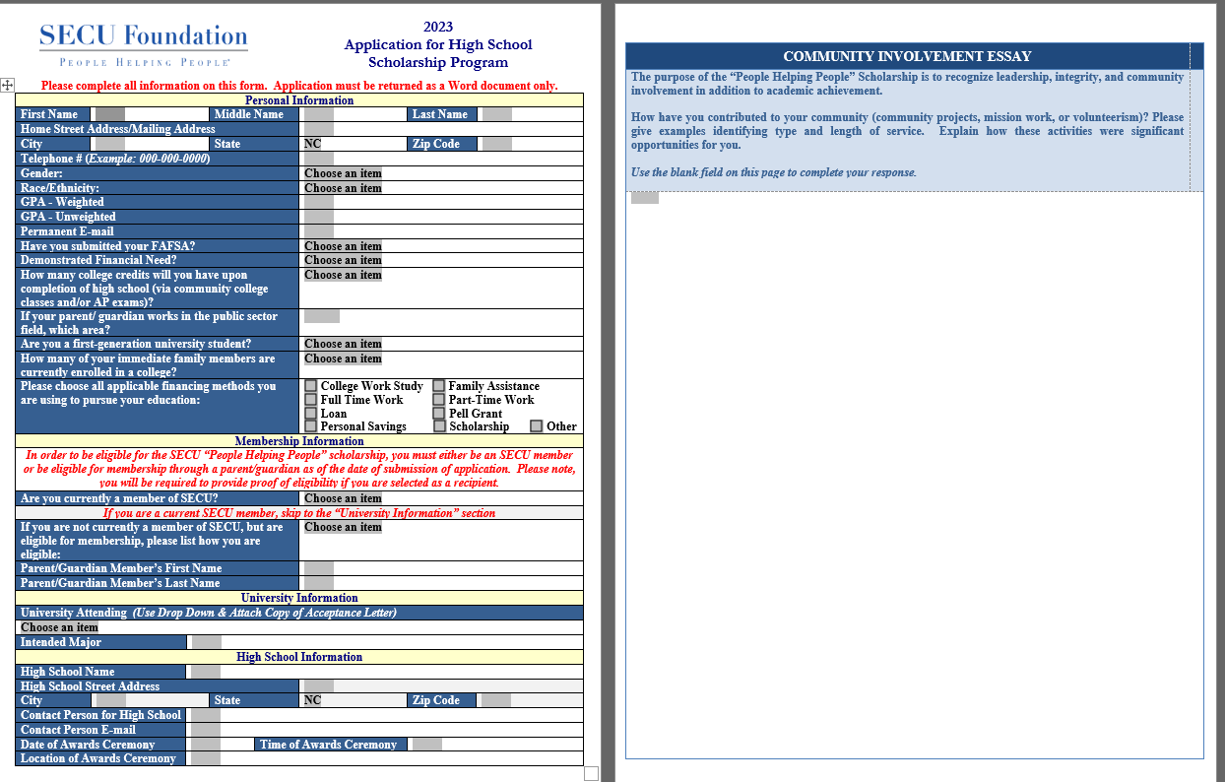
Completed student application and essay
Copy of the recipient’s university acceptance letter
Written LEA Scholarship Selection Committee Statement signed by all members on LEA Letterhead (NOT high school/school board foundation letterhead)
Signed and dated consent form
Membership Confirmation Document
Notes:
Notes:
The recipient’s completed application and essay. The Student Application must be sent in the Word Document provided (using drop downs). Please do not send this document as a PDF, Google Doc, or on any other converted format. The document is enabled to allow SECU Foundation to import student data into our database directly, so it must come back in that format.
*No SSN
*How many college credits…
*Reiterate formatting needs for this document

Slide 10
Scholarship Program
Other Selection Considerations:
Identified Financial Need (FAFSA completed)
Child of Public Sector Employee
Intended Major in Public Service Degree Programs
Student Application & Essay communicates community contributions
Student may be overlooked for other scholarships and accolades
Student will likely be able to use all 8 semesters of scholarship payments***
Notes:
While the People Helping People scholarship recognizes academic achievement by requiring a maintained 2.5 or higher unweighted grade point average of the recipient, the scholarship has a much broader purpose; it should also recognize students who demonstrate leadership, integrity and community involvement. Please refer to the 2023 Application for High School Scholarship which includes an essay portion that will provide the student an opportunity to highlight these aspects of their character. This portion should be written in the space provided on the second page of the application. Some other considerations are:
Our eligibility criteria states, that while it is not a requirement, identification of a financial need, as determined by submission of a Free Application for Federal Student Aid (FAFSA), should be taken into consideration by the selection committee. To be clear the scholarship is currently not a needs-based scholarship, however the recipient is required to have filed FAFSA to be eligible. Students will self-identify on the application whether they have filed FAFSA and if they have a financial need. SECU Foundation is not asking students to submit their FAFSA forms or EFC numbers with the application, nor are we requiring high schools or LEAs to verify or provide proof that the student has a financial need. The student application asks the student to answer yes or no to the two following questions: “Have you submitted your FAFSA” and have you “demonstrated financial need”. Your responsibility is only to confirm that they indicated “Yes” in response to submitting FAFSA to meet this requirement. High schools and LEAs are not required to provide proof or make a determination on whether or not a student has a financial need.
Preference should be given to students whose parents or guardians and family members are public sector employees living and working in North Carolina. Public sector employees include state, local, or federal government employees, public health employees, or public education employees.
In addition, preference should also be given to those students whose intended major is in a public service degree program - such as public health, public policy, public administration, or education . Students are asked to identify their intended major when completing their application.
The student application for the People Helping People Scholarship allows us to gain more insight into the scholarship recipient’s background and future plans. Included in this application is a community involvement essay (to be written on page 2 of the application). Since the purpose of the People Helping People Scholarship is to recognize leadership, integrity and community involvement in addition to academic achievement, we are asking students to complete the essay by highlighting ways they have contributed to their community. The essay calls for examples of the types and length of community service and asks the students to explain how those activities were significant to them. This must be completed as part of the application to be considered for the scholarship.
We would like for you to consider students who aren’t receiving all of the other recognition and accolades at your schools; students who may be overlooked for the biggest scholarships and awards
Since we pay out our scholarship in $1,250 payments over 8 semesters, if a student graduates early (s)he will forfeit any remaining payments; we will not pay a student a lump sum for unused semesters. Please consider a student’s ability to use all 8 semesters of scholarship payments when selecting recipients. We have added a question in our application that asks students how many college credits they will have upon high school graduation

Slide 11
Please contact the Foundation if you have any questions about whether a student would be able to use his/her scholarship!
Examples:
*RIBN Program
*NC State’s C3 Program
*UNC’s Global Gap Year Program

Slide 12
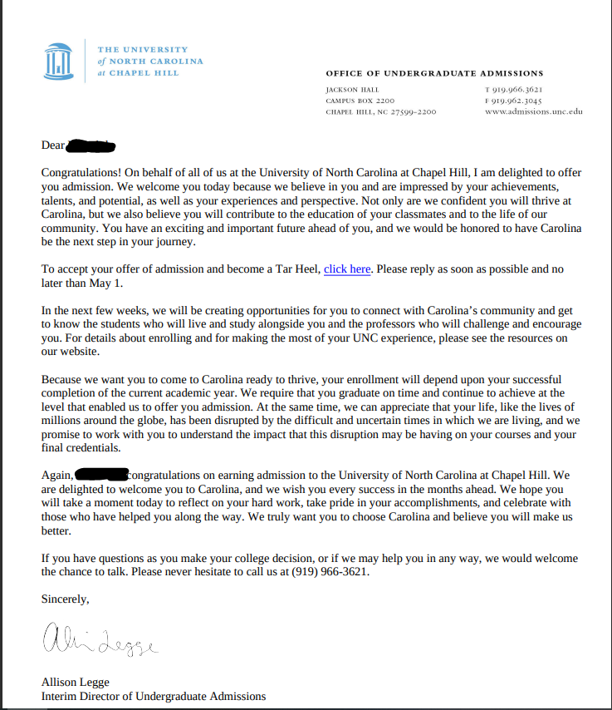
Completed student application and essay
Copy of the recipient’s university acceptance letter
Written LEA Scholarship Selection Committee Statement signed by all members on LEA Letterhead (NOT high school/school board foundation letterhead)
Signed and dated consent form
Membership Confirmation Document
Notes:
Notes:
*We only need the acceptance letter for the UNC System school the student listed on his/her application (we don’t need all of his acceptance letters)

Slide 13
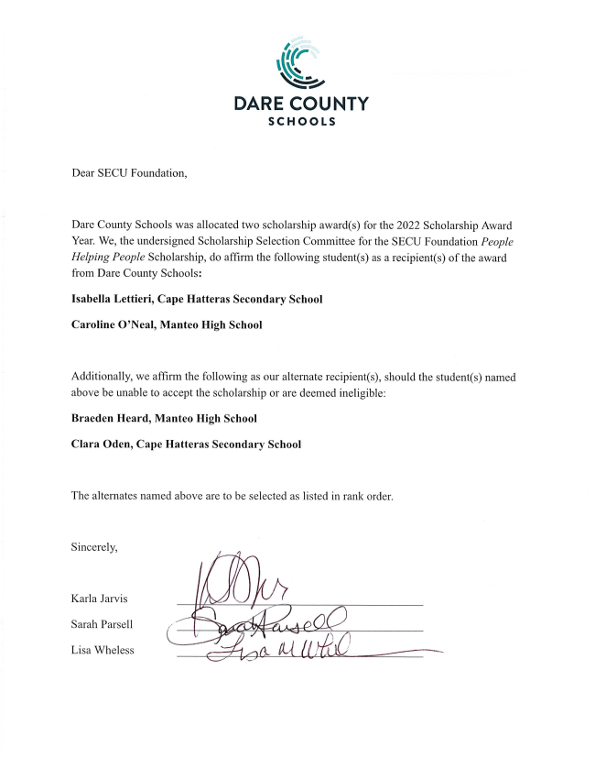
Completed student application and essay
Copy of the recipient’s university acceptance letter
Written LEA Scholarship Selection Committee Statement signed by all members on LEA Letterhead (NOT high school/school board foundation letterhead)
Signed and dated consent form
Membership Confirmation Document
Notes:
Once the high schools submit their applications to you (the facilitator), the Scholarship Selection Committee will review and make a final determination of the scholarship recipients for that LEA. A written statement identifying the LEA’s chosen recipients must be signed by all Scholarship Selection Committee members and submitted on LEA/School District Letterhead. SECU Foundation cannot accept selection letters on High School or School Board Foundation Letterhead.
The LEA Scholarship Selection Committee must identify an alternate student in the event the named recipient is unable to accept the scholarship. Reasons alternates may be awarded the scholarship in place of the original recipient include: the recipient received a full ride scholarship, chose to attend a private or out of state university, does not meet membership eligibility, or has declined the People Helping People scholarship. Please name an alternate choice for each scholarship recipient selected. Please be prepared to have your alternates scholarship packets ready to submit to SECU Foundation, should the original recipient become ineligible. To clarify, SECU Foundation should not receive any alternate scholarship materials until such time that an alternate needs to step in. If an alternate is awarded the scholarship, SECU Foundation will need the same scholarship packet and information for the alternate that is provided for the original recipient. SECU Foundation will verify membership eligibility for the alternate as well if they become the new recipient.
An example of what your selection letter should look like has been provided in the November 3rd email.
3) A written LEA Scholarship Selection Committee Statement, signed by all committee members naming the recipient(s) and all alternate(s). Please identify the high school that the recipient(s) and alternate(s) attend. The selection letter must be provided on LEA/School District letterhead. We cannot accept selection letters on high school or school district foundation letterhead. We have included an example of what must be provided on the LEA Scholarship Selection Letter in the November 10th email.

Slide 14
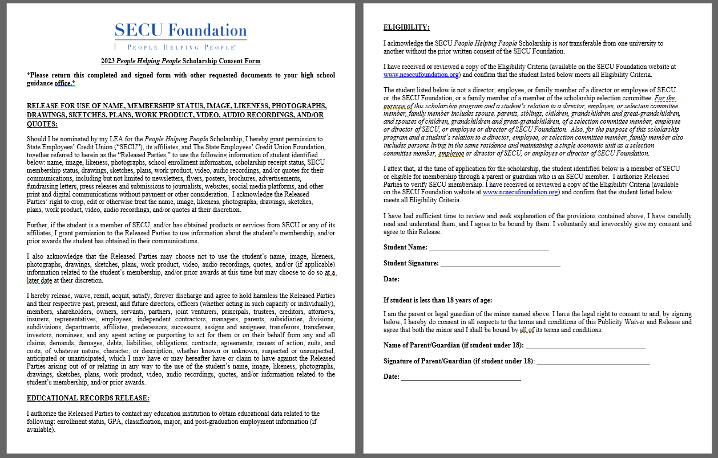
Completed student application and essay
Copy of the recipient’s university acceptance letter
Written LEA Scholarship Selection Committee Statement signed by all members on LEA Letterhead (NOT high school/school board foundation letterhead)
Signed and dated consent form
Membership Confirmation Document

Slide 15
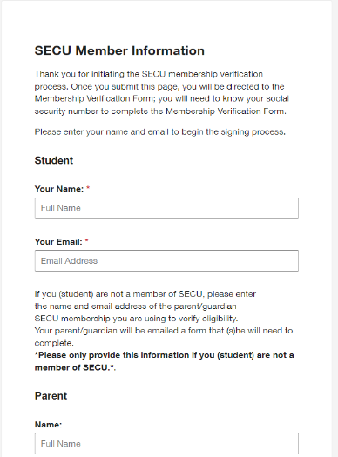
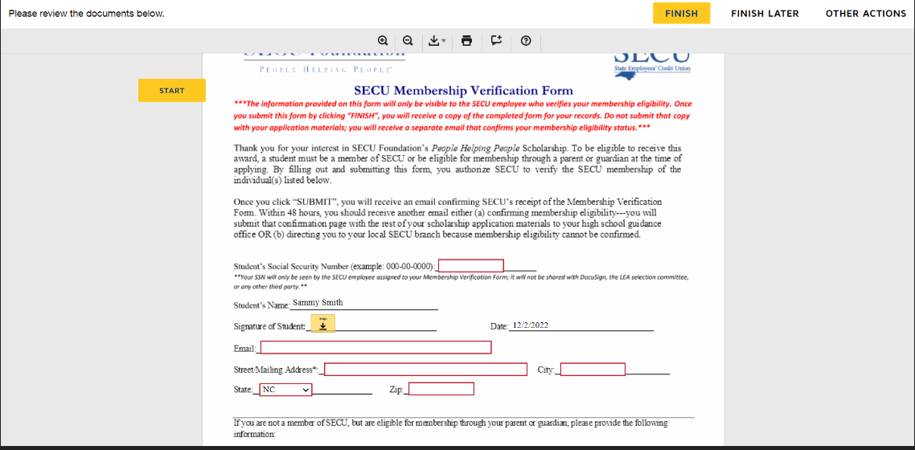
Completed student application and essay
Copy of the recipient’s university acceptance letter
Written LEA Scholarship Selection Committee Statement signed by all members on LEA Letterhead (NOT high school/school board foundation letterhead)
Signed and dated consent form
Membership Confirmation Document
1
2

Slide 16
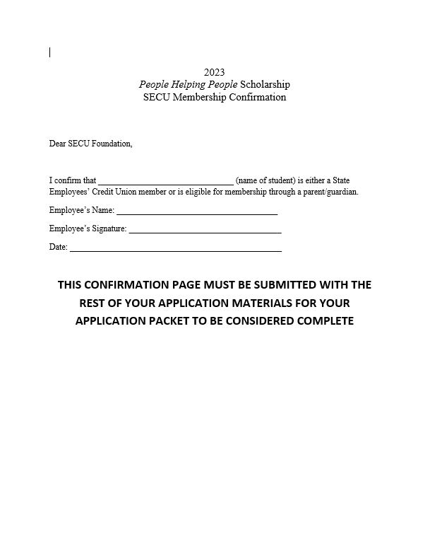
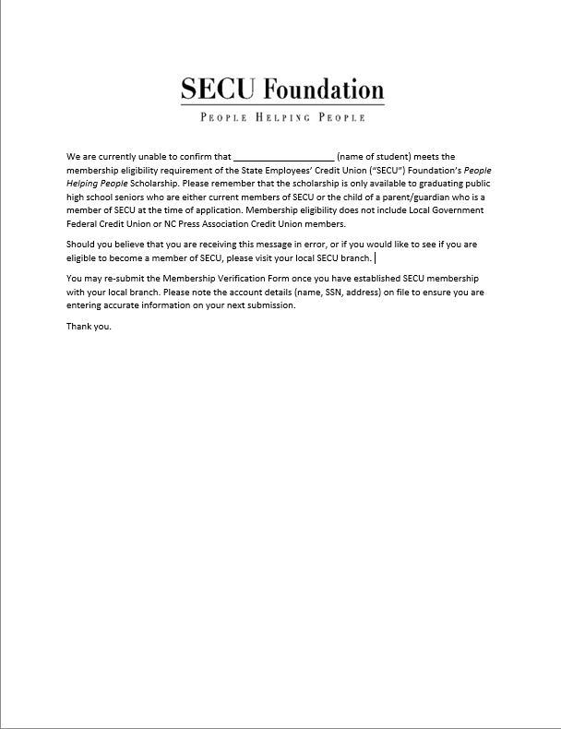
Completed student application and essay
Copy of the recipient’s university acceptance letter
Written LEA Scholarship Selection Committee Statement signed by all members on LEA Letterhead (NOT high school/school board foundation letterhead)
Signed and dated consent form
Membership Confirmation Document (Contd.)
3
OR

Slide 17
The LEA Scholarship Selection Committee will ensure the required information has been received for each recipient and submit the information to the SECU Foundation no later than April 3, 2023 for confirmation of eligibility:
Students should NOT be notified of the LEA’s decision until SECU Foundation has verified that it has received all materials
Once SECU Foundation has notified the LEA that all recipient(s) are eligible, recipient(s) names may then be provided to principals and counselors for the official announcement. ***Please do not wait until award ceremonies to notify students they have been selected.***
Notes:
The LEA Scholarship Selection Committee must ensure all required information has been received for each recipient and submit the completed scholarship application packet to SECU Foundation no later than April 3, 2023 for confirmation of eligibility.
Very Important - cannot stress this enough - Students should NOT be notified of the LEA’s selection decision on recipients until SECU Foundation has verified that the student meets the SECU membership eligibility. The last thing we want is for a student to be notified they were selected as a recipient, only to be told they are no longer the recipient due to not meeting the membership eligibility requirement. Once SECU Foundation has notified the LEA that the recipient or recipients are eligible, their names may then be provided to principals and counselors for the official announcement. ****WE WOULD LIKE FOR STUDENTS TO BE NOTIFIED AS SOON AS SECU FOUNDATION HAS CONFIRMED THE RECIPIENTS*****The Scholarship Selection Committee will need to advise SECU Foundation of the dates and times of the awards ceremony so that a representative of the local State Employees’ Credit Union office and an SECU Advisory Board member can be in attendance to present a certificate of award to the recipient(s) at the high school awards day. At the bottom of the first page of our application there is a section for LEAs to list the contact person for the high school’s award ceremony as well as a place to include the high school’s awards ceremony date, time, and location.

Slide 18
Contact Info:
Grant Kennedy, Program Officer
Grant.Kennedy@ncsecu.org
919-327-9485
SECU Foundation (General Contact Info)
secufoundation@ncsecu.org
844-296-4832

