Slide 1
NC DHHS K-12 COVID-19 Response Updates
March 1, 2021
Notes:
Becki - introduction

Slide 2
Agenda
CDC Operational Strategy for K – 12
K-12 COVID-19 Testing – Expanding Statewide
COVID Vaccine Distribution – Communications Resources
Speakers:
Rebecca Planchard – Senior Policy Advisor, NC DHHS
Natalie Ivanov - Program Director for the NC DHHS COVID-19 Statewide testing program
Sarah Hutchinson – Partner, Neimand Collaborative
NC DHHS COVID – 19 Response
Notes:
Becki

Slide 3
CDC Operational Strategy
Rebecca Planchard – Senior Policy Advisor, NC DHHS
Notes:
Becki

Slide 4
CDC Operational Strategy for K-12: Key Points for Communications Leaders
On 2/12/2021, the CDC released new operational strategy for K - 12 schools and the DOE released the first COVID-19 handbook.
The CDC’s updated operational strategy for K-12 schools overall aligns strongly with the health and safety requirements North Carolina/NC DHHS has emphasized throughout the pandemic, and new efforts currently underway.
The DOE’s new COVID-19 handbook aligns strongly with the implementation guidance in North Carolina from NC DHHS and NC DPI.
Health and safety efforts to prevent the spread of COVID-19 come in layers in our public schools: wearing masks, washing hands, screening for symptoms, etc., that are required in our public schools have been in place since August 2020 to keep our schools safer.
The updated federal guidance on school operations not only emphasizes requirements included in the StrongSchoolsNC guidance, but also supports the additional mitigation efforts of vaccinations and ongoing testing of K-12 staff.
Layered efforts help to reduce the overall spread of COVID in more ways than one, knowing that our schools are complex environments with lots of moving people and parts.
CDC's new K-12 operational strategy states that 6 feet social distancing should be maintained to the greatest extent possible when students are in-person. NC is in alignment with CDC recommendations: CDC recommends that “at least 6 ft physical distancing” be required in schools, equivalent to North Carolina's Plan B, or that “6 ft of physical distancing to the greatest extent possible” be required for in-person instruction, equivalent to Plan A.
CDC's new K-12 operational strategy emphasizes the importance of schools opening their buildings for in-person instruction, especially for younger children (K - 5th), with strict implementation of health and safety mitigation efforts. NC is in alignment with CDC recommendations.
Notes:
Becki

Slide 5
K-12 COVID-19 Testing – Expanding Statewide
Natalie Ivanov - Program Director for the NC DHHS COVID-19 Statewide testing program
Notes:
Natalie

Slide 6
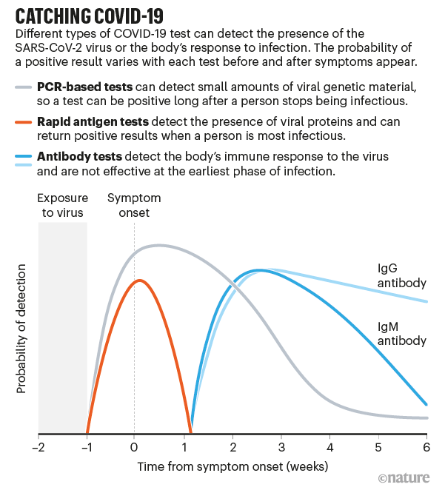
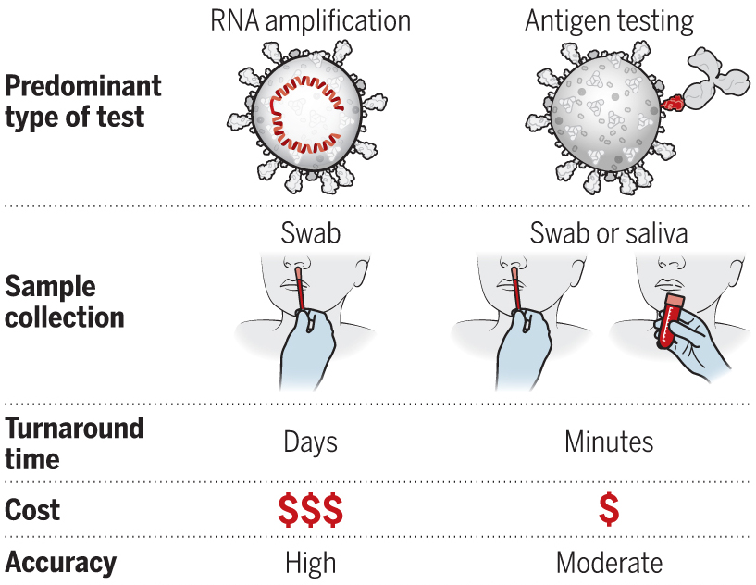
Review: How do we test for COVID-19?
Molecular/PCR-based tests and antigen tests diagnose current infection
Antibody tests detect prior infection
Abbott BinaxNOW are antigen tests; samples are collected via nasal swab
PCR-based
Antigen
NC DHHS COVID – 19 Response
Notes:
Natalie

Slide 7

CDC Recommends COVID-19 testing in K-12 Schools
The CDC released its updated K-12 School Operational Strategy on February 26th, 2021, which encourages testing as an additional layer of prevention in schools – NC guidance aligns
Testing should be combined with other key mitigation strategies, such as NC’s StrongSchools requirements: universal mask use, physical distancing, handwashing and maintaining healthy and clean facilities
Diagnostic testing for individuals who exhibit symptoms of COVID-19 at school or have recent known close contact to a person with COVID-19
Screening testing for all K-12 staff (adults) on a regular, routine basis (e.g., weekly) using rapid tests - sometimes referred to as “surveillance”
NC DHHS COVID – 19 Response

Slide 8
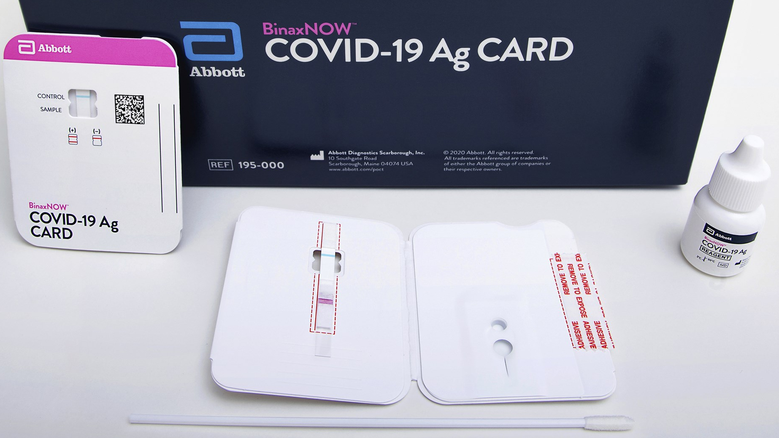

NC DHHS Piloted Access to Free Antigen Tests for K-12 Schools
In the fall, the US Department of Health and Human Services procured and distributed to states Abbott BinaxNOW COVID-19 tests
Designed for rapid diagnosis of active infections within 5-7 days of symptom onset​
Generally, less sensitive than PCR tests (greater chance of false negatives)​.
Who can do the tests? Someone who has undergone a training from BinaxNOW (does not need to be a healthcare professional). Testing personnel must collect and report patient and result information properly.
Where can the tests be done? A location that has a CLIA certificate of waiver and meet CLIA regulatory requirements
NC DHHS used these free tests to conduct a pilot of COVID-19 testing in K-12 schools
From Dec 2020 to Feb 2021, 53,000 free tests were sent to 17 schools districts and 11 charter schools to conduct testing at over 200 schools
3 check-in meetings along with a pre- and post- survey were used to support participants and gather qualitative and quantitative data about participating schools’ experience
NC DHHS COVID – 19 Response

Slide 9
COVID-19 Testing Pilot Schools
Alamance County: Alamance-Burlington School System (33 locations)
Bladen County: Emereau Bladen Charter School (1 location)
Buncombe County: Asheville City Schools (11 locations), Buncombe County Schools (44 locations), Francine Delany Charter School (1 location)
Cabarrus County: Cabarrus Charter K-12 (2 locations), Cabarrus County Schools (6 locations), Kannapolis City Schools (2 locations)
Catawba County: Catawba County Schools (29 locations), Hickory Public Schools (9 locations), Newton Conover City Schools (6 locations)
Durham County: Central Park School for Children (1 location), Healthy Start Academy (1 location)
Forsyth County: NC Leadership Academy (1 location)
Gaston County: Gaston County Schools (1 location)
Harnett County: Harnett County Schools (28 locations)
Johnston County: Johnston County Public Schools (1 location)
Lenoir County: Lenoir County Public Schools (17 locations)
Lincoln County: Lincoln Charter School (2 locations)
Madison County: Madison County K-12 Public Schools (6 locations)
Mecklenburg County: Lake Norman Charter (1 location), Sugar Creek Charter School (1 location), UpROAR Leadership Academy (1 location)
Pasquotank County : Northeast Academy for Aerospace and Advanced Technologies (1 location)
Surry County: Elkin City Schools (3 locations), Mount Airy City Schools (4 locations), Surry County Schools (20 locations)
Wilson County: Wilson County Schools (2 locations)

Slide 10
NC DHHS Expanding Access to Free Antigen Tests for K-12 Schools
Based on lessons learned from our pilot, NC DHHS will be expanding access to COVID-19 rapid testing to all K-12 public schools on an opt-in basis to add further protection for our students, school staff and teachers.
What | LEAs and Charter Schools may choose to request tests for either or both of the below options without implications for re-opening of their school(s): Testing of all individuals, including students, their families and school staff, who are symptomatic or had known exposure to a confirmed positive case Once weekly screening of all adults – including teachers and staff
Who | All public Local Education Agencies (LEAs) and Charter schools are eligible to request tests
When | Beginning Thursday, March 4th, 2021 LEAs/charter schools will be able to request tests through at least the end of the calendar school year
How | LEAs and Charter Schools interested in receiving the free tests are responsible for developing a plan to meet all testing requirements before submitting online request form to NC DHHS
NC DHHS COVID – 19 Response

Slide 11
To Receive Free COVID-19 Tests, the LEA/ Charter School Must:
Participating LEAs / charter schools are responsible for meeting all of the below requirements:
Obtain an CLIA certificate or partner with an entity with a CLIA certificate
Secure a signed physician order for testing or elect to use the Statewide Order
Ensure all testing personnel have completed training modules
Obtain consent prior to testing students and notify parents/guardians when testing performed
Verify ability to meet NC DHHS reporting requirements
Maintain an adequate supply of PPE to perform tests
Adhere to standards to properly handle and dispose of medical waste
Plan for safe isolation and quarantine
LEAs / charter schools can choose to meet these requirements independently or partner with a provider, laboratory or other similar organization.
NC DHHS COVID – 19 Response

Slide 12
Next Steps for LEAs/Charter Schools interested in free antigen tests
Online request form and testing guidance launch online via NC DHHS on Thursday, March 4th
LEAs/charter schools can begin requesting tests via online request form as soon as they are able to demonstrate that they meet all testing requirements
NC DHHS will provide the following resources to support interested LEAs / schools:
Weekly office hours to answer questions from interested or enrolled sites
Weekly DHHS-hosted training sessions on test results reporting platform, eCATR PTR
StrongSchoolsNC@dhhs.nc.gov for ongoing questions and support
NC DHHS COVID – 19 Response

Slide 13
COVID Testing Expansion in K-12 Schools: Key Points for Communications Leaders
CDC's new K-12 operational strategy includes diagnostic and screening testing for COVID-19 as a highlighted mitigation effort. NCDHHS piloted diagnostic testing in >200 schools. On March 4th, NC will expand beyond the pilot to offer testing resources for diagnostic testing for all and screening of adults in public schools statewide.
Diagnostic testing for COVID-19 means when symptomatic individuals and close contacts of positive cases receive a test.
Screening testing for COVID-19 means a percentage or group of individuals are periodically tested for the virus, whether or not they have symptoms or are close contacts. NC DHHS is recommending 1x weekly screening of all teachers and staff.
COVID-19 testing in K-12 schools is another mitigation layer being offered as an option to help keep teachers, staff, and students safer in schools. Consider it an additional tool in the toolkit for schools wishing to opt in.
NC has an ample supply of rapid COVID tests for public schools, which can be administered on-site by someone who is trained – not necessarily a medical professional.
Diagnostic testing in schools can help to identify if an individual with symptoms or close contact is positive or negative more quickly Screening testing in schools may reveal asymptomatic cases that otherwise might not be caught to quickly isolate presumptive cases, thereby reducing transmission
Notes:
Natalie hands over to Becki

Slide 14
COVID Vaccine Distribution – Communications Resources
Sarah Hutchinson – Partner, Neimand Collaborative

Slide 15
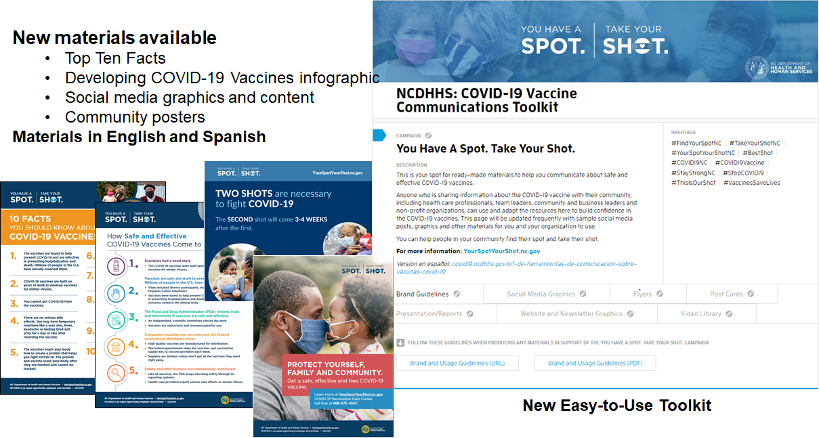
New Resources
https://covid19.ncdhhs.gov/vaccines/covid-19-vaccine-communications-toolkit

Slide 16

New Flyer:
Child Care and
School Workers
Available in Spanish and English
Download from Flyers section of the Vaccines Toolkit: https://covid19.ncdhhs.gov/vaccines/covid-19-vaccine-communications-toolkit
Customize your own using our brand guidelines: http://bit.ly/vaccines-brandguide

Slide 17
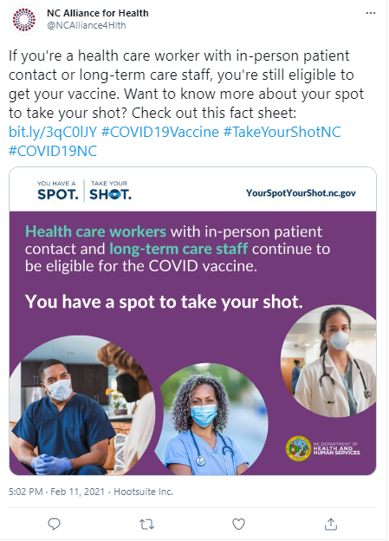
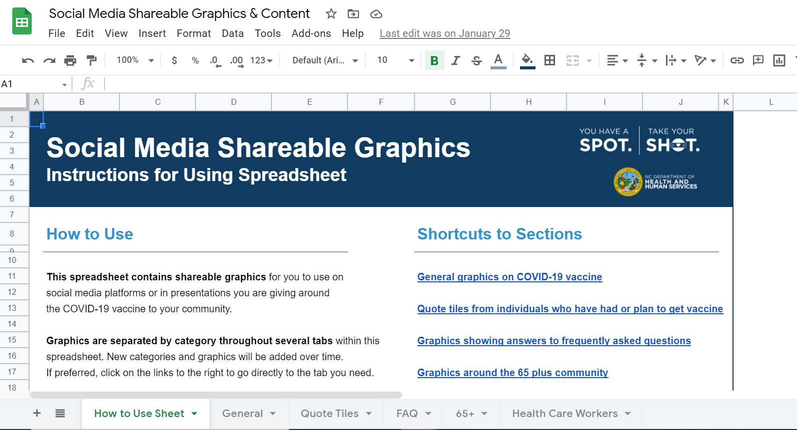
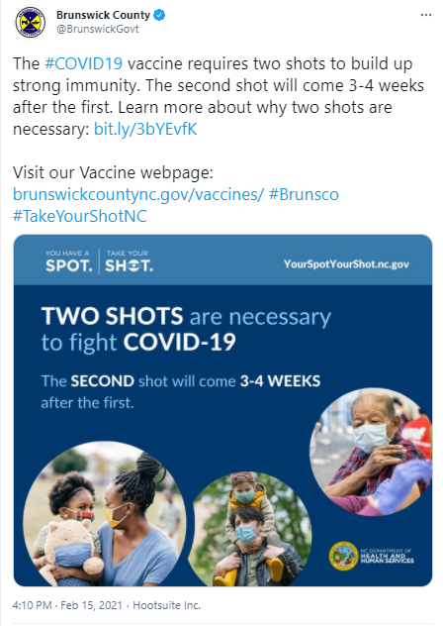
Social Media Content Distribution
Private Toolkit for Outreach & Engagement Partners
Editable Graphics for Customization
https://docs.google.com/spreadsheets/d/1CZusp4rhbMaTgiarj_oK_bhPAfFUFxwWvS-ZEckFGaM/edit#gid=1342422584

Slide 18

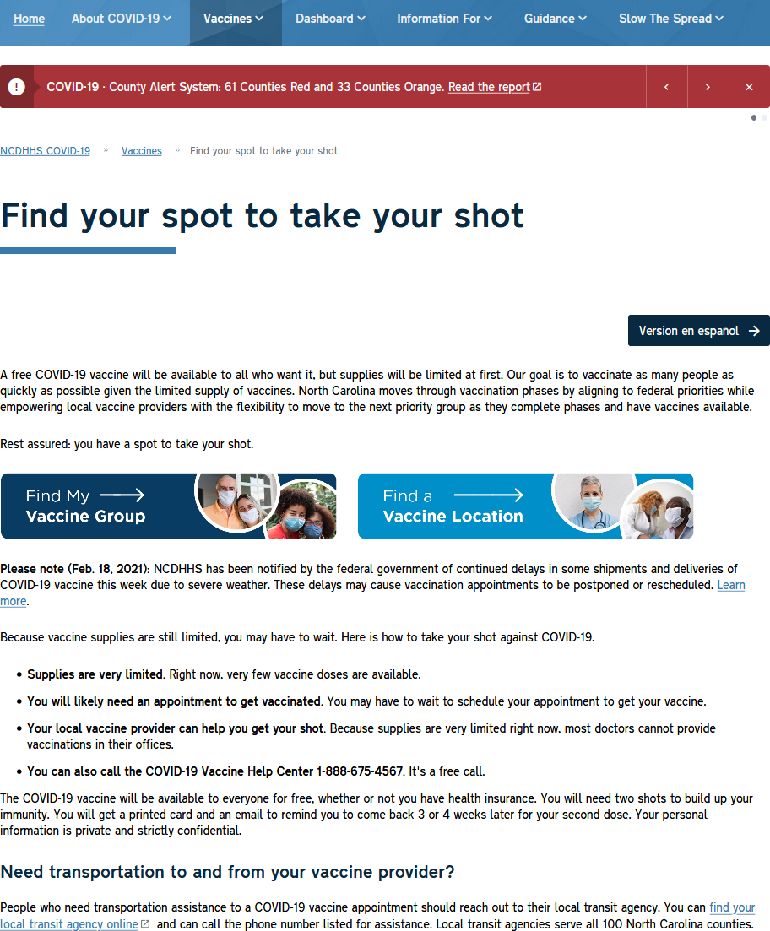

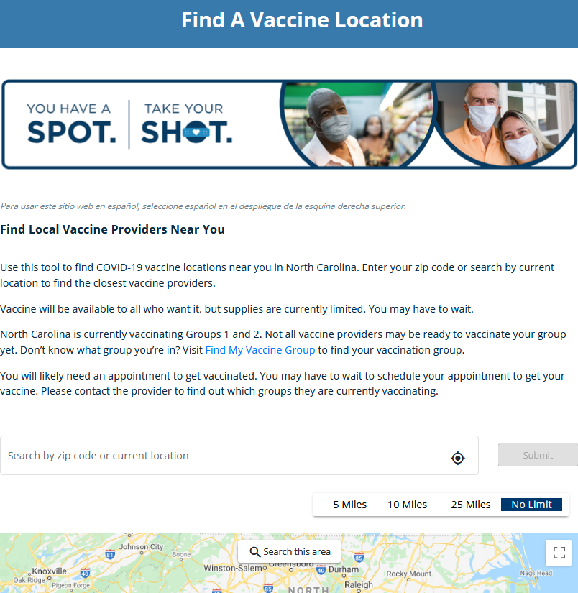
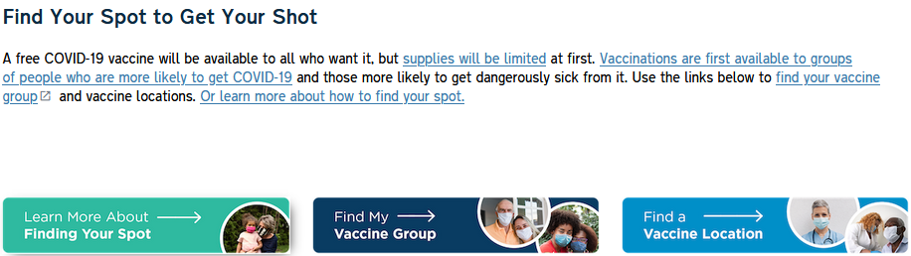
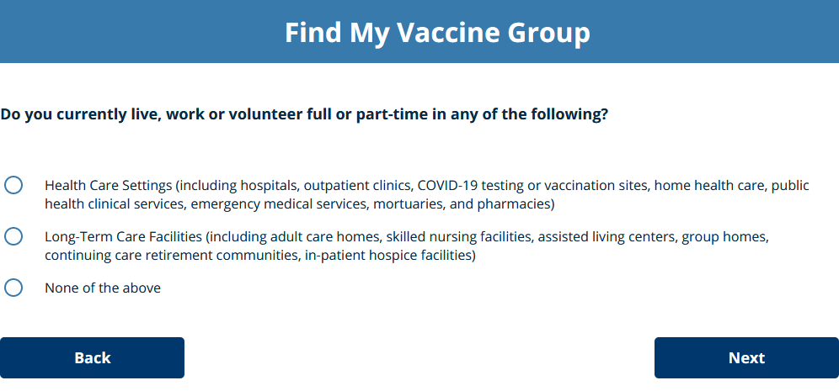
Expanded Web Tools: Eligibility Tracker, Vaccination Locator
http://yourspotyourshot.nc.gov/

Slide 19

Q & A
Reach out to StrongSchoolsNC@dhhs.nc.gov
for ongoing questions and support about NC DHHS K-12 COVID-19 response
NC DHHS COVID – 19 Response

