Slide 1
Individualized Education Programs
Module #6: Prior Written Notice

Slide 2
Prior Written Notice
Documenting Decisions
Notes:
Prior Written Notice, like all IEP forms, should capture the discussion and decision-making a specific IEP team used to move through the IEP process and develop each student’s IEP.

Slide 3
Prior Written Notice is one of the most important parental rights in Special Education.
Many authorities feel it is the second most important document next to the Individualized Education Program (IEP).
Notes:
Let’s unpack why this notice is prior and written…
This form/notice must precede the implementation of any IEP Team decision. In this way it is provided prior to implementation but after the IEP team meeting where decisions were made.
A written document helps to clarify any issues that were and perhaps continue to be unclear to the whole group. Documenting the decisions as well as why the IEP team arrived at the decision they did, what student data/information was used and what other options were considered helps to ensure the IEP Team process is individualized, data-driven and compliant with regulations and policy.
Sufficient information and clarity on this form/notice can avoid the confusion that most often leads to parent/family complaints and legal action.

Slide 4
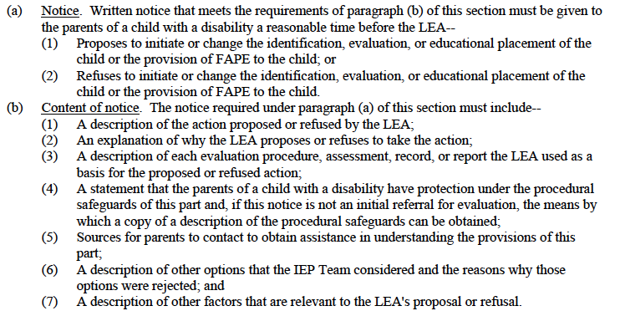
Prior Notice by the LEA; Content of Notice NC 1504-1.4
Notes:
NC 1504-1.4 provides the basis in policy for the content of notice. Paragraph (a) documents when notice must be given to the parent. The Prior Written Notice form documents the items listed in paragraph (c) items 1-7.

Slide 5
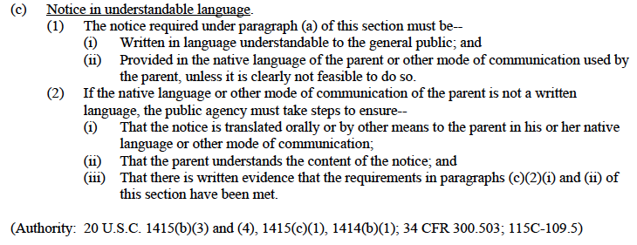
Prior Notice by the LEA; Content of Notice NC 1504-1.4
Notes:
The policy requirement for notice in understandable language is very important. Written statements should be easily understood by the general public – acronyms should be limited or spelled out for clarity. Notice should also be translated for parents that do not read English.

Slide 6
What is the Purpose of
Prior Written Notice?
Provides comprehensive documentation of proposed and refused actions made by an IEP team
Makes sure LEA and parents are clear and “on the same page” about this student’s educational program
Provides sufficient information behind the teams’ decision making regarding a particular proposed or refused action
Allows the parents or family adequate time to seek resolution if they disagree with the school’s decision
Notes:
The purposes of this document are few but critical!
Actions and decisions taken by an IEP team are spelled out here. The PWN not only documents what decisions were made at the meeting, but also why those decisions were made and what was used (data and other factors) to make the decisions.
This notice ensures clarity between the parent and LEA on the options proposed and refused while providing notice that the parents/family are able to exercise their rights if they are not in agreement with the decisions made.

Slide 7
When is Prior Written Notice Required?
Prior written notice is required to explain what the LEA proposes or refuses in regards to:
Initial or change in Identification
Evaluation
Educational Placement, or
Provision of a free and appropriate education (FAPE)
Notes:
As mentioned earlier, this notice summarizes all decisions the team makes. This affords parents who attend and those unable to attend the meeting the opportunity to review all of the information from the meeting and seek clarification, if needed, before the decisions are implemented.

Slide 8
When is Prior Written Notice Required?
It is given after a decision is made, but before a decision is implemented.
Think of it as “processing time” for a parent to absorb all that has been proposed or refused by the school team.
Notes:
As mentioned earlier, this notice summarizes all decisions the team makes. This affords parents who attend and those unable to attend the meeting the opportunity to review all of the information from the meeting and seek clarification, if needed, before the decisions are implemented.

Slide 9
Examples of When
Prior Written Notice is Required
Evaluation / Reevaluation
IEP Team proposes or refuses to:
Evaluate the child,
Administer a particular assessment,
Collect more data,
Determine eligibility / continuing eligibility based on existing data
Notes:
Please note that it does not matter if the team suggests or declines, the prior written notice must be completed.
Any decision an IEP team makes should be summarized (e.g., why, based on what, all options considered) in a prior written notice.
If a team decides to evaluate, administer a particular assessment or collect more data, the prior written notice should provide information about what is needed and why the evaluation/particular assessment is required. It is helpful to those evaluating and collecting the information to gain context and clearly understand what the IEP team needs.
In the case where the team makes a decision that eligibility can be determined based on existing data, the prior written notice should be explicit in documenting the data the team used for that decision.

Slide 10
Examples of When
Prior Written Notice is Required
Identification
IEP Team proposes or refuses to:
Identify a child as eligible for special education services and/or related services, if appropriate
Change categorical identification
Terminate eligibility for special education services
Notes:
In each of these cases, the prior written notice should provide the rationale behind the decision made:
What did the team consider?
What data compelled the team to determine the student has a disability?
How does the disability negatively impact the student's educational performance?
Does the student require specially designed instruction?
Why did they decide on the category they did?
Why did they eliminate any other categories considered?
Why are special education services no longer required?

Slide 11
Examples of When
Prior Written Notice is Required
Educational Placement
IEP Team proposes or refuses:
Initial or continued placement
Change in least restrictive environment along the continuum of placement alternatives
Remember: A child’s placement on the continuum must be determined at least annually. NC 1501-3.3
Notes:
Often, in these cases, teams do not sufficiently describe what information they used to decide this student’s placement:
Why were other placement options refused?
What about this student, his/her abilities or needs require this placement?
How was LRE considered or determined for this student? What student performance data was used or considered that aided the decision made?
What observations took place in what settings/context that assisted the team make the placement or LRE decision?

Slide 12
Examples of When
Prior Written Notice is Required
Provision of FAPE
IEP Team proposes or refuses :
Change the provision of a FAPE including:
Change in the measurable annual goal(s).
Change in the type, amount, or location of the special
education and/or related services.
Change in accommodations, modifications,
supplementary aids, supplementary services, supports,
and/or assistive technology; and
Addition/removal of behavioral intervention plan.
Notes:
The prior written notice should explain:
Why FAPE changed for this student? What performance data made that apparent? Why does FAPE continue to work in this situation as is?
What is the reason(s) for altering or keeping the annual goal?
Why must the service delivery change to provide FAPE for this student? How does the team know?
How does the team know the change is needed or not needed? What data was the basis for the change or refusal?

Slide 13
Multiple Decisions
All the proposals or refusals to initiate or change the identification, evaluation, educational placement, or provision of a FAPE must be documented in the Prior Written Notice
One form for all actions
Each decision must be outlined in all areas of the notice
NC 1504-1.4

Slide 14
Prior Written Notice Must Include Seven (7) Elements
Description of actions proposed
Detailed explanation of the actions proposed
Description of actions refused
Detailed explanation of actions refused
Description of each evaluation procedure, assessment, record or report the agency used to make their decision
Description of other options considered and why they were rejected
Description of other factors relevant to the decision
NC 1504-1.4(b)

Slide 15
Description of Action(s) Proposed:
Provide a description of each action that was proposed
Should be written as a statement that is factually grounded or informative
Can be bulleted or written as a list of actions

Slide 16
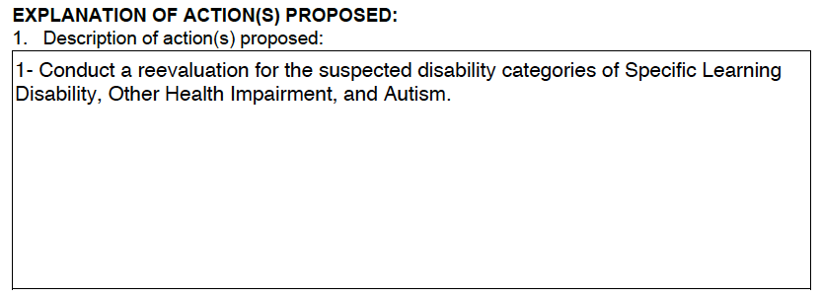

Slide 17
Explanation of Why Action is Proposed:
LEA details its rationale for its proposed action.
Parents should understand how the LEA reached its decision on a specific action
Include an explanation of each action proposed.

Slide 19
Description of Action(s) Refused:
Provide a description of each action that was refused
Should be written as a statement that is factually grounded or informative
Notes:
The actions refused documents any parent request regarding identification, evaluation and placement that was refused by the LEA.
This section is not intended to document all of the options the team considered, but rather the final decision of the LEA. This is particularly important with there is a disagreement and the LEA must make the final decision.

Slide 21
Explanation of Why Action is Refused:
Must specify the reasoning behind the school team’s decision to reject the parent’s requests

Slide 23
Description of Each Evaluation Procedure, Assessment, Record, or Report Used for Proposed/Refused Action:
You must identify each individual evaluation procedure, record, or report used in the decisions
Failure to do so excludes critical information that the parents need in order to give informed consent and/or file a complaint/seek due process
Notes:
Keep in mind, this requirement is more than just a list of assessments. Teacher observation and report cards alone are not a sufficient basis for actions proposed or refused.

Slide 24
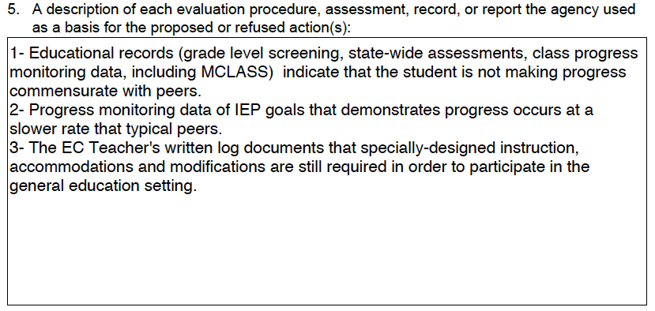

Slide 25
Notes:
Between numbers five and six on the Prior Written Notice form, the parent is notified in writing that the preceding decisions of the LEA are final. This helps distinguish between where the final decisions landed and the rest of the PWN, which documents all of the options the IEP team considered. In other words, it is the dividing line between the “yes/no” (final decisions) and the “maybe” (brainstorming options) considered by the team.

Slide 26
Description of Other Options Considered and Reasons Why These Options Were Rejected:
Provide a detailed description of any other options which were considered and why they were rejected

Slide 27
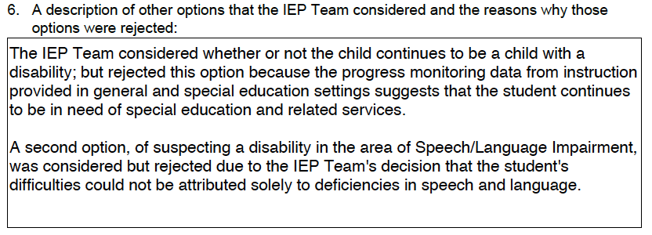

Slide 28
Description of Other Factors that are Relevant:
Other factors that may affect an LEA’s proposed/refused action
-examples: language issues, communication concerns,
health concerns, behavior concerns, work ethic, etc.

Slide 30
Notes:
“The date the decision will be implemented on” is just what it says. For example, if this date reflects a decision to implement an IEP the day after a meeting is held, the IEP Team has just provided notice to the parent that all scheduling arrangements, all notifications to the teachers of the child regarding his/her responsibilities regarding the implementation of accommodations/modifications, and all other details regarding the new IEP will be communicated to appropriate others prior to the start of the next school day in order for the IEP to be FULLY implemented as written and noticed. Make sure that not only have you provided parents access to their procedural safeguards regarding a dispute prior to implementation, but that you have also provided enough time to be able to FULLY implement the IEP as written.
“PWN was given to the parent by:” is where the name of the person providing the notice is documented and the date on which the written notice was provided.
“PWN was delivered by:” is where the method of delivery is recorded and the date on which it was delivered. The written notice could be delivered by hand, the postal mail, etc.

Slide 31
Remember….
The Prior Written Notice must be completed and given to the parent before implementation of any actions can occur.
Say it again, please…
Implementation of any action can not occur until after the parent has been given their copy of the Prior Written Notice.

Slide 32
Consider:
If the parent attends the meeting and the PWN is completed and handed to the parent at the end of the meeting, the meeting date and the given date will be the same. However, the implementation date should reflect the needed time to allow for the decisions to be fully implemented.
If the parent attends the meeting by phone, it would be likely that the meeting date and the given/delivered by dates would not be the same as the actual delivery of the document may not occur until the following day. Here, the implementation date should reflect time for the parent to receive the PWN along with the necessary time for the decisions to be fully implemented.

Slide 33
Cautionary Note…
Parents may appear to accept certain proposed actions and/or refusals during the meeting but then change their minds after reflecting. Just because a parent does not make an issue out of a particular decision during a meeting does not necessarily mean that the decision will not be challenged in the future.

Slide 34
…Cautionary Note
Therefore, it is critically important to write a comprehensive Prior Written Notice which includes:
all proposed/refused actions,
the reasons for them, and
other relevant factors
A well written Prior Written Notice is good documentation that the parents were made aware of all proposals and/or refusals and the rationale behind them.

