Slide 1
Individualized Education Programs
Module #5: Reevaluation
Evaluation Plan
Consent for Evaluation/Reevaluation
Notes:
This is Module #5 of IEP Forms Training- Reevaluation Report

Slide 2
Reevaluation

Slide 3
Reevaluation Process
What is a Reevaluation?
Notes:
The first part of this module will discuss what a reevaluation is.

Slide 4
What is a Reevaluation?
The process of examining existing data, and if determined necessary, gathering additional data in order to:
Determine continuing eligibility for special education;
Assure that the continuing individual needs of a student are identified; and
Assure appropriate educational programming (review and/or revision of IEP)
Eligibility
Programming
NC Policies 1500-2.28, 1503-2.4, and 1503-2.6
Notes:
According to the NC Policies Governing Services for Children With Disabilities, Reevaluation is the process of examining existing data, and if determined necessary, gathering additional data in order to:
Determine continuing eligibility for special education and related services;
Assure that the continuing individual needs of a student are identified; and
Assure appropriate instructional programming is being provided.
An IEP team will answer the question of whether or not FORMAL evaluations are needed to determine eligibility and/or make programming decisions.

Slide 5
Reevaluation Process
When is a reevaluation required?
Notes:
When is a reevaluation required?

Slide 6
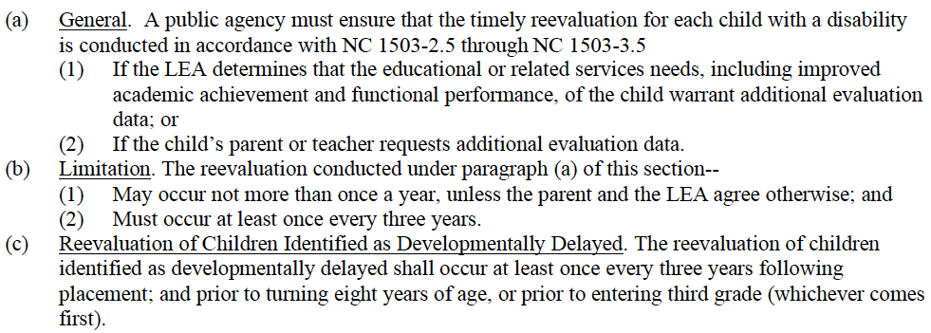
Reevaluations NC 1503-2.4
Notes:
These Policies establish the conditions by which a reevaluation MAY and MUST be conducted.

Slide 7
Reevaluations MUST Occur
for programming purposes.
NC 1503-2.4(a)
Notes:
Programming is defined as a need to gather formal evaluation data in order to review and/or revise the student’s current individualized education program. In this scenario, there are no questions or concerns about the child’s eligibility determination. Therefore, this reevaluation would not re-set the student three-year reevaluation date by which the IEP Team MUST consider whether or not a child continues to be a child with a disability.
The Policies indicate that the a “timely reevaluation” is conducted [NC 1503-2.4(a)]. However, there are no definitions of timely.
In the scenario in which programming is the purpose for reevaluation, “timely” could be defined in many ways. For example, prior to the annual IEP, sooner rather than later due to change in progress thus triggering the LEA’s responsibility to review and revise the IEP, etc.

Slide 8
Reevaluations MUST Occur
at least once every three years.
Notes:
A reevaluation must be conducted once every three years in order to determine whether a child with a disability continues to be a child with a disability, determine the unique needs of the student and ensure that the IEP is appropriately calculated to address those unique needs.

Slide 9
Reevaluations MUST Occur
before a change in eligibility for special education.
NC 1503-2.6(e)
Notes:
Reevaluations must occur before a child is exited from special education. This does not necessarily mean that evaluations must be conducted, but rather that the reevaluation process must occur with a review of existing data and an IEP Team determination about whether or not formal evaluations are required.
The EC Division often receives questions about whether or not a reevaluation must be conducted prior to removing related services. If the related service area corresponds to a primary or secondary eligibility category and the disability area is no longer suspected, then a reevaluation for the purpose of determining eligibility must be conducted. This interpretation is consistent with the policy citation on this slide referenced by (e)(1).
For example, if the child’s primary disability is “Specific Learning Disability” and the secondary disability is “Speech”, and “Speech” is no longer a suspected disability in need of specially-designed instruction; then a reevaluation to determine eligibility would be conducted. Both disability areas would be reviewed at the same time and the re-evaluation clock is reset for three years pending the outcome.
Later in this presentation, we will review when a reevaluation regarding removing a related service that is not tied to a specific eligibility area (programming), may or may not be needed.

Slide 10
Reevaluations MUST Occur
for students identified as developmentally delayed before turning eight years of age or prior to entering third grade.
NC 1503-2.4(c)

Slide 11
Part 1: Review of Existing Data

Slide 12
Part 1: Review of Existing Data
Record Review
Attendance
Past/current grades/work samples
Results of local and state assessment data
Relevant medical/health information
Discipline reports
IEP Progress
Summary
Evaluations and information provided by the parent/guardian/student
Classroom-based assessments
Observational data
Additional information from other sources
Notes:
The first step in the reevaluation process is to review existing data. The IEP team must document that existing data has been reviewed. The IEP team determines if existing data are current and relevant. Teams must always use multiple sources of data when making decisions. Information about the whole child should be considered.
The IEP team will review any formal evaluation results provided by the parent. This could include psychological testing, as well as evaluations from service providers such as private speech-language pathologists, occupational therapists, etc.
The IEP team will also discuss
-other information provided by the parent, including parent concerns around student progress; and parent report of academic, functional, and behavioral performance outside of the school setting.
-supports student may be receiving outside the school setting.
- Observational data provided by teachers, administrators and other relevant school staff
- Any additional information absences, suspensions, mobility rates, out-of-state IEP, etc.

Slide 13
Part II: Reevaluation Decision

Slide 14
Part II: Reevaluation Decision
Notes:
The IEP Team has two major decisions when it comes to reevaluations. These decisions are based on whether or not formal evaluations, requiring parent consent, are needed. In the screenshot above, the IEP Team has determined that no additional formal evaluations are needed. Since this is the decision made by the IEP Team, an explanation must be included. This explanation must be recorded on the reevaluation and then again on the prior written notice. Data should be included as a basis for the explanation.

Slide 15
Part II: Reevaluation Decision
NC 1503-2.6(d)
Notes:
If the IEP Team determined that no formal evaluations were needed, the parent has the right to disagree. This must be documented on the Reevaluation form. Policy clearly indicates that if the IEP Team determines that no additional data (formal evaluations) are needed that the parent has the right to request an evaluation to determine whether a child continues to be a child with a disability (eligibility) and/or to determine the child’s educational needs (programming). If a parent requests more evaluation for the purposes of eligibility and/or programming, the LEA is required to conduct the evaluation.

Slide 16
Part II: Reevaluation Decision
Notes:
The screenshot on this slide represents the IEP Team decision to conduct formal evaluations. At this point, the IEP Team must answer the questions regarding the reasons why the formal evaluations are needed. The team could select any combination of responses. However, one “yes” response in the eligibility area indicates that the IEP Team is either suspecting a change in the child’s eligibility status or if the child continues to need services. Since this decision point involves eligibility, the reevaluation clock (three-year) will be reset once the evaluations are conducted and eligibility is either confirmed or a new eligibility category is identified. The reevaluation clock will stop upon the determination that the child is no longer eligible. It is important to note here that the child’s eligibility MUST not lapse during the evaluation part of reevaluation for the purposes of eligibility. It is critical to think ahead of compliance timelines in order to assure that procedural requirements are met.
If the IEP Team’s decision is that formal evaluations are needed only for programming, then the reevaluation clock is not reset because eligibility was not in question at the time of this reevaluation. (This is not to be confused with the reevaluation that is required to look at both eligibility and programming every three years which DOES reset the three-year clock.) This scenario particularly addresses situations in which a reevaluation for the purposes of programming is needed sooner than the three-year requirement. In this case, it is highly recommended that the evaluation needed for programming is conducted prior to the child’s current annual IEP due date so that the evaluation results can be included in the present levels of performance and be used in the annual development of the IEP. In this scenario, disability worksheets and an eligibility determination are not required – REMEMBER if programming is selected, the IEP Team is not questioning the student’s eligibility but rather has a need for data that can only be gathered through a formal evaluation.
IEP Teams may look at BOTH eligibility and programming. However, this will reset the reevaluation clock at the IEP Team meeting for which eligibility is determined as a result of the completed evaluation.

Slide 17
Part III: IEP Team Participants

Slide 18
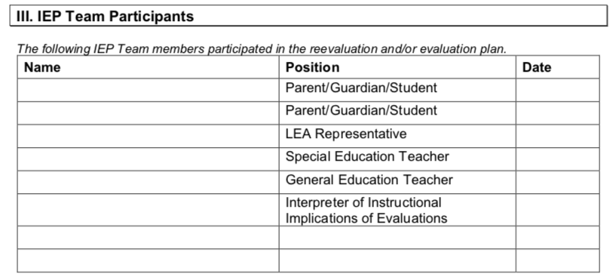
Notes:
This section documents the individuals that participated in the reevaluation and/or evaluation plan. At the discretion of the LEA, this can be a signature or a just a listing of the participants’ name. Remember – this documents PARTICIPATION; not a parental consent.

Slide 19
Part IV: Procedural Safeguards

Slide 20
Notes:
This section affirms that the parent has received the parent rights in accordance with the policy requirements. Additionally, all of the reevaluation documents - as appropriate (eligibility, PWN, evaluations, reevaluation, etc.) have been or will be provided to the parents.

Slide 21
Evaluation Plan Consent for Evaluation/Reevaluation

Slide 22
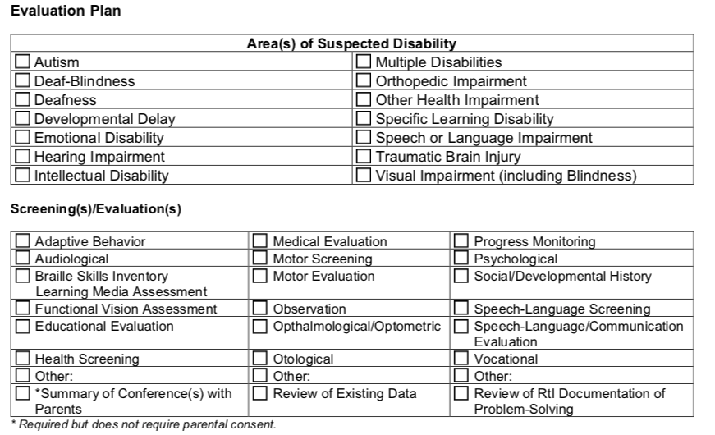
Notes:
Once the team decides to conduct an evaluation, an evaluation plan must be determined based on the area of suspected disability and/or the assessment needed for programming. The screenings and evaluations correlate with the Consent for Evaluation/Reevaluation form.
A crosswalk is available in the section “Consent for Initial Evaluation” to support the selection of the broader areas of required screening/evaluations found on the consent form and the specific evaluations listed under each of the disability areas.
The required evaluations for each disability area or area(s) can also be found in the Policies at NC 1503-2.5 Evaluation Procedures.

Slide 23
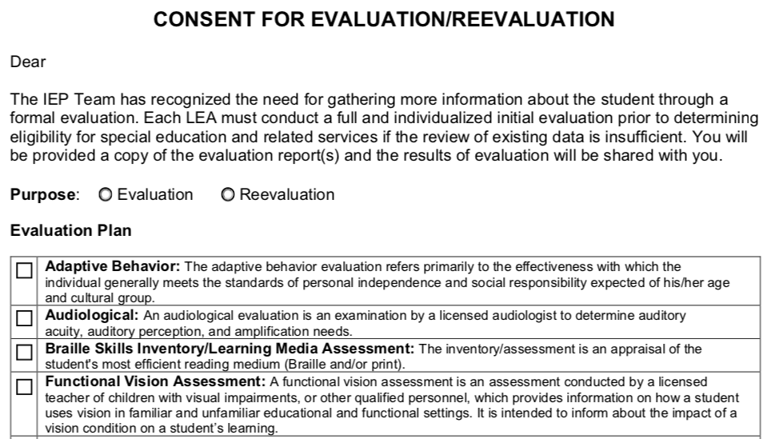
Notes:
This is a screenshot of the Consent for Evaluation/Reevaluation. The evaluation plan is a 1:1 correspondence with the definitions of evaluations/screenings necessary for determining eligibility and found in policy. Additionally, each of the disability categories identify specific evaluations/screenings for the disability suspected. All required screening/evaluations for disability areas have been cross walked to the Consent for Evaluation/Reevaluation form shown here.
For example, on the next slide you will see that selecting consent for ”Audiological” covers two different iterations of Audiological specified by policy for the specific suspected area of disability. Therefore, selecting “Audiological” on the consent covers the consent requirement for both iterations. Diagnosticians or evaluators can then select the appropriate iteration of “Audiological” to administer based on the area of suspected disability.

Slide 24
Crosswalk of Consent to Evaluate and Required Evaluations
Consent to Evaluate (form) | Required Evaluations (policy)
Adaptive Behavior | Adaptive Behavior Evaluation
Audiological Evaluation | Audiological Evaluation followed by ontological, when appropriate
 | Audiological evaluation, including air/bone conduction testing; speech receptive testing with/without amplification, and impedance testing to determine the type and extent of hearing loss
Braille Skills Inventory/Learning Media Assessment | Braille Skills Inventory and/or Media Assessment
Functional Vision Assessment | Functional Vision Assessment
Educational Evaluation | Educational Evaluation

Slide 25
Crosswalk of Consent to Evaluate and Required Evaluations
Consent to Evaluate (form) | Required Evaluations (policy)
Health Screening | Health Screening
 | Hearing Screening
 | Review of Medical History/Records
 | Vision Screening
Medical Evaluation | Medical Evaluation
Motor Screening | Motor Screening
Motor Evaluation | Motor Evaluation
Observation | Observation Across Settings
Ophthalmological or Optometric Evaluation | Ophthalmological or Optometric Evaluation
Notes:
Often there are questions regarding the amendment of a Consent for an Evaluation if only “screening” is selected for consent and the evaluator determines after screening that an ”evaluation” is required.
It is recommended that the IEP Team consider this possibility at the time consent is obtained and request consent for both the evaluation and the screening. If the evaluation is not needed, based on the results of the screening, the diagnostician/evaluator should include the reason why the evaluation wasn’t pursued when the results of the evaluation are documented and discussed with the IEP Team.
It is only a procedural violation if (1) The diagnostician/evaluator administers an evaluation without consent, or (2) An explanation isn’t provided regarding why an evaluation isn’t pursued if the screening data is sufficient. This understanding of a procedural violation should not be generalized beyond the scope of its reference to when evaluations are not completed as a result of screening data to offering an explanation (absent good solid data) as to why evaluations for which consent was provided were not conducted.
IEP Teams must ensure that the evaluations for which consent is obtained are conducted within the required timelines.

Slide 26
Crosswalk of Consent to Evaluate and Required Evaluations
Consent to Evaluate (form) | Required Evaluations (policy)
Otological Evaluation | Otological Evaluation
Progress Monitoring | (2) SRB Interventions to Address Academic/Behavioral Skills
 | (2) SRB Interventions to Address Academic/Functional Skills
 | (2) SRB Interventions to Address Academic Skills
 | (2) SRB Interventions to Address Behavioral/Emotional Skills
Psychological Evaluation | Psychological Evaluation
 | Psychological Evaluation for TBI
 | Psychological Evaluation including Cognitive/Social-Emotional Measures
 | Psychological Evaluation including Intellectual Evaluation
Notes:
You will note that progress monitoring data are part of required evaluations for specific areas of suspected disability. (Emotional Disability is an example)
Progress monitoring data may already be available at the time of referral as a result of interventions implemented through MTSS or other problem-solving team. Therefore, consent would not be obtained for progress monitoring because the data already exists.
However, If the progress monitoring data, as defined by policy for the area of suspected disability, is not available at the time of referral/when a disability is suspected, consent must be obtained and the scientifically research based interventions must be conducted concurrently with the other required evaluations for the disability suspected. These data are then discussed at the IEP Team meeting in which the evaluations are shared and eligibility determined.
Remember: The absence of intervention data, or in this case – progress monitoring, cannot be used to deny or delay a timely evaluation if a disability is suspected.

Slide 27
Crosswalk of Consent to Evaluate and Required Evaluations
Consent to Evaluate (form) | Required Evaluations (policy)
Social/Developmental History | Social/Developmental History
Speech-Language Screening | Speech-Language Screening
 | Articulation/Fluency/Language/Voice/Resonance Screening
Speech-Language/Communication Evaluation | Articulation/Fluency/Language/Voice/Resonance Evaluation
 | Communication Evaluation
 | Communication Evaluation including Receptive, Expressive and Augmentative Skills
 | Speech-Language Evaluation - including Language Semantics and Pragmatics
 | Speech-Language Evaluation

Slide 28
Crosswalk of Consent to Evaluate and Required Evaluations
Consent to Evaluate (form) | Required Evaluations (policy)
Vocational Evaluation | Vocational Evaluation
Assessment/Behavior Rating Tool Specific to Autism | Assessment/Behavior Rating Tool Specific to Autism
Behavioral/Emotional Evaluation | Behavioral/Emotional Evaluation

Slide 29
Do I need to conduct a Reevaluation?
Special Transportation
Related Service
Secondary Disability
Exit from Special Education
Functional Behavior Assessment

Slide 30
Essential Questions
When determining whether or not to engage in a reevaluation, it is important to ask:
What NEW or ADDITIONAL information (formal evaluation) is needed for
Eligibility;
Programming; or
Eligibility AND Programming.

Slide 31
Scenario #1: Special Transportation
Essential Questions
Do I need to provide special transportation to enable the child to access their education at a particular school?
If yes, what formal evaluations are needed?
It is highly likely that this situation will not require formal evaluation, therefore, formal evaluation/reevaluation is not needed. The team should review and revise the IEP as appropriate based on existing data.

Slide 32
Scenario #2: Special Transportation
Essential Questions
Do I need to provide special transportation as a result of a behavioral concern on the bus?
If yes, what formal evaluations are needed?
It is very possible that this situation will require a formal evaluation/reevaluation to obtain consent for a Functional Behavioral Assessment to determine what supports and services are required to transport the student safely to and from school.

Slide 33
Scenario #3: Adding/Removing a Related Service
Essential Questions
Do I need to ADD a related service?
If yes, what formal evaluations are needed?
It is highly likely that this situation will require a formal evaluation/reevaluation to obtain consent for an appropriate formal evaluation to determine if related services are required to provide FAPE.
The purpose of the reevaluation will be for PROGRAMMING.

Slide 34
Scenario #4: Add/Removing a Related Service
Essential Questions
Do I need to REMOVE a related service?
If formal evaluations are needed -
This situation will require a reevaluation to obtain consent for an appropriate formal evaluation since the team determined that there is not appropriate existing data (progress monitoring, etc.) available to remove the service.
The purpose of the reevaluation will be for PROGRAMMING.
If no formal evaluations are needed –
This situation will require a review and revision of the IEP since the team had appropriate progress monitoring data available to remove the service from the IEP.
Notes:
Please remember, all decisions must be based on multiple sources of data. This scenario specifically addresses the removal of a related service that is NOT also a primary or secondary eligibility area.
If the removal of speech as a related service also removes speech as an eligibility category, then a reevaluation for eligibility and programming purposes is necessary. This was explained in more detail earlier in this presentation.

Slide 35
Scenario #5: Add/Removing a Secondary Disability
Essential Questions
Do I need to ADD or REMOVE a primary/secondary disability?
Since this area is directly related one of the student’s eligibility areas, a reevaluation MUST occur to gather the appropriate data to determine:
that the student no longer meets the eligibility criteria for the disability, or
the student has an additional area of eligibility.
The purpose of the reevaluation is ELIGIBILITY.
Examples: Primary – SLD Primary: ED
Secondary – Speech Secondary: Language Impairment

Slide 36
Scenario #6: Exiting from Special Education
Essential Questions
Does someone suspect that the child is no longer eligible for special education and related services?
If yes, what formal evaluations are needed?
This situation always requires a reevaluation. The team must consider the appropriate evaluations necessary to determine whether or not the student continues to be a student with a disability, has an adverse effect, and requires special education and related services.
The purpose of the reevaluation is ELIGIBILITY.

Slide 37
Scenario #7: Functional Behavior Assessment (FBA)
Essential Questions
Do I need to conduct an FBA to address a student’s behavioral needs?
If yes, what formal evaluations are needed?
This situation will require a formal evaluation/reevaluation to obtain consent for a Functional Behavioral Assessment to determine what supports and services are required to address the student’s unique behavioral needs.

