Slide 1
Individualized Education Programs
Module #4a: Present Level of Academic and Functional Performance Consideration of Special Factors
Communication Plan Worksheet

Slide 2
Standards Based IEPs
A standards-based IEP is one in which the IEP team has incorporated state content standards in its development.
Prior to developing IEPs, all IEP team members, including parents, need to be familiar with the general education curriculum, including the state’s academic content standards and state assessments. Academic content standards form the basis of the general education curriculum and cover what students are expected to know and be able to do. In order to make informed decisions about each student’s strengths and needs, the IEP team should consider how the student is performing in relation to the state’s grade-level content standards for the grade in which the student is enrolled.
Notes:
As educators begin to consider the data and information needed to write PLAAFPs, begin with the North Carolina standards and determine how to align the PLAAFP and goals with the standards to begin closing the gaps, increasing functional skill levels, and focusing on the most critical skills. The PLAAFPs should consider the student academic levels in comparison to the state standards, and in order to develop annual IEP goals aligned with State academic content standards for the grade in which a child is enrolled. This alignment, however, must guide AND not replace the individualized decision-making required in the IEP process. In fact, the IDEA’s focus on the individual needs of each child with a disability is an essential consideration when IEP Teams are writing PLAAFPs and annual goals that are aligned with State academic content standards for the grade in which a child is enrolled. This is required so that the child can advance appropriately toward attaining those goals during the annual period covered by the IEP.

Slide 3
Connecting IEPs to State/District Standards Means…
Referring to standards to determine expectations at grade level
Using the standards as a guide to determine what is important for the student to learn or be able to do
Conducting an analysis to determine the gap between grade expectations and student’s current skills/knowledge
Notes:
In a case where a child’s present levels of academic performance are significantly below the grade in which the child is enrolled, in order to align the IEP with grade-level content standards, the IEP Team should:
Consider the skills needed to make progress toward or achieve the grade level standards. For students following extended content standards, consider the progress based on those standards and the relationship to the general standards and scope of instruction. Then, based on the data collected to determine the present levels of academic achievement and functional achievement,
determine annual goals that are ambitious but achievable.
The PLAAFP should
provide the baseline data to identify the present levels, and guide the development of goals aligned with state standards.
lead to annual goals, targeting what the student cannot do but needs to learn; in other words, the critical skills needed to make progress.
lead to ambitious annual goals
Two additional resources are from:
1. Minnesota Department of Education, Developing Standards-Based IEP Goals and Objectives A Discussion Guide available at: https://education.state.mn.us/mdeprod/idcplg?IdcService=GET_FILE&dDocName=050483&RevisionSelectionMet hod=latestReleased&Rendition=primary
2. An OSEP-funded project regarding implementation of standards-based IEPs: inForum: Standards-Based Individualized Education Program Examples available at: www.nasdse.org/portals/0/standardsbasediepexamples.pdf

Slide 4
Trajectory for Student Success
Data-rich PLAAFP
Goals Written with Measurement in Mind
Sensitive Progress Monitoring
Effective SDI
PM & Intervention/ Lesson Plan
This is data-driven individualization
Notes:
The PLAAFP is the cornerstone of the IEP. It drives and links all other IEP components together to move students toward successful outcomes.
A PLAAFP contains the measurable baseline data describing and outlining the student's current levels of performance, and explains how the disability impacts the student participation and progress in the general curriculum. This leads to the goals developed with the plan of how to monitor the student's progress (PM-Progress Monitoring). Then, progress is measured regularly, and the SDI (Specially Designed Instruction) is adjusted to ensure adequate progress toward the goals from the baseline established in the PLAAFP is achieved or the IEP team meets to address a lack of progress.

Slide 5
Why PLAAFP Quality Matters
Everything is dependent on PLAAFP:
Writing goals
Measuring progress
Developing lesson plans
Vague, general PLAAFPs may be a denial of FAPE
Notes:
The Dispute Resolution Consultants have reported increased findings in which the quality of the PLAAFP is considered and examined.
If educators do not get the present level correct, the rest of the “building” will not be stable, will be misaligned, and may not provide the information needed to accurately measure the progress. If it is not clear where to begin, other items will be off and potentially noncompliant.
PLAAFPs that are not clearly based on measurable data may be interpreted as a denial of FAPE.

Slide 6
Present Levels of Academic Achievement and Functional Performance (PLAAFP)
(1) A statement of the child’s present levels of academic achievement and functional performance
(i) How the child’s disability affects the child’s involvement and progress in the general education curriculum; or
(ii) For preschool children, as appropriate, how the disability affects the child’s participation in appropriate activities;…
NC Policies 1503-4.1
Notes:
A review of policy: A PLAAFP contains a statement of the child’s present levels of academic achievement and functional performance which is based on measurable data. This data establishes the baseline, or the present level, from which the annual goals will be measured and on which progress will be documented. The PLAAFP explains how the disability impacts the student’s participation and progression in the general curriculum.

Slide 7
Academic Achievement
Generally refers to a student’s performance in academic areas (e.g. reading, language arts, and math); or
For preschool children, age appropriate developmental levels
Notes:
What are “academic and functional performance?”
Questions to consider to describe academic performance:
What do we know about the student’s response to academic instruction (interventions & progress monitoring data)?
What programs, accommodations (i.e., classroom and testing) and/or interventions have been successful with the student?
Are there assessment data (i.e., state, district and/or classroom) that provide useful information for making decisions about the student’s strengths and needs (e.g., patterns in the data)?
What have we learned from previous IEPs and the student academic data that can inform decision making?
What do we know about the preschool student’s developmental levels based on data we have collected through assessment, instruction, and/or observations?

Slide 8
Functional Performance
Refers to non-academic skills or activities
Describe skills needed in the context of routine activities of the classroom and school day
Can vary depending on the individual needs of the student
Functional performance impacts educational achievement
Notes:
What are “academic and functional performance?”
Questions to consider to describe “functional performance?”
Does the student have other needs that are related to his or her disability but are not directly related to academic instruction/standards?
What appears to be constraining independent functioning such that specially designed instruction and related services must be provided?
Possible information sources to consider for functional performance • Discipline/behavioral data, including functional behavior assessments (FBAs) • Attendance data • Observations • Outside service providers • Classroom teachers • Mental health screening information • Medical information • Transition data (including both formal and informal transition and vocational assessments and interest inventories) • Functional skills data • Evaluation reports (adaptive function, organizational checklists, related service provider reports) • Organization and study skills (illustrating independent classroom functioning)

Slide 9
The PLAAFP answers …
Where does the child stand in terms of academic and functional performance?
How does the child’s disability affect his/her involvement and progress in the general education curriculum ?
Notes:
First, the PLAAFP describes the individual strengths and needs of the student in relation to accessing and mastering the general curriculum, which includes both academic and functional needs that are related to the student’s disability.
Next, the PLAAFP requires that you consider the factors related to the student’s disability and the unique needs of that student. Then based on that, the PLAAFP describes HOW those unique factors affect the student learning, demonstrating what he or she knows, participating in instruction/social opportunities/functional activities, and making progress.
Questions to Consider:
How does the student’s disability affect participation and progress in the general curriculum?
What skills does the student need to make progress in the general curriculum?
Is the student on track to achieve grade level proficiency within the year?
Where is the student in comparison to the targets set for students without disabilities?
How are behavior and social skills affecting involvement and progress?
Where is the student with functional skills when compared to students without disabilities and how does this interfere with participation and progress?

Slide 10
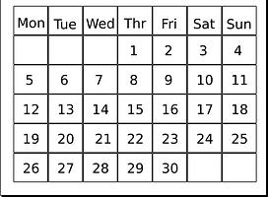
Current
Measurable
Relevant
Understandable
Objective
Notes:
Now, let’s discuss “source of relevant information” to develop a well written Present Level of Academic Achievement and Functional Performance (PLAAFP)
CURRENT: Is the information up-to-date and timely? —meaning information should be based on the results of the most recent assessments or evaluations. Current baseline and progress monitoring data provide an accurate picture of what the child can and cannot do in a specific academic/functional area and establishes a baseline for monitoring of progress in school and class TODAY-right now. Consider your own performance evaluation-would you want your performance progress measured based on data that is old and not reflective of what you have done or are doing now?
OBJECTIVE: Not based on what someone thinks, feels, or heard through the grapevine, but is clear, concise data.
RELEVANT: The information must be relevant. Related to the skill and functioning abilities, and what is most important for this student. Talking about the child’s disability category is not necessarily relevant. What is relevant are the individual needs in that particular skill area based on the disability.
MEASUREABLE: Once information that is current, objective and relevant is identified, all of it needs to be reviewed to ensure that it is measurable. It must be clearly defined, countable, observable--something that happens or does not happen. Consider terms such as “struggles with, has difficulty with.” Without explaining what those mean, they are not measurable and do not provide a baseline for the goals.
UNDERSTANDABLE: Finally, all of this needs to be written so that it is self-explanatory (as in the instructions) or an explanation need to be included.
Clip art from https://pixabay.com/
Understandable clip art from http://www.clipartpanda.com/
“Use this image on your Powerpoints, School Projects, Reports and More!

Slide 11
Common Mistakes
Too much information...
Notes:
Before we move into working with PLAAFP statements, let’s talk about some common mistakes to avoid
COMMON MISTAKE #1
The first common mistake is including too much information that is not relevant. PLAAFPs addressing academic skills contain statements like “the student is very friendly with peers and helpful in class”, “we feel like the student has many friends, or “the student tries hard and has a supportive family.” While some of these type of statements might be required if addressing functional skills like work habits or social skills, many times these extra statements are included when addressing academic levels. The problem with including too much information in a PLAAFP statement is that it interferes with the focus on the student's actual needs in the area identified. If you are including too much information it becomes really difficult to identify the student's actual needs-what is it that the student can or cannot do? How does this compare to same age peers without disabilities? How does this compare to the NC Standards? Why is this important? The PLAAFP section is the place to review the data from your assessments and to clearly explain the present level instead of including all information about the student.
Image found on Bing “All Creative Commons” licenses and located at http://www.the-vital-edge.com/stakeholder-argument/

Slide 12
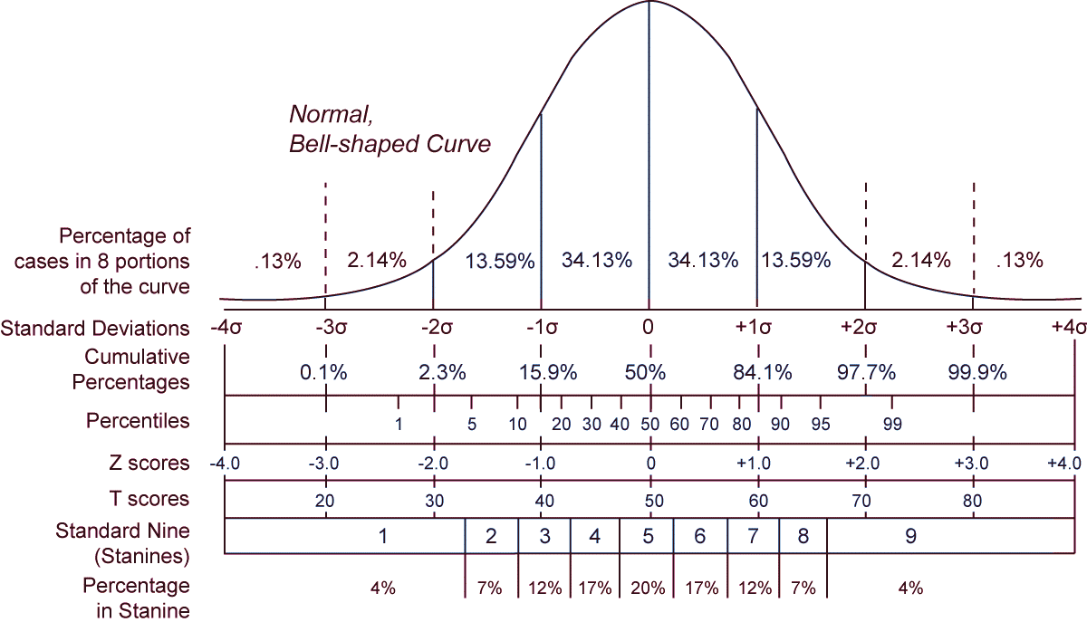
Common Mistakes
Too specific...
Notes:
COMMON MISTAKE #2
The second common mistake is using information that is too specific-not understandable-with over-reliance on test scores from the evaluations. The PLAAFP should be understandable and everyone on the IEP team needs to clearly understand what the student can and can’t do and how the data supports that—this includes the general education teacher, the special education teacher, related service providers, administrators, and most importantly the parent.
If the student leaves your LEA or school, then the receiving school or LEA should be able to implement the IEP and provide specially designed instruction. Therefore, use clear, easily understood, language with understandable data painting the picture. Remember that it needs to pass the stranger test—could someone else inherit the PLAAFP and know that student’s strengths, needs and the effects of the disability AND be able to implement the services with accurate progress monitoring?
Graphic from: https://commons.wikimedia.org/wiki/File:The_Normal_Distribution.svg
This work has been released into the public domain by its author, Heds 1 at English Wikipedia. This applies worldwide. In some countries this may not be legally possible; if so: Heds 1 grants anyone the right to use this work for any purpose, without any conditions, unless such conditions are required by law.

Slide 13
Common Mistakes
Too general...
Notes:
COMMON MISTAKE #3
The third common mistake is describing the student’s academic and functional performance in terms that are too general. This does not help focus on the student's actual needs. When we use statements such as “the student is struggling with their reading, the student has inappropriate behavior” or “the student has poor communication skills,” without clear, objective data to support the statement, we do not know where to “place the measuring tape to start measuring progress.”
All of those statements may be true, but the general statements do not assist the IEP team to drill down and focus on the student’s individual needs and the required special education services to support learning.
Image found on Pixabay at https://pixabay.com/en/measurement-millimeter-centimeter-1476919/

Slide 14
Present Level(s) of Academic and Functional Performance
Complete the current descriptive information by using norm-referenced, criterion-referenced, or any other valid data sources, as well as descriptive information for each of the relevant areas. Include current academic and functional performance, behaviors, social/emotional development, transition and other pertinent information. All areas assessed should be addressed and a determination made as to whether the data indicates an area is in need of specially designed instruction.
Notes:
This shows the instructions for the required information that must be included when writing a PLAAFP in the NC forms…
Present Level(s) of Academic and Functional Performance
Complete the current descriptive information by using norm-referenced, criterion-referenced, or any other valid data sources, as well as descriptive information for each of the relevant areas. Include current academic and functional performance, behaviors, social/emotional development, transition and other pertinent information. All areas assessed should be addressed and a determination made as to whether the data indicates an area is in need of specially designed instruction.

Slide 15
AREA(S) IN NEED OF SPECIALLY DESIGNED INSTRUCTION (SDI) must be addressed within the IEP (e.g. annual goals, accommodations, specially-designed instruction, behavior intervention plan, etc.)
Area(s) Assessed | Source of Relevant Information Include date of assessment and baseline data. Scores should be self-explanatory. If not, and explanation must be included. | AREA(S) IN NEED OF SDI Yes/No
Present Level of Performance:
Notes:
The IEP team must review and document the baseline data in each area assessed and determine, based on the data, if the student requires specially designed instruction (SDI) to address an area of need. If the area assessed does require SDI, the indication would be ,”YES.” However, there are times when teams might determine students do not need SDI and indicate, “NO.” For example, following an initial evaluation in which multiple academic and functional areas were assessed – the results must be documented on the IEP; however not all areas may require SDI. Also, if the IEP team determined further data was needed to make programming proposals/determinations, but upon collection and review of the data, the area was not identified as an area in need of SDI, the team might indicate “NO.”

Slide 16
AREA(S) IN NEED OF SPECIALLY DESIGNED INSTRUCTION (SDI) must be addressed within the IEP (e.g. annual goals, accommodations, specially-designed instruction, behavior intervention plan, etc.)
Area(s) Assessed | Source of Relevant Information Include date of assessment and baseline data. Scores should be self-explanatory. If not, and explanation must be included. | AREA(S) IN NEED OF SDI Yes/No
Reading Fluency | Phonics Survey 06/04/2017​ 9/10 closed syllable words with blends and diagraphs​ CVCe words 1/10 and vowel team syllables 0/10​ Kindergarten high frequency words 100% and 1st grade high frequency words 98%​ Oral reading measures of rate and accuracy using graded passages at 1st and 2nd grade level (05/15/2018 and 05/20/2018) Average correct response to weekly comprehension questions (Independent 1/5 and with moderate cues 4.5/5) | YES
Present Level of Performance:
Mario is able to accurately read 9/10 closed syllable words containing consonants blends and digraphs. He can decode CVC words with blends (ie: sp-, br-), but does not decode words with long vowel patterns (CVCe) or vowel team syllables. He is unable to apply phonics and word analysis skills to decode unfamiliar words in 2nd grade levels passages with accuracy and automaticity. This also affects his comprehension of materials because he must stop frequently when encountering unfamiliar words. He is unable to independently respond to questions after reading passages at this level, but is able to respond when given moderate verbal cues on where locate the information in the text.
Notes:
This is an example describing a Present Level of Academic and Functional Performance for Reading Word Recognition. Based on this data, the student does require SDI in this area.

Slide 17
AREA(S) IN NEED OF SPECIALLY DESIGNED INSTRUCTION (SDI) must be addressed within the IEP (e.g. annual goals, accommodations, specially-designed instruction, behavior intervention plan, etc.)
Area(s) Assessed | Source of Relevant Information Include date of assessment and baseline data. Scores should be self-explanatory. If not, and explanation must be included. | AREA(S) IN NEED OF SDI Yes/No
Behavior | 8/10, 11, 13/2018 Observations and teacher reports-leaves area (15x), under desk (2x) hands over ears (5x) lined up items on his desk (2x) in 1 hour. Andy required 1 to 2 cues to re-engage when in area, 5 cues if out of area. He removed himself and began scripting when items lined up were disturbed. He avoided the group situation and removed himself when placed in group unless given 100% prompting | YES
Present Level of Performance:
During work times, Andy flaps his hands in front of his face and will line up objects in a precise, orderly fashion becoming upset when that order is disturbed (5-7x day). Andy has difficulty engaging in class and group activities. He requires a significant amount of adult support in the classroom as he tends to wander around and needs verbal redirection to return to his seat. He will comply but he requires assistance to complete all group assignments (100% cued). When he leaves the area, he can be redirected back to his task with 3-5 verbal cues. Andy is generally compliant when working individually with redirection required to keep working. He withdraws or remains aloof in group situations (75%-95% of group activities), and when he leaves his area, he requires increased cues to return and engage in work.
Notes:
This is an example describing a Present Level of Academic and Functional Performance for classroom behavior

Slide 18
AREA(S) IN NEED OF SPECIALLY DESIGNED INSTRUCTION (SDI) must be addressed within the IEP (e.g. annual goals, accommodations, specially-designed instruction, behavior intervention plan, etc.)
Area(s) Assessed | Source of Relevant Information Include date of assessment and baseline data. Scores should be self-explanatory. If not, and explanation must be included. | AREA(S) IN NEED OF SDI Yes/No
Sign Language Development | Standardized Visual Communication Sign Language Checklist I, 5/10 items correct (not skilled rating) American Sign Language Receptive Skills Test 1st grade level; Informal Observations of use of ASL in Classroom and functional listening environments (9/28/2018) | YES
Present Level of Performance:
Harold is able to combine simple noun-verb agreements in ASL and can ask and answer simple "Who" and "Where" questions. He is unable to use complex sentence structures like that of typical 5th grade ASL user and is unable to follow the culturally appropriate turn taking rules when it comes to conversations. He will initiate a conversation appropriately, but is unable to apply the correct grammatical rules like eye gaze, head nods, and body shifts. Harold can recognize facial expressions that describe feeling and recognizes names of familiar people. He is only able to attend to the interpreter using American Sign Language for 10 minutes.
Notes:
This is an example describing a Present Level of Academic and Functional Performance that is one sample describing the data collected and an area of need for a student receiving services from an interpreter.

Slide 19
AREA(S) IN NEED OF SPECIALLY DESIGNED INSTRUCTION (SDI) must be addressed within the IEP (e.g. annual goals, accommodations, specially-designed instruction, behavior intervention plan, etc.)
Area(s) Assessed | Source of Relevant Information Include date of assessment and baseline data. Scores should be self-explanatory. If not, and explanation must be included. | AREA(S) IN NEED OF SDI Yes/No
Fine Motor | 07/22/18 - School Function Assessment, Activity Performance Areas: Within Normal Range/Strengths: campus travel (105) maintaining/changing positions (107) up/down stairs (101) Significantly delayed/Needs: manipulation with movement (66); eating/drinking (78) using materials (47); hygiene (71); set up/clean up (61) clothing management (63); written/computer work (39) | YES
Present Level of Performance:
Edie does: use computer mouse/navigate familiar software independently; close started zipper; open doors, classroom containers Edie does not: manage clothing fasteners/tie shoes; open food containers/packaging use storage and organizational materials per classroom routine ; use pencil, touch screen, or keyboard for written expression; Edie routinely protests and attempts to abandon area/task within 5 seconds when prompted to attempt tool use on his own
Notes:
This is an example describing a Present Level of Academic and Functional Performance for fine motor skills

Slide 20
Describe any relevant medical information: Currently, Maria's mother reports that there are no changes in her medical information. Maria has her own hearing aids which are provided and maintained by her family.
Notes:
The IEP team uses this section to report any relevant medical information that pertains to the student. This may be a report provided by the parent updating medical information, it can be used to describe the specific needs and how those are addressed, such as medication administered at school or specific information about hearing aids that parents are maintaining.

Slide 21
Effects of the Disability
The PLAAFP must…
Describe how the disability impacts the student’s involvement and progress in the general curriculum.
Convey the unique challenges or barriers that exist for the student as a result of the disability.
Describe the current levels of independence and any need for assistance.
Notes:
21
Remember that we must describe the impact the disability has on the student’s academic and functional performance in school. Earlier, we talked about
Questions to Consider as you write the impact statement.
How does the student’s disability affect participation and progress in the general curriculum?
What does the student need to learn the knowledge and attain the skills to progress in the general curriculum?
Is the student on track to achieve grade level proficiency within the year?
Remember that this statement is unique and should reflect the unique challenges that exist for the student-not just a repetition of the eligibility. This is not a statement of eligibility or services or a general statement that the disability does affect the student’s access but must specifically describe how the disability affects the student in the general curriculum.

Slide 22
Describe how the disability impacts involvement and progress in the general curriculum: Mario’s disability hinders his ability to: Read (decode words, read fluently, and comprehend what he reads) Complete tasks (in large or small group settings) and remain in assigned area Perform fine motor activities accurately and effectively and this negatively impacts involvement and progress in the general curriculum because it prevents him from: Effectively engaging with grade level materials, Independently and accurately completing fourth grade level academic and functional tasks, and Meaningfully participating in large and small group instruction independently
Notes:
The most important thing to remember and understand is HOW the student’s disability impacts the involvement AND progress in the general curriculum. Notice that all areas that are addressed with SDI are captured here, as well.

Slide 23
Consideration of Special Factors
NC Policies NC 1503-5.1 (a) (2)
Notes:
Moving onto Special Factor considerations, the IEP team must determine if the student has limited English Proficiency, has any special communication requirements, requires assistive technology, or requires the use of Braille.
The IEP would need to consider each of these, and if YES is selected, the document will note where this need is addressed in the IEP for the student.
It is important to know the specific requirements when considering the need for instruction in Braille…

Slide 24
Consideration of Special Factors Instruction in or Use of Braille
IEP Teams Must Consider:
Does the student have a VI (visual impairment)?
If yes to a VI, then braille instruction will be offered, unless there is data to support print.
The Learning Media Assessment is documentation of whether the student will use print or braille.
Document consideration on Prior Written Notice
Notes:
According to IDEA, it is assumed that if a student has a visual impairment (regardless of whether or not the student has a primary or secondary eligibility of VI on the IEP or is made eligible under a different qualifying category), then the student will receive Braille instruction; (i.e., visual impairment = braille instruction) unless there is data to support otherwise. The data used to support the decline of use/instruction in Braille is a Learning Media Assessment, conducted by a certified Teacher of the Visually Impaired. The discussion of the Visual Impairment and data used when addressing this IEP question is recorded in the Prior Written Notice (DEC 5). Within the Prior Written Notice, IEP teams must always address why braille instruction will be offered or was declined and how this determination was made. Specifically, IEP teams must consider:
Does the student have a VI (visual impairment)?
If yes to a VI, then braille instruction will be offered, unless there is data from a Learning Media Assessment to support print. REMEMBER…The Learning Media Assessment needs parental consent AND The Learning Media Assessment is conducted by a Teacher of the Visually Impaired.
Then…All discussion is documented in the Prior Written Notice and in the meeting minutes, if minutes are used by the LEA.

Slide 25
NC Policies NC 1503-5.1 (a) (2)
Notes:
Next, the IEP team continues considering the needs of the student, and if the student is a student with a documented hearing loss, and the team responds with “yes,” this must be addressed in the IEP and will require that the IEP team complete the Communication Plan Worksheet.
Students who will require (the IEP Team will check YES) a Communication Plan Worksheet be completed include the following:
Those in the eligibility process being considered for a primary or secondary disabling condition of hearing impairment, deafness or deaf-blindness; AND,
Those in the eligibility process for any disability category other than HI, DF, or DB who have a confirmed, documented hearing loss of any type, nature, or degree, except those with transient, conductive hearing loss.
Note: if any of the students above are found eligible for special education and related services, the CPW MUST be completed at all annual review and reevaluation IEP meetings as required by Session Law 2013-119 House Bill 317.
Also Note: The CPW is constructed in such a way for IEP Teams to have a discussion around the special factors for students with hearing loss; it asks IEP Teams to consider specific things. At the time this document is completed, determinations about goals, services, placement, etc. are NOT being made. This answers to the questions should assist the IEP Team when determining those things later on in the IEP Process.

Slide 26
Communication Plan Worksheet for Deaf/Hard of Hearing Students
The Communication Plan Worksheet (CPW) required by Session Law 2013-119 House Bill 317, is to be used by IEP Teams for any child with an IEP who has a hearing loss including:
Students for which Deafness, Deaf-Blindness, or Hearing Impairment is a primary or secondary area of eligibility
Students with a documented hearing loss with ANY disability
Students with a documented hearing loss who are entering the initial eligibility determination process
Notes:
The Communication Plan Worksheet (CPW) is required to be used in NC by IEP teams when determining eligibility and developing IEPs for students with documented hearing loss. HB 317 focuses specifically on low incidence Deaf and Hard of Hearing students in an effort to ensure that, language and vocabulary for accessing grade-level content is being considered.
If the IEP team is considering the needs of a student who has a primary area of eligibility is Autism, yet has a hearing loss, would the IEP team be required to complete a CPW?
YES! The CPW supports the team in making a determination as to whether the Hearing Loss is negatively impacting the student’s ability to develop appropriate language when compared with other students with like age, cognitive levels and disabilities. Again if data indicates that language is indeed an area of need for this student, it is addressed in the IEP.
Remember: Students who will require (the IEP Team will check YES) a Communication Plan Worksheet be completed include the following:
Those in the eligibility process being considered for a primary or secondary disabling condition of hearing impairment, deafness or deaf-blindness; AND,
Those in the eligibility process for any disability category other than HI, DF, or DB who have a confirmed, documented hearing loss of any type, nature, or degree, except those with transient, conductive hearing loss.
Note: if any of the students above are found eligible for special education and related services, the CPW MUST be completed at all annual review and reevaluation IEP meetings as required by Session Law 2013-119 House Bill 317.

Slide 27
Purpose of Using the CPW
Session Law 2013-119 HB 317 is an “Act to Improve Educational Outcomes for NC Children Who are Deaf or Hard of Hearing” by:
Considering the Student’s Language and Communication Needs
Determining, based on specific current formal and informal data, that the student has the language necessary for accessing grade level content standards.
Language Used for Communication
Mode of Communication Used for Academic Instruction
Functional Language and Vocabulary
Determine how the student accesses the general education curriculum, and the supports that provide access, including direct services, and accommodations/modifications
Notes:
The Communication Plan Worksheet guides the IEP team in a discussion that reviews the current data of a student with a documented hearing loss. This review of data is conducted to assist the IEP in determining, “Does the student have the communication, language, and literacy skills necessary to acquire grade-level academic skills and concepts in the general education curriculum?”
If the answer to the question is “YES”: Then the IEP team then looks at specific goals and objectives that are appropriate to support the student in other areas that may be preventing them from acquiring grade level academic skills.
If the answer is “NO”: Then what is the plan to be used by the team and what Specially Designed Instruction, related services, modifications, accommodations will be used to support the student in closing the language/vocabulary gap in order to obtain grade-level skills and concepts in the general education curriculum?

Slide 28
Notes:
The Communication Plan Worksheet begins with the student’s personal information and information about the hearing loss with amplification type. Then, the IEP team completes Section I. Consideration of Student’s Language and Communication Needs. This section begins with indicating the conversational and instructional language(s) used by the student.

Slide 29
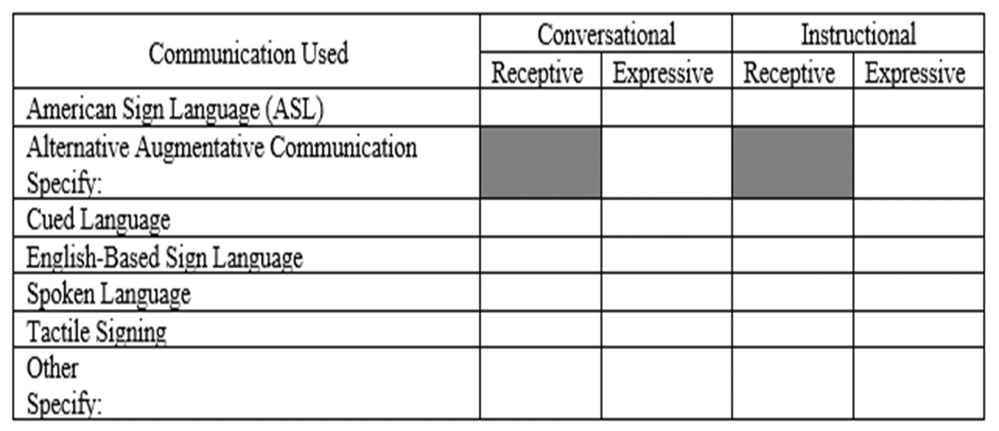
The student’s communication mode(s) and/or methods used to establish language is one or more of the following: (check all that apply)
Notes:
Then, next in Section I. Consideration of Student’s Language and Communication Needs, the team completes number 2, documenting the student’s communication mode(s) and/or methods used to establish language.

Slide 30
Notes:
Next in Section I. Consideration of Student’s Language and Communication Needs, for questions 3, 4, 5 and 6, the IEP team considers assessment data and describes the student’s functional language and vocabulary level, the languages and modes of communication with parents and family members, ways the language and communication needs of the student and family members can be addressed in the IEP, and any other comments needed to fully consider the Student’s Language and Communication Needs.

Slide 31
Notes:
Next, in Section II. of the Communication Plan Worksheet, the IEP team considers, the Opportunities for Direct Communication with Peers and Professional Personnel, as well as the Opportunities for Instruction in the Child’s Language and Communication Mode by responding to the three questions.

Slide 32
Notes:
In Section III., the IEP team considers the Academic Level and answers the question, “Does the student have communication, language, and literacy skills necessary to acquire grade-level academic skills and concepts in the general education curriculum?” This followed with a description of the supports to consider to continue or increase proficiency, based on the answer to the first question.

Slide 33
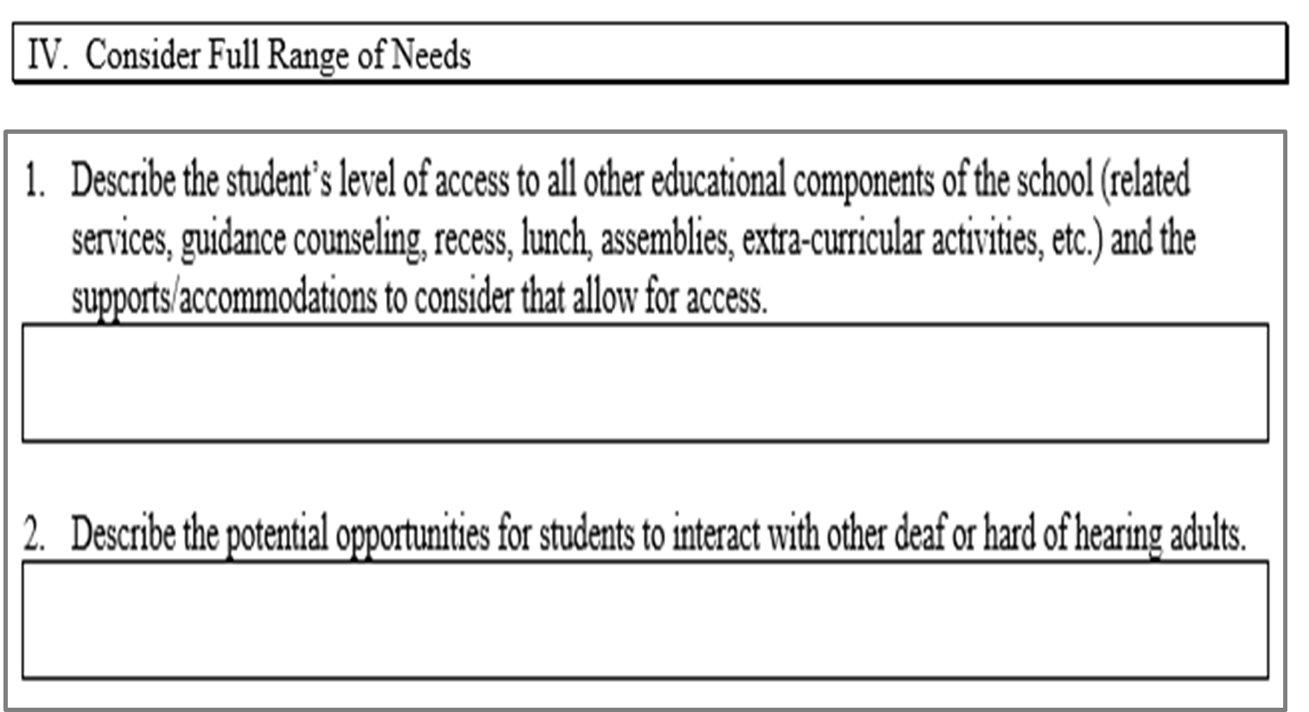
Notes:
Next, in Section IV. of the Communication Plan Worksheet, the IEP team considers the Full Range of Needs. They will “Describes the student’s level of access to all other educational components of the school and the supports/accommodations to consider that allow for access,” and they will “Describe the potential opportunities for students to interact with other deaf or hard of hearing adults.”

Slide 34
Notes:
In Section V., the team considers the need for Amplification and Assistive Technology devices and/services by responding to the 2 questions. Note that if amplification or AT are not being considered, and explanation is required.

Slide 35
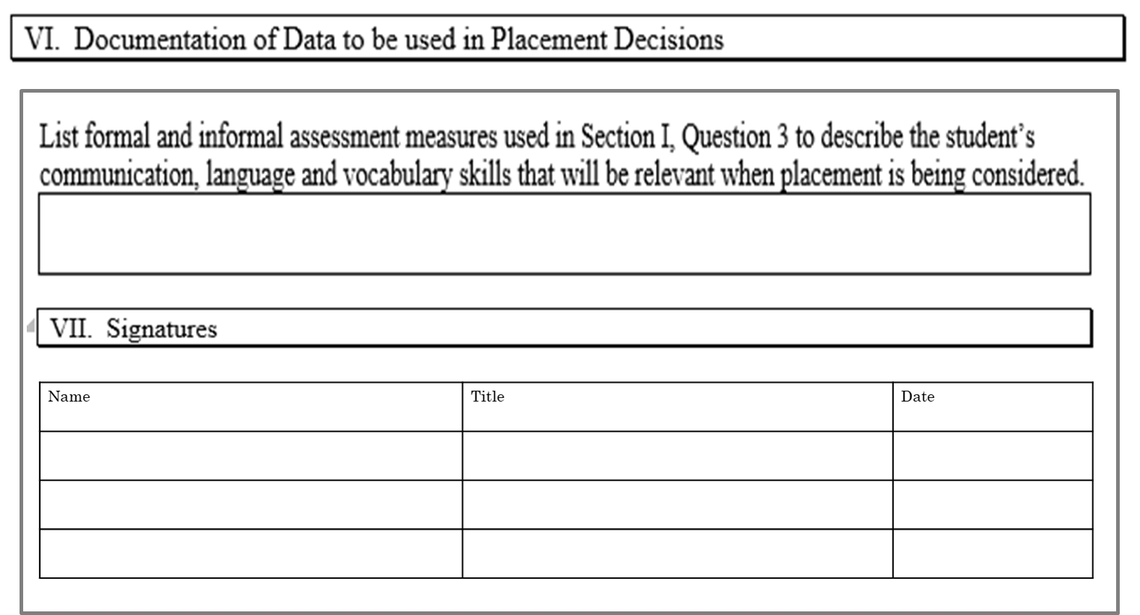
Notes:
Lastly, the IEP team will provide Documentation of Data to be used in Placement Decisions by listing the formal and informal assessment measures used to address Section I., Question 3 to describe the student’s communication, language, and vocabulary skills that will be relevant when placement is being considered.
(Question 3 in Section 1 asked the IEP team to use “the data from annual assessments measuring language necessary for literacy, describe the student’s functional language and vocabulary level.”)

Slide 36
NC Policies NC 1503-5.1 (a) (2)
Notes:
Following the considerations that are required if a student has a hearing loss, the IEP team must consider if the student has behaviors that impede learning, and if so, how the behavior is being addressed. These are examples that may be selected to indicate how the behavior is being addressed, and again, the location in the IEP must be indicated.

Slide 37
Additional Considerations
NC Policies NC 1503-5.1 (a) (2)
Notes:
The IEP team should also consider these additional factors. Based on evaluations, does the student require Adapted PE? Is the student a student with a significant cognitive disability and therefore the IEP team has determined the student will follow the Extended Content Standards?
The LEA then has the opportunity to again consider any additional parent concerns and to document those. The team may have already documented concerns in the prior location of the IEP. However, if the parent shares further concerns, this allows a return to page one to address those concerns, as appropriate. Lastly, additional information about possible needed supports for academic, functional, personal changes or circumstances, if these apply, can be considered and documented. For example, an IEP team may address upcoming transitions between grade levels, schools, etc.

