Slide 1
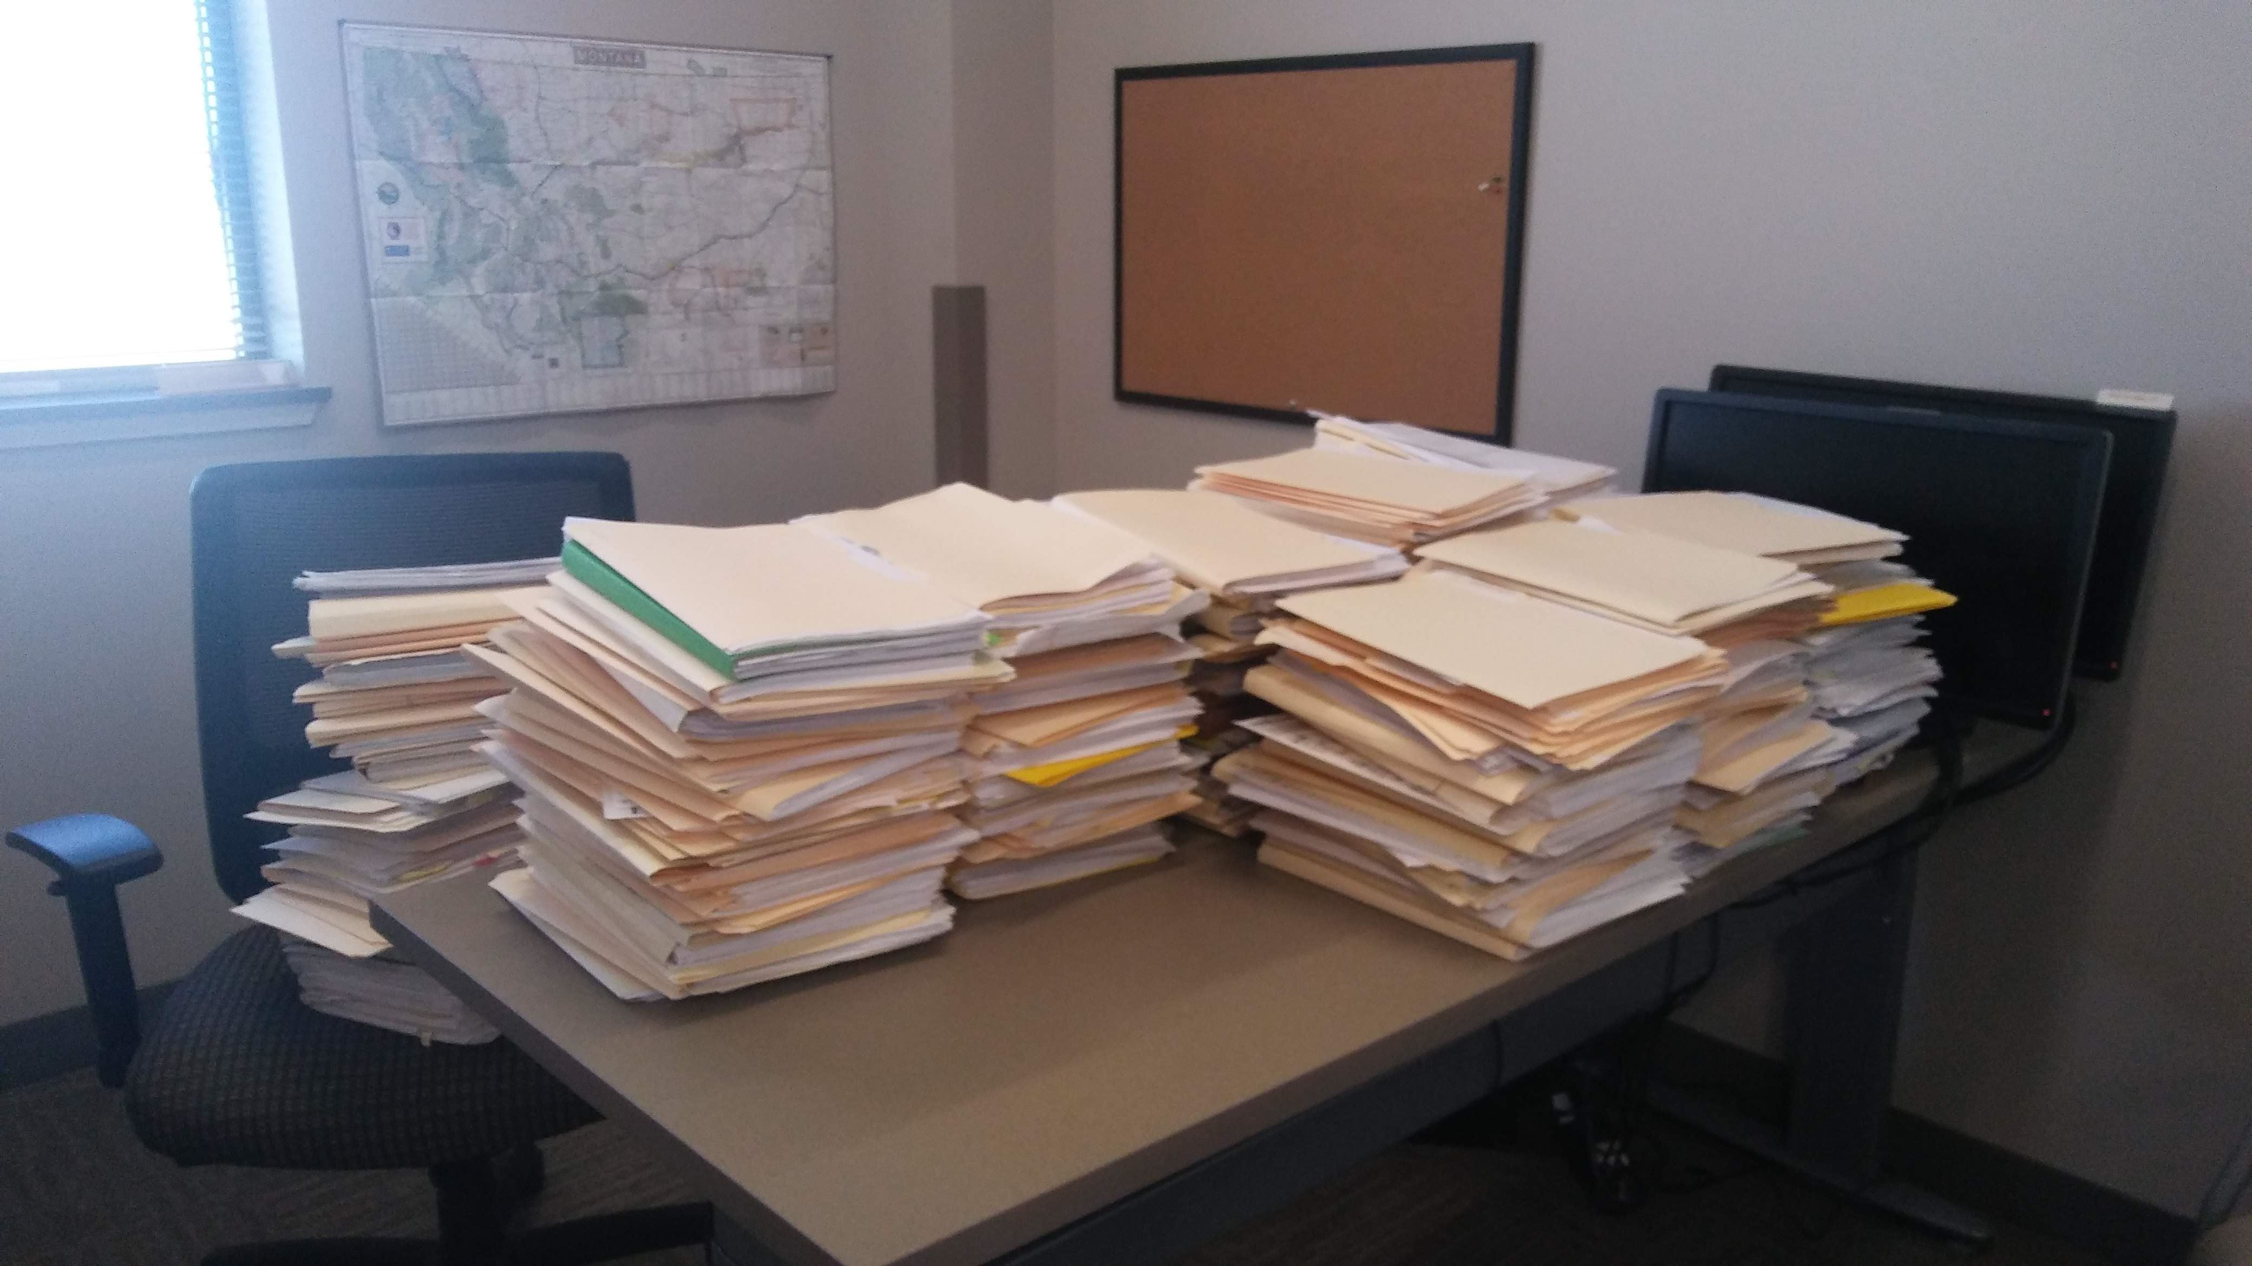
RECORDS RETENTION: To Keep or Not To Keep
Updates on the requirements for records disposal for Conservation Districts

Slide 2
What is RIM? (Records and Information Management)
And why do we care?

Slide 3
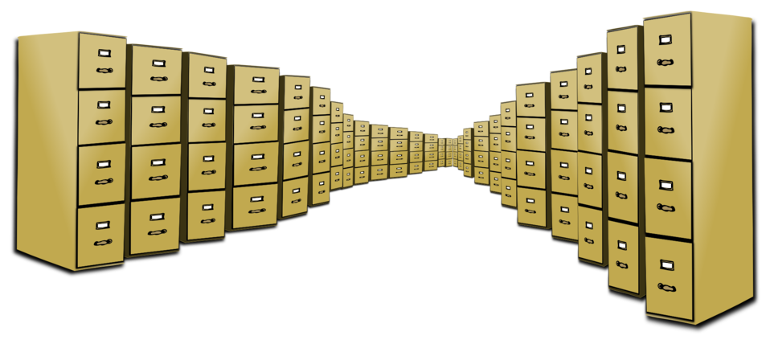
What is Records and Information Management?
The practice of controlling and governing the most important records of an organization, through the records life-cycle. It includes identifying, classifying, prioritizing, storing, securing, archiving, preserving, retrieving, tracking and destruction of records

Slide 4
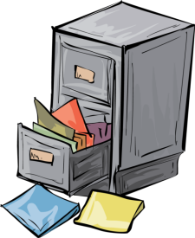
…and why do we care?
Because the Law says we have to
Because overall it will
reduce the cost of storage
mitigate risk of litigation
ensure data quality
increase efficiency
improve access
preserve history
Because of public access requirements

Slide 5
So, What IS a record?
MCA 2-6-1002. Public record. (13) “Public record” means public information that is: (a) fixed in any medium and is retrievable in usable form for future reference; and (b) designated for retention by the state records committee, judicial branch, legislative branch, or local government records committee.

Slide 6
Every Record has a Life Cycle
Creation or Receipt
Active records-maintained and accessed frequently
Inactive records-stored according to retention schedules
Disposition-
Permanent records
Destruction of non-permanent records

Slide 7
Paper Records Management
Starts with good organization
Filing system could mirror the schedule for disposal
Local Government Services-Schedules for Disposal and other forms
All Records require some sort of RIM application:
toss immediately
retain for “x” years
keep permanently/preserve

Slide 8
What Does DNRC Permanently Store For Us?
Minutes
Annual Plans
Annual Reports
Documentation on the Formation of the Conservation District
So if you aren’t sending these in already, you probably should…

Slide 9
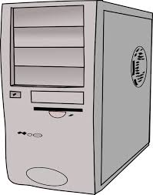
Electronic Records
Records may be kept on a digital medium if a records retention schedule and a digital migration plan has been completed and approved for the agency’s records
The RIM Training has recommendations on electronic file management (see references)
This is an area that we are still working on

Slide 10
Schedules for Records Retention: …yes, you need to use more than one
Changes are coming
Use the most up to date version (see references)
Use the schedules that apply to your records
Schedule 1-General
Schedule 5-Accounting and Financial
Schedule 9-Conservation Districts
Schedule 24-Human Resources
There may be more!!!

Slide 11
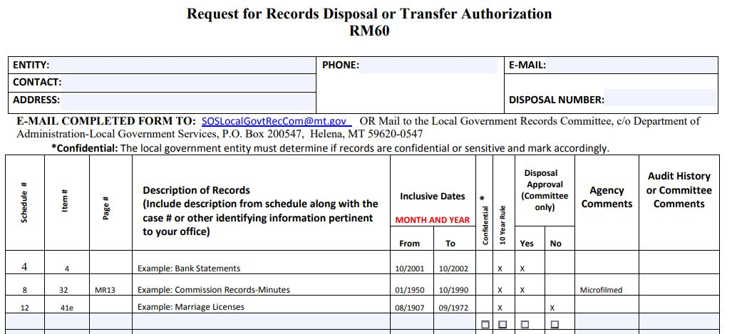
Use the Appropriate Disposal Form
The RM60

Slide 12
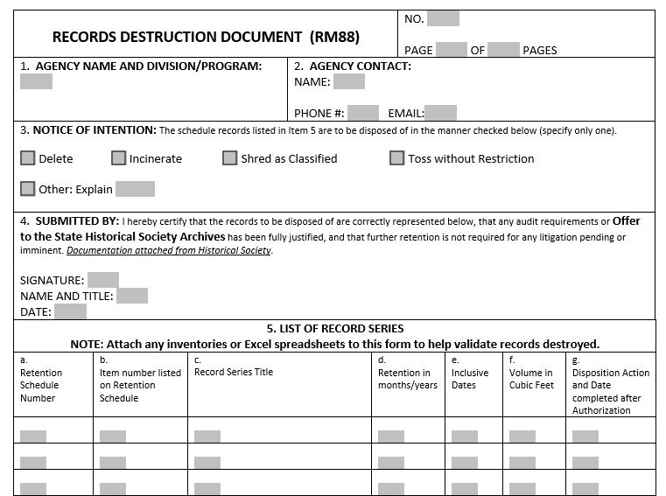
For Records that don’t need review prior to disposal…
The RM88

Slide 13
Submit the RM60 form to the Local Government Records Committee
Scan and email it to SOSLocalGovtRecCom@mt.gov
OR
Mail to:
Local Government Records Committee
c/o Department of Administration-Local Government Services
PO Box 200547
Helena MT 59620-0547
Don’t forget to Keep a Copy whichever form you use!!!

Slide 14
Things to Consider:
Once upon a time, a pair of DHS agents wandered into my office…

Slide 15
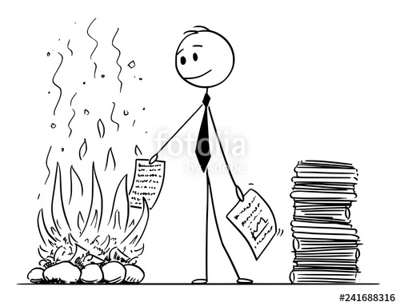
The moral of that story is: “just because the schedule says that you CAN destroy something, doesn’t necessarily mean you should”

Slide 16
References:
For more in-depth RIM training topics: https://sosmt.gov/records/
RIM Basic Training: https://sosmt.gov/records/toolkit/rim-training/
For the Local Government Services CURRENT SCHEDULES:
https://sosmt.gov/records/local/

