Slide 1

Unit Leader Training
January 12, 2022

Slide 2
Agenda
Roles/Responsibilities of Unit Leader
Approval Processes (Unit, Program)
Overview of TP Manual & Other Resources
Questions?

Slide 3
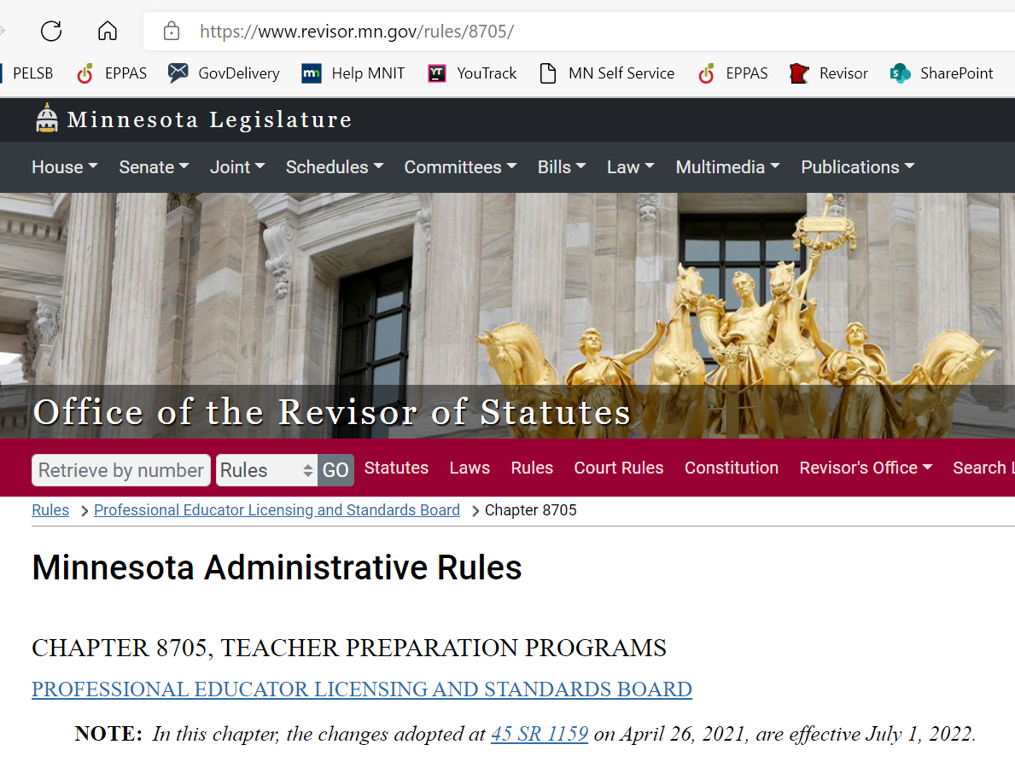
Unit Leader
PELSB Related Roles & Responsibilities
Chapter 8705, 8710, MN Statutes 122A (read last unit report, program reports and findings)
Administer all licensure programs as approved
Maintain an assessment system – storing, tracking, reporting
Recommend candidates upon completion of teacher preparation program
Communicate with the Board

Slide 4
Unit Leader Recommendations
Contact PELSB Teacher Education Specialists with updated contact information, or even better, complete a new contact.
If there are items from your unit on the Teacher Preparation Committee (TPC) agenda or Board agenda, attend/listen. Board meetings are recorded but TPC meetings are not.

Slide 5
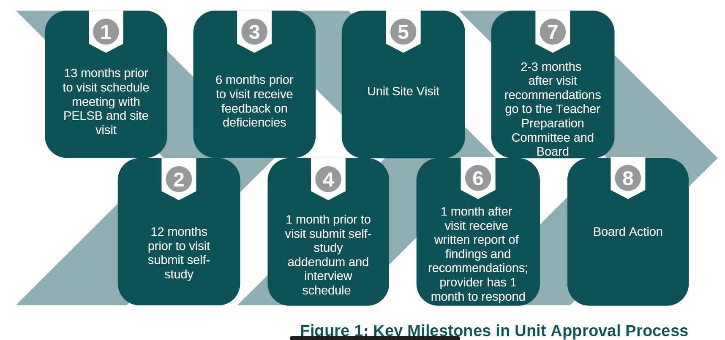
Unit Approval Process
To initiate this process, PELSB will request potential dates for site visit: 15-24 months in advance.

Slide 6
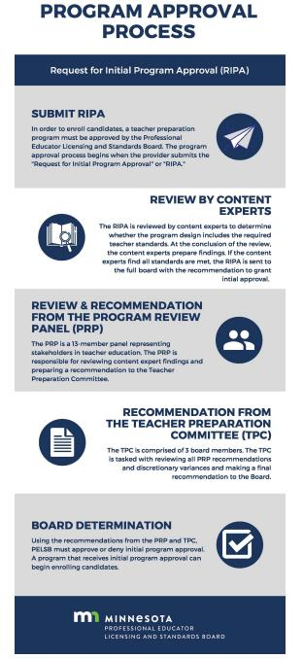
Program Approval Process
Two external reviews
If recommended for “not approve” may not resubmit for one year (PELSB & reviewer capacity).
Notes:
Two external reviews
If recommended for “not approve” may not resubmit for one year
The reason for these rules is about PELSB and reviewer capacity.

Slide 7
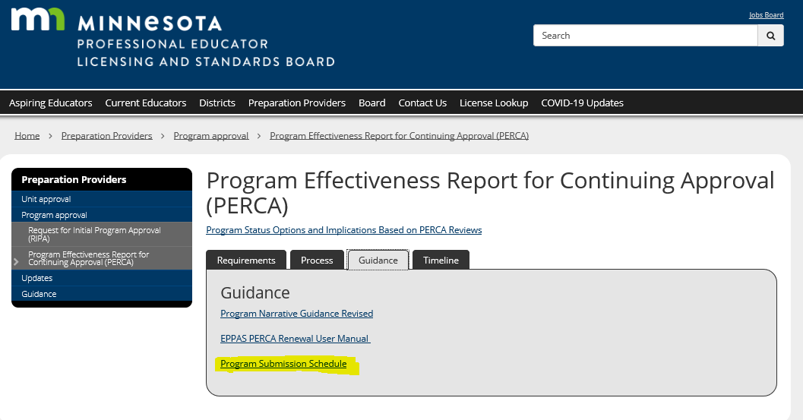
Program Review Panel
Notes:
Program submission is every three years

Slide 8
Discretionary Variance Process
Program: Submitted in EPPAS
Unit: Submitted to Michelle via form-Unit Leadership
Individual: Submitted to Michelle via form-Unit Leadership
NOTE: DV's have expiration date: July 1, 2022 for all previous variances granted for 2014 rule
Notes:
Program – submitted through EPPAS – PRP makes a recommendation, TPC makes a recommendation to full Board
Unit and individual – submit to Michelle Sandler who will share with TPC – TPC makes recommendation to full Board

Slide 9
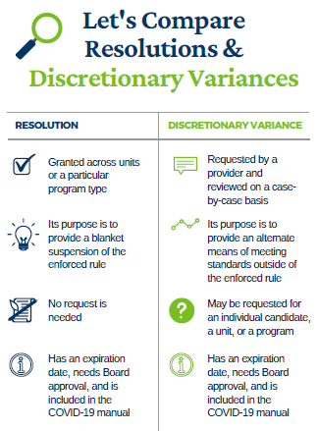

Slide 10
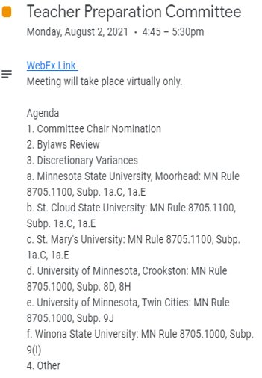
Teacher Preparation Commitee
Notes:
All preparation provider input needs to be in writing for all agenda items.
Encouraged to listen in to hear the discussion but there isn’t an opportunity for public comment.

Slide 11
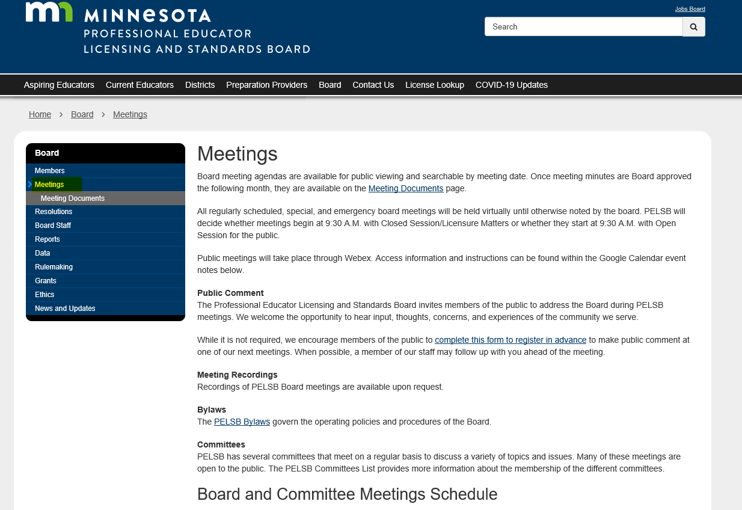
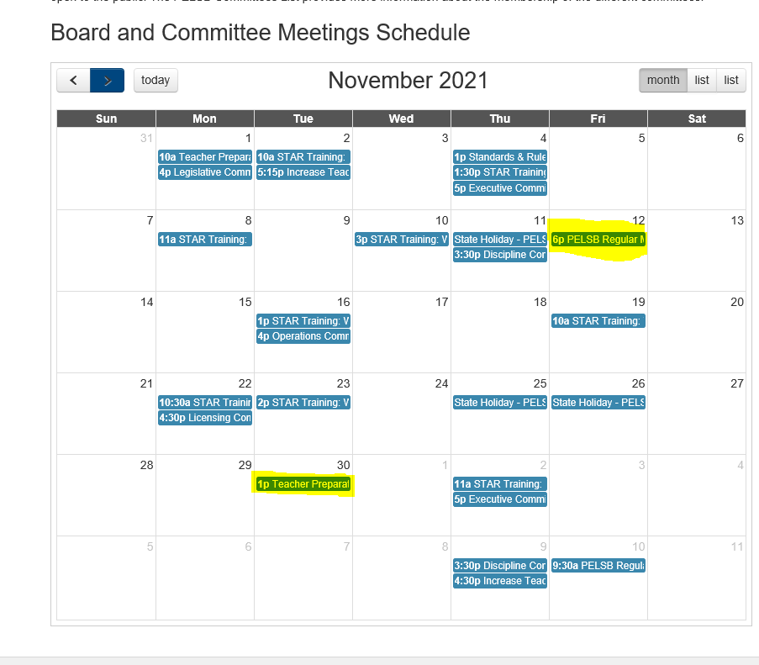
Finding Links to PELSB Meetings

Slide 12
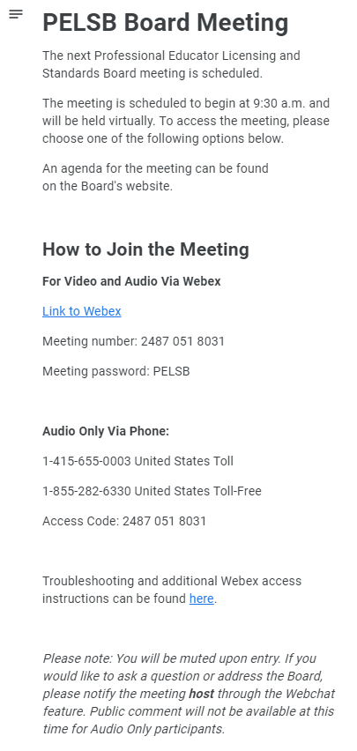
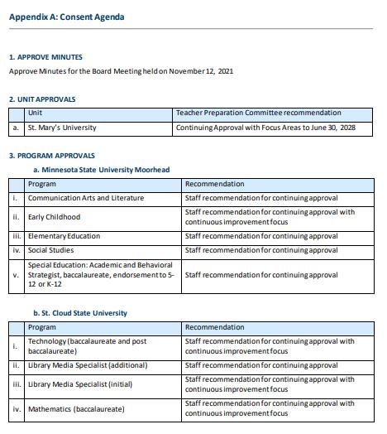
Links to PELSB Meetings/Board Agenda
Notes:
Consent agenda is on Appendix A

Slide 13
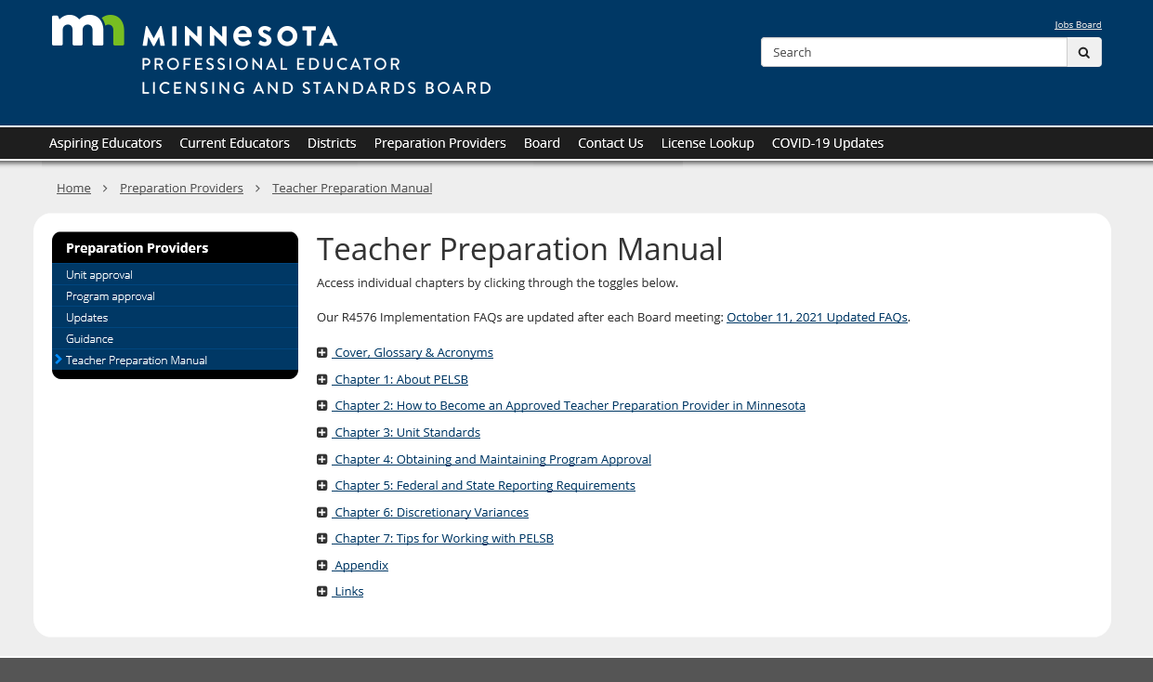
Teacher Preparation Manual https://mn.gov/pelsb/providers/teacherpreparationmanual/

Slide 14


4576 Implementation Updates

Slide 15
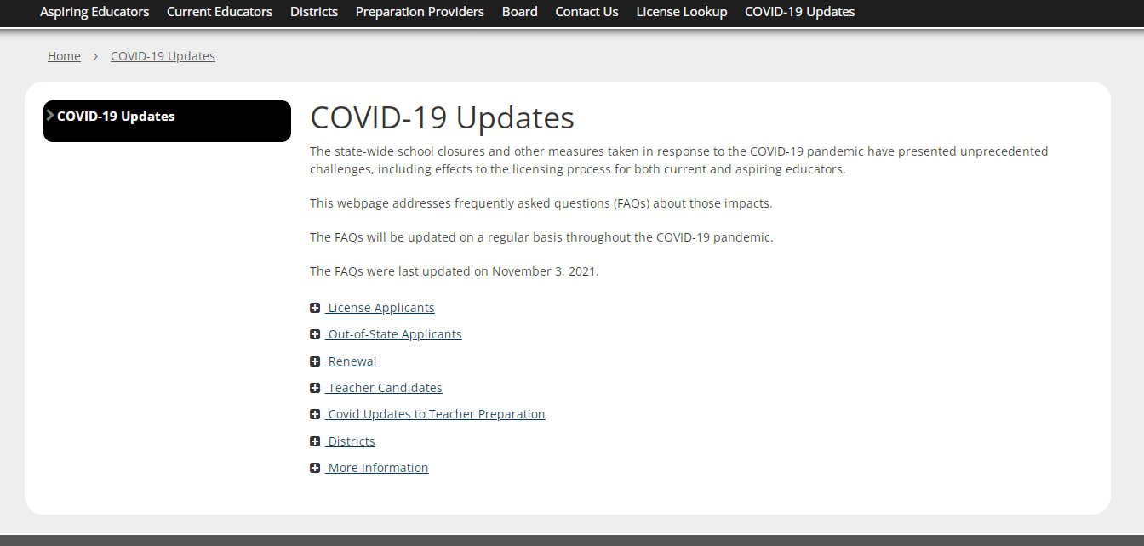
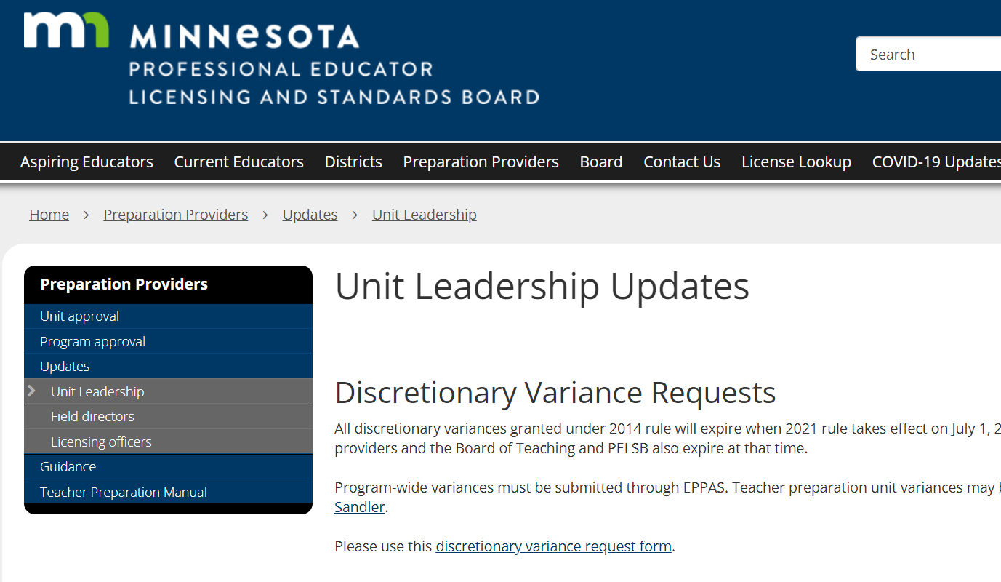
Unit Leader Updates
Monthly Emails (after each Board Meeting)
Check updates on Updates>Unit Leadership page
Notes:
The COVID 19 page will be removed in the near future. You will find this information on the Teacher Preparation Manual page.

Slide 16
Thank you for all you do!
QUESTIONS?
FAQ Inbox: https://forms.office.com/g/UBZGHh7VFC
Tyra Nelson-Reck: Tyra.Reck@state.mn.us
Michelle Sandler: Michelle.Sandler@state.mn.us
Notes:
Tyra

