Slide 1

Preparing for A NEW YEAR in SSIS Admin

Slide 2
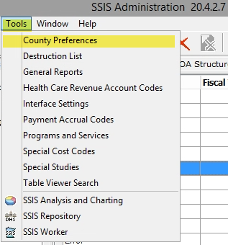
SSIS Admin overview
Yearly Settings
Agreement Language
Security Functions
Service Arrangements
Accrual Codes
Sub-Services

Slide 3
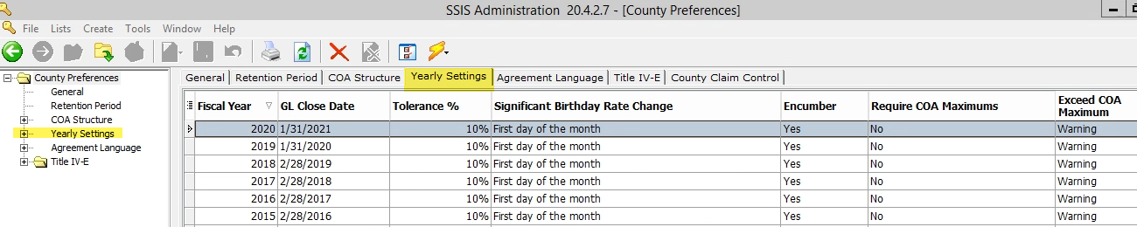
Yearly Settings Tab

Slide 4
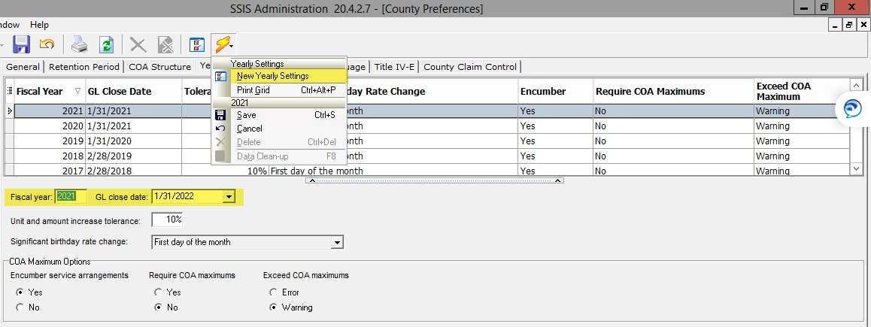
Create a new yearly setting

Slide 5
Yearly Settings to Review
GL Close Date
  One setting per year
Unit and amount tolerance
  Increase unit, amount tolerance % for Service Arrangements
Significant birthday rate change
  Set by DHS in SSIS for every agency as the First Day of the month and is not editable.
Encumber service arrangements
Require COA maximums
Exceed COA maximums

Slide 6
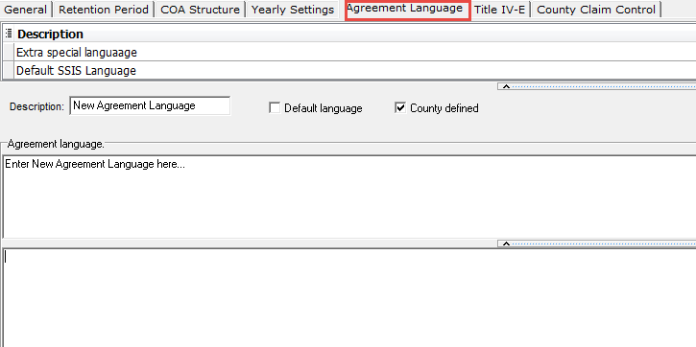
Agreement Language
Create Agency defined language for Service Agreements.

Slide 7
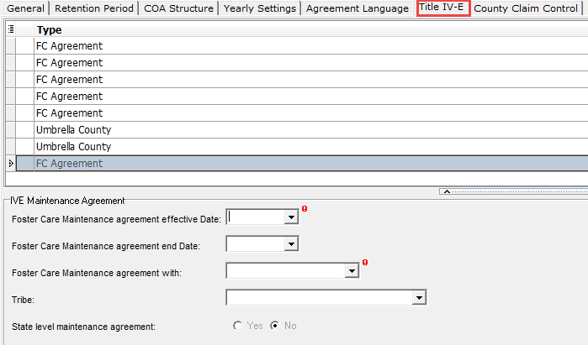
Title IV-E tab
Review and update Title IV-E Agreements for the new year
  Add end dates for those that are closed
  Enter any new Title IV-E Agreements

Slide 8
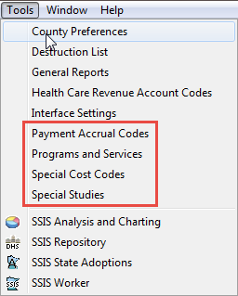
Review Other Settings in SSIS > Administration > Tools
Payment Accrual Codes
Programs and Services
  Agency sub-services
Special Cost Codes
  Agency defined
Special Studies

Slide 9
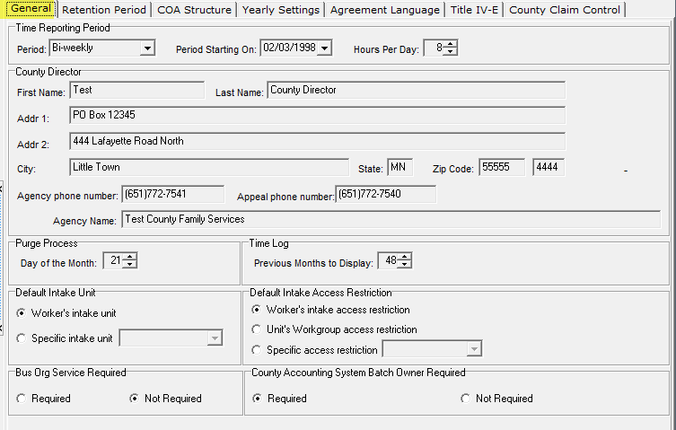
General Tab

Slide 10
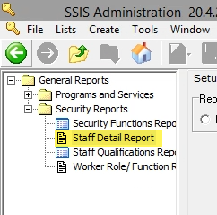
Review security functions
Review Roles for users and remove roles of staff who have left the agency

Slide 11
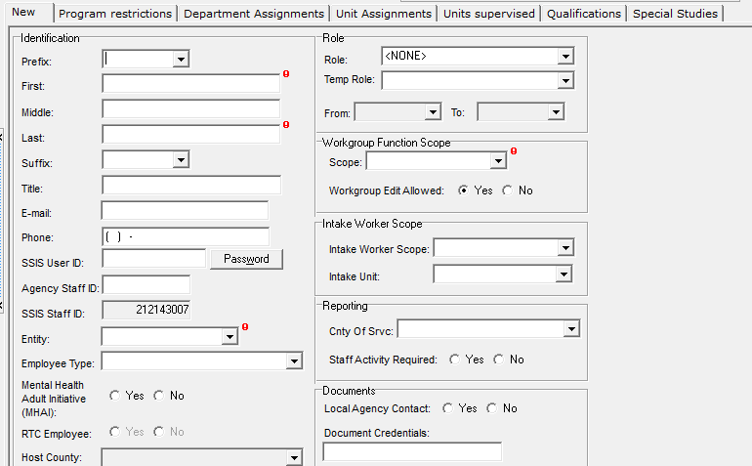
Review user profiles
Should current roles be updated?

Slide 12
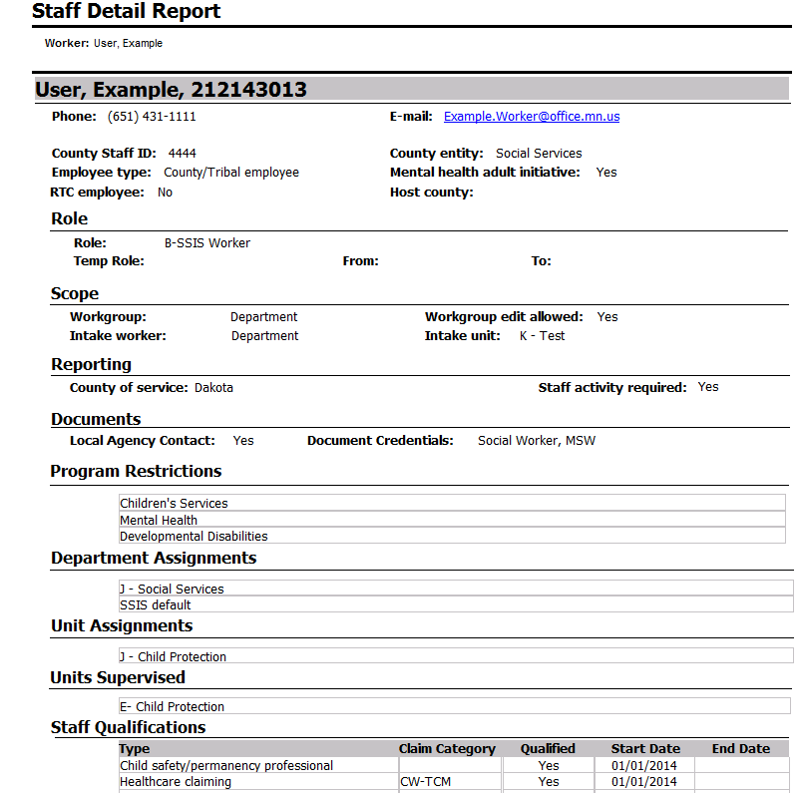
“Big picture” user setup
Staff Detail Report:
  User Roles
  Workgroups
  Department Assignments
  Unit Assignments
  Units Supervised
  Staff Qualifications

Slide 13
“Big picture” questions
Are all staff entered?
Do all staff who are no longer employed have a role of “None”?
Are all site locations entered and correct?
Are all departments correct?
  Units associated with departments?
  Staff correctly associated with units?
  Supervisors correctly associated with units?
  Roles with appropriate assigned functions?
  Staff assigned to roles?
  External placement case managers updated?

Slide 14
Review and setup of service arrangements
Service Arrangements for Legacy Foster Care Placements can be created for the whole year.
The current Northstar foster care rates end 06/30/20XX. Northstar Placements in 20XX will require at least two Service Arrangements.
  One for 01/01/20XX to 06/30/20XX
  One for 07/01/20XX to 12/31/20XX

Slide 15
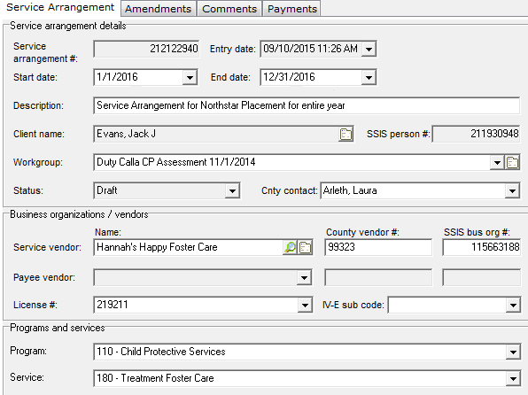
Legacy placements Service Arrangement

Slide 16
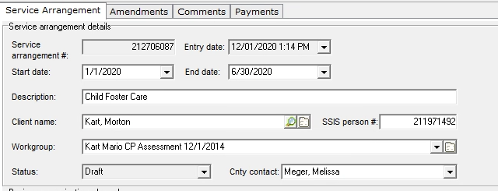
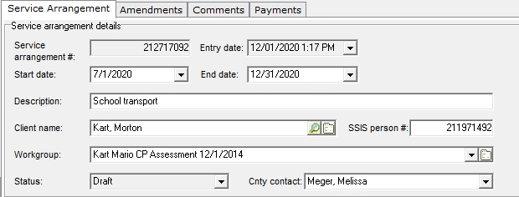
Northstar placement Service arrangement

Slide 17
Questions to Ask
Are there accrual codes in SSIS that are no longer active in your accounting system?
Are there accrual codes in your County Accounting System that are not in SSIS?
Are end dates needed for any Special Studies?
Does the level need to change on a Special Study?
Can a worker do the job they need to do in SSIS with their currently assigned Security Functions?
Do they have more security functions than they actually need?

Slide 18
Thank You!

