Slide 1
WORKFORCE ONE (WF1)
Dislocated Worker and WIOA Adult
Funding Stream and Performance Guidance
amy.carlson@state.mn.us
State Program Administrator Coordinator

Slide 2
IN THIS GUIDE
GUIDE TOPIC | SLIDE NUMBERS
Differences between Program Year, Performance Year, and Grant Year | 3
Differences in “PY” and “FY” | 4 – 5
Grant Periods – How long are they? | 6 – 8
Number 1 reason activities need updating due to funding streams | 9 – 10
How to find cases needing funding information updates | 11 – 18
How to update activities with new funding information | 19 – 25
Number 2 reason activities need updating due to funding streams | 26 – 27
Other important information to know during grant closeouts | 28 – 31
Important reminders on performance indicators and cohorts | 32 – 40
State Program Administrator Coordinator contact information | 41

Slide 3
What’s the difference between Program Year Performance Year, and Grant Allocation Year?
PROGRAM YEAR
Only lasts for one year
Not grant specific
Easy way to reference a time period
PERFORMANCE YEAR
Measures participant success rates in 5 indicators
Not grant specific
Only lasts for one year but includes exited participants from the past
FORMULA GRANT YEAR
One allocation grant is awarded every year per funding source
Every awarded grant remains active for 2 years

Slide 4
What’s the Difference between PY and FY?
NOTHING BUT A TITLE FOR PERFORMANCE
Program Year (PY): Titled with the year it began
Fiscal Year (FY): Titled with the year it ends
THIS MEANS FOR PERFORMANCE
July 1, 2022 – June 30, 2023
IS Program Year 2022 AND Fiscal Year 2023

Slide 5
What’s the Difference between PY and FY?
NOTHING BUT A TITLE FOR FORMULA GRANTS
Program Year (PY): Titled with the year it was awarded
Fiscal Year (FY): Titled with the second-year funds continue to be available
THIS MEANS
July 1, 2022 – June 30, 2024
IS Program Year 2022 AND Fiscal Year 2023

Slide 6
Each Program Year Formula Allocation
HAS A
TWO YEAR
GRANT PERIOD

Slide 7
Available allocations to use
07/01/2021 -06/30/2022
WIOA Adult Formula Allocations
WIOA Adult Program Year 2020 allocation and the
WIOA Adult Program Year 2021 allocation
Dislocated Worker Formula Allocations
WIOA DW Program Year 2020 allocation and the
WIOA DW Program Year 2021 allocation
State DW Program Year 2020 allocation and the
State DW Program Year 2021 allocation

Slide 8
Available allocations to use
07/01/2022 -06/30/2023
WIOA Adult Formula Allocations
WIOA Adult Program Year 2021 allocation and the
WIOA Adult Program Year 2022 allocation
Dislocated Worker Formula Allocations
WIOA DW Program Year 2021 allocation and the
WIOA DW Program Year 2022 allocation
State DW Program Year 2021 allocation and the
State DW Program Year 2022 allocation

Slide 9
Number ONE
Most Common Reason to
Update Funding Stream Information
In Workforce One

Slide 10
Most Common Reason #1
A Program Year Allocation reaches its expiration date
This means the money your location received at the beginning of a program year two years ago is no longer available. It has reached its expiration date.
Since the grant is no longer active (it has closed), you will need to close all activities showing that funding stream as its funding source with the last date that funding stream was available (June 30 or earlier)
If those participants will continue receiving any of those services, you will need to open new activities showing the funding source taking over payments for those continued services with the first date the funding stream began supporting the service (July 1 or later)

Slide 11
Finding Your Data
The Activity Detail Report will provide you all the activities needing updates due to the expiring grant

Slide 12
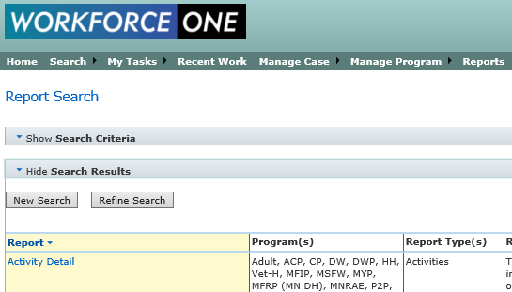
How to find cases using Old Funding Streams
1
2
Click “Reports”
Find the “Activity Detail” Report

Slide 13
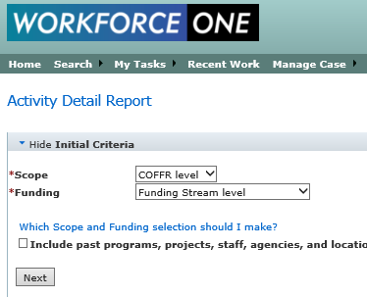
How to Find Cases using PY20 Funding Streams
1
2
3
Select “COFFR level” for the Scope and
Select “Funding Stream level” for the Funding
Click NEXT

Slide 14
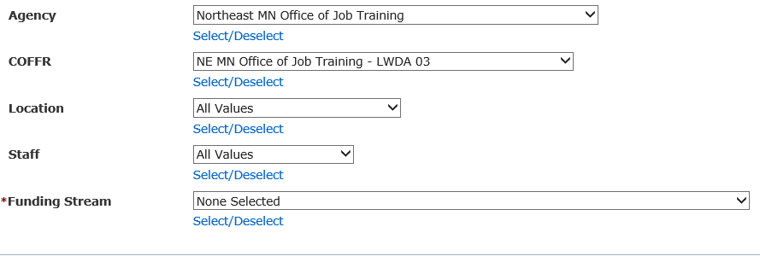
How to Find Cases using PY20 Funding Streams
To select more than one click on “Select/Deselect”
Select the Agency/COFFR/Location/Staff criteria you want the report on
Click on “Select/Deselect” below the Funding Stream option box so you can select multiple funding streams (grants) for your report

Slide 15
Again, how many PY20 Funding Streams
do you have?
Local Area Workforce Development Areas (LWDAs):
PY20 WIOA Adult
PY20 WIOA Dislocated Worker
PY20 State Dislocated Worker
Small Layoff Independent Grantees (SLIGs):
PY20 State Dislocated Worker

Slide 16
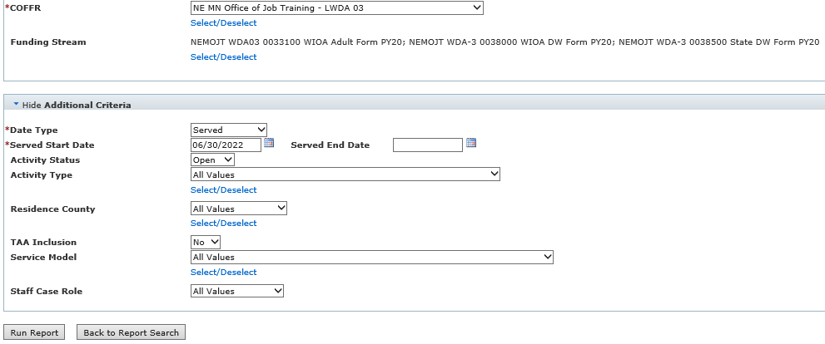
Find Cases currently accessing PY20 grants
Select Old Funding Streams
You only need “OPEN” activities
Click “Run Report”
After you have selected the old funding streams, use the date you are running this report as the Served Start Date, select “Open” Activity Status, “No” to TAA Inclusion, then click “Run Report”

Slide 17
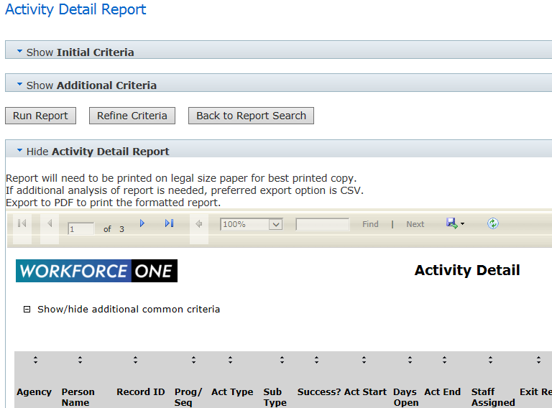
Getting the report into your computer
To export the report and save the data to your computer
1. Click on the floppy disk icon
2. Select the format you want saved
(CSV recommended)

Slide 18
Using the report to alert your staff
When you export to your computer you will see it is a spreadsheet
Save the report to your computer
Click on the triangle between “1” and “A” in the far-left corner of your spreadsheet.
This will highlight your entire spreadsheet
Click on “Data” within the top menu bar
Select “Remove Duplicates” within the top menu
Make sure the only box checked is the box for “Record_ID”
Click “OK”
You now have the unique case IDs needing staff attention

Slide 19
Required WF1 Data Entry
For the PY20 Grant Closeouts

Slide 20
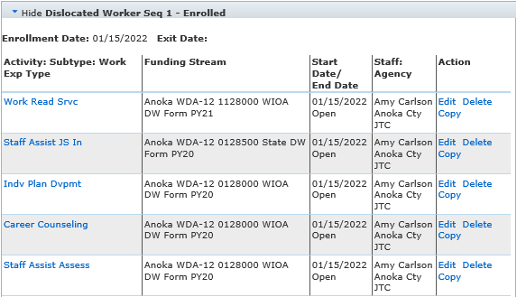
Staff need to find the services supported by the PY20 grants within each WF1 Case Record
PY21 State DW
PY20 State DW
PY20 WIOA DW
PY20 WIOA DW
PY20 WIOA DW
PY20 funding ends = 06/30/2022

Slide 21
Data Entry for Services CONTINUING under a New Funding Source
If the participant WILL continue receiving this service,
Click “COPY” in the “Action” column of the activity line currently supported by
PY20 funds.
(Each activity needs to be copied individually)
Click “Copy”
Click “Copy”
Click “Copy”

Slide 22
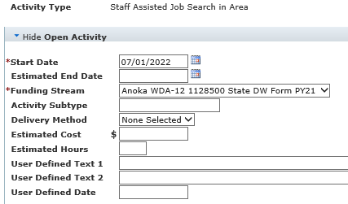
Data Entry for Services CONTINUING under a New Funding Source (Continued)
When copying an activity
1. Enter the date the new funding source will begin supporting the service (07/01/2022)
2. Select the new funding source supporting the service
(The PY21 or PY22 grant)
Read through the copied information as you scroll to the bottom of the Screen.
Make updates as needed.
3. Click “Save”
Step 1
Step 2
Step 3
Repeat this process for each continuing activity/service currently supported by an expired/expiring grant

Slide 23
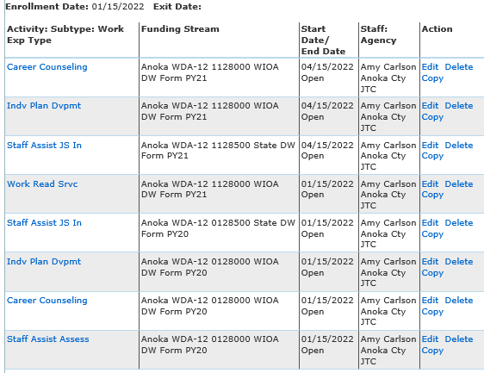
The end result after performing this required data entry
NEW or NO UPDATE NEEDED (in blue)
All continuing services previously supported by an expiring/expired grant are copied into new activities with the grant that will financially support that service moving forward
PY20 ACTIVITIES STILL OPEN
(in pink)
SEE NEXT SLIDE
NEW
NEW
NEW
No Updated Needed
Service not Continuing
Expired Grant
Expired Grant
Expired Grant

Slide 24
How to handle the old activities and the activities no longer continuing
Amy Carlson will mass close all open activities
Nothing further needs to be done at this time
Between the dates of August 1 – August 15 all activities with PY20 funding streams supporting them will be mass closed
Activity Completion Statuses will be “Successful”
Activity End Dates will be 06/30/2022
Program providers can choose to close these activities in WF1 themselves if they choose to do so.
What if the required data entry was not completed?
See Next slide

Slide 25
What if Required Data Entry was not completed?
If the required data entry was not completed, Amy Carlson will not be able to mass close PY20 open activities for all cases not completed
If there are only activities on a case with expired funding streams at the time of the mass closure, those cases will not be closed out of the PY20 grant
Amy will provide a list of all cases needing corrections made to local area management teams
This alert will provide instructions on how to correct each case that was not included in the mass closure
Copying old activities as well as closing old activities will need to be perform by the program provider

Slide 26
Most Common Reason #2
A Program Year Allocation is spent out before its expiration date
This means the money your location received at the beginning of a program year was fully spent out (expended) before the two-year timeframe
Since there is no money left in that funding stream, you will need to close all activities showing that funding stream as its funding source
If those participants will continue receiving any of those services, you will need to open new activities showing the funding source taking over payments for those continued services
(See next slide for more information)

Slide 27
Requesting Amy’s Assistance for Most Common Reason #2
After the program provider’s management team has inspected each case to ensure all continuing activities have been copied into a new activity and an active grant was selected within it
Email amy.carlson@state.mn.us requesting a mass grant closeout
Provide the grant name being closed
Provide the date the grant was no longer available/spent out
Allow a 2-week notice to complete the requested mass closeout

Slide 28
Other Important
Information to know/Exceptions related to the grant closeouts in WF1

Slide 29
Pending Exit Type Activities During a grant closeout
“Employed, Pending Exit” and “Pending Exit, Other”
When these activities are used, it means
The participant is no longer receiving any services (no other activities should be open the case)
The case manager is simply waiting the 90-day period before the case will be exited retroactively to the last date of service
The end date of this activity and the exit date will be during the grant period timeframe
DO NOT COPY THESE ACTIVITIES (If the participant returns for additional services, contact Amy Carlson for assistance)

Slide 30
Training services fully funded by the expiring grant but still attending
Take note of all participants who have Pre-paid Training
Confirm the participant’s training was fully funded by the expiring grant and no further training expenses will be applied for that training
Confirm the participant will still be attending the fully-paid training after the grant expires
Follow the required data entry for all other activities on the case (Do not copy the training activity)
Make a list of all participants in this situation because they will automatically be included in the mass closure
After the mass closure takes place, reopen these training activities by editing them and removing the end date

Slide 31
DISLOCATED WORKER AND ITS CONNECTION WITH TAA SERVICES
TAA activities are NOT associated with Dislocated Worker funding. This means TAA does not need to be alerted to DW activities closing due to DW funding nor does TAA need to perform any data entry on their end when this occurs.
TAA Specialists DO NOT have the ability to capture credentials in WF1:
If your dislocated worker has a training activity on their case with any funding source you are responsible for capturing the credential within 365 days of the participant’s DW program exit date
TAA Specialists DO NOT have the ability to capture Measurable Skill Gains:
If your dislocated worker has a training activity on their case with any funding source you are responsible for capturing the MSG

Slide 32
Other Reminders
Performance Indicators and Cohorts

Slide 33
What are you “Enrolling” in?
WHEN COMPLETING THE ENROLLMENT SCREEN IN WF1
You are ONLY
Enrolling the participant into a PROGRAM
You are NOT
Enrolling the participant into any specific grant
“Enrolling” into a grant means an activity or support service in WF1 has that grant selected in it

Slide 34
REMINDER
If a participant will continue receiving a service financially supported by a grant that is no longer available
DO NOT EXIT THEM
The only time a participant EXITS the program is after that participant has not received a service for 90 days
(The exit date is retroactive back to the last date of service)

Slide 35
REMINDER
If a participant was scheduled to begin training but before any training costs were applied the participant decided not to attend training
DO NOT SIMPLY CLOSE THE TRAINING ACTIVITY, DELETE IT!
If there is a training activity on record, reports will look for a captured credential
If there is not a credential captured, it will result in a a negative in the Credential Attainment Rate

Slide 36
Performance Indicators
Performance Measure | Numerator | Denominator is | Activity in WF1 that triggers performance
2nd Quarter Employment | Has at least $1 in Wage Detail in the 2nd quarter after Exiting or has Supplemental Wage Information entered into the Follow-up tab of WF1 for the 2nd quarter after exiting | All Exiters during reporting period except those exited with exclusion | Any WF1 Activities
4th Quarter Employment | Has at least $1 in Wage Detail in the 4th quarter after Exiting or has Supplemental Wage Information entered into the Follow-up tab of WF1 for the 4th quarter after exiting | All Exiters during reporting period except those exited with exclusion | Any WF1 Activities

Slide 37
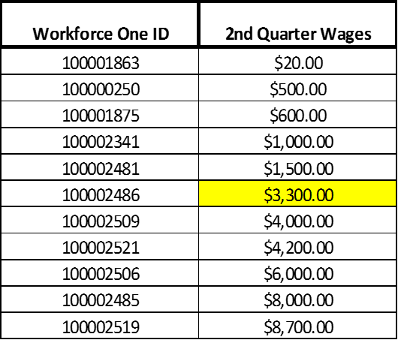
Performance Indicators (Continued)
Performance Measure | Calculation | Included | Activity in WF1 that triggers performance
Median Earnings | See Below | Total quarter wages for each participant showing wages in the 2nd quarter after exiting except for those exited with exclusion | Any WF1 Activities

Slide 38
Performance Indicators (Continued)
Performance Measure | Numerator | Denominator | Activity in WF1 that triggers performance
Credential Attainment (Post-Secondary) | Credential was captured in WF1, Attainment date was during enrollment or within 1-year of exit, AND the type of credential attained is recognized | Date of exit is within reporting period AND was enrolled in "Post-Secondary" except those exited with exclusion | Apprenticeship, Classroom Training, Credential Attained without Training, Entrepreneurial Training, and GED training (if the GED student exits to employment), Occupational Skills Training, Prerequisite Training, Remedial Training, TAA Apprenticeship

Slide 39
Performance Indicators (Continued)
Performance Measure | Numerator | Denominator | Activity in WF1 that triggers performance
Measurable Skills Gain | Documented increase of functioning level, transcript, report card, milestone, or skills progression during reporting period | All participants enrolled in training leading to a recognized postsecondary credential or employment except those exited with exclusion. It encompasses all WIOA training, OJT, Apprenticeship, and Customized Training | Apprenticeship, Classroom Training, Credential Attained without Training, Customized Training, Entrepreneurial Training, GED Training, Incumbent Worker Training, Incumbent Worker Credential Waiver, Occupational Skills Training, OJT, OJT - Public or Private, Prerequisite Training, Remedial Training, TAA Apprentice

Slide 40
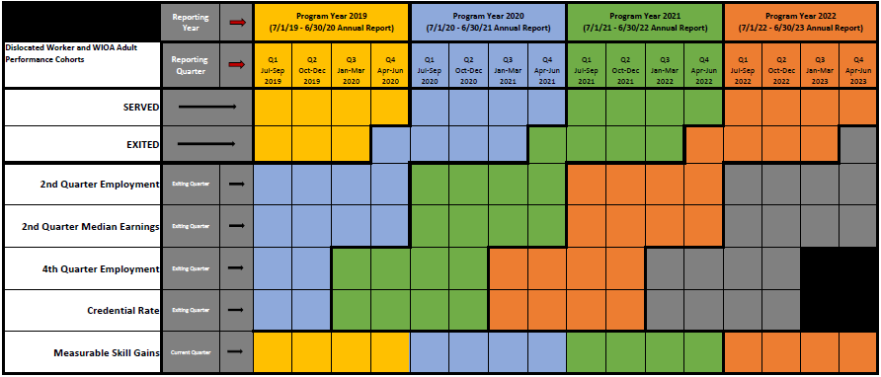
PY19, PY20, PY21, & PY22 Cohorts
See next couple of slides for directions on how to use this chart

Slide 41
Performance
Questions?
Amy Carlson
State Program Administrator Coordinator
Office of Adult, Dislocated, and Trade Impacted Worker Services
amy.carlson@state.mn.us

