Slide 1
Minnesota’s Eligible Training Provider List (ETPL)
February 2021

Slide 2
Introduction
The Eligible Training Provider List (ETPL) has two components:
the Career and Education Explorer, the public-facing website which will be able to be accessed and searched by the general public, and
the Training Provider Portal, which is a secure website for training providers to add and edit information about their trainings.
Notes:
Training Provider Portal:
https://apps.deed.state.mn.us/lmi/Etpl/
CEE Education Search:
https://apps.deed.state.mn.us/lmi/cpt/EducationSearch

Slide 3
Introduction (cont.)
Under federal WIOA law, all states are required to maintain a list of eligible training providers. In Minnesota, the Department of Employment and Economic Development (DEED) administers this list.
The ETPL is required for WIOA Title I (Adult, Dislocated Worker and Youth) program.
Notes:
All states are required under the federal Workforce Innovation and Opportunity Act (WIOA) to maintain a list of institutions, programs and courses known as the Eligible Training Providers List (ETPL). This list ensures that Minnesotans and customers in WIOA programs (i.e., Adult, Dislocated Worker or Youth) can find quality training programs that provide credentials upon completion.
(WIOA Section 122)

Slide 4
Who’s on the ETPL?
Check out the Career and Education Explorer data tool for a current list of institutions:
mn.gov/deed/careers

Slide 5
What’s on the ETPL?
Program customers can find course and program information, including:
A description of the training
Length of training
Credits or contact hours needed for completion
Tuition and fees
Award or credential issued after completion of training
WIOA certification or non-credentialed training designation for each program
In Planning Stages: Increased performance information about courses and programs

Slide 6
How a School Becomes an Eligible Training Provider
Step 1: Training Provider must meet and submit initial eligibility criteria
Step 2: Training Provider creates user profile in ETPL Provider Portal
PAUSE: ETPL Administration activates user account
Step 3: Training Provider provides information about programs and courses
PAUSE: ETPL Administration approves each training listed on the ETPL
Step 4: Training Provider must continue to meet eligibility requirements
Notes:
These steps are also clarified in the ETPL Provider Portal Handbook. A link to this resource can be found through DEED’s ETPL Policy under Resources. Link: https://apps.deed.state.mn.us/ddp/PolicyDetail.aspx?pol=565

Slide 7
Step 1: Training Provider must submit initial eligibility criteria
No training provider is required to be listed on the ETPL. It is completely voluntary.
In Minnesota, a training provider must meet two requirements to be listed:
Have a public, physical location in Minnesota
The institution must be licensed, registered, or legally exempted by the Minnesota Office of Higher Education (OHE), with a few exceptions based on specific occupations.
Examples of training organization that OHE does not regulate include CDL/truck driving, flight school some medical training, and state or national registered apprenticeship programs.
State- or federally-approved registered apprenticeship programs (RAPs) are automatically eligible to join the ETPL. However, RAPs opt-in to being listed.
Notes:
Note on defining ‘physical location’ – some training providers may be headquartered outside of MN. If the training is a physical convening of people based in MN, then the provider may be considered to have a physical location in MN and may list trainings based in MN.
Note about third party providers and their status with OHE. If two trainers share a physical space, each trainer must have their own programs be licensed, registered, or legally exempted with OHE. For example, if ABCTrainer conducts trainings physically located at Quniversity, Quniversity is not responsible for ensuring the quality of the trainings provided by ABCTrainer. ABCTrainer needs to take the same steps with OHE independently of Quniversity to be listed on the ETPL.
(eligibility requirements from WIOA section 122)

Slide 8
Step 1 (detour) What does OHE do?
OHE leads the process to license, register, or temporarily exempt (from licensure) trainings offered by institutions in Minnesota, with a few exceptions based on specific occupations.
This licensure and exemption process has a purpose; it ensures that the public is Minnesota is protected if a training provider closes.
This process of licensure or exemption can be a lengthy process.
Notes:
The ETPL administrator can help a training provider connect to the right people at the Office of Higher Education.
Registered schools: http://www.ohe.state.mn.us/sPages/PIRInsts.cfm
Licensed: http://www.ohe.state.mn.us/sPages/141Insts.cfm
There is no list of exempt institutions. Why? Exemption is only valid for 2-years and status could change daily.
For state dislocated worker, OHE recognizes schools’ programs that are registered in other states and participate in the State Authorization Reciprocity Agreement (SARA); https://www.nc-sara.org/directory. Again, counselors need PROGRAM LEVEL DOCUMENTATION.

Slide 9
Review: If the training provider is on Minnesota’s ETPL…
It is licensed, registered or exempt with the Office of Higher Education.
It has been vetted with the appropriate state agency who regulates that occupational training.
It is a state or national registered apprenticeship program.
NOTE: If using WIOA Title I training funds, the program must be listed on the ETPL. Just seeing the training institution on the ETPL is not enough.

Slide 10
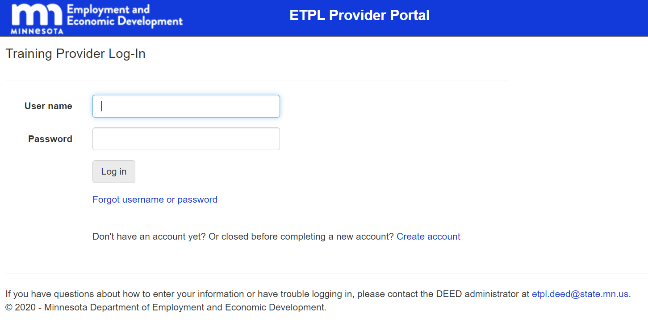
Step 2: Training Provider representative creates user profile
Each school needs a contact.
Institutions must sign up for an account through the ETPL Provider Portal.
https://apps.deed.state.mn.us/lmi/Etpl/

Slide 11
Step 3: Training Provider submits training information
Approved Users in the ETPL Provider Portal submit program and course information
Approval happens at the level of programs and courses
Not all trainings offered by a training provider may be eligible
Notes:
Trainings provided by third party training providers are not allowed on the ETPL.

Slide 12
WIOA-certification & non-credentialed training flags
The ETPL includes courses, programs and registered apprenticeships, which may or may not have a “WIOA-certification” or “Non-credential” training designation.
WIOA certification = credentialled training
Training institutions must request that a program be considered for WIOA certification.
If a training does not end in an industry-recognized credential but is occupation specific, DEED issues it a “Non-credentialed training” designation.
Notes:
If a training does not end an industry-recognized credential but is occupation specific, DEED issues it a “Non-credentialed training” designation.
This is (largely) a signal to the employment counselor for how they must enter this training activity in our case management system. Providers cannot claim a credential on these trainings.
For example – a preparation course that does not include the exam for the credential would be noncredentialled training. Career counselor enters in WF1: noncredentialled training for the training. If client pursues the exam independent of the training, counselor enters credential without training.
State Dislocated Worker program or WIOA Title I training dollars can pay for BOTH WIOA-certified and non-credentialed training, however only WIOA-certified programs can be entered in WF1 as credentialed training activities and accumulate towards credential attainment performance measure.
Credentialled training aligns with the federal definition of a credential (e.g. TEN 25-19, Attachment 1)

Slide 13
Another note about WIOA-certification
“WIOA-certification” is largely a term only used in Minnesota.
We do not WIOA-certify training institutions. Only courses, programs, and registered apprenticeships can be WIOA-certified if they result in an industry-recognized credential.
DEED administers WIOA Title I funds to 16 Local Workforce Development Area (LWDA) Boards. They may have their own policies, which can include only funding training programs that are WIOA-certified.
If you are a counselor, please check your local policies.
Notes:
WIOA-certification helps employment counselors record their training correctly in our case management system.

Slide 14
Step 4: Continuing Eligibility
ETPL participation is not permanent
DEED’s Program Monitoring team strongly recommends that counselors print the ETPL page showing the program and whether it’s WIOA certified or non—credentialed and place print out in file

Slide 15
Step 4: Continuing Eligibility
Maintain initial eligibility criteria
Location in Minnesota
Appropriate approval from state agency (e.g. exemption renewal)
Updates to training listings on the ETPL – required every 24 months
Performance reporting
Minnesota utilizes SLEDS to decrease reporting burden
States are required to utilize performance criteria in evaluating continuing eligibility. ETPL Administration is revising appropriate measures.
Notes:
1. DEED removes training institutions that close, have their licensure statue from OHE revoked, or fail to provide the required course/program data from the ETPL.
2. All training institutions need to update their course and program listings biennially (every two years) or face removal from the ETPL.
3. For Performance Reporting
Required data for states outlined in TEGL 3-18
4. Performance:
Match OHE for active license and exemption renewal
Revisions include:
changes from federal guidance, ETP Team leadership, OHE Licensing and Registration team, SLEDS research team, training providers, committee/board members
Equal training completion rates between WIOA and non-WIOA participants?
Training must focus on in-demand careers? (e.g. LMI data, top 500 in-demand SOC codes?) – concern about limiting the list by industry sector

Slide 16
VALIDATION and DOCUMENTATION

Slide 17
Recap: Using WIOA Dislocated Worker and Adult funds
If a program/course IS NOT on the ETPL, WIOA training funds cannot be used to pay for the training.
If a program/course is on the ETPL then WIOA training funds can be used. However,
IF the training is WIOA-certified, then it would be considered credential training.
IF the training is Non-Credentialed training, then it would be considered non-credentialed training.
IF the training is neither, then WIOA training funds cannot be used. Other support or career service funds could fund this training.
Minnesota observes ETPL reciprocity with other states, so WIOA training funds could be used with an out-of-state training institution if the program/course in question is on another state’s ETPL. Validation is required in the counselor’s case file.
Notes:
The ETPL is updated daily, and often by user feedback! If you are a counselor and have found a program that is not currently on the ETPL, but seems like a good fit, reach out to us at etpl.deed@state.mn.us and we will see if we can add the program to the list.

Slide 18
Reciprocity
Minnesota observes reciprocity with other state ETPLs.
This means that if a training program is not offered in Minnesota, but is on another state’s ETPL, you can connect your customer to that training.
Please print out web page that lists the training institution and the training program on other state’s ETPL.
In WF1, you’ll need to select “School Not in Minnesota” drop-down option.
In the WIOA Certification Status field within that same activity you will select “Certified Outside of MN”.
Notes:
Reciprocity typically applies for neighboring states. Reciprocity is also specific to each program, not the school or institution.
If a national training provider offers a physical training in multiple states, the training provider needs to be licensed, registered, or exempt in the state where the training is being held. For example, if XYZ class is offered by ABC trainer in Wyoming and is on Wyoming’s ETPL, and ABC trainer offers XYZ class in Minnesota, reciprocity does not apply for the Minnesota training.

Slide 19
Recap: Using State Dislocated Worker funds
If using State Dislocated Worker funds, the training institution does not need to be listed on the ETPL, however the training does need to meet the eligibility criteria.
The training institution DOES need to be registered, licensed, or exempt by OHE:
You can find lists of registered training institutions and licensed career schools on OHE’s website. And out-of-state institutions recognized by OHE on SARA.
There is not an online list of exemptions, as exemption letters issued by OHE expire two years after issuance.
Proof of registered (print out from OHE website or SARA), licensed (print out from OHE website), or exemption status is required in the case file.

Slide 20
How DEED works with the Minnesota State System
DEED receives bulk uploads from the Minnesota State Colleges and Universities monthly.
The bulk upload is for-credit program offerings.
The MinnState requests WIOA-certification for all for-credit programs.
Non-credit training updates are manual and decentralized. Each campus may designate someone on the non-credit side to have access to the Training Provider Portal to add/update and request WIOA-certification for non-credit courses.
Third party training providers are not allowed on the ETPL.

Slide 21
How DEED Works with University of Minnesota
Currently all University of Minnesota offerings are manual.
DEED is planning with the University of Minnesota’s Office of Institutional Research to establish a bulk uploads process for their for-credit programs.

Slide 22
COMMON QUESTIONS

Slide 23
Common questions we get from counselors
What about certification/credentialing tests?
Tests are not training and won’t be on the ETPL. Organizations that provide training AND access to a test for certification/credential may be listed on the ETPL.
Can I use this training provider?
For State Dislocated Worker: yes, if they are registered, licensed or exemption with OHE or on another state’s ETPL or listed on SARA (for State Dislocated Worker). For WIOA Title I: yes, if the program is on the ETPL in Minnesota or another state.
Can you connect with this training provider and get them through the OHE process or join the ETPL?
Sure, but we can’t make them. (Email preferred. With COVID and telework, ETPL Administration currently does not have a work phone.)
Can I get a printed copy of the ETPL?
No, it changes daily.
Notes:
SARA = State Authorization Reciprocity Agreement

Slide 24
Questions we get from participants
I’m a Dislocated Worker participant; and I want this training. Can you help?
Sure, I’ll try. And I’ll be reaching out to your employment counselor to let them know that we’ve spoken.
I heard that I can get WIOA money for fund my training; how do I do that?
Let me connect you to your local CareerForce location. They can help determine if you are eligible for WIOA or another workforce training program that might help funding training.

Slide 25
What we tell training providers
All workforce training programs with training are eligibility-based.
This means there are enrollment requirements a customer must meet.
WIOA program participants work with their employment counselors to set an employment plan, which may include training to help them reach their goal.
It’s very important that the employment counselor drives the relationship with the client.
WIOA Title I mandates that customers are provided with training options (like the ETPL) to make an informed choice.

Slide 26
Thank you!
ETPL Administrator
etpl.deed@state.mn.us

