Slide 1

Revenue estimates and economic Outlook
March 10, 2022
David Farkas
Acting Executive Secretary
Board of Revenue Estimates

Slide 2
Notes:
Mention ARPA Reducing FY22
Expanded EIC for TY21
Epanded Child & Dependent Care Credit for TY21
Mention Corporate profits surge in FY21 – slower in FY22 and FY23 as corps provide pay raises
Mention assume that federal budget is resolved today and that the Debt Ceiling is raised with no significant fallout
Mention no assumption about prospective federal tax changes which could have impacts on flow through as well as income realization

Slide 3
Summary of December Changes
 |  | Fiscal Year 2022 |  |  | Fiscal Year 2023
 |  | $ Change From Est | % Growth From Prior Year |  | $ Change From Est | % Growth From Prior Year
Personal Income Tax |  | $479 | 7.1% |  | $511 | 7.1%
Corporate Income Tax |  | $217 | 9.9% |  | $159 | 4.9%
Sales Tax |  | $142 | 13.3% |  | $64 | 2.7%
Other |  | $28 | 24.2% |  | $2 | -2.5%
Total Revenue |  | $867 | 7.8% |  | $737 | 4.8%
Notes: dollars in millions; amounts may not sum due to rounding
Notes:
Mention ARPA Reducing FY22
Expanded EIC for TY21
Expanded Child & Dependent Care Credit for TY21
Mention Corporate profits surge in FY21 – slower in FY22 and FY23 as corps provide pay raises
Mention assume that federal budget is resolved today and that the Debt Ceiling is raised with no significant fallout
Mention no assumption about prospective federal tax changes which could have impacts on flow through as well as income realization

Slide 4
Summary of December Changes
Growth by Tax Type |  | PIT | CIT | SUT
FY22 Growth Forecast |  | 7.1% | 9.9% | 13.3%
Fiscal YTD Growth |  | 11.3% | 43.9% | 26.3%
Growth needed rest of year to hit estimates
 | March | 1.9% | -15.1% | 1.1%
 | December | -7.2% | -40.9% | -4.5%

Slide 6
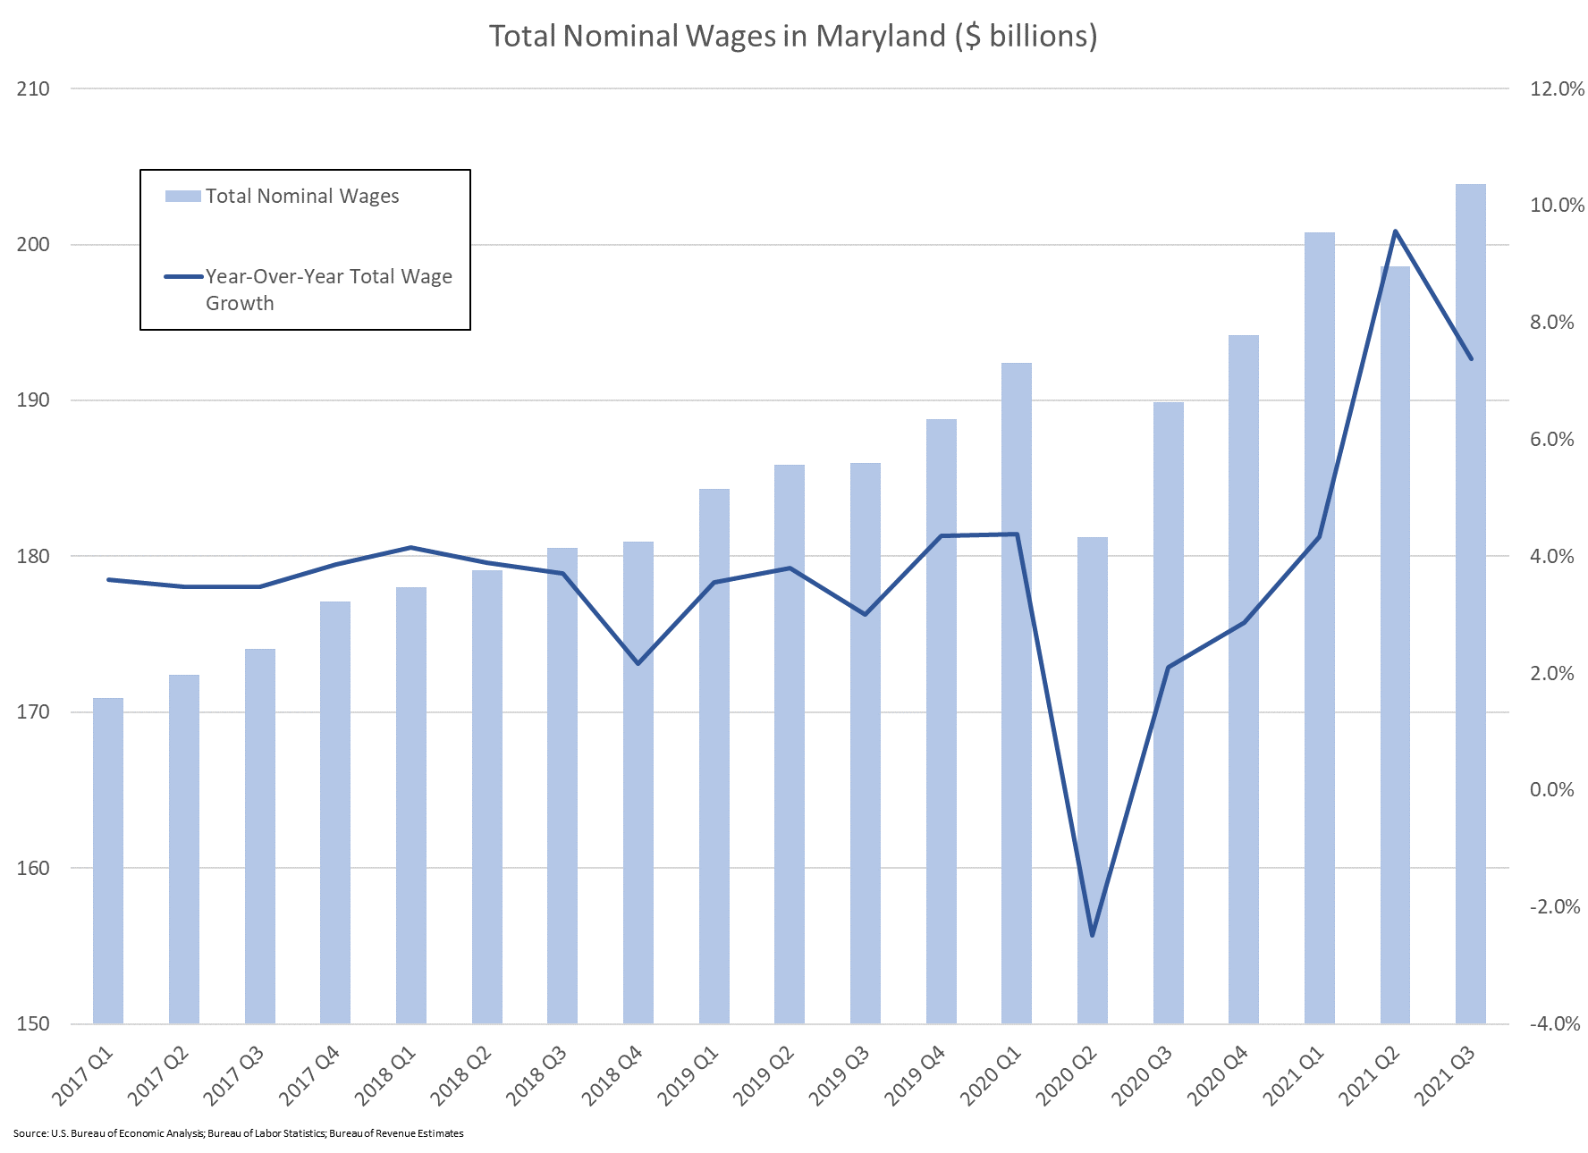
Notes:
Charts here: O:\Bureau\2021 Interim\Anne Arundel Co Chamber of Commerce\Wages Charts.xlsx
Data Pulled From: "O:\Board\FY 22\March\Macro Compare - Mar 21 v1.1.xlsx“
Make it just nominal wages and make it look like the chart on slide 12: bars for the level and a line for the rate of change

Slide 7
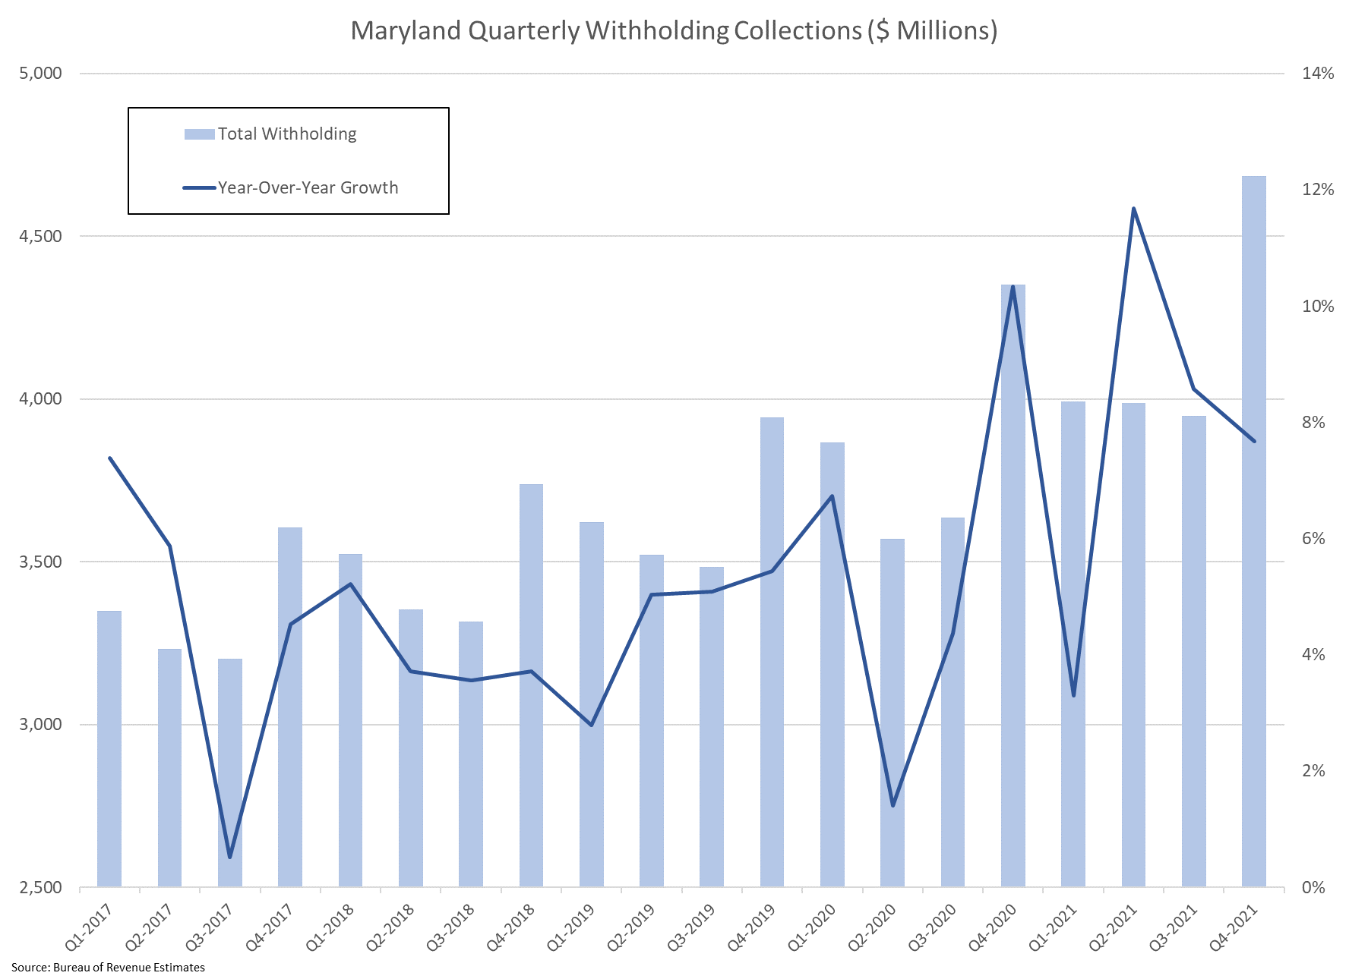
Notes:
Charts here: O:\Bureau\2021 Interim\Anne Arundel Co Chamber of Commerce\Wages Charts.xlsx
Data Pulled From: "O:\Board\FY 22\March\Macro Compare - Mar 21 v1.1.xlsx“

Slide 8
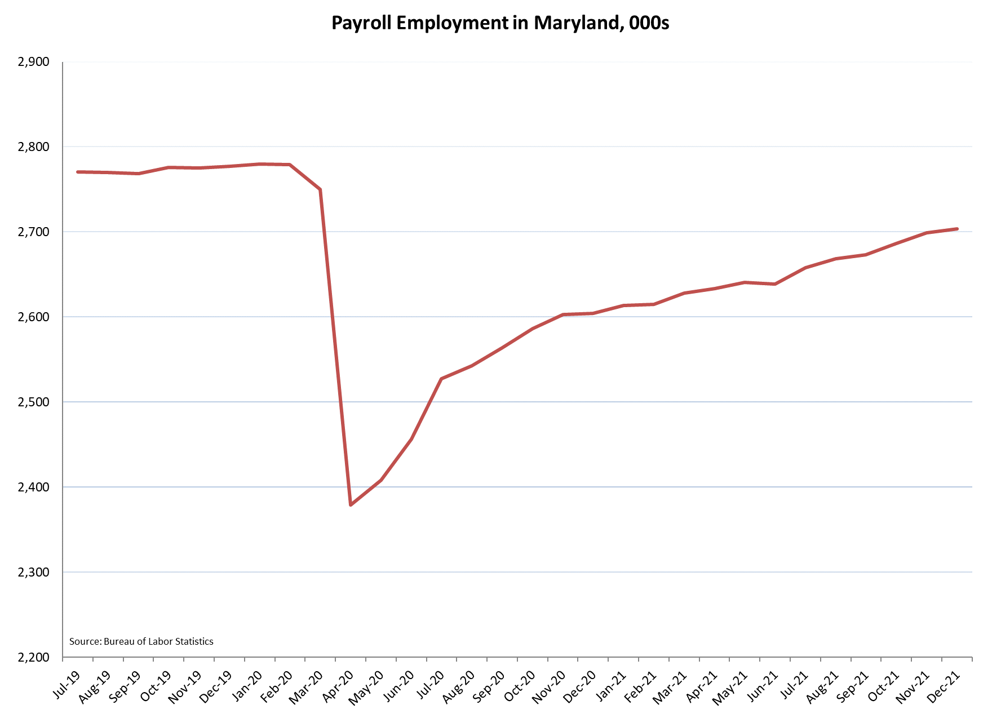
Notes:
O:\Bureau\Ongoing Economic Charts\Employment[Total Emp (3)]

Slide 9
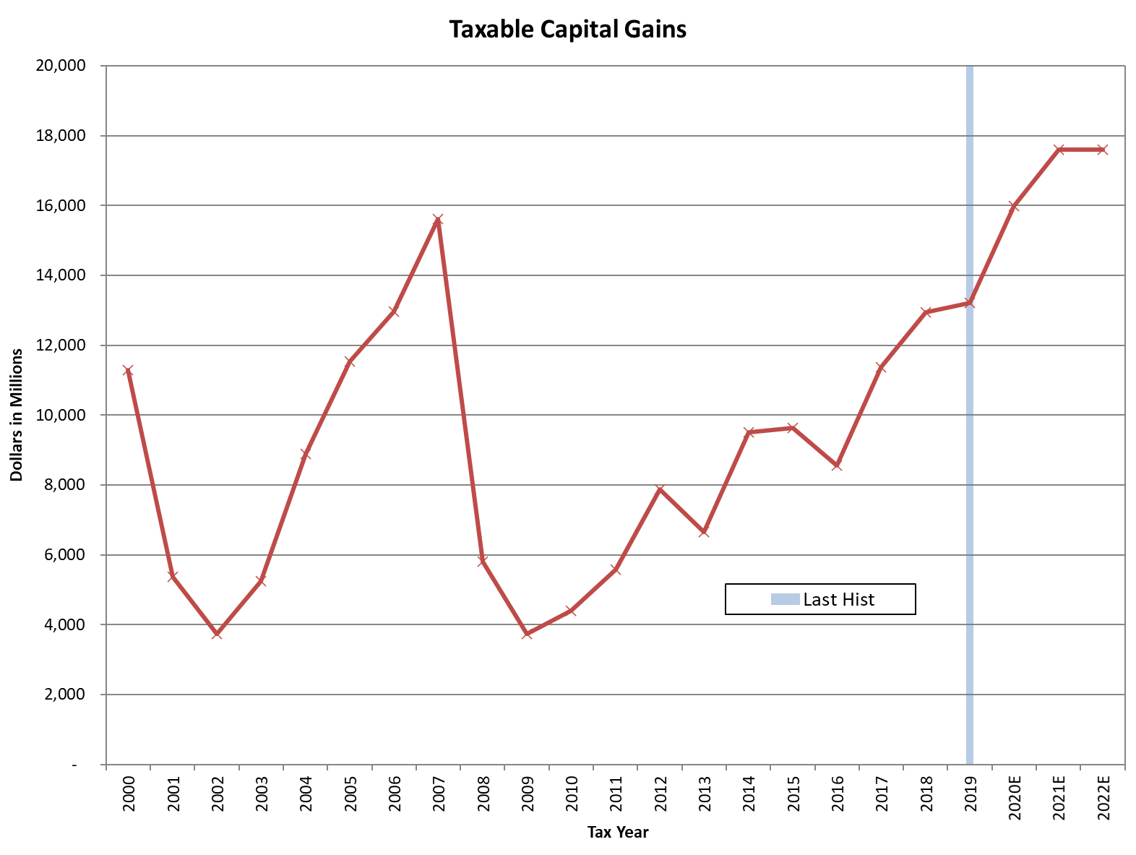
Notes:
Source: O:\Board\FY 22\March\PIT\Inc Tax - Mar22 - (V 3.0).xlsx --- Chart17 tab
***DO NOT UPDATE – MARCH PRESENTATION. Forecast is unchanged since December***

Slide 10
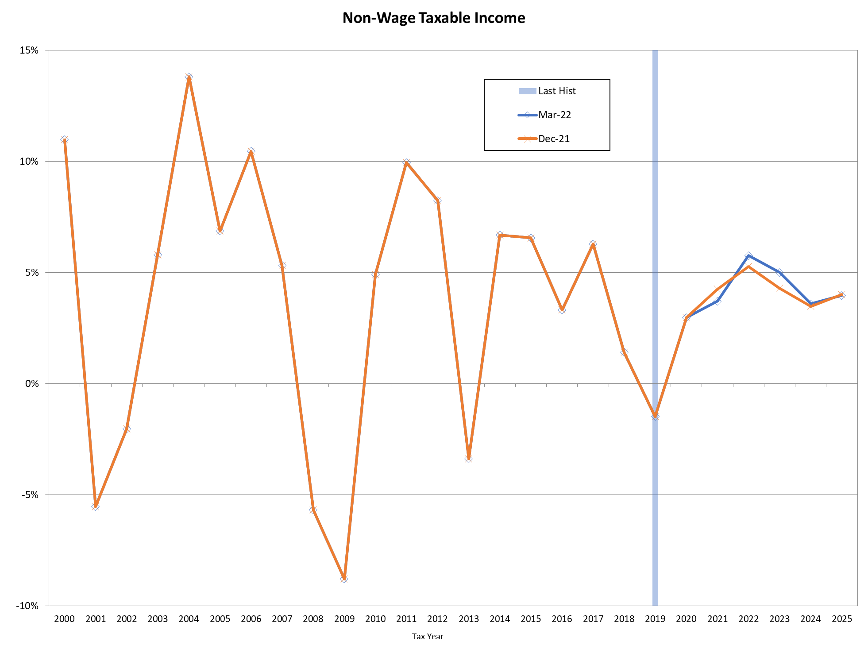

Slide 11
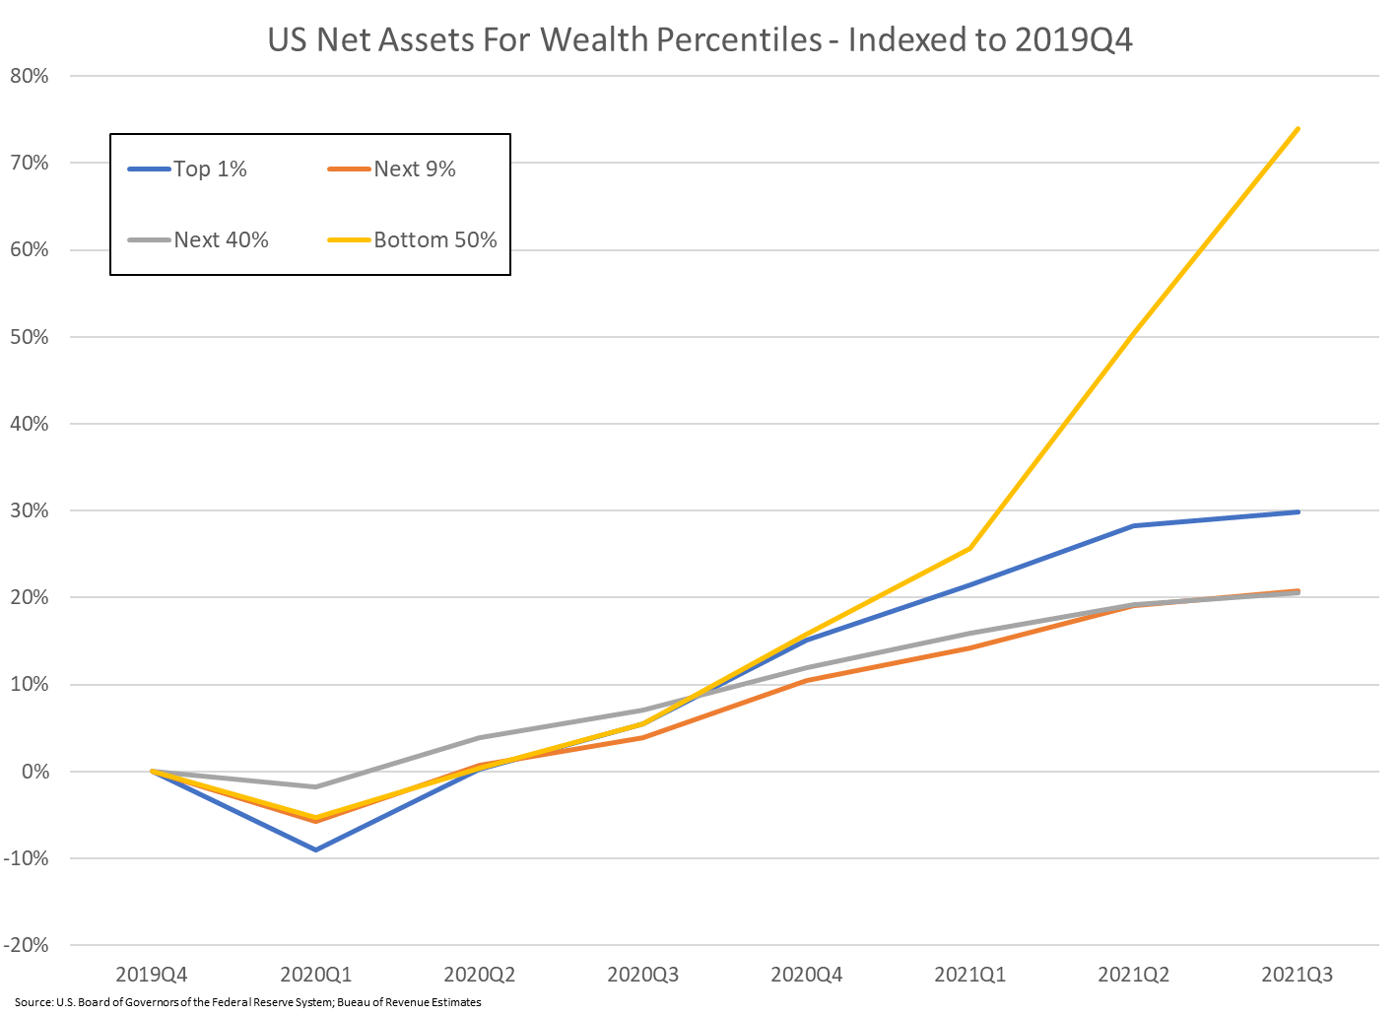
Notes:
O:\Bureau\2021 Interim\Chart Work\Household Finances - FRB 1.1.xlsx

Slide 12
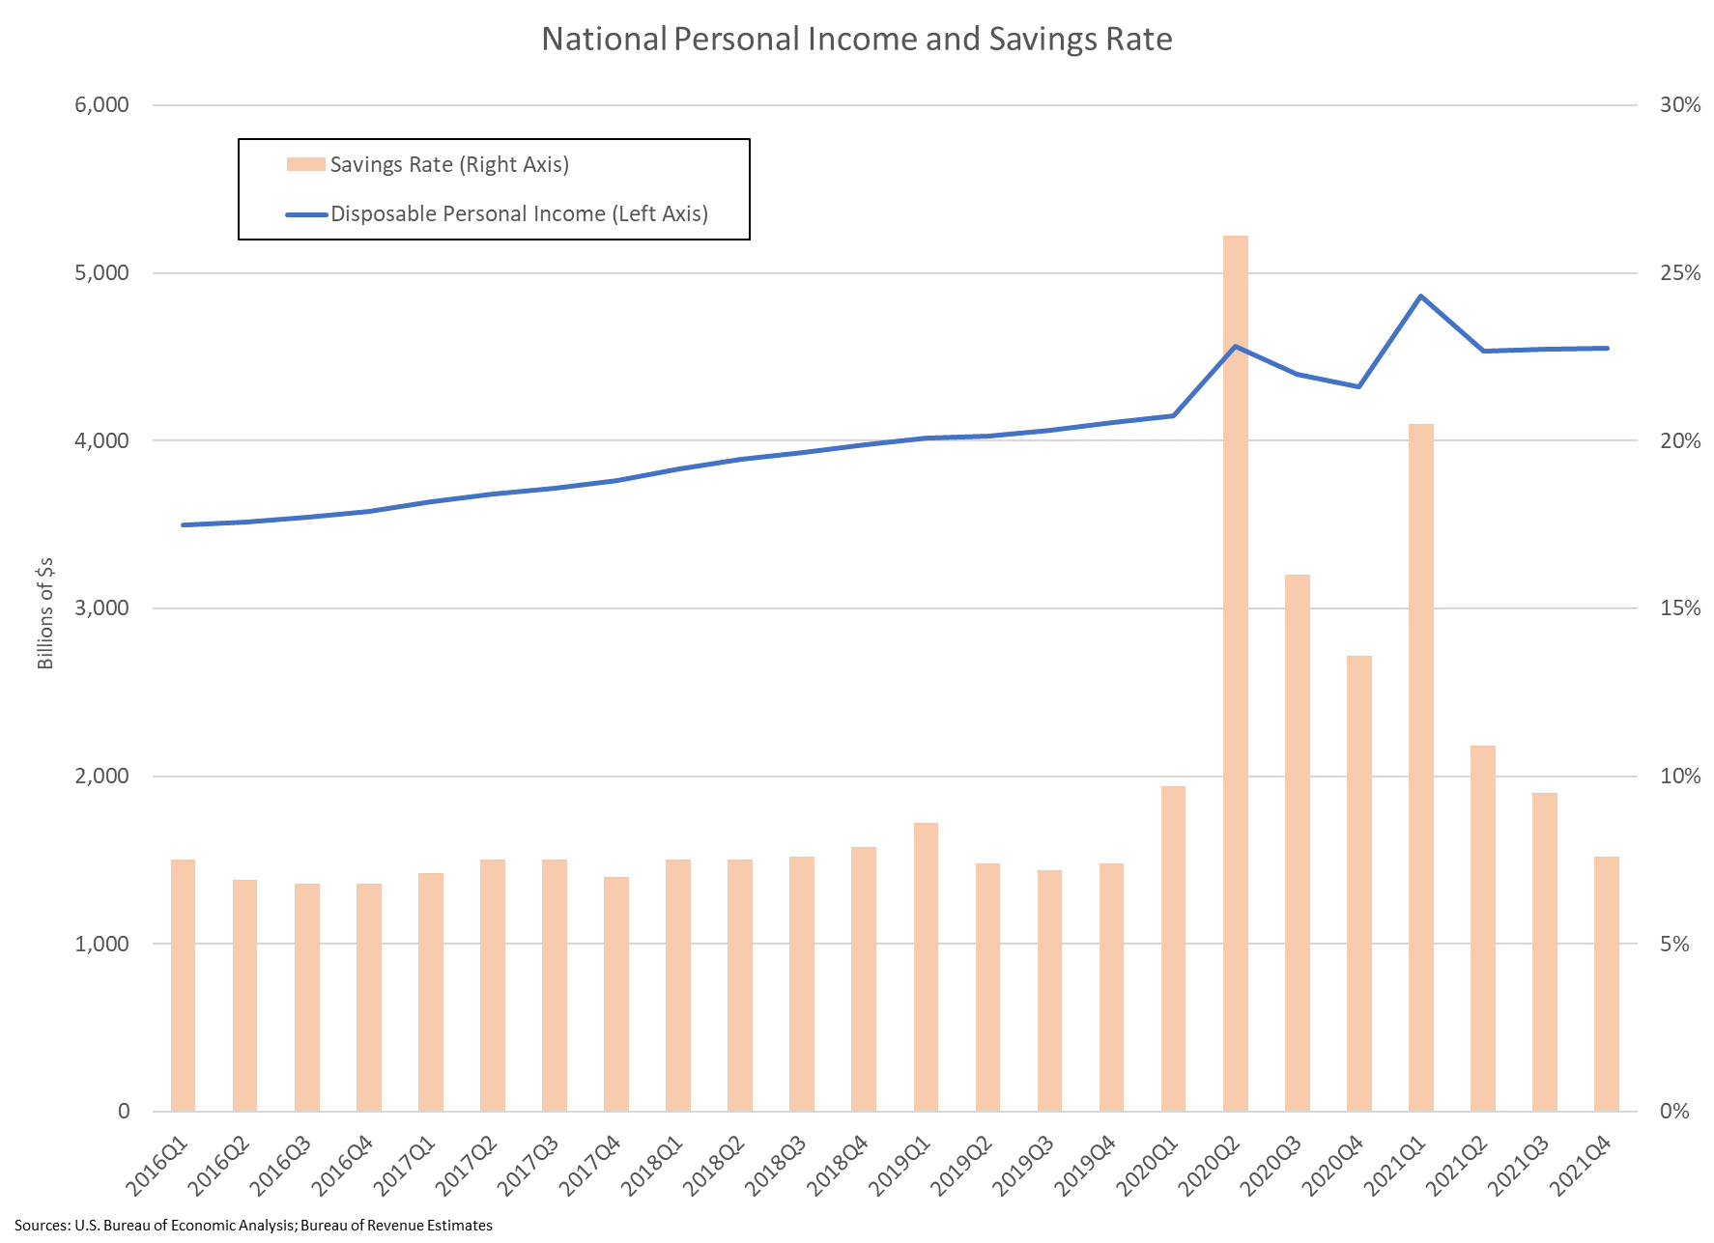
Notes:
Chart & Data: O:\Bureau\Ongoing Economic Charts\Personal Income & Savings Rate.xlsx

Slide 13
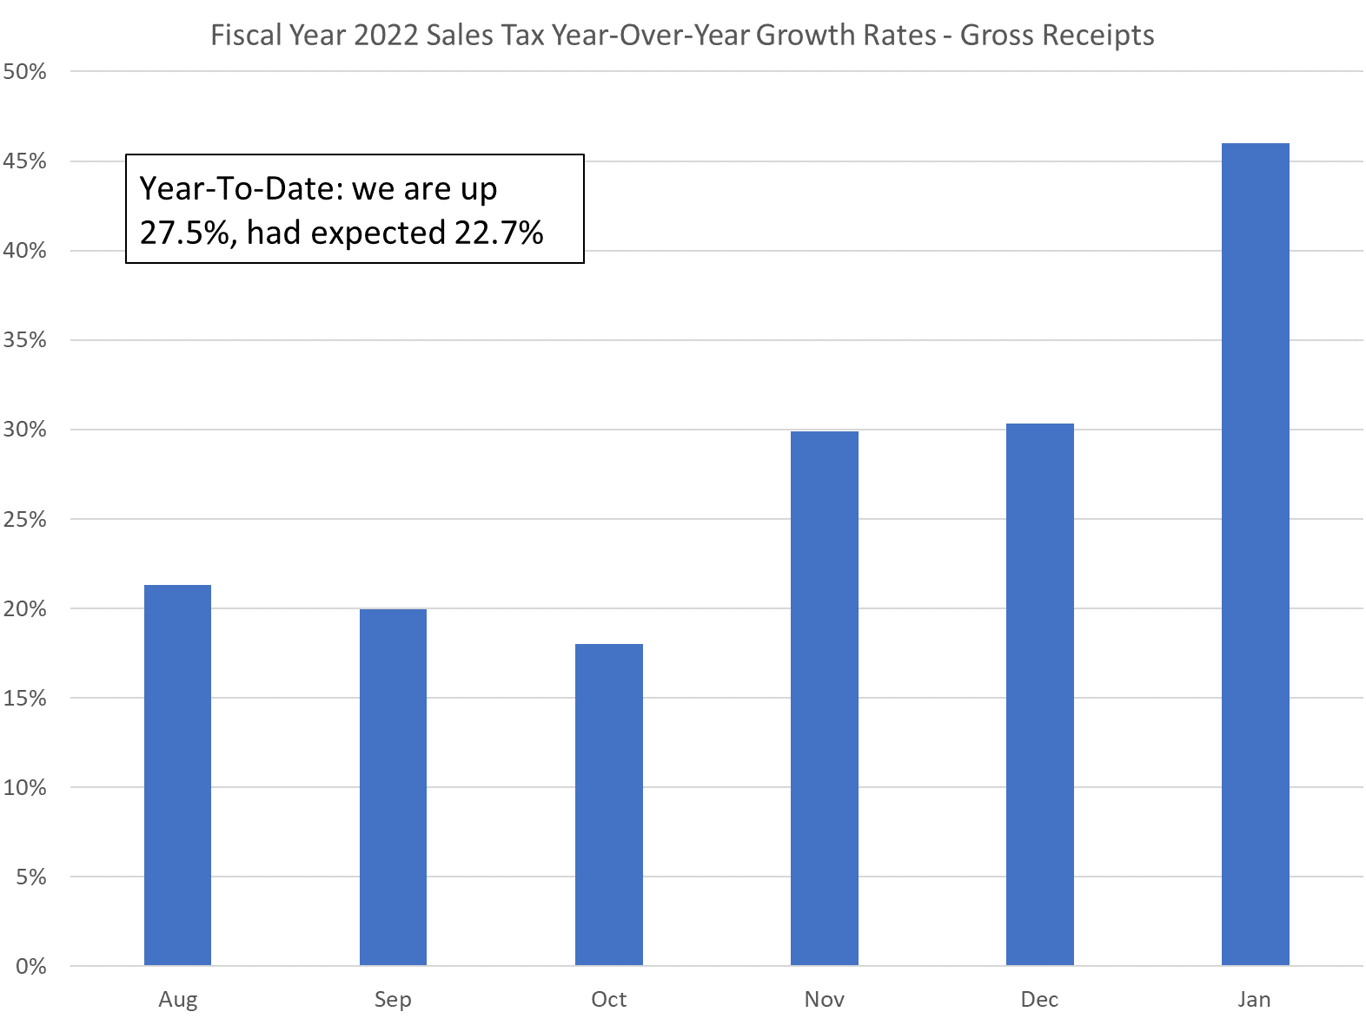
Notes:
Chart: O:\Board\FY 22\March\SUT - Gross Receipts YTD.xlsx
Sourced from various SUT tracking sheets

Slide 14
Risks
Covid
Geopolitics - war in Ukraine and retaliatory sanctions
  Higher gas prices
  Less spending on other goods
Loose Monetary Policy
  Monetary policy is too loose
    Transitory inflation of the Covid supply shock becoming persistent
    Risks a short-term inflationary boom followed by rapid tightening
      Short-term boost to nominal revenue growth
Capital Gains / non-wage income
  At high levels
  Declining asset prices means lower potential cap gains income
  But a sell-off can result in significant capital gains income realizations

Slide 15
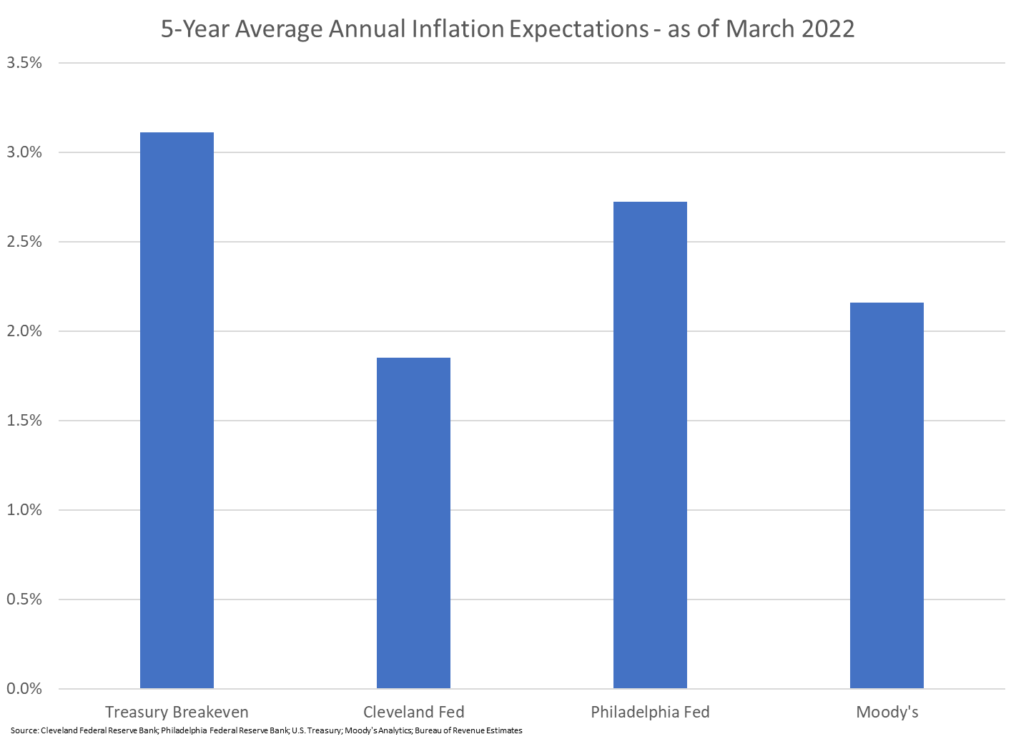
Notes:
O:\Bureau\Ongoing Economic Charts\Inflation Expectations.xlsx

Slide 16
In Summary
Most of the revenue adjustments are based on YTD revenue collections
  Some upward adjustment to both wage and non-wage income growth
Nonwage income is at very high levels
  Typically these peaks are not sustainable for extended periods of time
  The timing and size of a downturn is impossible to estimate
  Downturns are typically rapid, but so is the recovery
Ongoing inflation will boost nominal revenue collections
  And also nominal expenditures
Notes:
O:\Bureau\Ongoing Economic Charts\Inflation Expectations.xlsx

Slide 17
Thank You
David Farkas
Comptroller of Maryland
Acting Executive Secretary,
Board of Revenue Estimates
dfarkas@marylandtaxes.gov

