Slide 1

Economic Impact of pandemic relief programs in Maryland pandemic spending workgroup
MaY 2021
Andrew Schaufele
Chief
Bureau of Revenue Estimates

Slide 2
Notes:
Shows the evolotuoin of our forecast and the very positive impact that the fed and policy had on economy and revenues
As illustrated, we are now back to flat with Pre-Covid, yet the plan is still to spend another $350B on S&L governments

Slide 3
Monetary Policy – Federal Reserve
Interest Rate Target
  Significant and pre-emptive reduction in rate target
Quantitative Easing
  Larger than any single round during Great Recession
Forward Guidance
  Keep rate target low
  Inflation target is an average over time, not a ceiling
    Promise to make up for past misses
Lending programs

Slide 4
Major Covid-19 Relief Bills – Federal Fiscal Policy
Coronavirus Preparedness and Response Supplemental Appropriations Act (CPARSA):
  Passed – 03/06/2020
  $8.3 billion in for Covid-19 response and vaccine research.
    $3 billion for Covid-19 Vaccine R&D
Families First Coronavirus Response Act (FFCR) :
  Passed – 03/18/2020
  $104 billion in direct spending
    Expanded sick leave
    Free Covid-19 testing
    Economic support for states
Coronavirus Aid, Relief, and Economic Security Act (CARES):
  Passed – 03/27/2020
  $2.2 trillion in economic stimulus
    $1,200 stimulus checks
    Expanded UI benefits & eligibility
    PPP funding
Consolidated Appropriations Act of 2021 (CAA):
  Passed – 12/27/2020
  $900 billion in economic stimulus
    $600 stimulus checks
    Extending UI benefits & eligibility
    Second round of PPP funding
American Rescue Plan Act of 2021 (ARPA):
  Passed – 03/11/2021
  $1.9 trillion in economic relief
    $1,400 stimulus checks
    Extends expanded UI through September
    Extends previous relief programs
    Additional economic support for states
    Expanded Child & Dependent related tax credits

Slide 5
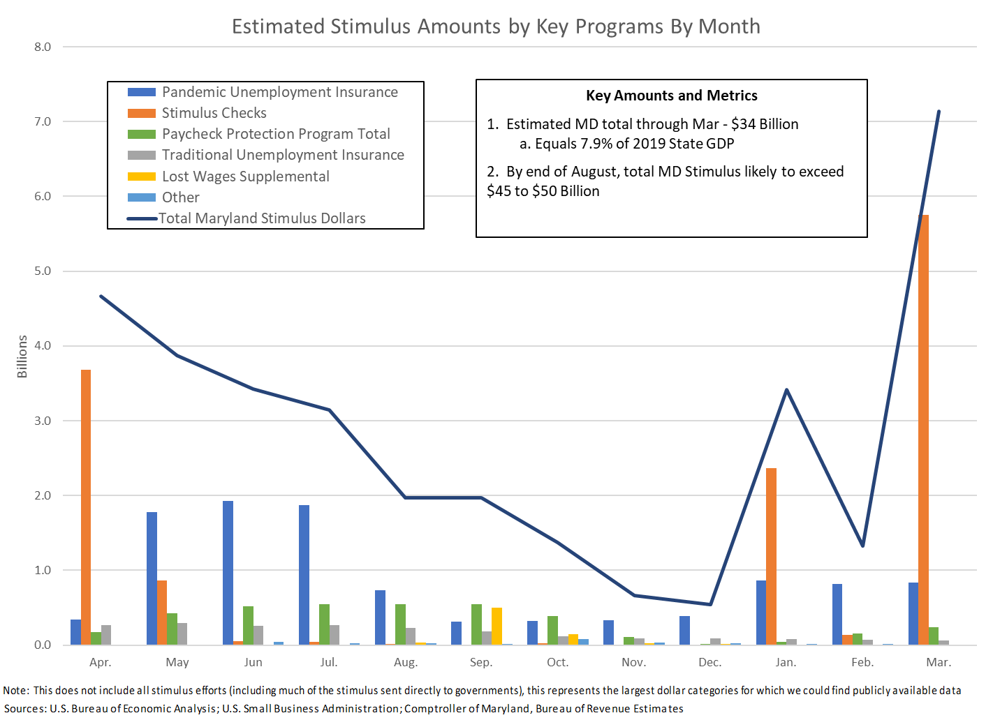
Notes:
-- Total UI = $12.8B
-- Total EIP = $13.0B
-- Total PPP = $3.7B – MD Companies received about $12B

Slide 6
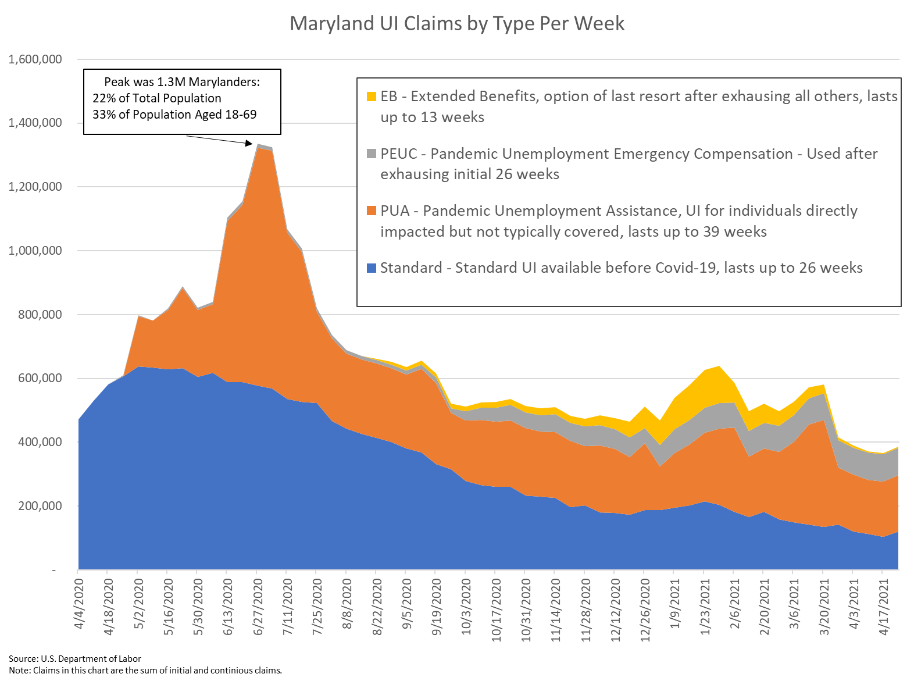
Unemployment Response Has Been Significant

Slide 7
Economic Impact Payments (Stimulus Checks) - Significant

Slide 8
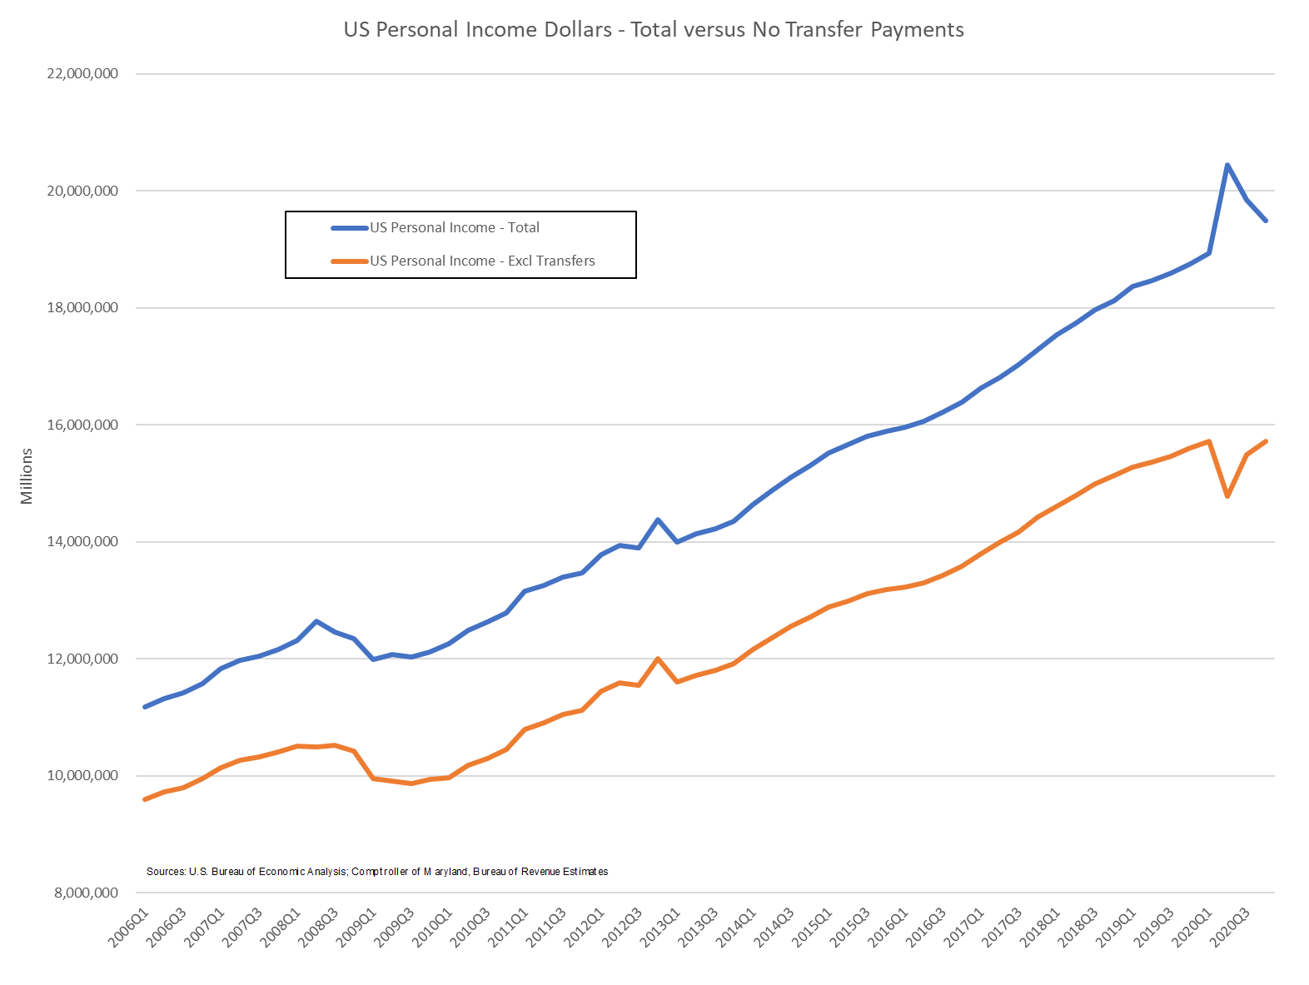
Federal Support Has Sustained Income in the Aggregate

Slide 9
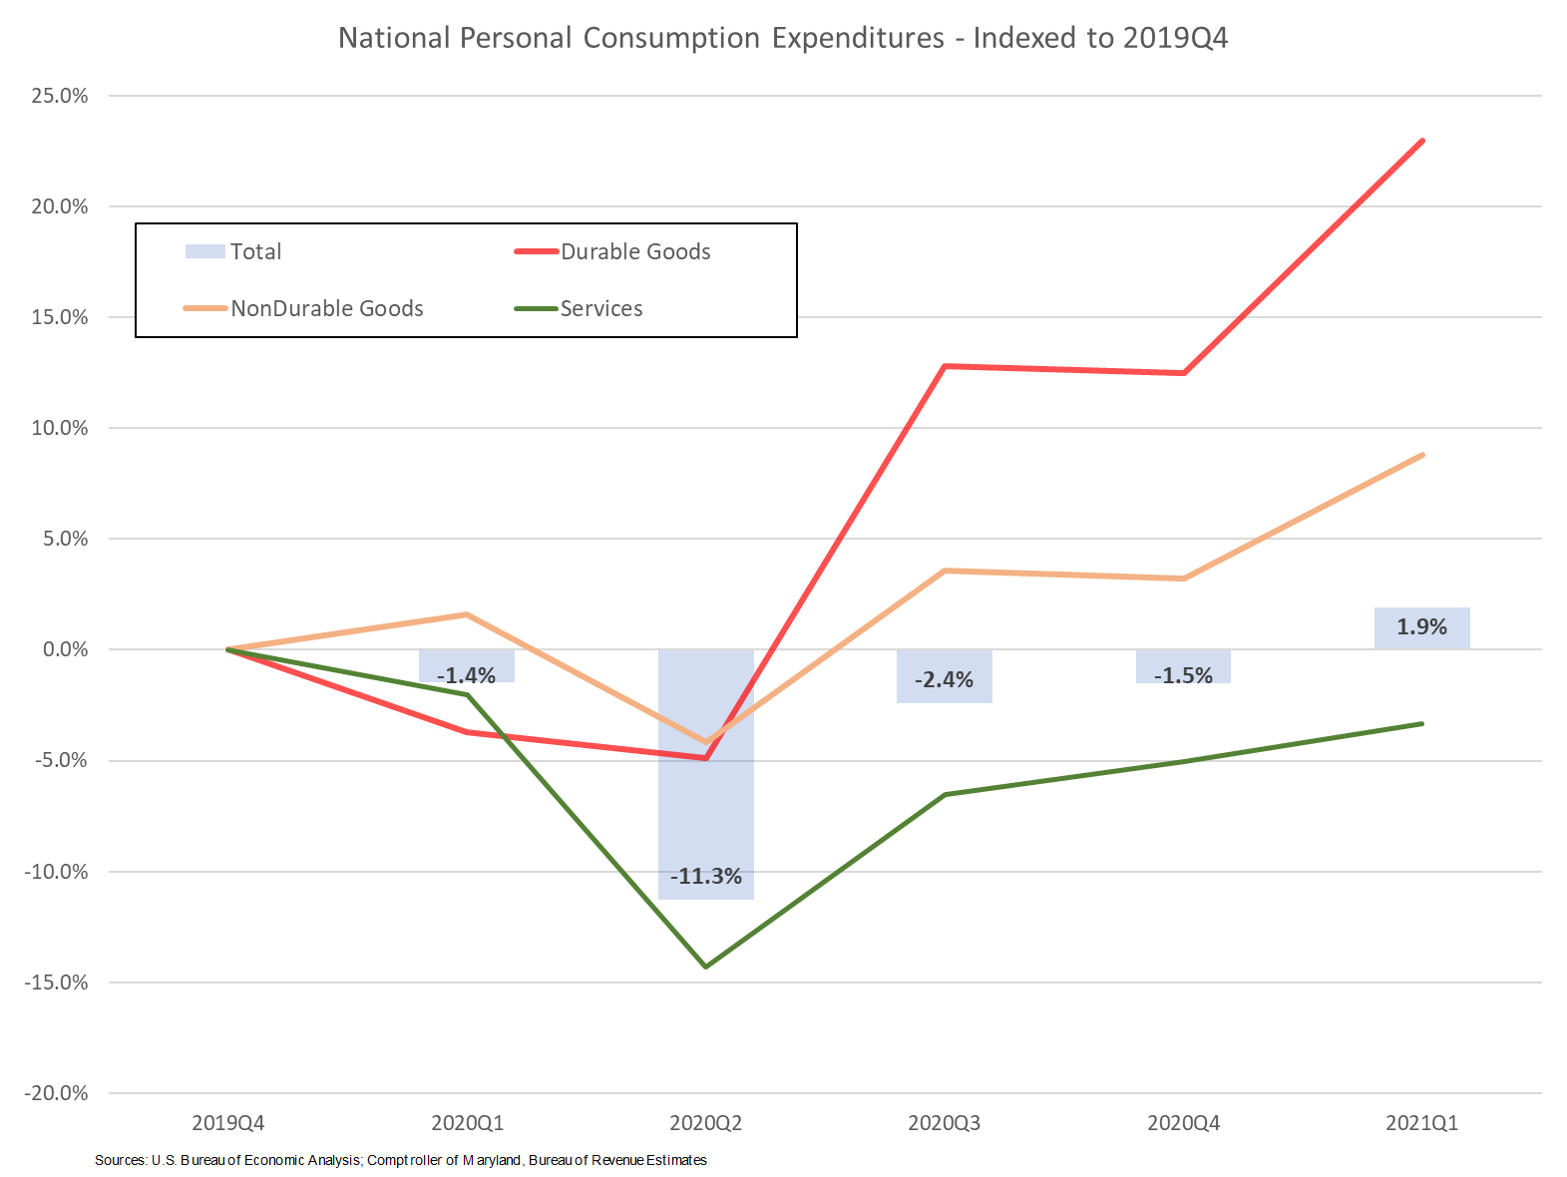
Federal Support Has Supported Spending in the Aggregate

Slide 10
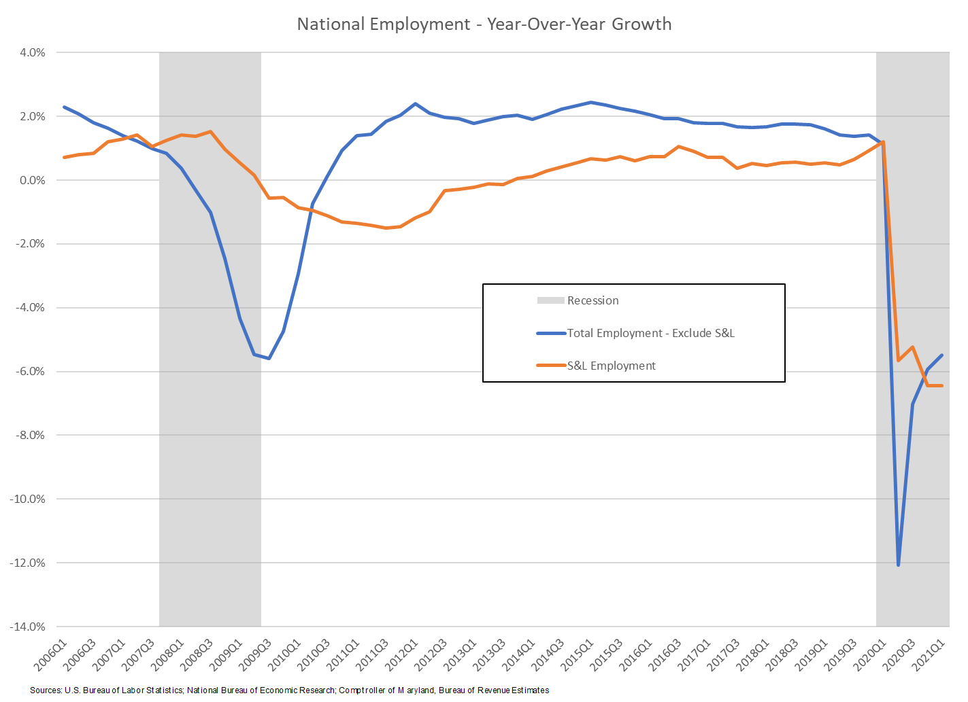
Federal Spending Also Intended to Support S&L Employment

Slide 11
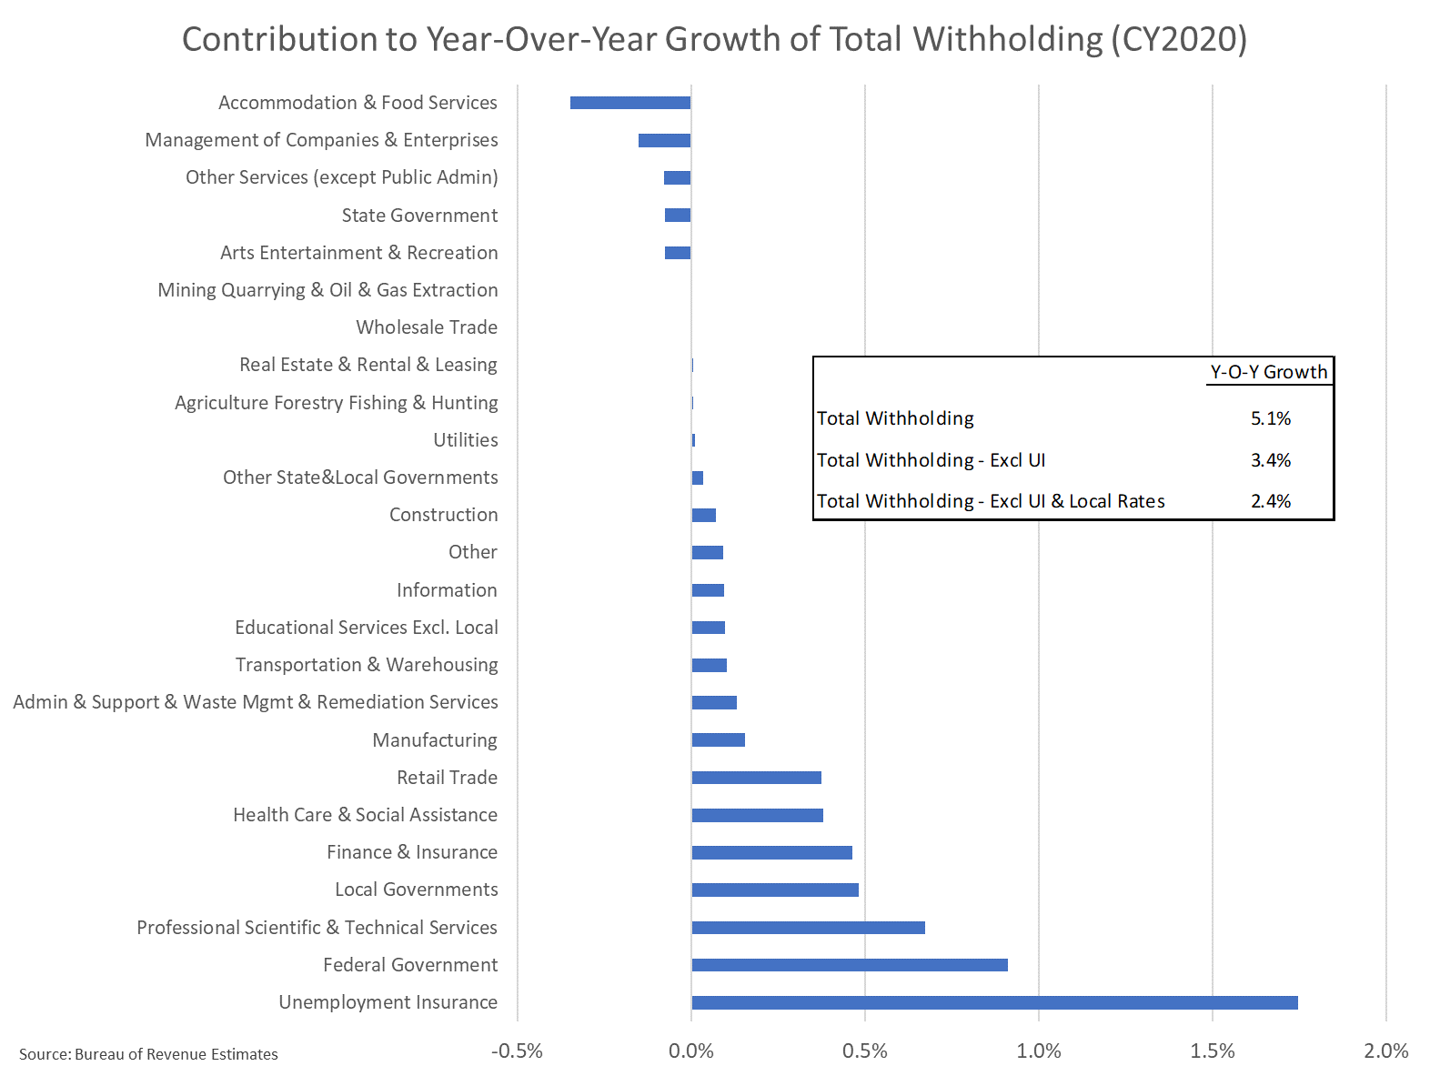
Stimulus Minimized Contagion

Slide 12
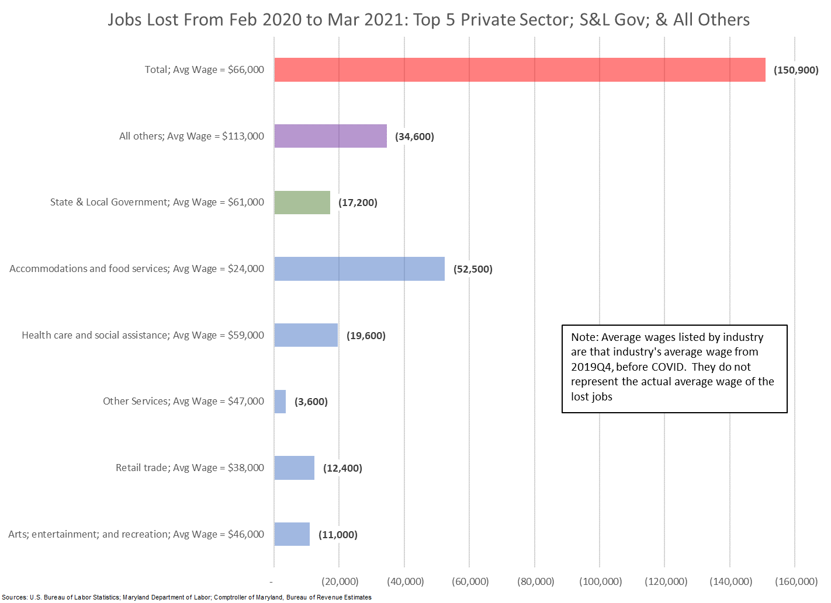
Labor Impact Still Significant – 5.4% fewer workers than Pre-Covid

Slide 13
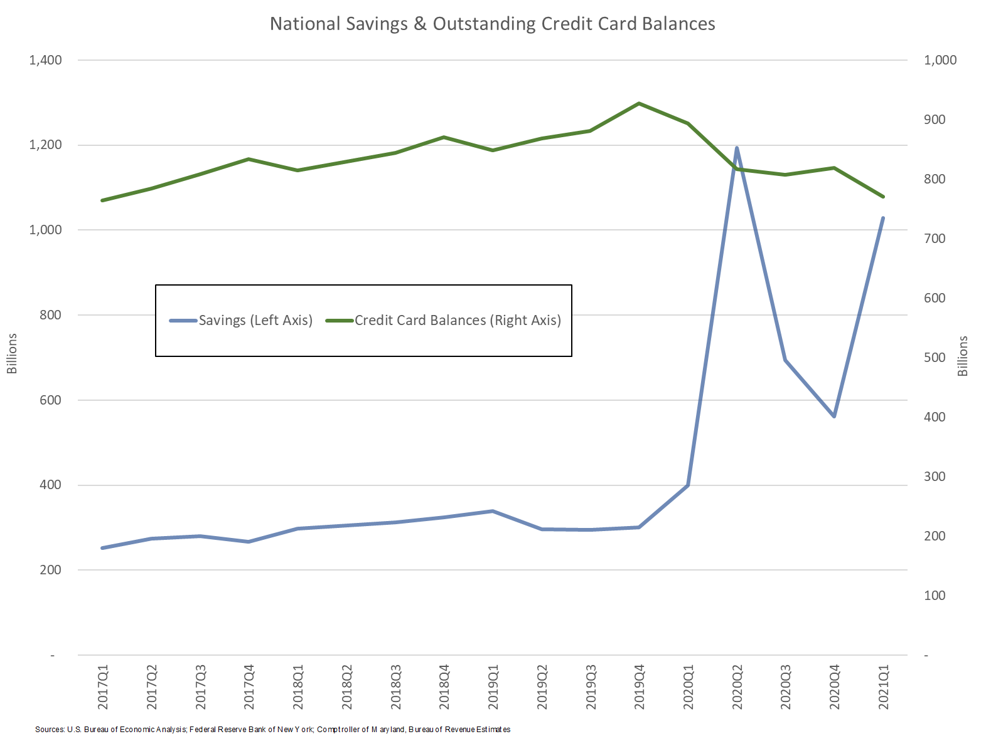
High Expectations for Future Spending

Slide 14
Final Thoughts – Recent Events Are Encouraging, But Long Way to Go
FREE LUNCH? What is the cost for our stimulus???
  Short-Term Inflation versus Long-Term Inflation
  Higher Interest Rates – slower future economic growth
What happens to the broader financial economy with delayed and perhaps delinquent mortgage and rent payments?
Local budgets to be more impacted due to heavier reliance on property tax? (Commercial property to undergo valuation correction)
Accelerated shifts to AI and robotics?

Slide 15
Thank You
Andrew Schaufele
Comptroller of Maryland
Chief, Bureau of Revenue Estimates
aschaufele@marylandtaxes.gov

