Slide 1
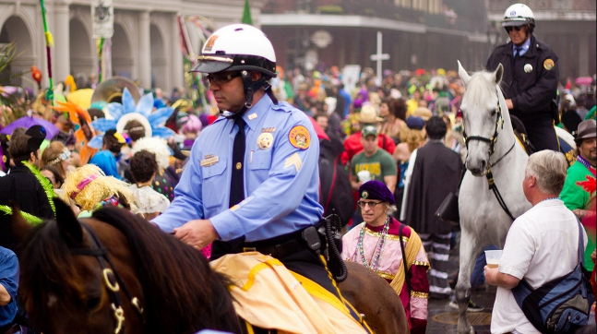
New Orleans Police
Mardi Gras 2027 Changes

Slide 2

Where we were in 2026...
NOPD experienced difficulties shifting assignments to allow for varying routes during the same evening.
  This was especially difficult shifting from the Sparta route (Jefferson to poydras) to try and cover for the Pygmalion route (Magazine to Convention Center).
Later evenings create a higher potential for overtime expenses (going late into the night) and a shorter turn-around time for officers.
  Officers often have less time off between shifts, causing officers to be tired, increasing burnout, and increasing the possibility of human error while providing essential public safety functions.

Slide 3
2027 Route Updates
NOPD is implementing route and schedule changes to help address these difficulties
  Route Changes:
    Sparta will now start at Tchoupitoulas/Napoleon instead of Jefferson/Magazine
      This will help the proper coverage and manpower for evening parades on January 30, 2027.
    D’Etat will now start at Magazine/Napoleon instead of Jefferson/Magazine
      This will help provide smoother formation transitions, allowing the parades better opportunity for smooth operations on February 5, 2027.

Slide 4
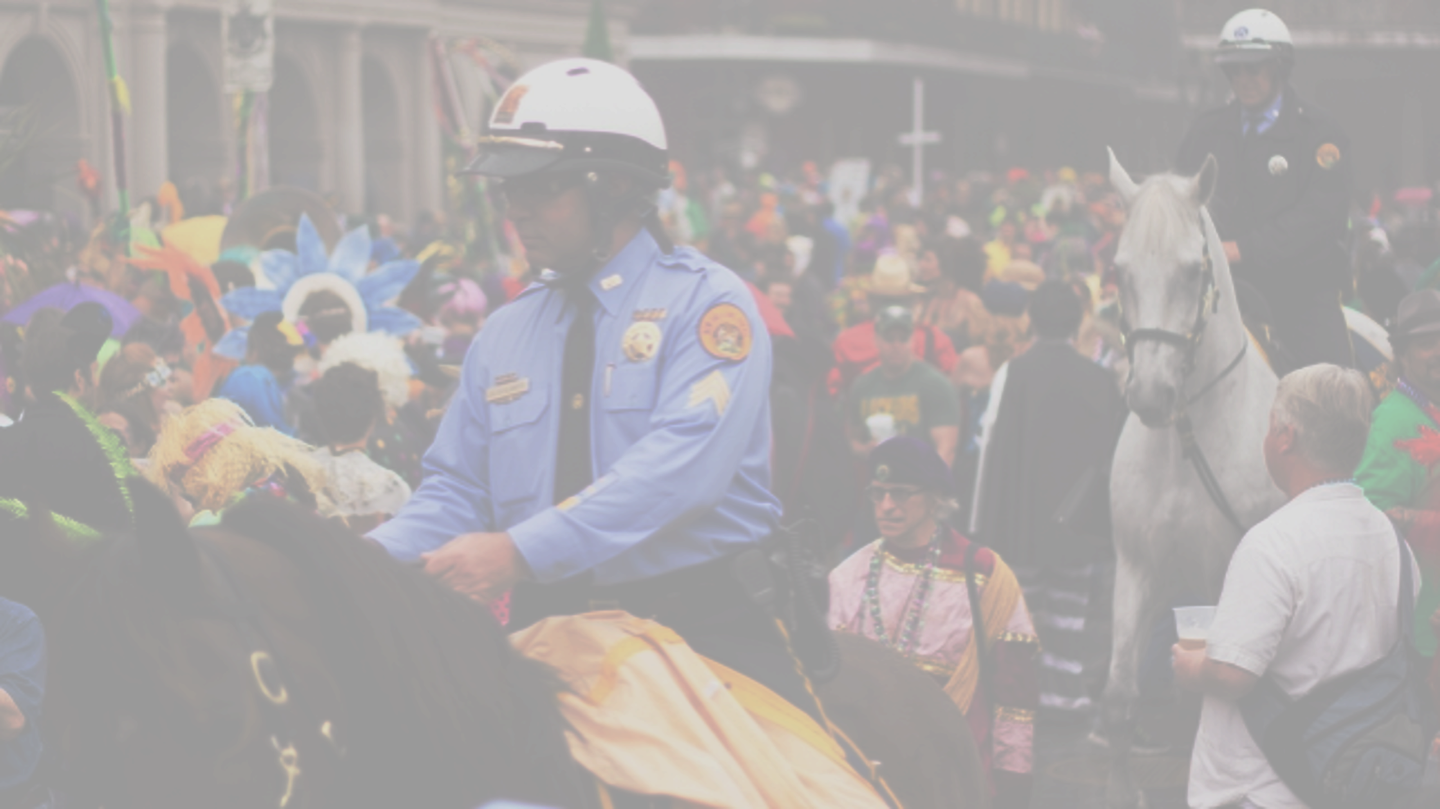
2027 Mardi Gras Parade Schedule Changes
Day | Krewe | 2026 time | 2027 time
Wednesday (2/3/2027) | Druids | 6:15 PM | 5:00 PM
 | Alla | 6:45 PM | Follows Druids
Second Friday (2/5/2027) | D’Etat | 6:30 PM (followed Hermes) | 5:30 PM (moved in front of Hermes)
 | Hermes | 5:30 (in front of D’Etat) | 6:00 PM (follows D’Etat)
 | Morpheus | 7:00 PM | Follows Hermes
Second Saturday (2/6/2027) | Tucks | 12:30 PM | 1:00 PM

Slide 5
2027 Parking Enforcement Updates
NO Parking will be enforced in designated parade formation areas from four (4) hours before the parade begins.
  Regular Formation areas include:
    Tchoupitoulas Street from Louisiana Avenue to Jefferson Avenue
    Jefferson Avenue from Magazine Street to Tchoupitoulas Street
    Napoleon Avenue from Magazine Street to Tchoupitoulas Street
  Parade specific formation areas:
    Marconi Dr. and Orleans Ave from Florida Blvd. to S. Carrollton Ave. (Endymion)
    Holiday Dr. from Fiesta St. to MacArthur Blvd. (NOMTOC)
    Napoleon Ave from S. Saratoga St. to S. Claiborne Ave. (Iris)
  Mardi Gras Day formation areas:
    S. Claiborne Ave from Jackson Ave. to Earhart Blvd. (Zulu)
    S. Claiborne Ave from Napoleon Ave. to Third Street. (Rex)
    S. Claiborne Ave from Napoleon Ave. to S. Carrollton Ave. (Elks/Crescent City)

Slide 6

Questions?

