Slide 1
Legislative Changes to Carnival
Ordinance Cal. No. 35,491
Notes:
-Worked with NOPD, a subcommittee of the Mayor’s Mardi Gras Advisory Committee, and individual krewes to draft various updates to the carnival code (Chapter 34)

Slide 2
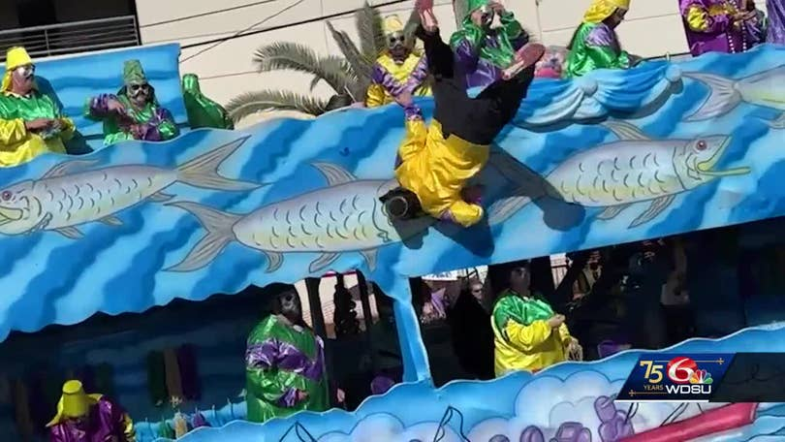
Riding on a Float
Riders must keep both feet on the float at all times.
No standing on boxes, bags, or climbing over the edge of the float.
All riders must wear safety harnesses.
Notes:
Krewe Captains are concerned about rider safety. Riders are climbing up on the floats, standing on uneven surfaces, and taking other risks when throwing items. For the safety of the riders, both feet must remain on the float at all times.
Currently, the code only requires harnesses for children. We’re updating this to mandate all float riders have harnesses.
Keeping both feet on the float and wearing a safety harness will help prevent avoidable accidents like the one pictured here that happened in Jefferson Parish a few years ago.

Slide 3
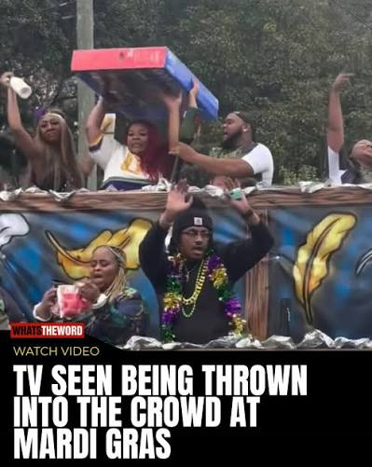
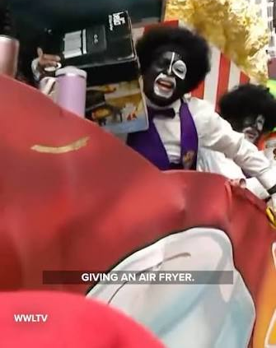
Throws
Anything thrown from a float must be pre-approved
Glass bead necklaces cannot exceed 220 grams in weight
Throws cannot exceed 3.5 pounds in weight
Notes:
There’s been an explosion of inappropriate and dangerous throws over the past few years. Heavy, expensive throws like televisions and small kitchen appliances might seem like a dream catch. But the weight of these items combined with the frenzy they cause are significant public safety issues.
Moving forward, carnival krewes must approve all throws thrown from a float. In addition, throws will have weight limits. Glass necklaces cannot exceed 220 grams and there is a maximum throw weight of 3.5 pounds. Our office worked with throw manufacturers to come up with these weight limits.

Slide 4
Marching Bands
Bands may not stop to perform along the parade route when the parade is moving.
Support Vehicles
Support vehicles must travel with their element.
No large gaps!
Car Clubs
Parades limited to three vehicular based elements.
All vehicular elements must ride two abreast.
Notes:
Large gaps in parades present serious public safety concerns. It is vital that parades maintain momentum and floats and elements follow closer behind each other.
To this end, the Mayor’s Mardi Gras Advisory subcommittee recommended prohibiting marching bands from stopping along the parade route to perform.
Support vehicles must travel with their elements. NOPD has noticed that support vehicles stop along the route to chat or otherwise become separated from their associated element/band.
Currently, car club elements often ride the route single file. This creates a significant issue with parade formation and unnecessarily increases the length of a parade. All car clubs must ride two abreast. No more single file!

Slide 5

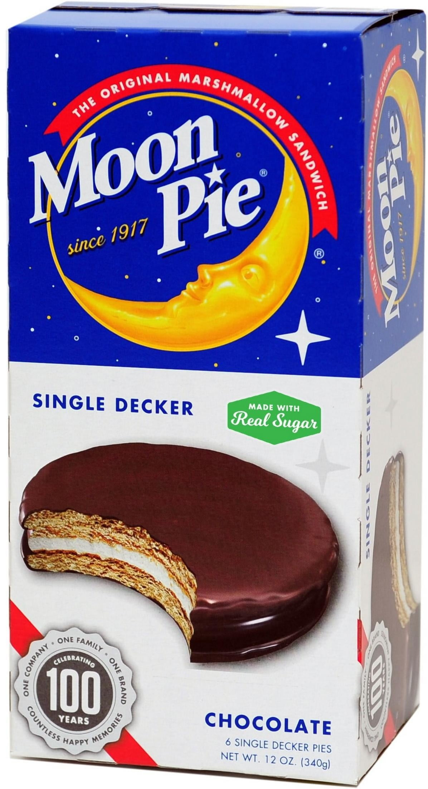
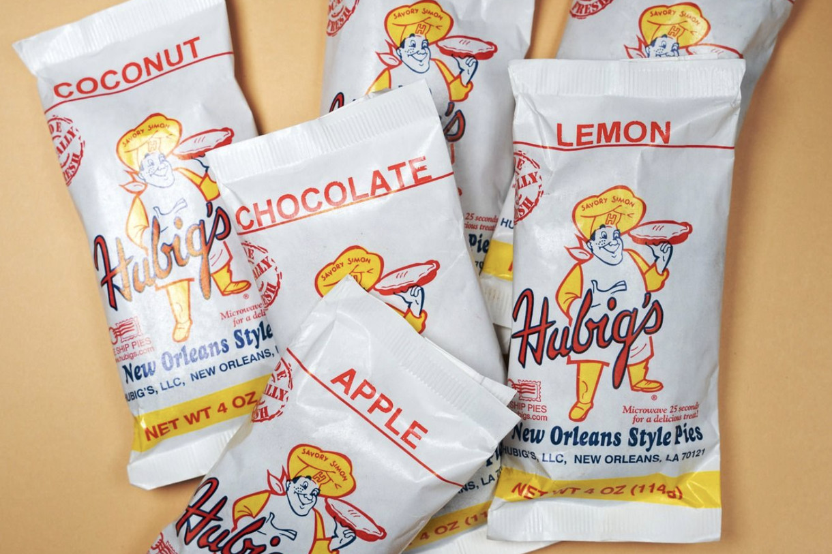
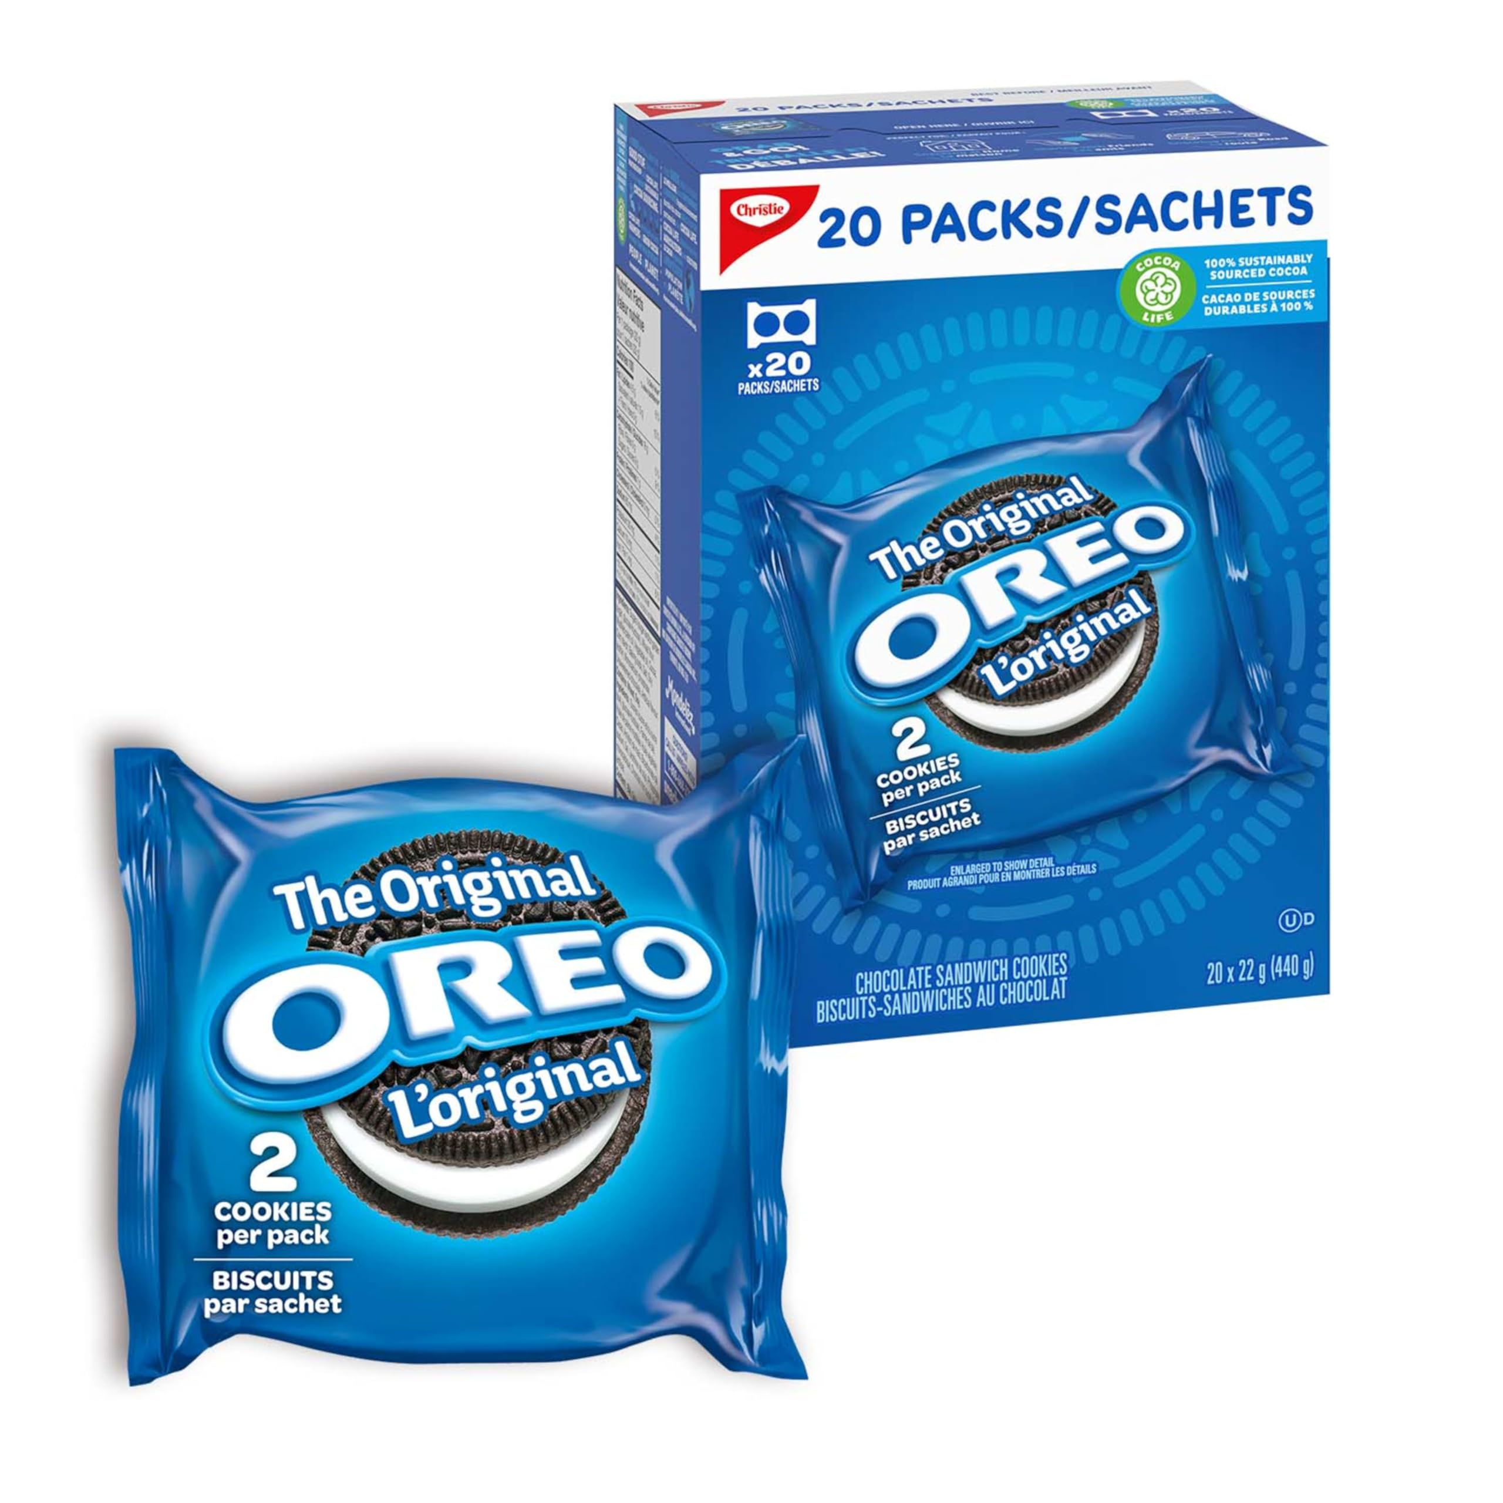
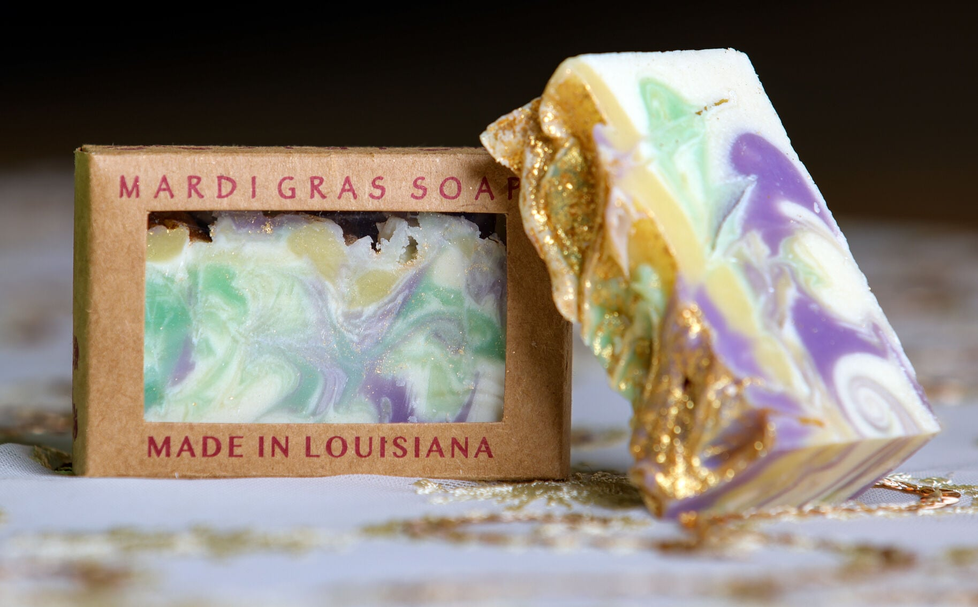
Branded Food Throws
Krewes may approve the throwing of certain branded items:
  Pre-packaged snacks and other food products.
  Branded small personal items.
Notes:
Food throws are becoming increasingly popular. However, it’s almost impossible to get a food throw without a manufacturer logo or trademark.
Carnival krewes can now approve riders to throw branded snacks, candy, and other food products, similar to those pictured here.
In addition to food, our office has an amendment to allow krewes to approve the throwing of small personal items with manufacturer logos/trademarks. This may include things like locally made soap, eco-friendly glitter, candles, and other small items. Small personal items cannot exceed twelve inches in size and must weigh less than one-half pound.

Slide 6
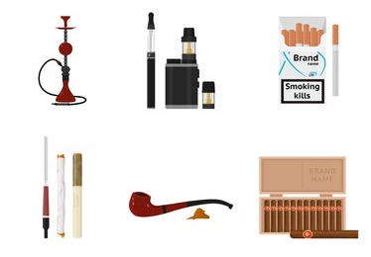
No Smoking on Floats
No cigarettes, cigars, vapes, hookah, electronic smoking devices.
Violators will be removed from the parade.
Notes:
The Mayor’s Mardi Gras Advisory subcommittee asked that we expand the smoking prohibition for float riders. Now, in addition to cigarettes, riders cannot use any tobacco products like cigars, vapes, hookahs, and electronic smoking devices. Violators are to be immediately removed from the parade.

Slide 7
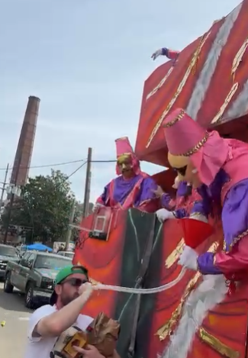
No Dispensing Alcohol Off a float
No beer funnels
No jell-o shots
No throws with alcohol
Notes:
We all love a good party. However, the dispensing of alcohol from a float is getting out of hand. This alcohol ban is a direct request from the Mayor’s Mardi Gras advisory subcommittee.
Riders may drink alcohol, they can share jello-shots with their fellow riders. This prohibition is specific to throwing or otherwise dispensing of alcohol from a float to someone in the crowd.

Slide 8

No GLASS ON THE FLOAT
Notes:
No glass on a float (except for glass bead necklaces.) No glass beer bottles, no glass wine bottles, no glass cups, no glass liquor bottles. Children are getting injured from glass throws.
You can continue to drink alcohol, just make sure you’re loading your float with canned beverages and plastic bottles ONLY.

Slide 9
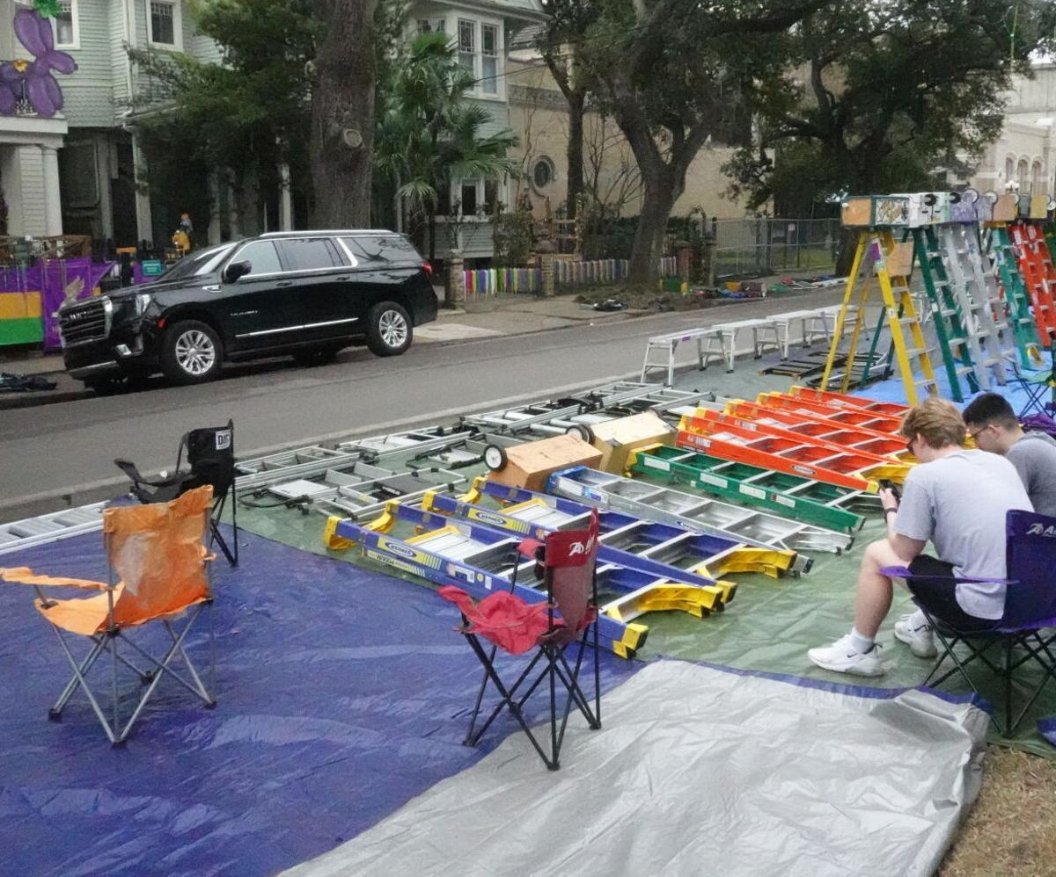
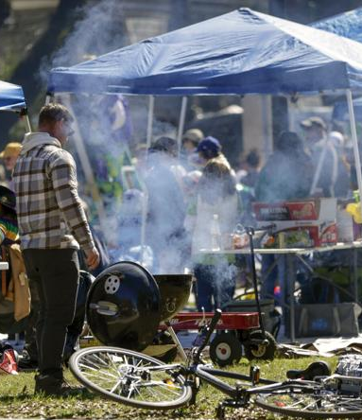
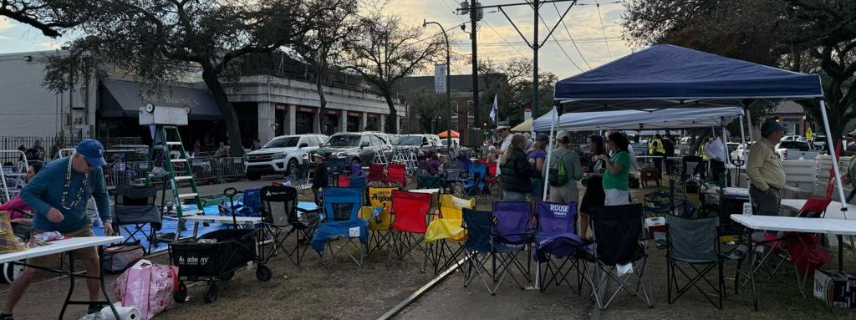
Enforcement Changes
Misdemeanor Offense
  Violations of ladder, tent, grill, toilet laws (Sec. 34-33) now criminal offense
Civil Fines Increased
  $1000 for 1st offense
  $2000 for 2nd offense
Notes:
Finally, the Krewe of Chad continues to be an issue. Enforcement is also a continued concern. To aid in enforcement, violations of Section 34-33, which prohibits ladders tied together, tents, enclosing of public spaces, grills, open flames, and the like, will be a misdemeanor criminal offense.

