Slide 1
Tropical Storm Arthur
Joint Climate Change and Sustainability and Public Works, Sanitation and Environment Committee
New Orleans City Council
July 30, 2026

Slide 2
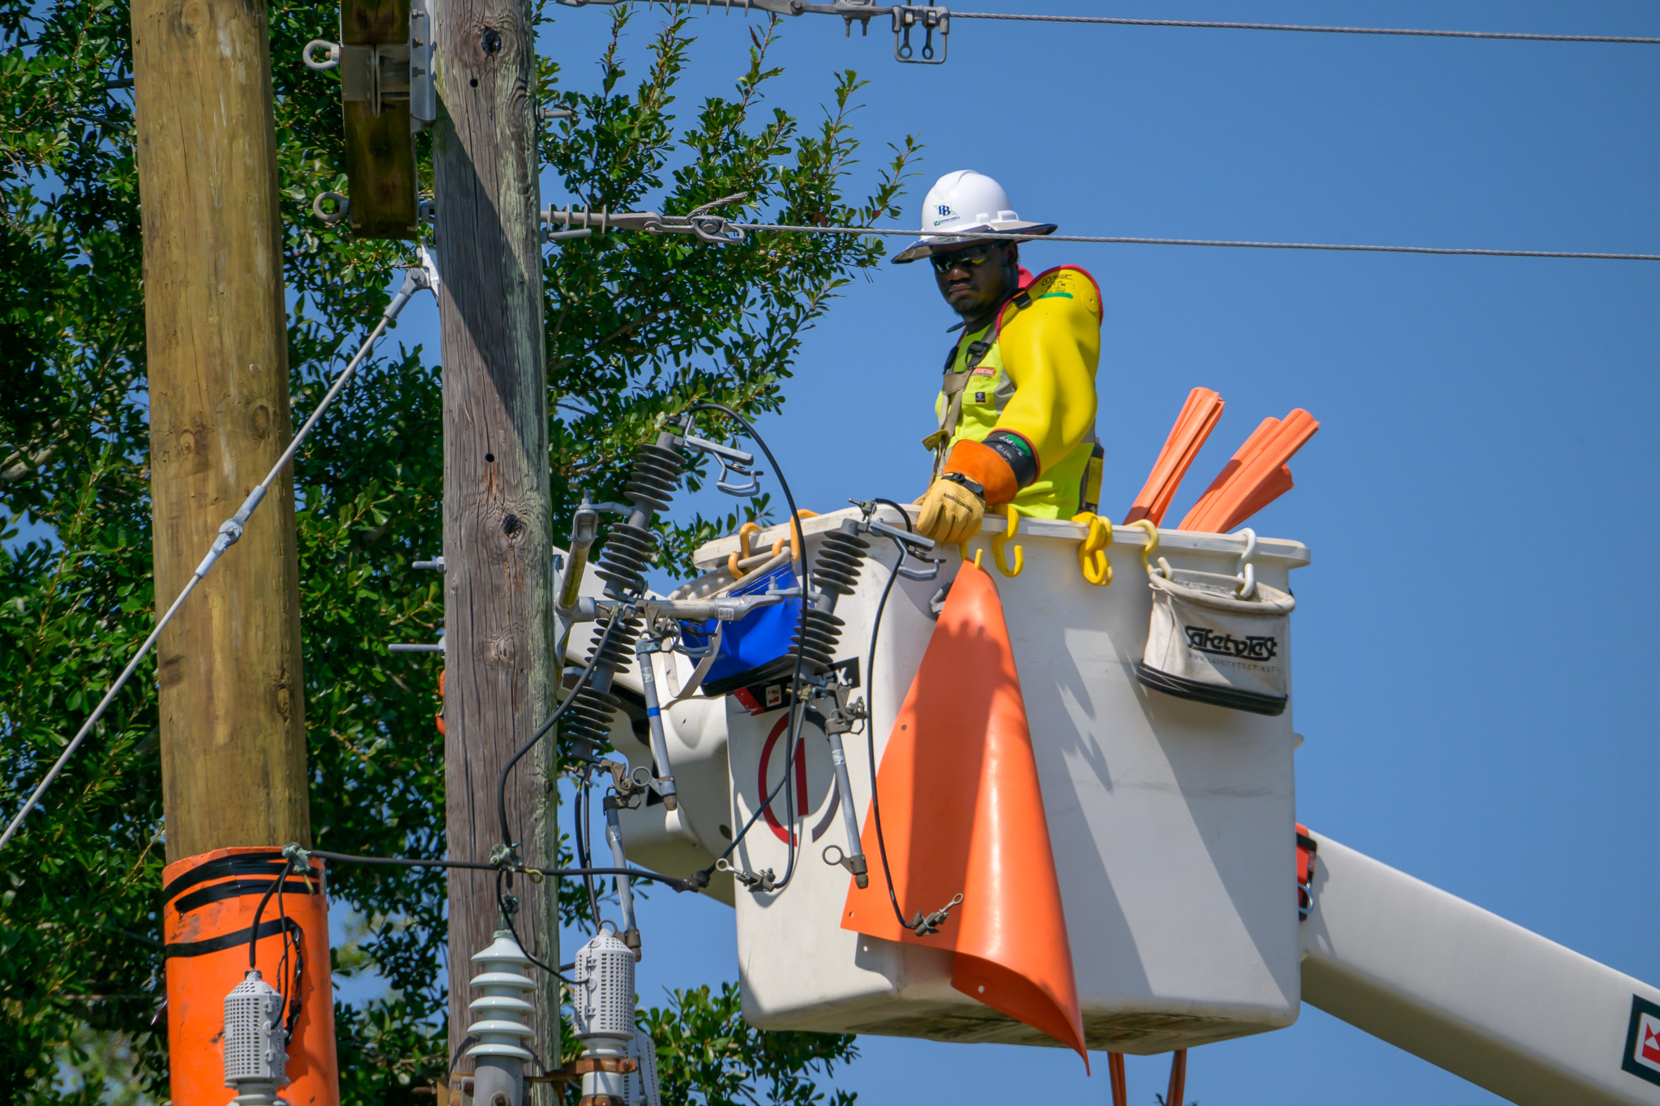

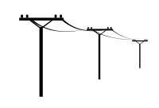
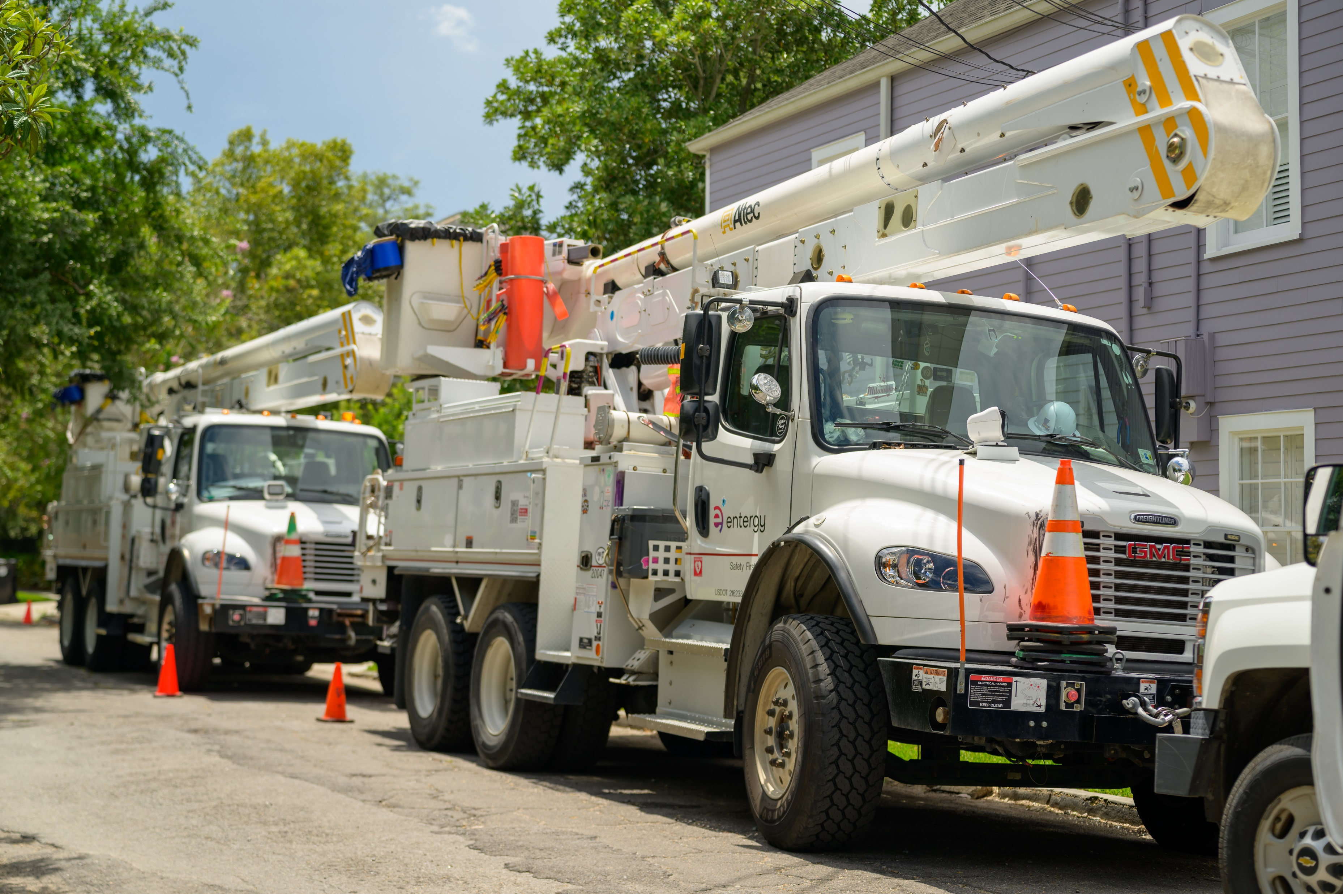
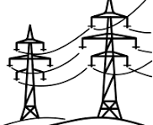

ENO Electric System
Over 95,000 Distribution poles
Nearly 1,800 miles of Distribution line
~35,000 Transformers
Nearly 2,200 Transmission structures
~140 miles of Transmission line
24 Substations

Slide 3
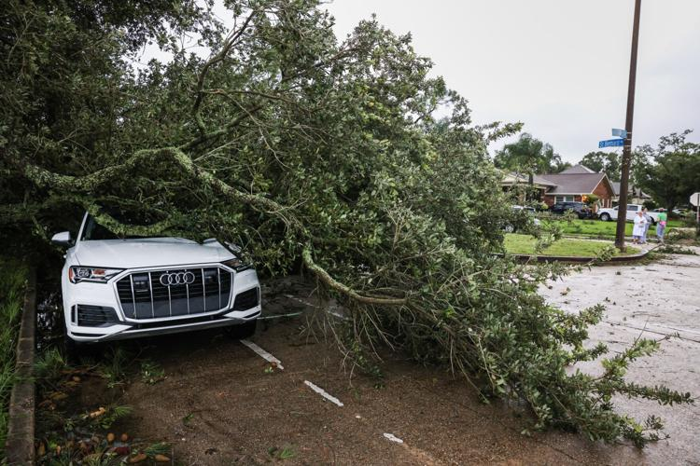
Tropical Storm Arthur – June 18, 2026
Maximum sustained winds of 40 MPH
Storm-total rainfall amounts exceeding 12 inches in areas, with some locations seeing totals approaching 20 inches
15 confirmed tornadoes across LA and MS including a EF1 tornado that impacted City Park to Lakeview
Source: NASA
Total Customers Impacted: 6,690*
Restoration:
All Customers Restored Same Day (6/18) Before Midnight
No Damages to ENO Transmission System
Damages by Council District
 | Poles | Cross Arms | Transformers
District A | 7 | 9 | 4
District B | 0 | 0 | 0
District C | 0 | 1 | 0
District D | 5 | 11 | 4
District E | 0 | 0 | 0
TOTAL | 12 | 21 | 8
* ENO is still analyzing data, and numbers may shift slightly

Slide 4
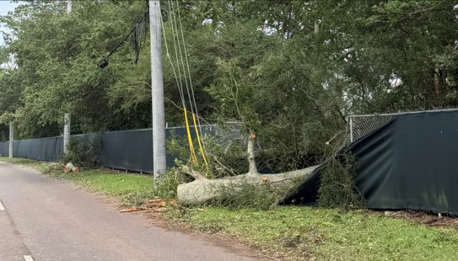

None of the Poles Installed During Phase 1 Resiliency Were Impacted Despite Nearby Damage

Slide 5
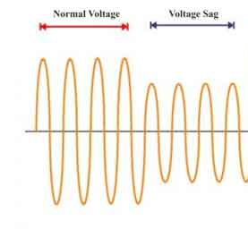
SWB Power Complex
Timeline of Events:
Normal Voltage
Voltage Sag
May 20 – Event *
Equipment failure on the transmission grid
June 18 – Event *
Transmission outage on the BES, storm debris contacted the line caused by tornado
June 25 – Site Visit
Working with SWB & Third-Party engineering firm to review event
In both events Sullivan Substation did NOT lose power
Entergy Existing Standards:
Entergy has an established power quality standard for both Steady State conditions and Voltage Sag Disturbances
Reference Document: https://www.entergylouisiana.com/wp-content/uploads/Power-standard-2024.pdf
  Guided by American National Standards & EPRI National Study

Slide 6
Restricted Use Legend and Disclaimer: The distribution of this material is limited to members of the [Board of Directors, Office of the Chief Executive, Entergy management, Corporate Risk Committee] and their designees. The information included herein is prepared solely for internal use. It may include information based on assumptions and hypothetical scenarios not representative of current business plans. These hypothetical scenarios do not represent any or all current or future Entergy business plans but are merely estimates, projections, and discussion points. As a result, actual outcomes may differ. This information may also include commercially sensitive proprietary information, legal advice from counsel, and/or other confidential non-public information not appropriate for general distribution.
Notes:
This version of the endcard should ONLY be used with sensitive, proprietary information, legal advice from counsel, and or other confidential, non-public information not appropriate for general distribution.

