Slide 1

Municipal and Traffic Court of New Orleans
Criminal Justice Committee of the City Council
6.29.2026

Slide 2
Overview
Communtiy Court
Quarterly Report of Filings and Dispositions
Online Case Resolution
Additional Updates

Slide 3

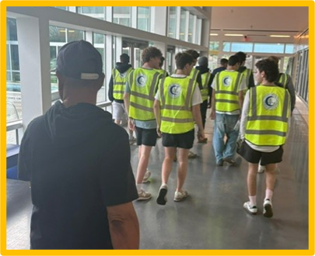
Crescent City Community Court
1261 Pre-Screen Intakes Conducted 681 Total Participants
148 Participants Served in 2026

Slide 4
2025 Top Charges
Charge | Count | Percentage
Theft | 26 | 31%
Trespassing | 16 | 19%
Property Damage | 12 | 14%
Disturbing the Peace | 12 | 14%
Noise Complaints | 11 | 13%
The data illustrates only the top 5 charges

Slide 5
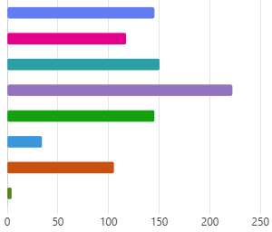
2025 Most Common Needs
At Assessment
 | Housing | 145
 | Substance Use | 117
 | Employment | 150
 | Mental Health | 222
 | Trauma | 145
 | Youth Services | 34
 | Education | 105
 | Other | 4

Slide 6
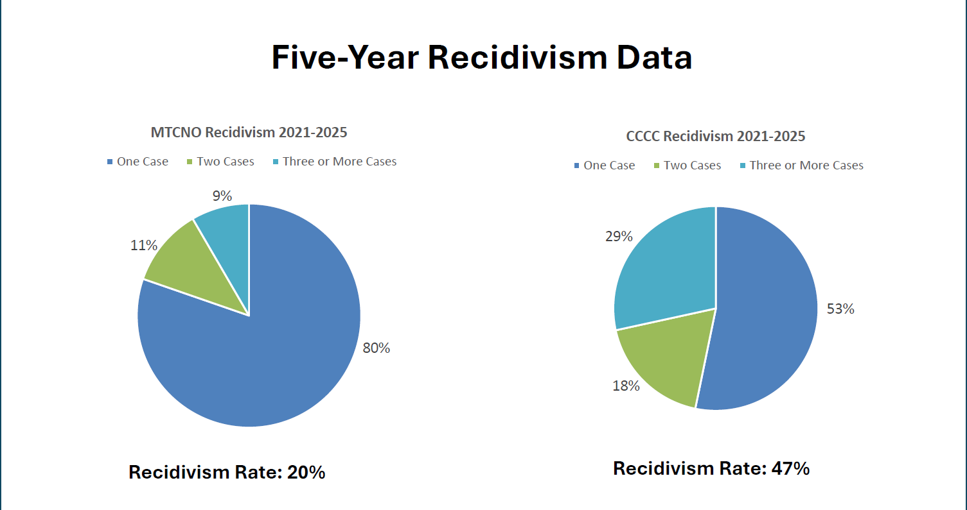

Slide 7
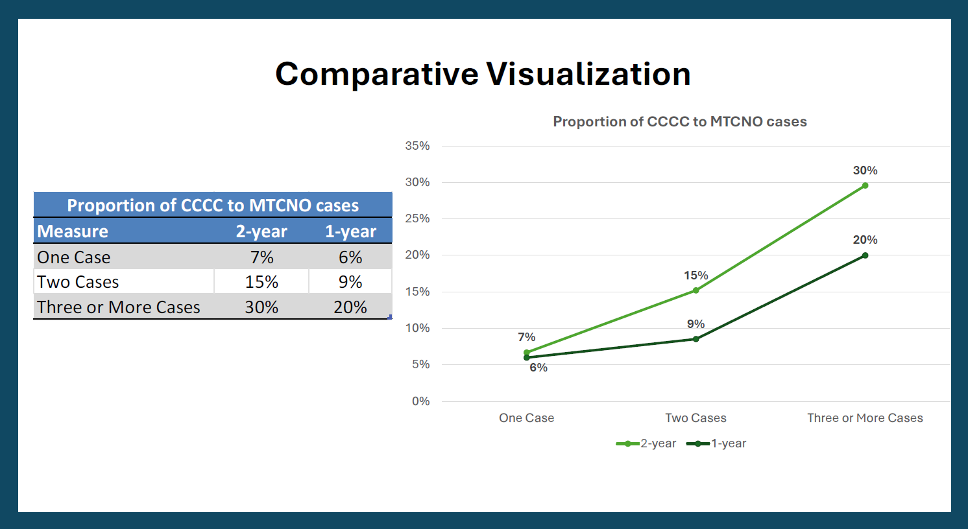

Slide 8
Community Court Updates
Leadership Transition
Funding and Staffing

Slide 9
Municipal and Traffic Court of New Orleans
2026 Case Filings and Dispositions
Case Type | Number of Filings | Number of Dispositions
Misdemeanor | 1,559 | 11,292
Traffic | 7,577 | 9,691
Driving While Intoxicated (DWI) | 214 | 182
Total | 9,350 | 21,165
*Date range: 1/1/26- 6/26/26

Slide 10
Municipal and Traffic Court of New Orleans

Slide 11
Online Case Resolution

Slide 12
Additional MTCNO Updates
Returned to 727 S. Broad in January 2026
Judicial Reductions

Slide 13
Contact
Chief Judge Robert E. Jones, Administrative Judge of MTCNO rejones@nola.gov
Monique M. Boissiere, Judicial Administrator monique.boissiere@nola.gov
504-658-9709
Christopher P. Sens, Clerk of Court
cpsens@nola.gov
504-658-9772
Marie Kerrin, Community Court Director
marie.kerrin@nola.gov
504-813-2128

