Slide 1


NEW ORLEANS POLICE DEPARTMENT
Criminal Justice Committee
City Council Presentation
Anne E. Kirkpatrick, Superintendent of Police
June 29, 2026

Slide 2


Departmental Overview
FQ Security & DPW Update
  Crime Statistics 2026 YTD
  Violent Crime Reduction Update
  Traffic Enforcement & Parking Operations
  Recruitment Efforts
  Current Strength and Separations
  NOPD HQ & Infrastructure Update
  Overtime 2026

Slide 3

FQ Security Update
Bourbon Street Terrorist Incident on January 1, 2025, has continued to impact NOPD’s approach and coverage of all special events, Mardi Gras 2026, SEAR 1 alert for the second weekend of parades
NOPD has met with stakeholders to determine next steps for FQ barriers, a proposal of 18 permanent barriers for Bourbon Street and Jackson Square was recommended
Deputy Mayor Harrison working with DPW engineers to establish guidelines for installation of barrier, next step procurement process

Slide 4

DPW Transition Update
Anticipate NOPD only handling Bus Route Enforcement
Successfully completed transfer of 59 Parking and Towing employees from DPW to NOPD May 31st, no issues
Ground Transportation Bureau (GTB) transfer currently under review to determine department best suited to assume primary authorities based on current codes

Slide 5
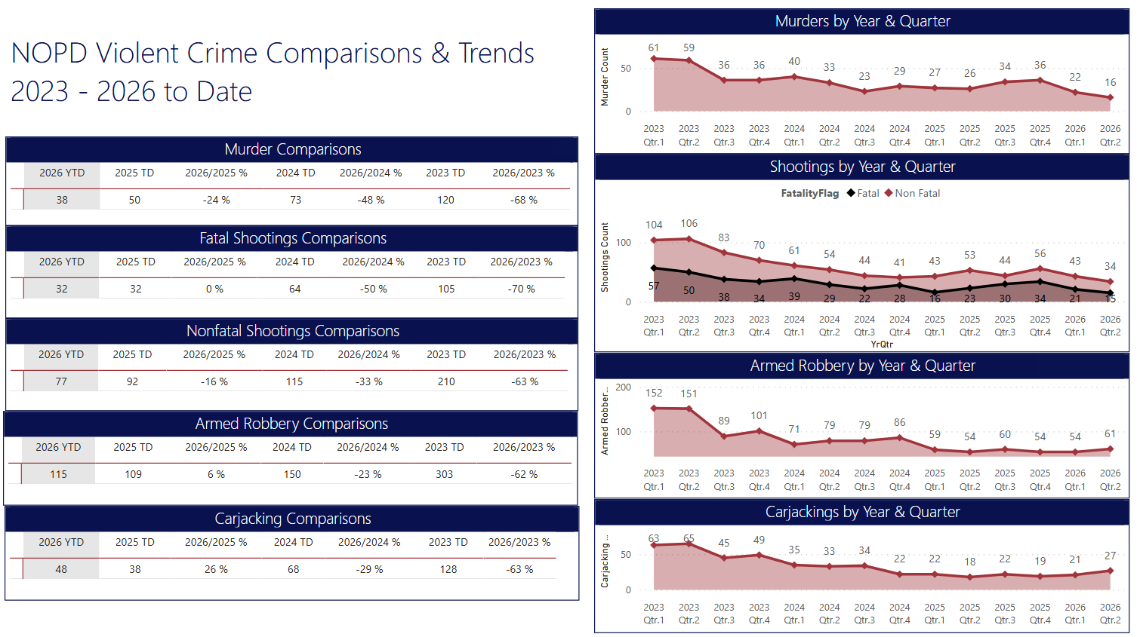

Slide 6
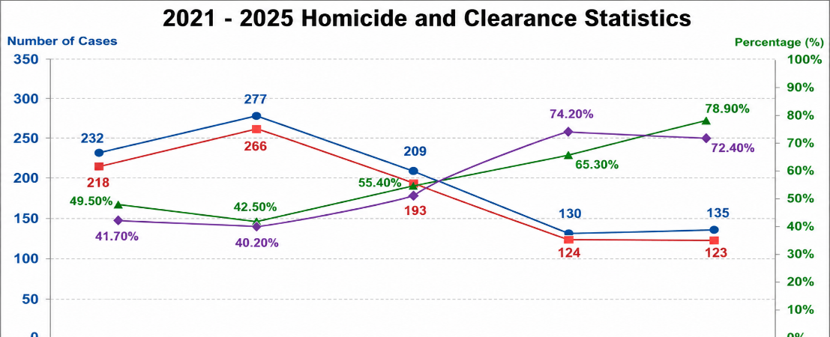
NOPD Homicide Unit Exceptionally High Clearance Rate
So far this year there have been 40 MURDERS and 42 cases SOLVED (some cases from last year were solved in the current year) for a 105 % SOLVE rate. For perspective the homicide count and solve rates for 2021-2025 are depicted on chart

Slide 7
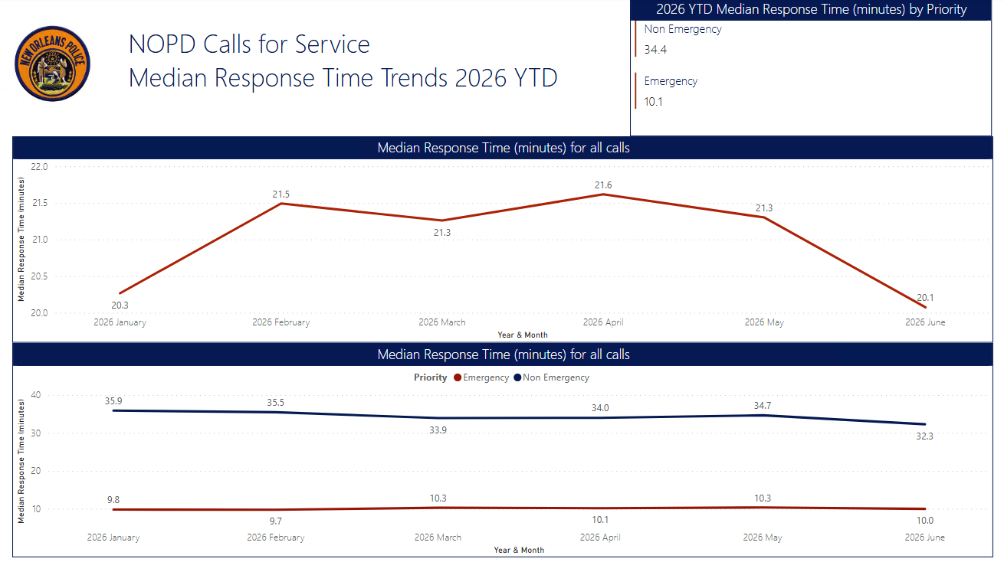

Slide 8
Violent Crime Reduction Strategies
Violent Crime Strategies in Progress
Continue with weekly GRIP meetings using Data Analytics and wholistic approach to violent crime.
Continue to work with DA’s Office on N.O.D.I.C.E. (recent shutdown of carwash being used for illegal narcotics & drug dealing, operation summer storm)
Continued collaboration with federal, local and State law enforcement partners and in task forces with occasional focus surges to apprehend violent criminals.
Will be partnering with Thomas Abt and the Violence Reduction Center with Commissioner Daniel Shanks to expand upon the GRIP and NODICE strategies with more evidence-based strategies that would best fit New Orleans.

Slide 9
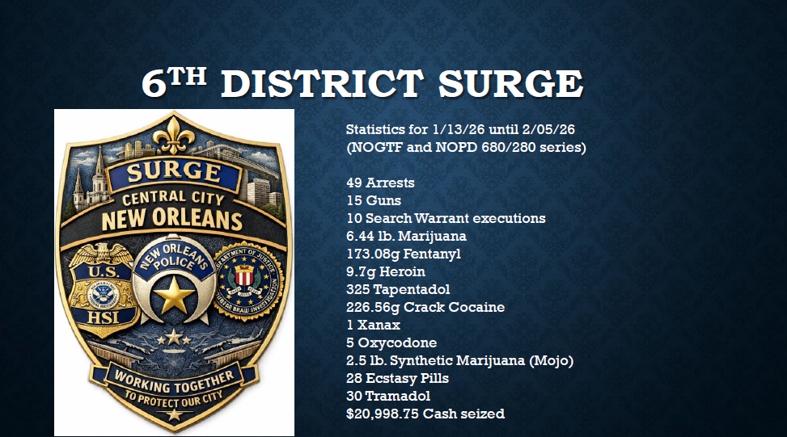

Slide 10
Violent Crime Collaboration Cases Highlighted
OPDA Seizes Car Wash: Disrupting Drug Distribution Operation Near St. Augustine High School
NEW ORLEANS, LA — On Monday, April 6, 2026, in a coordinated, multi-agency enforcement operation led by the Louisiana State Police HIDTA Task Force, detectives executed search and arrest warrants resulting in the Orleans Parish District Attorney’s Office (OPDA) seizure of Fat’s Car Wash, a business identified as a front for a narcotics manufacturing and distribution operation.
The operation reflects a high level of collaboration between local, state, and federal partners, including the Louisiana State Police, the New Orleans Police Department (NOPD), the FBI New Orleans Field Office, and the Louisiana National Guard.

Slide 12
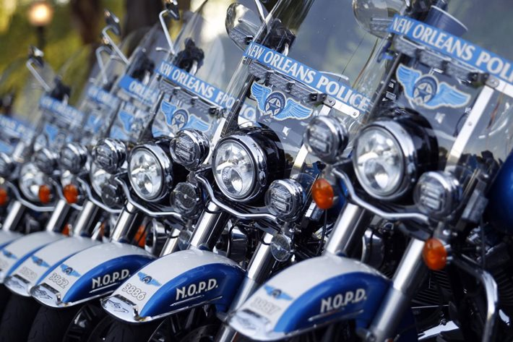
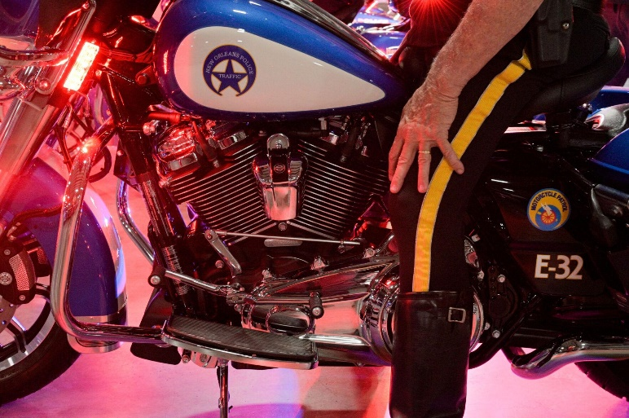
Traffic Enforcement & Parking
NOPD increased traffic enforcement efforts this year
This has resulted in 65% more traffic citations issued compared to previous years
Increased traffic enforcement and directed safety initiatives have contributed to fewer crashes citywide
May 31, 2025, Council transferred parking and towing duties from DPW to NOPD to provide more efficiency in managing citywide enforcement (force multiplier for enforcement)

Slide 13
Enforcement Activity – Stops, Citations & Arrests
2025 YTD vs 2026 YTD as of June 20th
Summary
• Notable changes vs 2025: Enforcement activity increased across nearly every category year-over-year.
Increased enforcement coincides with reductions in overall crashes, fatal crashes, and traffic fatalities citywide.
• Action items: Maintain focus on impaired driving, speeding, and other hazardous moving violations.
Continue high-visibility traffic enforcement in high-crash and high-complaint areas.
65%
52%
19%
(100)%
0%
140%
317%

Slide 14
Traffic Crashes YTD
YTD as of June 20th (Source NOPD Analytics Unit)
Summary
• Key drivers: Increased traffic enforcement and targeted safety initiatives have contributed to fewer crashes citywide.
• Notable changes vs 2025: The reduction in crashes aligns with the decrease in fatal crashes and traffic fatalities observed in 2026.
• Action items: Maintain proactive traffic safety operations to sustain the downward trend in crashes throughout the remainder of the year.

Slide 15
Parking and Towing Enforcement and Collections
NOPD Parking and Towing Stats - June 2026
Week | 5/31-6/6 | 6/7-6/13 | 6/14-6/20 | 6/21-6/27 | 6/28-7/4
Parking Enforcement Unit |  |  |  |  |  | TOTALS
Total Citations Issued | 1749 | 2244 | 1835 |  |  | 5828
Booting/Collections Unit
Boots applied | 146 | 146 | 79
Parking Fines Collected | $4,670.00 | $6,852.34 | $2,230.00 |  |  | $13,752.34
Speeding Fines Collected | $17,570.00 | $19,825.00 | $12,015.00 |  |  | $49,410.00
Red light Fines Collected | $8,910.00 | $7,695.00 | $4,185.00 |  |  | $20,790.00
Total Fines Collected | $31,150.00 | $34,372.34 | $18,430.00 | $0.00 | $0.00 | $83,952.34
Towing Unit
Parking Violation Tow | n/a | n/a | 88 |  |  | 88
Booted Tow | n/a | n/a | 10 |  |  | 10
Abandoned Tow | n/a | n/a | 1 |  |  | 1
NOPD Tow Request (evidence) | n/a | n/a | 9 |  |  | 9
NOPD/City Vehicle Tow | n/a | n/a | 9 |  |  | 9
Total Tows | 100 | 120 | 117 |  |  | 337
Abandoned Veh. Unit (Almonaster)
Junk Vehicles Stickered | 69 | 79 | 57 |  |  | 205
Abandoned Vehicles Chalked | 22 | 33 | 18 |  |  | 73
Service Requests | 157 | 158 | 109 |  |  | 424
Junk Vehicles Removed | 5 | 10 | 11 |  |  | 26
Vehicles GOA | 75 | 70 | 65 |  |  | 210
Self Initiated Enforcement Actions | 1 | 4 | 3 |  |  | 8

Slide 16
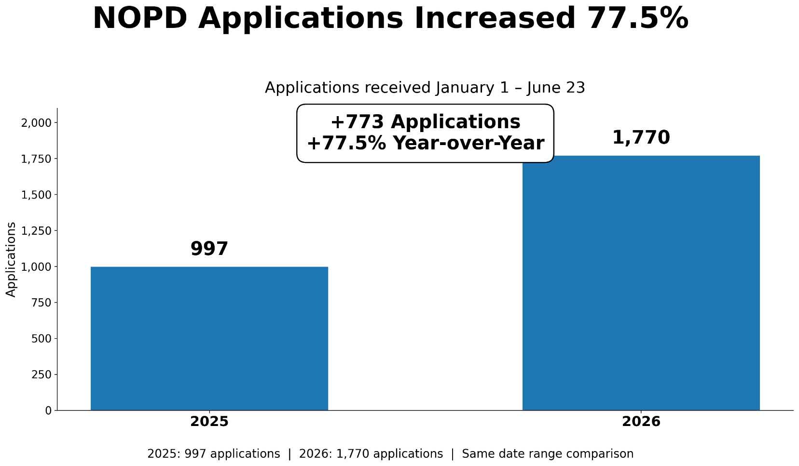
Recruitment Effort Updates

Slide 17
Recruitment Metrics
2025 vs 2026
Recruitment Results – Detailed Metrics
Overall Growth
Applications +77.5%
Hires +37.5%
Metric | 2025 | 2026 | %Increase
Applications | 997 | 1,770 | +77.5%
Test Takers | 341 | 431 | +26.4%
Background Investigations | 142 | 165 | +16.2%
Hired | 32 | 44 | +37.5%

Slide 18
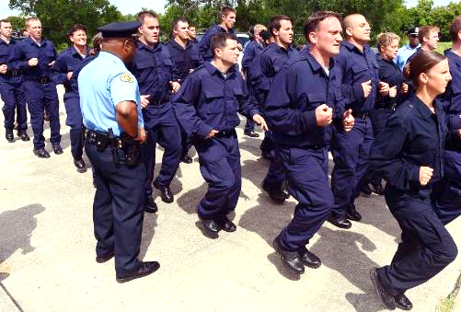
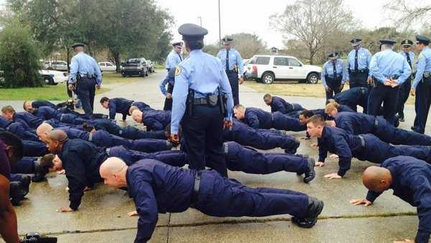
Results
Class 206 –32 Recruits - Graduated March 2026, currently in FTO Phase 3
Class 207—25 Recruits Graduation July 2026
Class 208 – 26 Recruits Graduation October 2026
Class 209 – 10 hired, 6 scheduled onboarding, 18 psych, 33 background - Launch date July 2026
Laterals- 1 scheduled onboarding, 5 background
Reinstatements – 1 in Academy, 3 background

Slide 19
Current Strength - Separations
2026 STAFFING LEVELS YTD
Current 2025 Comm strength 902
Current 2025 Civilian strength 361
Current 2025 Recruit strength 54
Total 1,317
2026 SEPARATIONS YTD
Current Comm Separations 47
Current Civilian Separations 15
Total 62

Slide 20

Facility Needs Update
Property and Evidence Building – critical, may have potential facility in NOLA East
Academy needs – out-grown and cost to maintain – AC alone is $450,000 – no restroom facilities on driving course
Opportunity to move into MLK School being vetted by DPM
Police/Fire/EMS
Possible Regionalization with Feds and other jurisdictions

Slide 21

DXC HQ & Infrastructure Update
NOPD IT & Sex Offenders only operations at 715 S Broad-Sex Offenders potential move to criminal court building being vetted; NOPD IT vetting plans for move to Paris Avenue provided MLK building is made available
Crime Lab 4th Floor Renovation for DNA requested in recent 2026 Capital Budget Hearing- Capital Projects vetting renovations
(must happen to ensure accreditation)
HVAC issues are improving
6th District- A/C issue again, $8k needed for compressor
3rd District- Rental a/c, new unit on order
7th District- A/C fully operational
Academy – 50% operational, new compressor and coils needed
CE&P- A/C fully operational
Crime Lab- Temporary unit installed, original 2 new chiller had 4 factory defects, DPM in process of replacing warranty expired
4th District- recent issue, waiting on contractor
2nd District- A/C installed improperly factory defect, $17k for repair

Slide 22
2026 LAB
HIRE REQUEST
Department has requested to hire 2 CODIS positions to satisfy requirement for DNA Lab accreditation
  Council approved CODIS positions June 2026, initiated background for CODIS Admin & CODIS Specialist
  Hired controller April 2026

Slide 23
NOPD Overtime
Monitoring Overtime Usage Bi-weekly
PPE | GF CODE | OT GF EXPENDED | BUDGETED AMT
 |  |  | $23,000,000.00
1/10/2026 | 6001020 | $1,215,238.52 | $21,784,761.48 | New Year's/Sugar Bowl
1/24/2026 | 6001020 | $589,044.13 | $21,195,717.35 | MLK
2/7/2026 | 6001020 | $840,341.89 | $20,355,375.46 | MG
2/21/2026 | 6001020 | $3,341,432.73 | $17,013,942.73 | MG
3/7/2026 | 6001020 | $391,064.88 | $16,622,877.85
3/21/2026 | 6001020 | $391,218.27 | $16,231,659.58
4/4/2026 | 6001020 | $503,102.94 | $15,728,556.64 | Good Friday
4/18/2026 | 6001020 | $403,199.95 | $15,325,356.69
5/2/2026 | 6001020 | $453,604.33 | $14,871,752.36
5/16/2026 | 6001020 | $369,673.21 | $14,502,079.15
5/30/2026 | 6001020 | $457,025.89 | $14,045,053.26 | Memorial Day
6/13/2026 | 6001020 | $0.00 | $14,045,053.26
6/27/2026 | 6001020 | $0.00 | $14,045,053.26
7/11/2026 | 6001020 | $0.00 | $14,045,053.26 | 4th of July
7/25/2026 | 6001020 | $0.00 | $14,045,053.26
8/8/2026 | 6001020 | $0.00 | $14,045,053.26
8/22/2026 | 6001020 | $0.00 | $14,045,053.26
9/5/2026 | 6001020 | $0.00 | $14,045,053.26
9/19/2026 | 6001020 | $0.00 | $14,045,053.26 | Labor Day
10/3/2026 | 6001020 | $0.00 | $14,045,053.26
10/17/2026 | 6001020 | $0.00 | $14,045,053.26 | Indigenous
10/31/2026 | 6001020 | $0.00 | $14,045,053.26
11/14/2026 | 6001020 | $0.00 | $14,045,053.26
11/28/2026 | 6001020 | $0.00 | $14,045,053.26 | Thanksgiving
12/12/2026 | 6001020 | $0.00 | $14,045,053.26
12/26/2026 | 6001020 | $0.00 | $14,045,053.26 | Xmas
 | 6001020 | $0.00 | $14,045,053.26 | Balance Year End
TOTAL |  | $8,954,946.74

Slide 24


