Slide 1
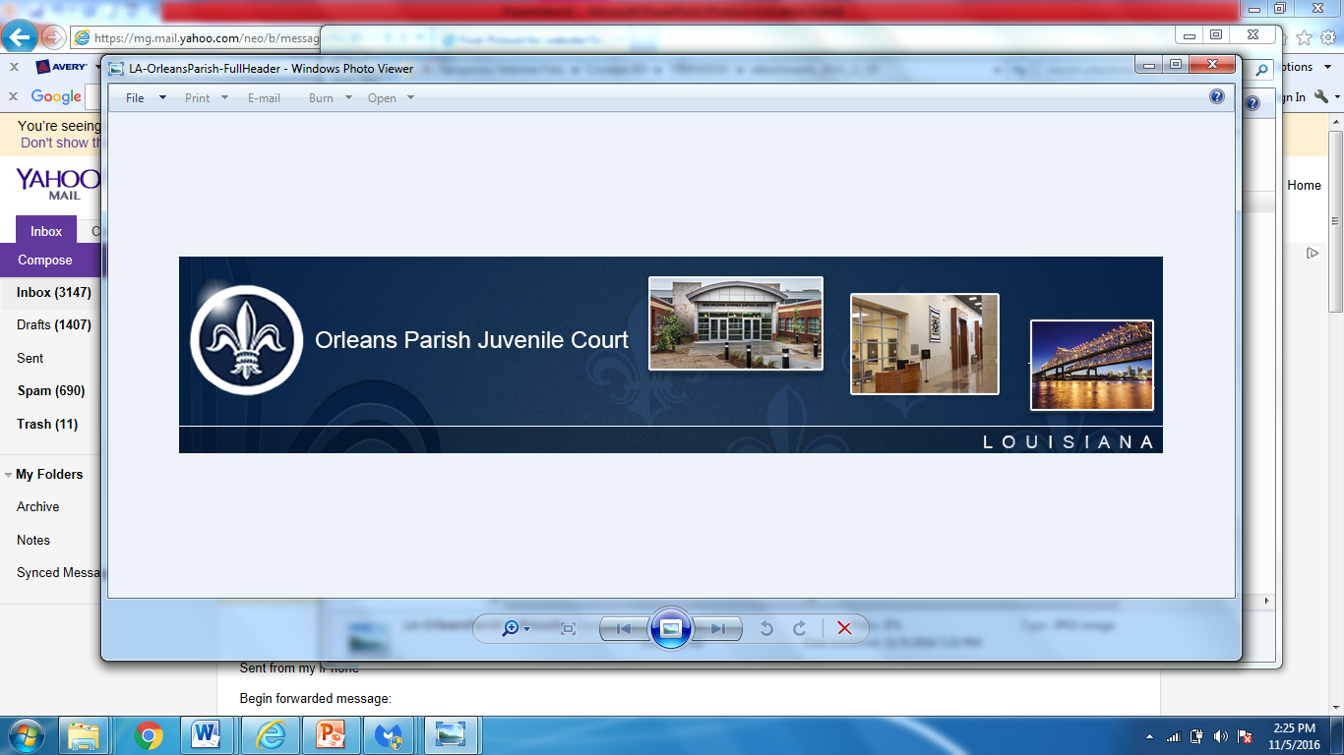
Fulfilling Our Purpose:
“Strengthening Public Safety for our Community”
Quarterly Law Enforcement Check In @
June 29, 2026
Criminal Justice Committee
June 29, 2026

Slide 2



The Judges of Orleans Parish Juvenile Court believe that, through a unified voice and collaboration, the New Orleans Juvenile Justice System can be a leader in administering fair and equal justice, provide individualized comprehensive and effective programs for delinquent and neglected youth, and ensure accountability that builds safe, resilient families and communities.
To provide a court of excellence for children, youth, and families by enforcing the Louisiana Children’s Code.

Slide 3

CURRENT BUDGET/STAFFING

Slide 4
ORLEANS PARISH JUVENILE COURT
2026 CURRENT STAFFING AND APPROVED BUDGET
Org | Description | FTE | PT | Budget | Vacancies*
8302 | Administrative Services | 14 |  | $1,261,307 | 4*
8302 | Other Operating - Contractors | 10 | 1 | $775,989
8303 | Clerk's Services | 4 |  | $292,011
8308 | Judges Personnel | 10 |  | $677,711.0
 | Total | 38 | 1 | $3,007,018 | 4*

Slide 5

2025 Vacancies
2 Vacancies –
1 Case Manager
1 Data Analyst
(Vacant beginning 1/1/2026)
_________________________________
2 Vacancies – 1 Court Clerk II
1 Law Clerk
(Result of resignations)

Slide 6
Juvenile Arrests for 2024, 2025, January 1, 2026 to June 26, 2026 Offenses between Monday – Friday, 8AM – 3:30PM

Slide 7
.
Juvenile Arrests for 2024, 2025, January 1, 2026, to June 26, 2026 Offenses between Monday – Friday, 8AM – 3:30PM

Slide 8


Slide 9


Slide 10

2026 CHALLENGES

Slide 11

1. Staff Vacancies
. 2. Staff Security Gate

Slide 12


