Slide 1
Waymo, Robotaxi and Zoox:
Autonomous for-hire vehicles and the City of New Orleans
City Council Transportation Committee, June 10, 2026
Ashley Becnel, Executive Counsel

Slide 2
Agenda
What are autonomous for-hire vehicles?
1
Federal Regulations
2
State and City Regulations
3
Waymo Testing in New Orleans
4
City Legislation
5

Slide 3
What are Autonomous For-Hire Vehicles?
3
Autonomous: driverless
For-hire: available to provide rides to passengers in exchange for a fare, similar to taxis and rideshare
Waymo: Most established, operated by Google
Robotaxi: Operated by Tesla
Zoox: Operated by Amazon

Slide 4
Federal Regulations
Levels of Automation:
  Level 0 – Momentary Driver Assistance
    You drive, you monitor
    Driver is fully responsible for driving the vehicle while system provides momentary driving assistance, like warnings and alerts or emergency safety interventions.
  Level 1 – Driver Assistance
    You drive, you monitor
    Driver is fully responsible for driving the vehicle while system provides continuous assistance with either acceleration/braking OR steering.
  Level 2 – Additional Driver Assistance
    You drive, you monitor
    Driver is fully responsible for driving the vehicle while system provides continuous assistance with both acceleration/braking AND steering.

Slide 5
Federal Regulations
Levels of Automation:
  Level 3 – Conditional Automation
    System drives, you must be available to take over upon request
    System handles all aspects of driving while driver remains available to take over driving if system can no longer operate.
    i.e. Tesla
  Level 4 – High Automation
    When engaged, system drives, you ride
    When engaged, system is fully responsible for driving tasks within limited service areas. A human driver is not needed to operate the vehicle.
    Not available on today’s vehicles for consumer purchase
  Level 5 – Full automation
    When engaged, system drives, you ride
    When engaged, system is fully responsible for driving tasks under all conditions and on all roadways. A human driver is not needed to operate the vehicle.
    Not available on today’s vehicles for consumer purchase

Slide 6
Federal Regulations
How do I know whether this is safe?
  Vehicles are tested by the companies that build them and must comply with Federal Motor Vehicle Safety Standards and certify that their vehicle is free of safety risks
  Higher levels of automation are in testing but are not yet available for purchase

Slide 7
Federal Regulations
Automated Vehicle Complaint Form
  Nhtsa.gov/report-a-safety-problem#/automated-vehicle/automated-vehicle-information
  Vehicle Safety Hotline: 888-327-4236

Slide 8
What are Autonomous For-Hire Vehicles?
3
Autonomous for-hire vehicles operate at Level
4
High Automation, no human driver necessary
Restricted to operating in specific mapped geographical areas (“geofenced”)
Waymo: Manual controls remain unused during passenger transit but may be operated remotely; traditional seating layout
Robotaxi: Manual controls remain unused during passenger transit but may be operated remotely; traditional seating layout
Zoox: No manual controls; face-to-face seating

Slide 9
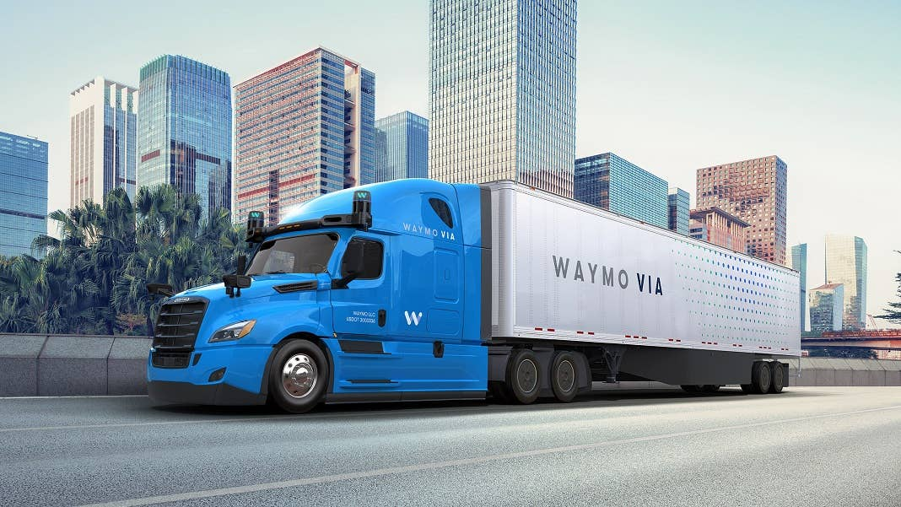
State and Local Regulations
The State of Louisiana only regulates commercial autonomous vehicles
Notes:
Already present in Texas

Slide 10
State and Local Regulations
City regulations focus on drivers
  CPNC: Traditional taxis
  TNC: Rideshare (Uber/Lyft)

Slide 11
State and Local Regulations
Driver includes every person in actual operation of a vehicle licensed for operation as a for-hire vehicle under this chapter, whether as owner or agent, bailiff, lessee, servant or employee of the owner.

Slide 12
State and Local Regulations
Sec. 162-81. - Required.
  It shall be unlawful for any person to drive any vehicle regulated by this chapter without possessing a current driver's permit or a duplicate thereof should the same be lost or destroyed.
Sec. 162-83. - Photographs and fingerprints.
  Each applicant for a driver's permit shall submit photographs according to the requirements for identification established by the ground transportation bureau and shall submit to being fingerprinted.
Sec. 162-90. - Photo identification.
  Every driver shall wear a photo identification designed according to specifications of the director of the department of public works. Such identification shall be worn on the chest of the driver during all hours of duty and in such a position that it is plainly visible at all times.

Slide 13
State and Local Regulations
California:
  Police can cite autonomous vehicles for moving violations (“Notice of AV Noncompliance”)
  AV companies must respond to emergency calls from first responders within 30 seconds
  AV companies must maintain an approved, publicly-posted First Responder Interaction Plan detailing how officers can access vehicle overrides
  Emergency officials can use geofencing to prevent AVs from entering active emergency scenes
  Required minimum $5m in liability insurance coverage
  “Safety Case” testing
  Maintenance of two-way communication link between passengers and remote operators at all times
  Public complaint portal

Slide 14
State and Local Regulations
Texas:
  Requires DMV authorization
  Vehicles must have recording devices and meet certain safety and failure requirements
  Companies must submit First Responder Plans
  Public complaint portal
Notes:
Texas cities are preempted from regulating Avs; this is also true in Tennessee (Waymos operate in Nashville) and Florida (Orlando and Miami)

Slide 15
State and Local Regulations
New York City:
  Prior pilot testing permit expired March 31, 2026 and was not renewed so these vehicles cannot operate in NYC
  Human operators must be seated behind the wheel, capable of taking control of the vehicle at any time
  Taxi requirements prohibit for-hire use of such vehicles
Notes:
Boston also does not support laws allowing Waymo, largely as a result of union outreach. Massachusetts state law would have to be changed to allow AVs

Slide 16
Waymo Testing in New Orleans
Waymo is currently testing around 12 vehicles here with drivers in all vehicles
Planning to transition to autonomous tests later in 2026
For-hire service would not begin until testing is completed

Slide 17
City Legislation
Goals:
Ensure that adequate safety controls exist to protect passengers and other citizens using the public right-of-way
  Clear rules for treatment of passengers
  Legal guardrails regarding liability toward other cars, cyclists, and pedestrians
  Protocols for public safety interactions
Work toward parity in fees among all types of for-hire vehicles
​

Slide 18
City Legislation
Q1
Q2
Q3
Q4
2027
Conversations among City stakeholders including Ground Transportation Bureau
Conversations with industry stakeholders; Transportation Committee discussion
Ordinance drafting and introduction
Waymo autonomous testing; administrative work to implement ordinance
Licensed for-hire autonomous vehicle rides available

