Slide 1
City of New Orleans City Council Governmental Affairs Committee-Safety & Permits
As of May 2026

Slide 2
Safety and Permits Overview
The Department of Safety & Permits is made up of various divisions. These divisions work collectively to ensure safety standards for all construction and building uses.
Focusing on organizational-wide improvements will enhance customer service and rebuild public trust.

Slide 3
Interim Director of Safety and Permits
Susannah Kirby
Susannah’s qualifications position her to carry out the Mayors vision:
  Sewerage and Water Board– Comptroller → Chief Customer Service Officer, 2023-2026
  Tulane University – Director of Finance, 2020-2022
  University of Arkansas for Medical Sciences– Senior Financial Manager, 2015-2020

Slide 4
Department of Safety and Permits
Safety and Permits is made up of various divisions, which work collectively to ensure that safety standards are met for all construction and use of buildings and properties in the city of New Orleans
Divisions of S&P
  Building divisions
  Electrical & Mechanical Trade Licenses
  Special Events
  Zoning Division

Slide 5
Past and Future for Safety and Permits
Past Challenges | Future Progress and Priorities
Timely Permit Issuance | Filling Key Vacancies
Lack of communication and transparency | New communication structure and community engagement events
Internal and External Education | Cross training and refined job aids/checklists

Slide 6
Recent Wins
Removing barriers, improving service and building trust
Temporary ABO
Community Engagement
New online application process for trades
Elimination of permit requirements for >2 year vacancy

Slide 7
April SPICEcenter Call metrics
Safety and Permits Information and Customer Engagement call center

Slide 8
SPARC City Council Dashboard
Safety and Permits Assistance and Response to Council
Category | Count
Building | 16
Electrical | 5
Mechanical | 8
Plan Review | 5
Special Events | 2
Permit Intake | 2
Short Term Rental | 2
Trade Licenses | 2
Zoning | 24
Status | Count
Open | 7
In Progress | 8
Waiting | 0
Escalated | 0
Closed | 53

Slide 9
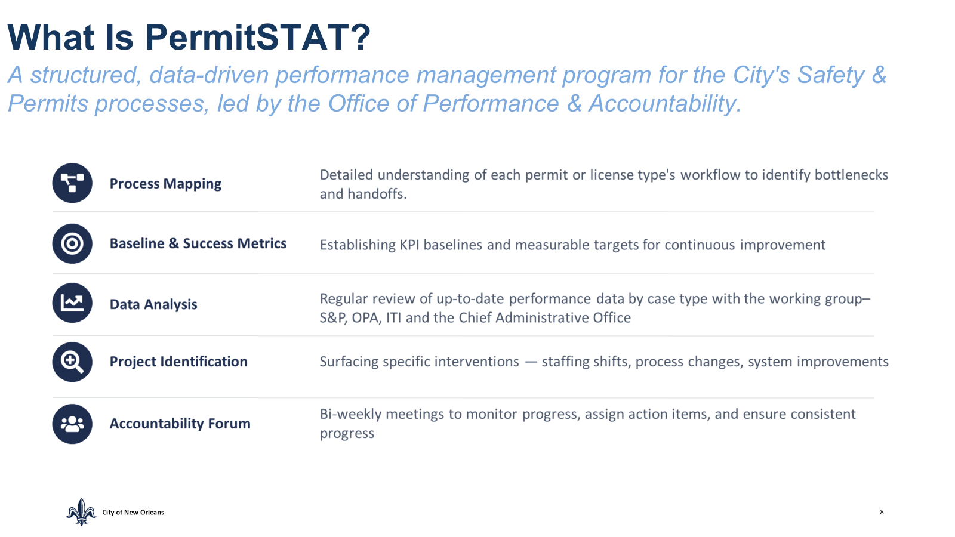

Slide 10
Safety and Permits
Phone: 504-658-7200
Address: 1340 Poydras
Street, Suite 800
New Orleans, LA 70112
Hours: 8am-5pm Monday to Friday
May, 2026

