Slide 1

NORD SUMMER HIGHLIGHTS
HIRING AND PROGRAMS
www.nordc.org

Slide 2
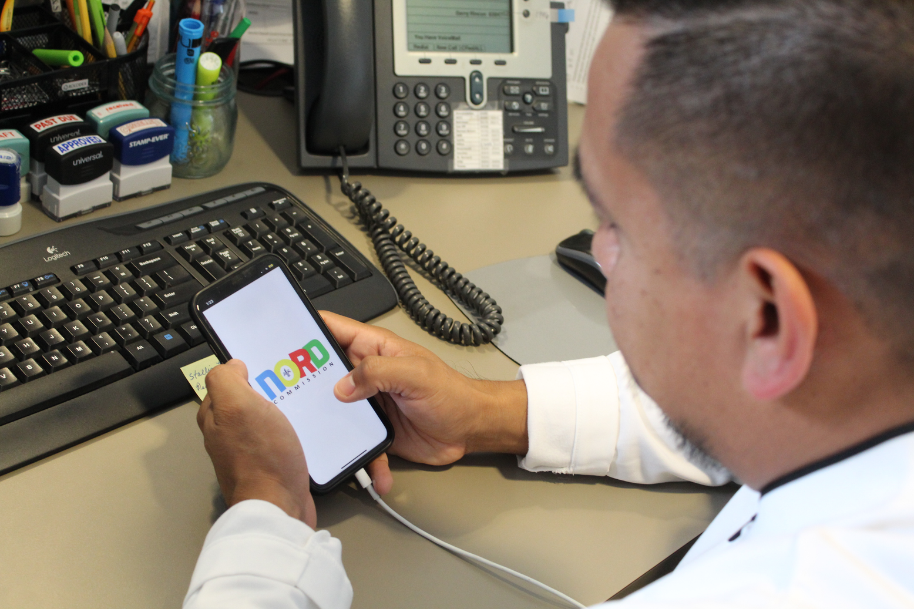
SEASONAL
HIRING GOALS
Lifeguards Needed:
100 positions to fill
Summer Camp Staff:
31 positions to fill

Slide 3
LIFEGUARD APPLICATION
STATUS (TOTAL 77)
1
3
22 pending background checks/drug screens
4
40 completed packets
2
13 pending misc issues (work permits, IDs, certs)
2 failed drug screens (CS letters sent)
As of 5.5.26

Slide 4
SUMMER CAMP COUNSELOR
STATUS (TOTAL 34)
1
3
4 pending background checks/drug screens
4
21 completed packets ready for onboarding
2
5 pending misc issues (expired IDs, missing forms)
4 failed drug screens (2 now cleared)
As of 5.5.26

Slide 5
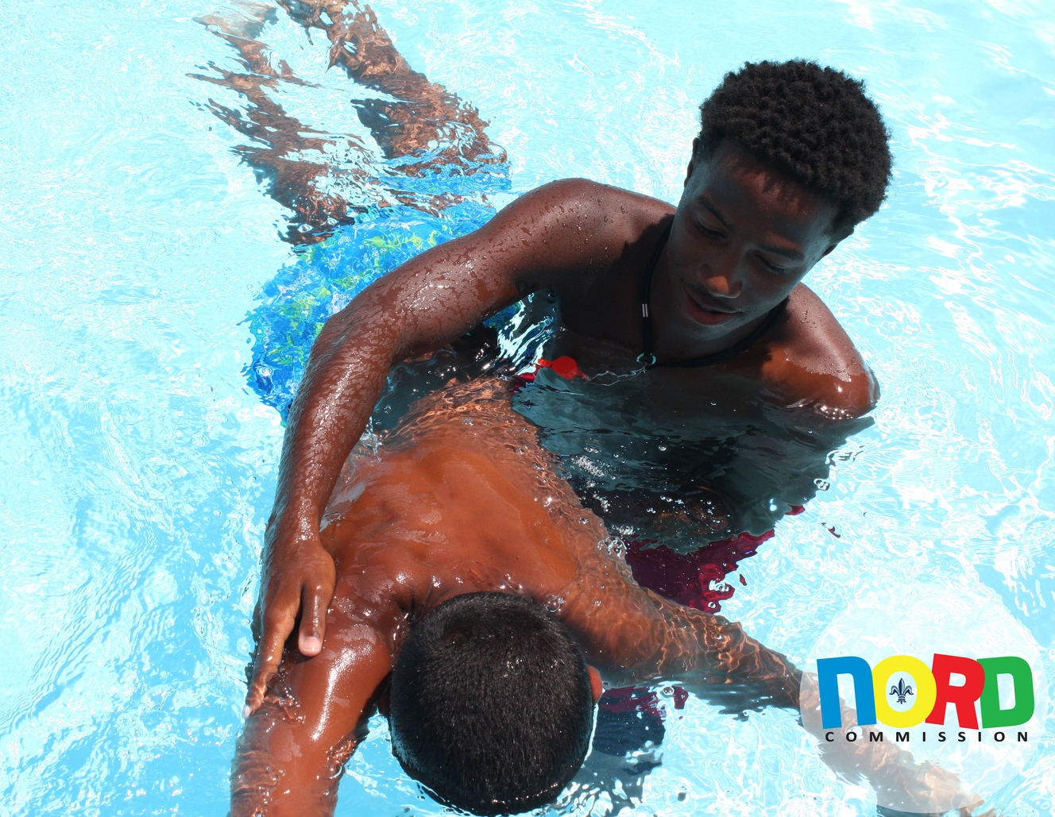
LIFEGUARD HIRING
Starting salary is $17.58 / hour for Lifeguard I
HOW TO APPLY & CRITERIA
1
Candidates must be at least 15 years old
2
Must take and pass a swim test at a NORD pool
3
Applicants that pass the test are then placed in the lifeguard certification class
4
If they pass the certification program, they are directed to NORD’s Admin office to complete the application packet
5
Applicants must pass a background check and a drug test before being hired.

Slide 6
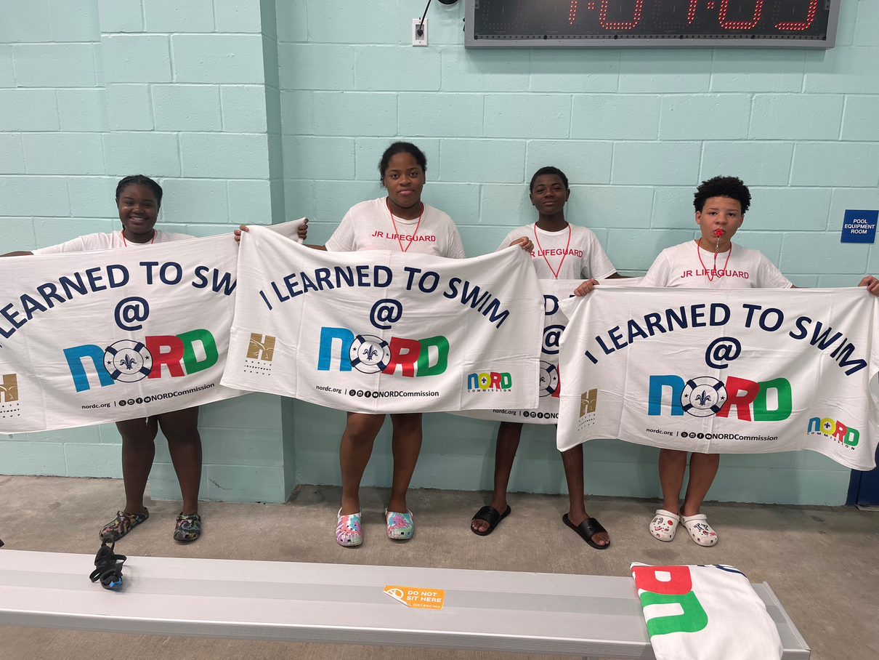
STIPEND BASED PROGRAMS
JR. LIFEGUARDS
Earn a stipend of up to $450 as a Jr. Lifeguard Teen Career Camp Participant
Open to 13 - 15 Year Olds
6 week camp program runs June 1st - July 10th
Available at all 5 NORD Natatoriums, between the hours of 8am - 3pm
To apply, visit nordc.org /summer camp for a list of required documents and contact Destiny Collins at 504-658-3015 to schedule a registration appointment

Slide 7
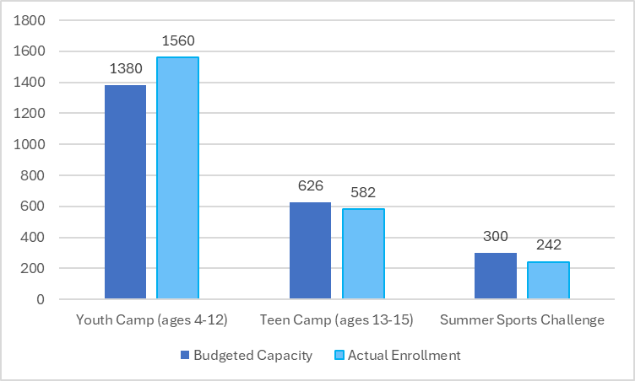
SUMMER CAMP
REGISTRATION
Capacity vs. Actual Enrollment
Youth & Teen camp registration always begins the 2nd Saturday in March. Youth camps were full within 1 month! Teen career camp registration closed May 7th with extremely limited availability at 2 camp locations.

Slide 8
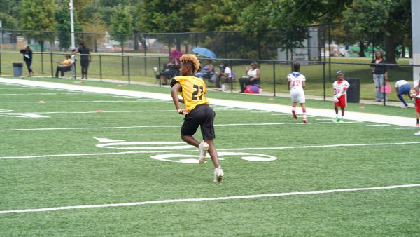
STIPEND BASED PROGRAMS
SUMMER SPORTS CHALLENGE
Teens can earn a stipend of up to $450 through this summer evening program
Open to 13 - 17 Year Olds
Must participate up to 6 hours a week for 6 weeks, June 1st - July 10th, 4pm - 7pm
Evening programs include 7 x 7 flag football, volleyball, basketball, e-Sports, Podcast, and more!
To apply, visit nordc.org /summer camp for a list of required documents and contact Destiny Collins at 504-658-3015 to schedule a registration appointment

Slide 9

SUMMER
PROGRAMS
F
R
E
E
Swimming Lessons for all ages at NORD’s Natatoriums & Select Outdoor Pools
Open Play Basketball and/or Volleyball available at NORD Recreation Centers for Youth & Adults most evenings
Youth Athletic Team Sports offered this summer include Baseball / Softball and Flag Football
Family Game Nights - May 15th at Morris FX Jeff Rec Center and July 17th at St. Bernard Rec Center
Open / Family swim times at all Outdoor Pools including 2 brand new splashpads

Slide 10
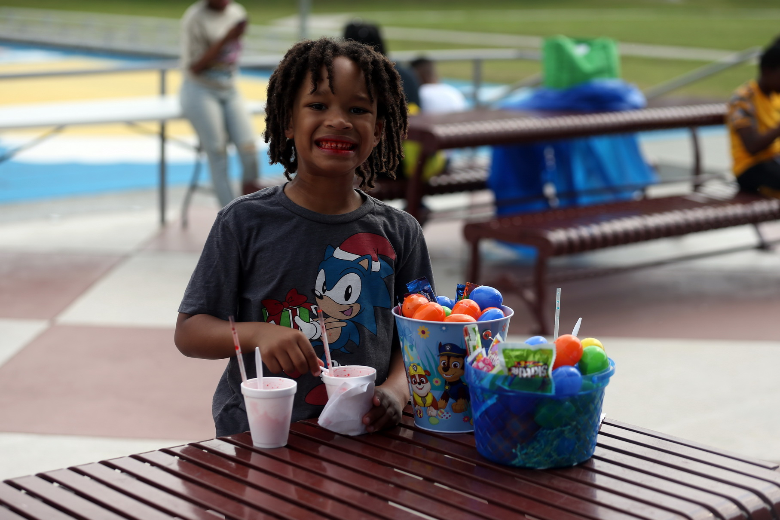
THANK
YOU
www.nordc.org

