Slide 1


Slide 2

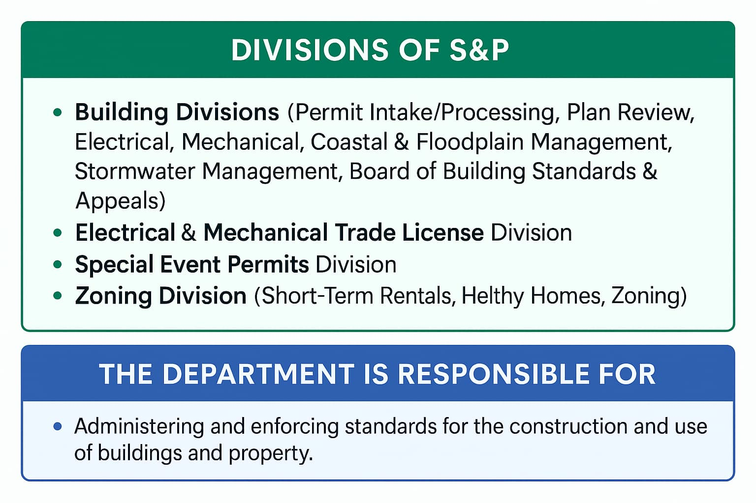
The Department of Safety and Permits is made up of various divisions, which work collectively to ensure that safety standards are met for all construction and use of buildings and properties in the city of New Orleans.

Slide 3
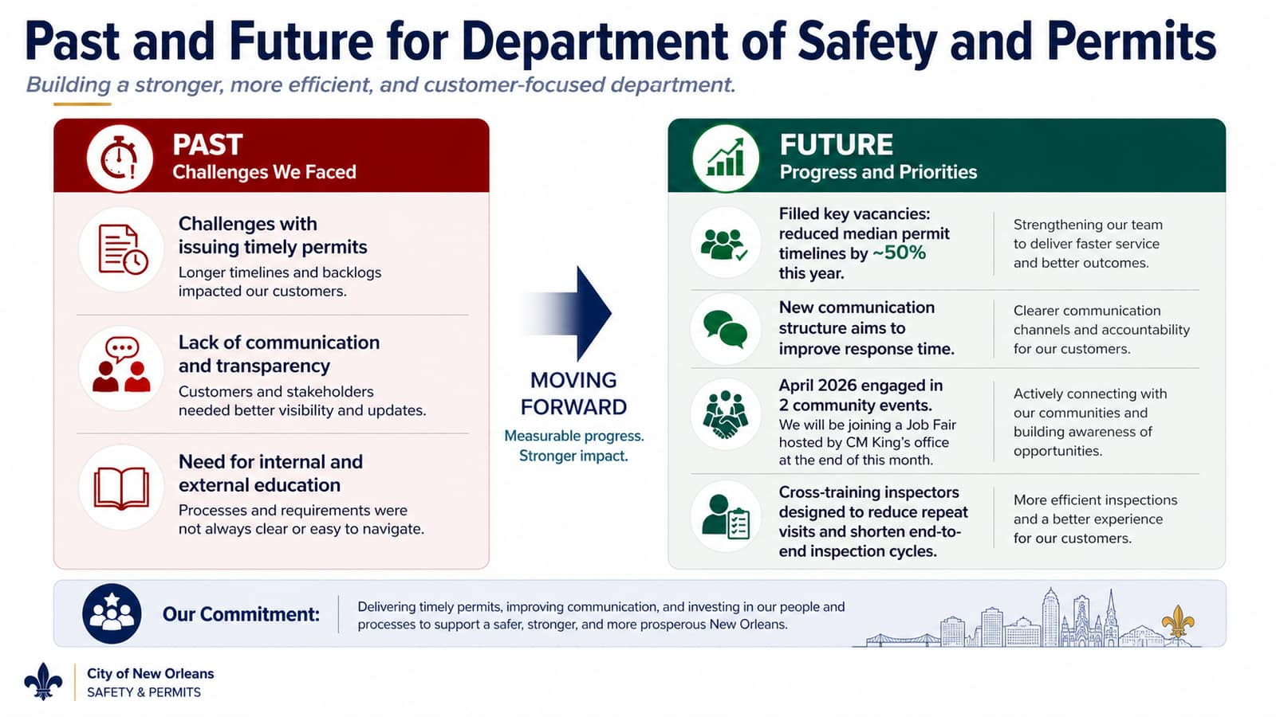

Slide 4
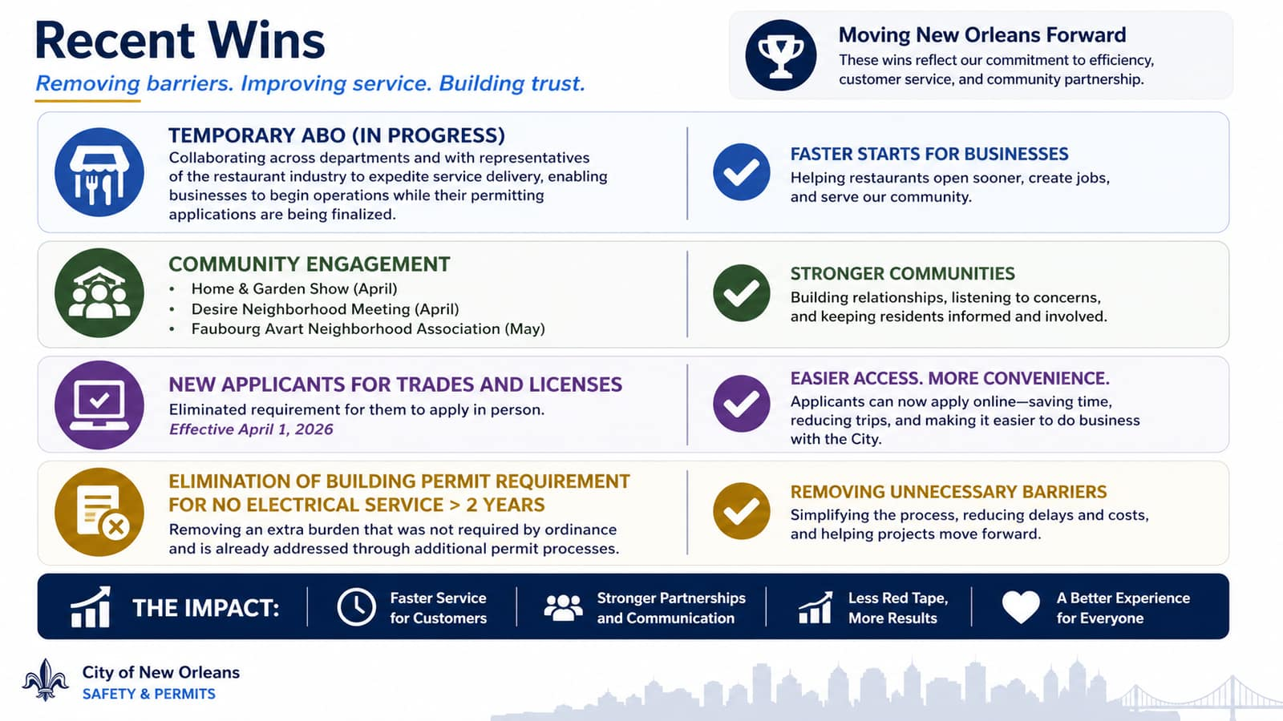

Slide 5
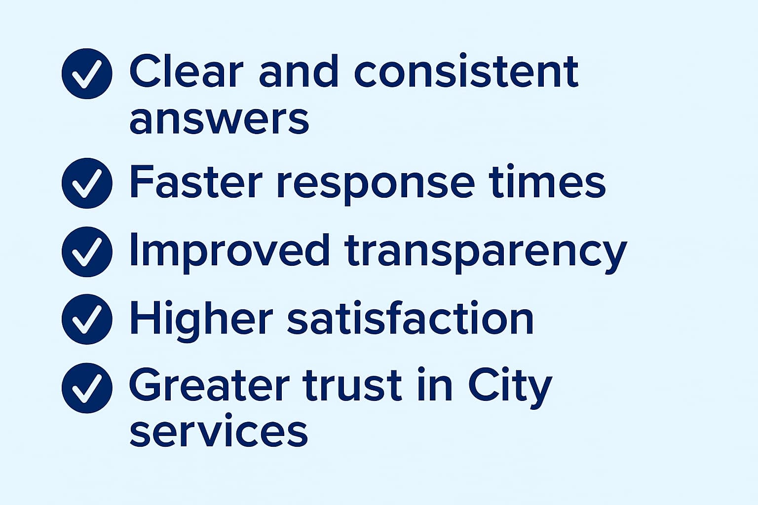
Impact of Improved Services for Customers & Council
Strengthening communication is critical for customers and the City Council — it improves the customer experience through clearer, more responsive service while reducing confusion and complaints that too often fall to Council offices to resolve.

Slide 6
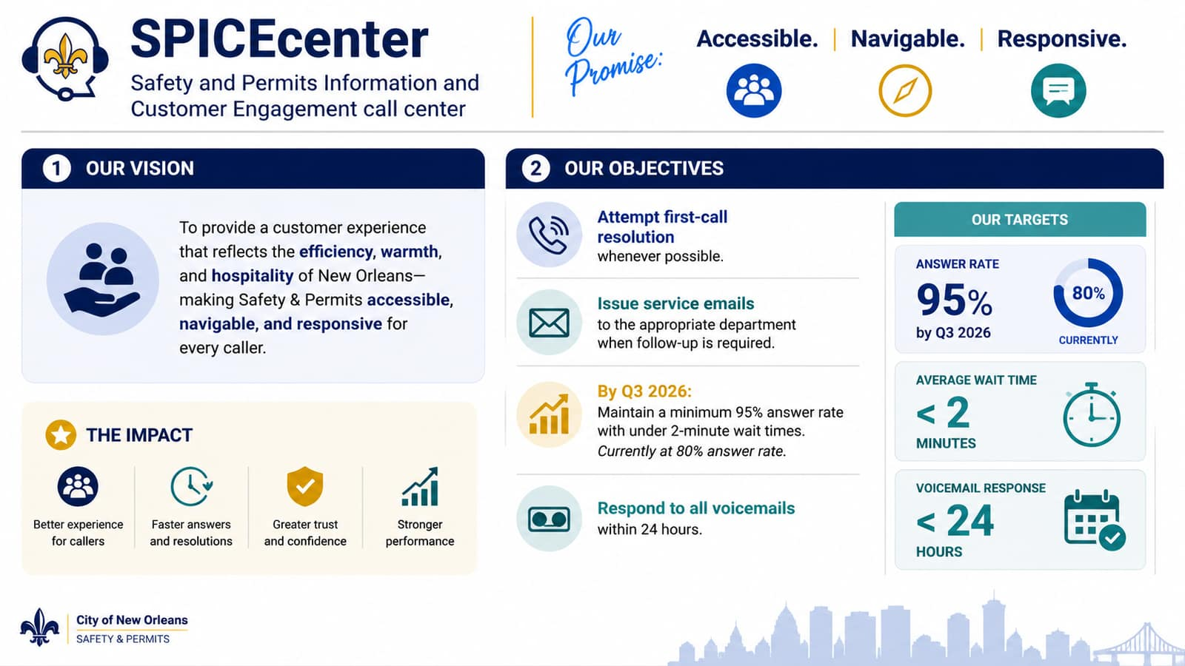

Slide 7
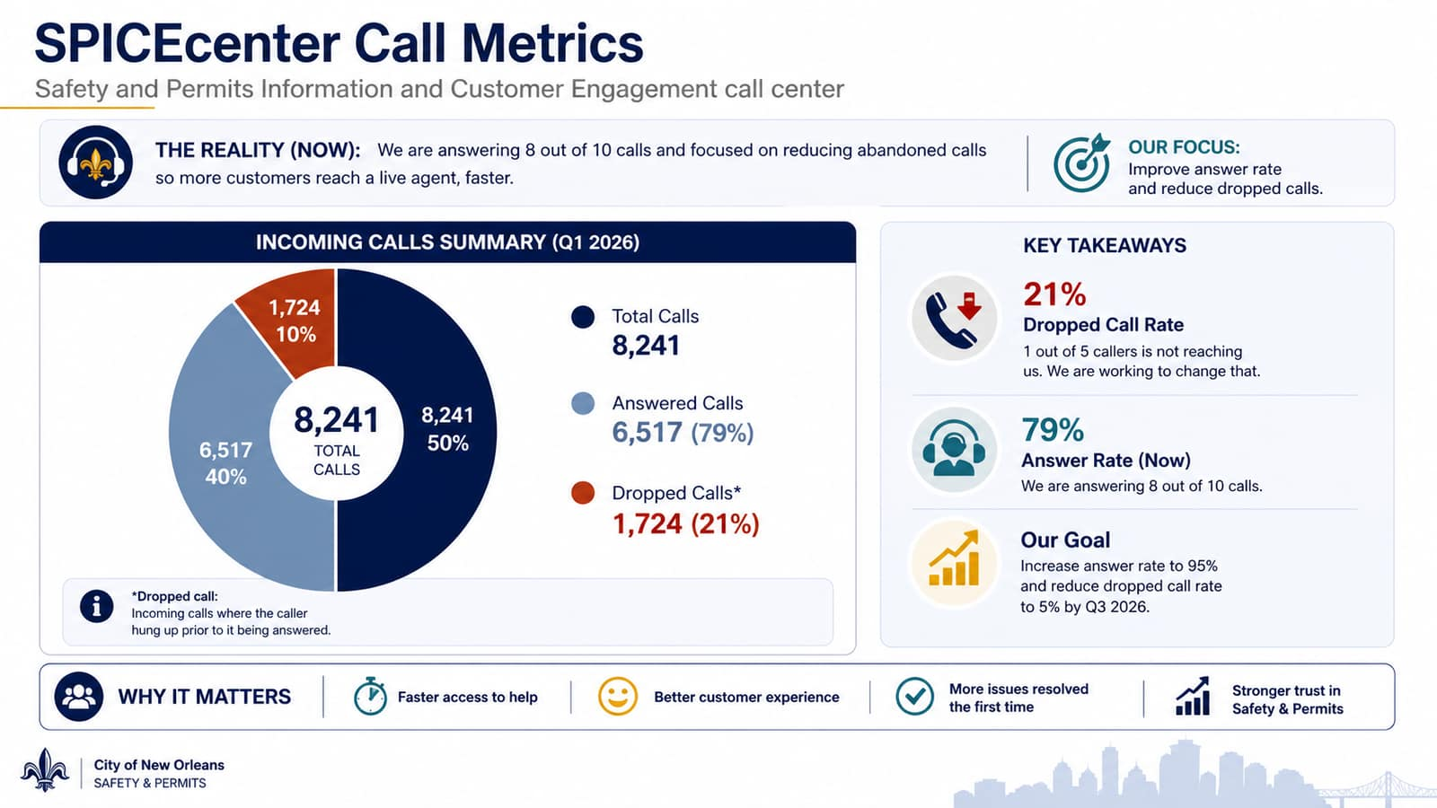

Slide 8
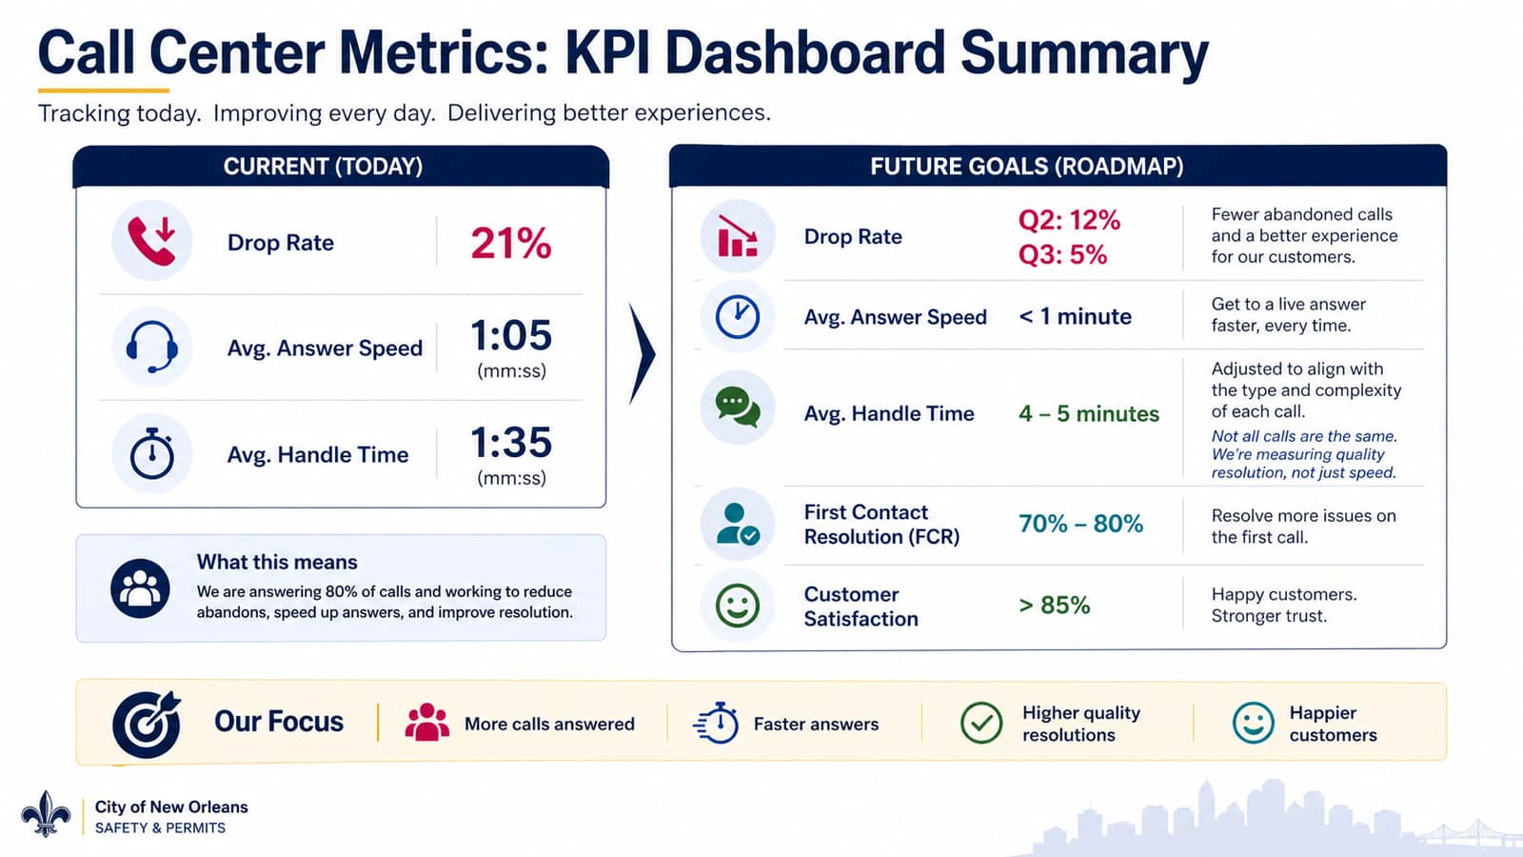

Slide 9
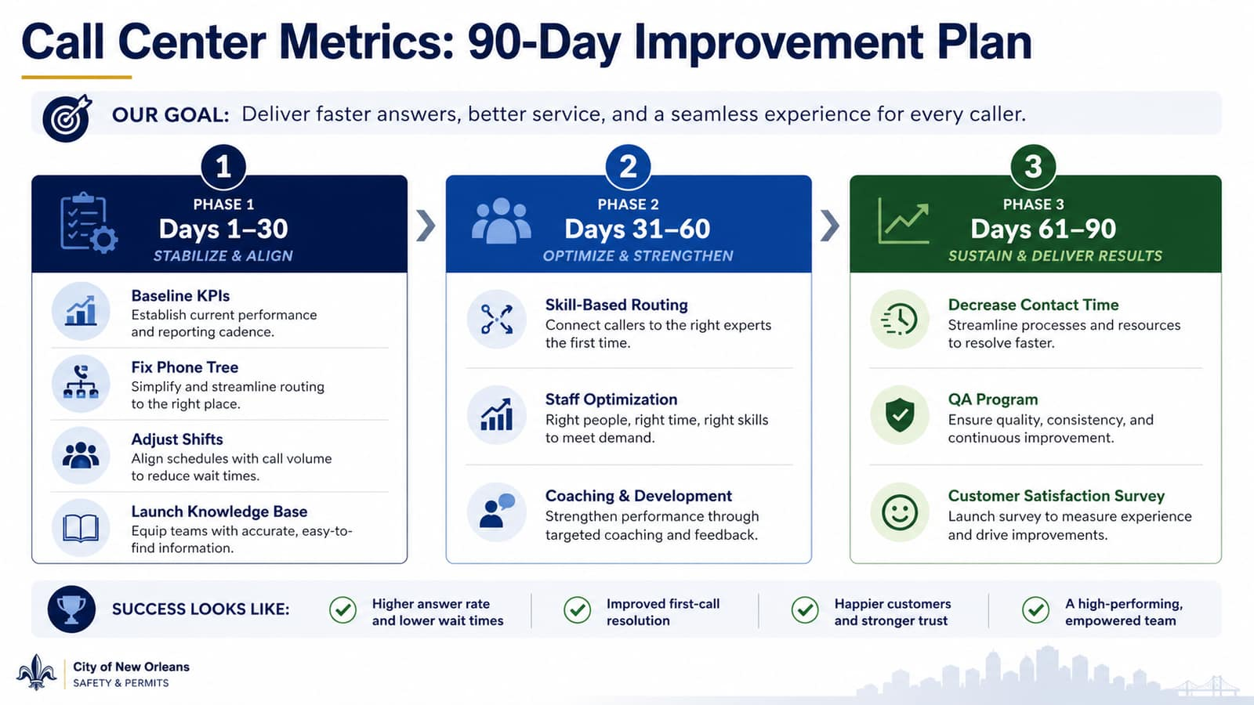

Slide 10
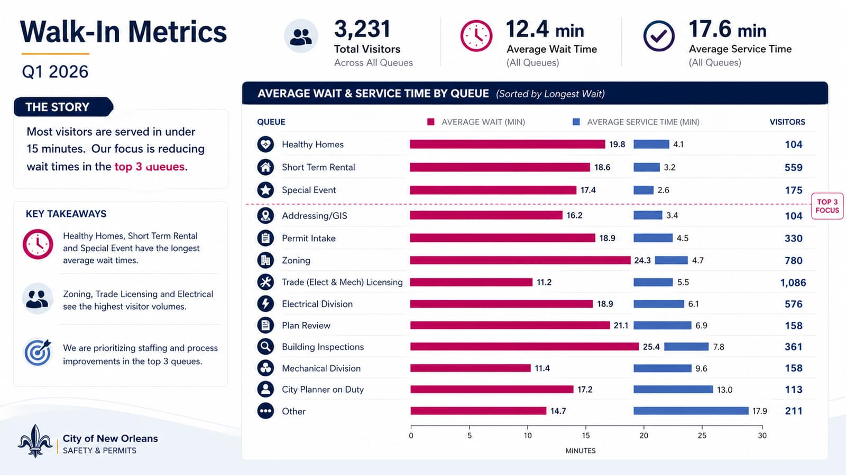
AVERAGE SERVICE TIME
AVERAGE WAIT TIME

Slide 11
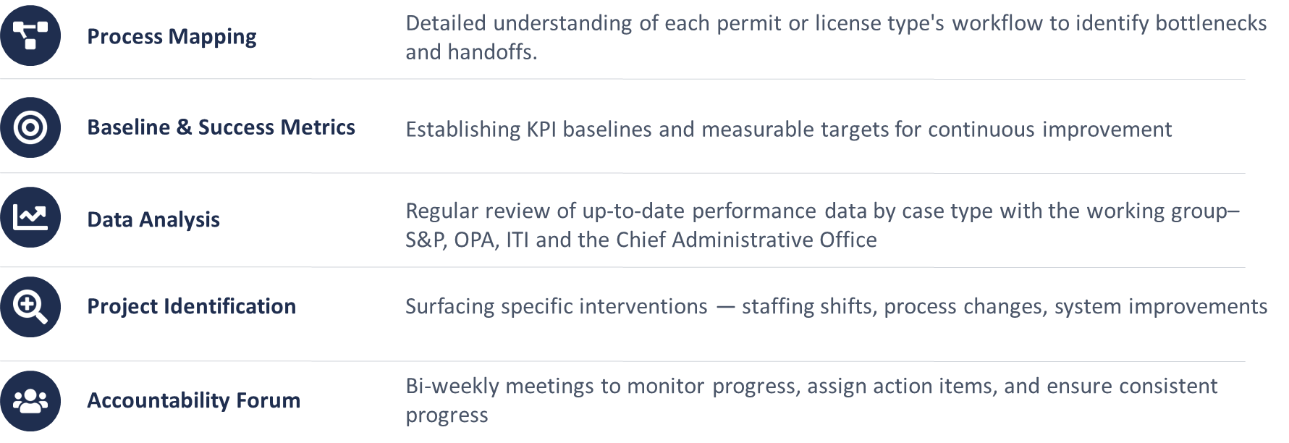
What Is PermitSTAT?
A structured, data-driven performance management program for the City's Safety & Permits processes, led by the Office of Performance & Accountability.

Slide 12
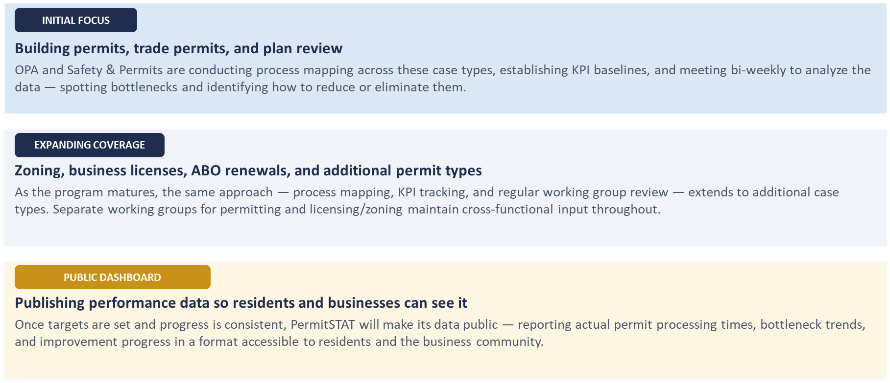
Building the Program, Expanding the Impact

Slide 13
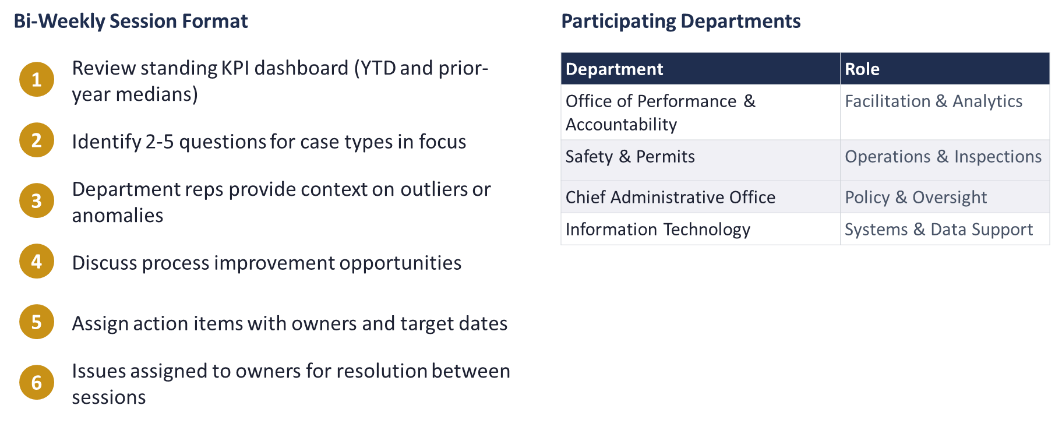
Working Group & Meeting Structure

Slide 14
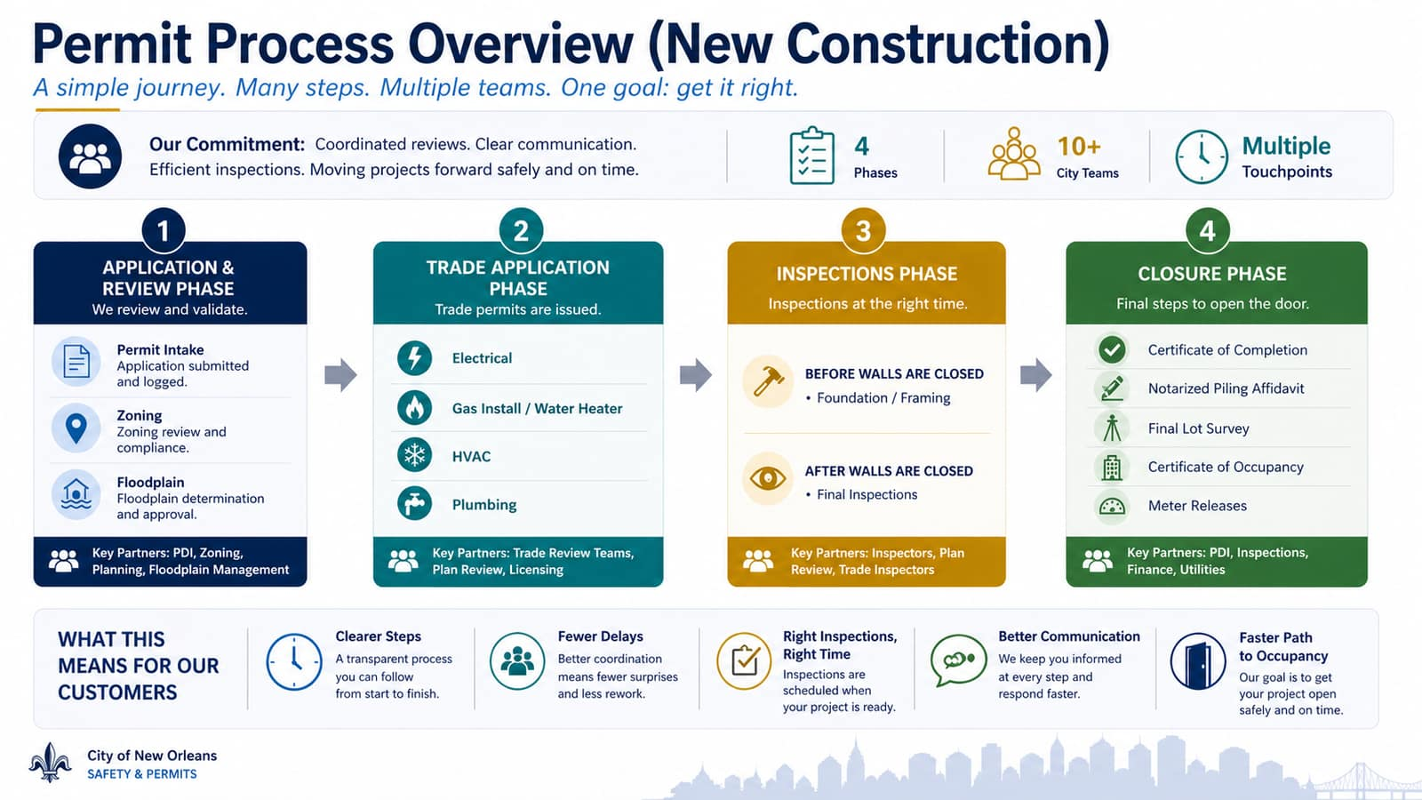

Slide 15
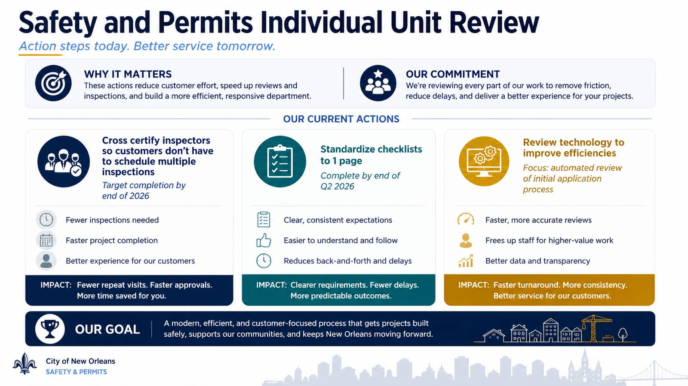

Slide 16
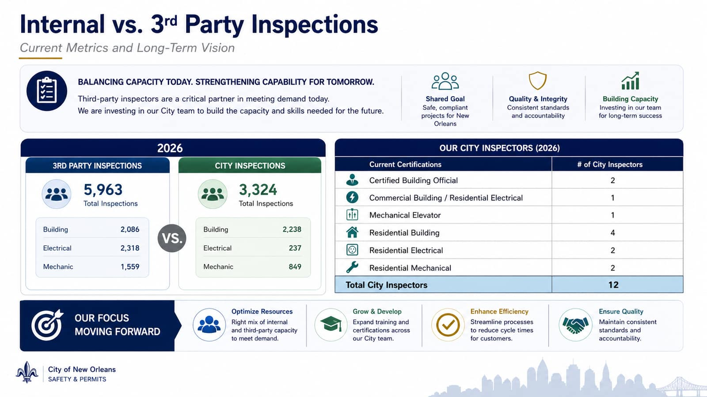

Slide 17


Slide 18


