Slide 1
Ordinance Cal. No. 35,425
(By-Request)
Transfer of Parking and Towing Enforcement from the Department of Public Works to NOPD
As of April 29, 2026

Slide 2
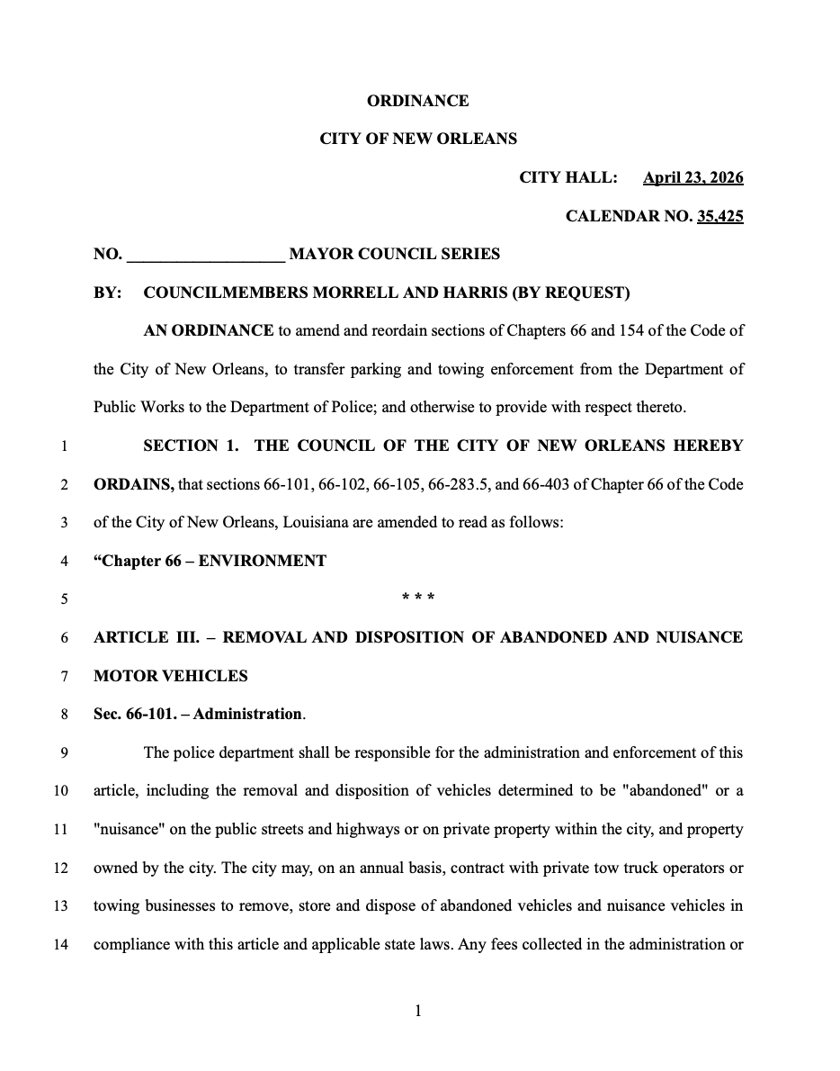
Ordinance Cal. No. 35,425 (By-Request)
City Council introduced Ordinance Cal. No. 35,425 (By-Request CMs Morrell and Harris) at the April 23, 2026 Council meeting to move the City’s parking and towing enforcement team to the NOPD.
Law, NOPD, DPW, CAO, Performance & Accountability, ITI, Finance, and Revenue have worked collaboratively with Council President Morrell’s Office to execute this instrument.
Ordinance amends Chapters 66 and 154 of the Code of the City of New Orleans.

Slide 3
Overview of Ordinance 35,425 (By-Request)
Goal: Authorize NOPD to enforce laws regarding parking and abandoned or nuisance vehicles and clarifies that NOPD has custody over impounded vehicles. Shifts responsibility from DPW to NOPD.
Responsibilities: NOPD shall be responsible for the administration and enforcement, including the removal and disposition of vehicles determined to be "abandoned" or a "nuisance" on the public streets and highways, on private property within the city, and on property owned by the City.
Private Storage/Disposition: The City may, on an annual basis, contract with private tow truck operators or towing businesses to remove, store and dispose of abandoned vehicles and nuisance vehicles.
Fee Collection: Any fees collected shall be transmitted to the Department of Finance for deposit into the general fund. All towing, storage and other such fees contained in this section shall remain consistent w/ the current schedule of prescribed rates and requirements for non-consensual towing and recovery services issued by the LA Public Service Commission.

Slide 4
Challenges Ordinance 35,245 Aims to Address
The goal is a more streamlined system where enforcement, towing, and policing are aligned.
The move to shift parking and towing enforcement to NOPD addresses existing concerns re: safety, efficiency, and revenue collection.
Existing safety concerns during towing and enforcement.
The shift would help with complicated cases (ex: refusals to move vehicles, illegal activity tied to cars, etc.) by partnering parking enforcement teams with law enforcement officers.
Improved coordination: moving responsibilities to NOPD allows one agency to control planning and deployment, especially during festivals, parades, and large-scale events. This reduces delays and confusion stemming from multiple departments coordinating.
Address unpaid parking tickets contributing to City’s budget shortfall.
Fewer cars blocking driveways, fire hydrants, or travel lanes; better traffic movement; and less long-term vehicle abandonment.

Slide 5
Ongoing Staffing and Structural Shift
Existing DPW parking enforcement workers would move under NOPD as civilian employees.
The City is also planning to hire roughly 50 parking enforcement officers and tow drivers this summer.
DPW has agreed to integrate any employees that do not transfer to NOPD into their existing operations to make the transition as seamless as possible for impacted employees.

Slide 6
Cal. No. 35,425 (By-Request)
Thank you! Questions?

