Slide 1
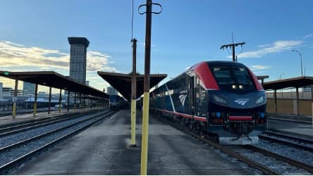
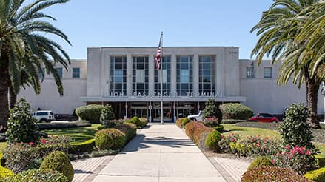
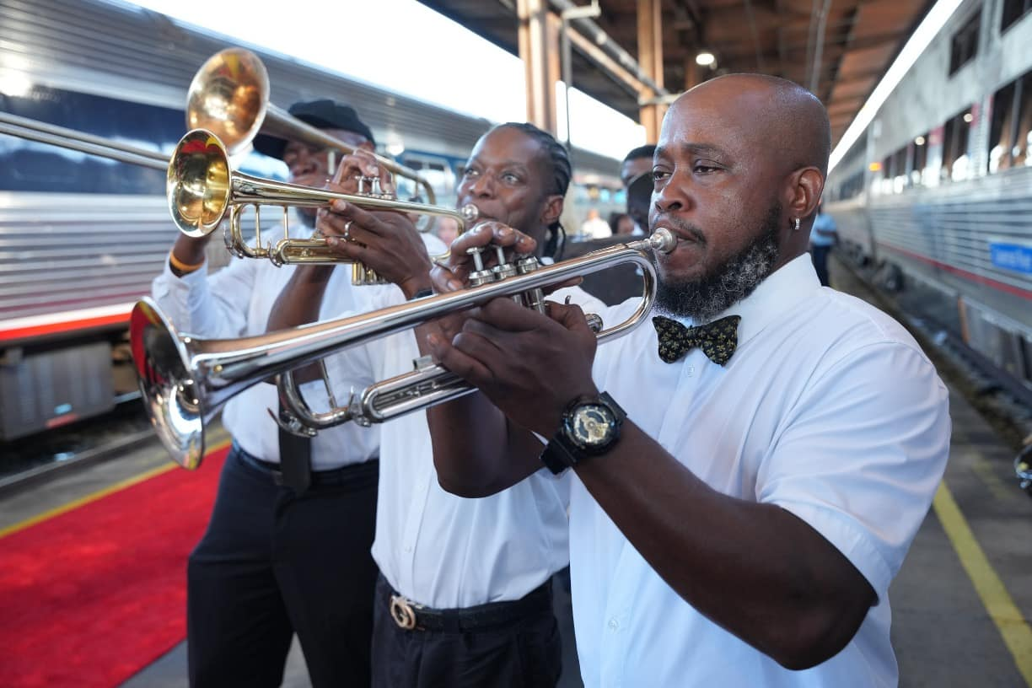
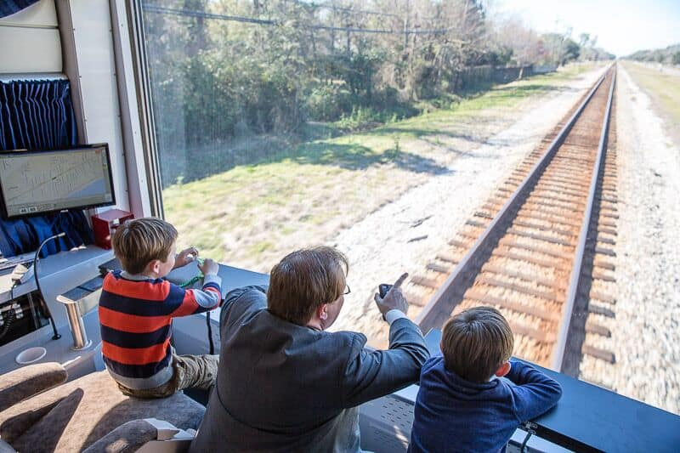
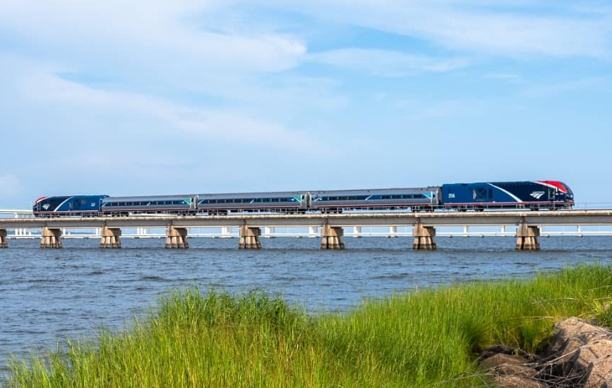
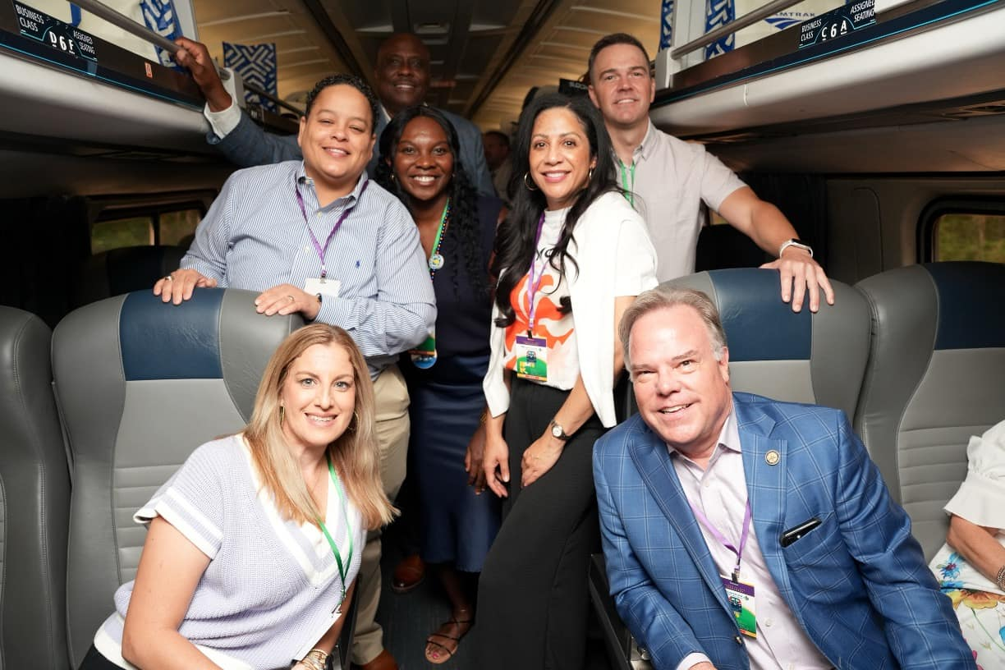
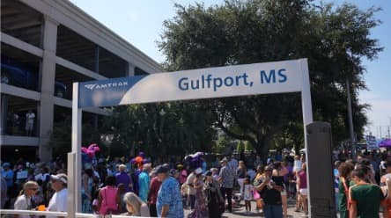
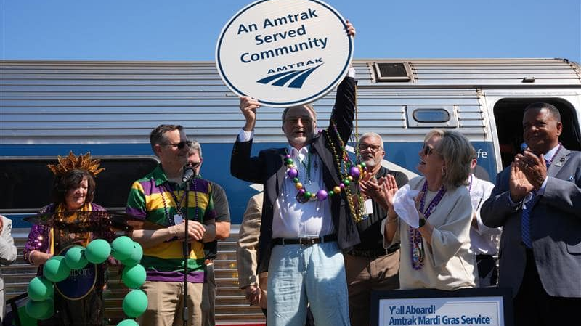

Amtrak Mardi Gras Service Update
April 2, 2026
T. L. Stennis III
Amtrak Director of Government Affairs – South

Slide 2
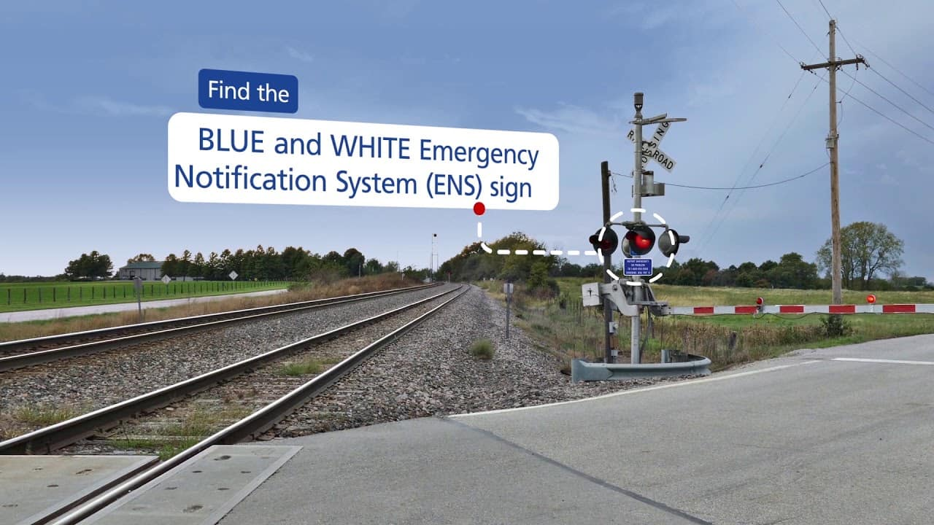
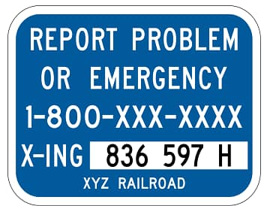
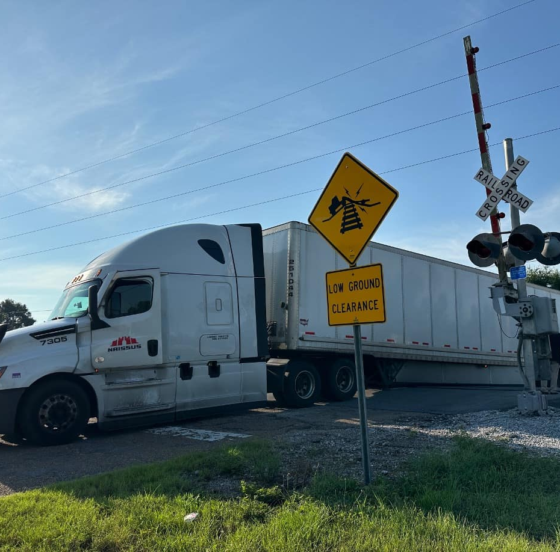
Safety: Emergency Notification Systems (ENS)
In case of emergency at grade crossings, use ENS signs to get help
Pratt Ave. Gulfport, MS on Launch Day

Slide 3
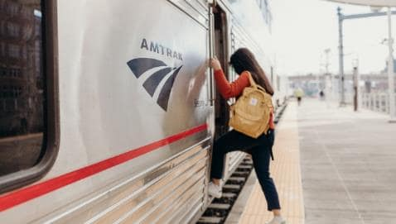
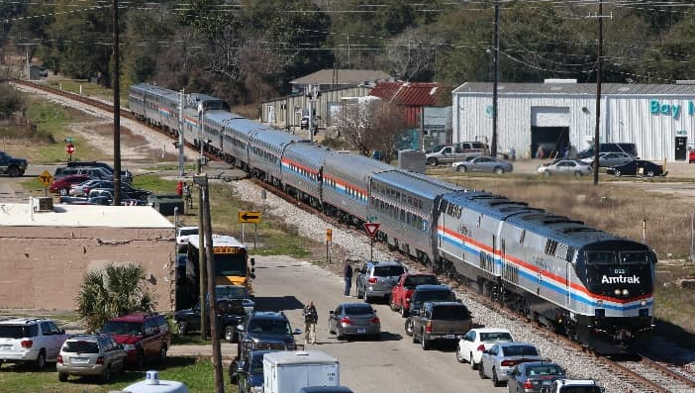

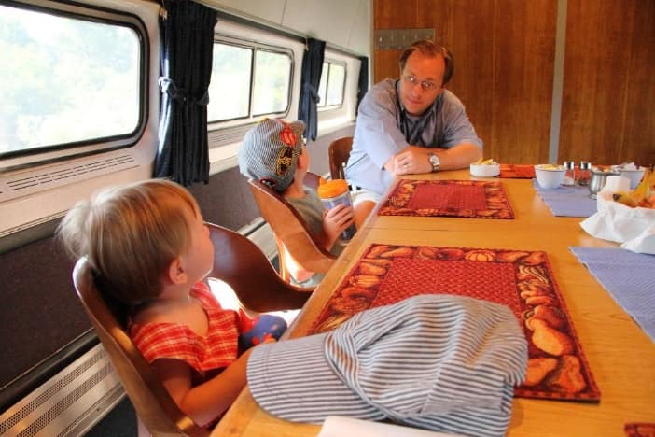
Amtrak History & Overview
Quick Facts
Back-to-back RECORD ridership & revenue
34.5 million+ riders
$4B total revenue
280+ trains per day
40+ routes covering
21,400+ route-miles
524 stations in
46 states, DC, & Canada
21,000+ employees
By law, freight railroads were once obliged to offer passenger service. In the 1950s and ’60s, shifting transportation patterns, encouraged in part by government subsidization of air and highway travel, made passenger rail service unprofitable— driving many railroads to the brink of bankruptcy.
Congress created Amtrak to relieve railroads of their obligation to serve passengers; in exchange, those railroads granted Amtrak certain rights, including the right to use their tracks and facilities. The company began national operations on May 1, 1971.
While congressionally chartered, Amtrak is operated and managed as a private, for-profit corporation. By law, its mission is to “provide efficient and effective intercity passenger rail mobility consisting of high-quality service that is trip-time competitive with other intercity travel options.”

Slide 4
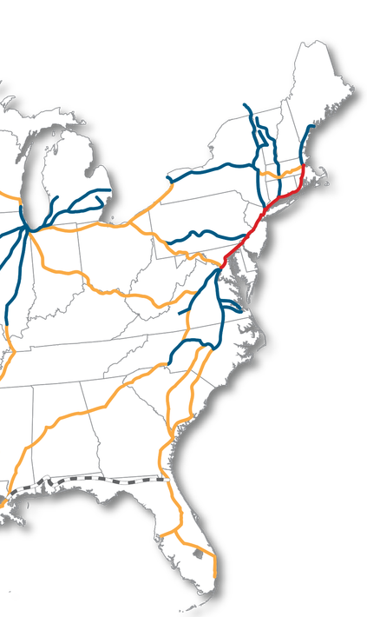
Service Lines: Three Lines, Two Accounts
Northeast
Corridor
Northeast Corridor Service Line (NECSL)
Fast, frequent, operationally profitable service along an electrified, mostly Amtrak-owned rail line (the NEC) linking cities between Boston & DC. Includes high-speed Acela service, soon to reach 160mph..
National
Network
State-Supported Service Line (SSSL)
Short corridor routes (750 miles or less), mostly over freight host railroad tracks, connecting communities within a single region; served per contracts with sponsoring states, which provide operating support. (Amtrak supplies crew, and often fleet). Governed by the Passenger Rail Investment and Improvement Act (PRIIA), section 209.
Long-Distance Service Line (LDSL)
Interregional routes (more than 750 miles), mostly over freight host railroad tracks, that serve both major cities and small, rural communities; most routes are multi-day, and most trains feature sleeper & dining cars. Service levels guaranteed by law; federal government provides operating support.

Slide 5
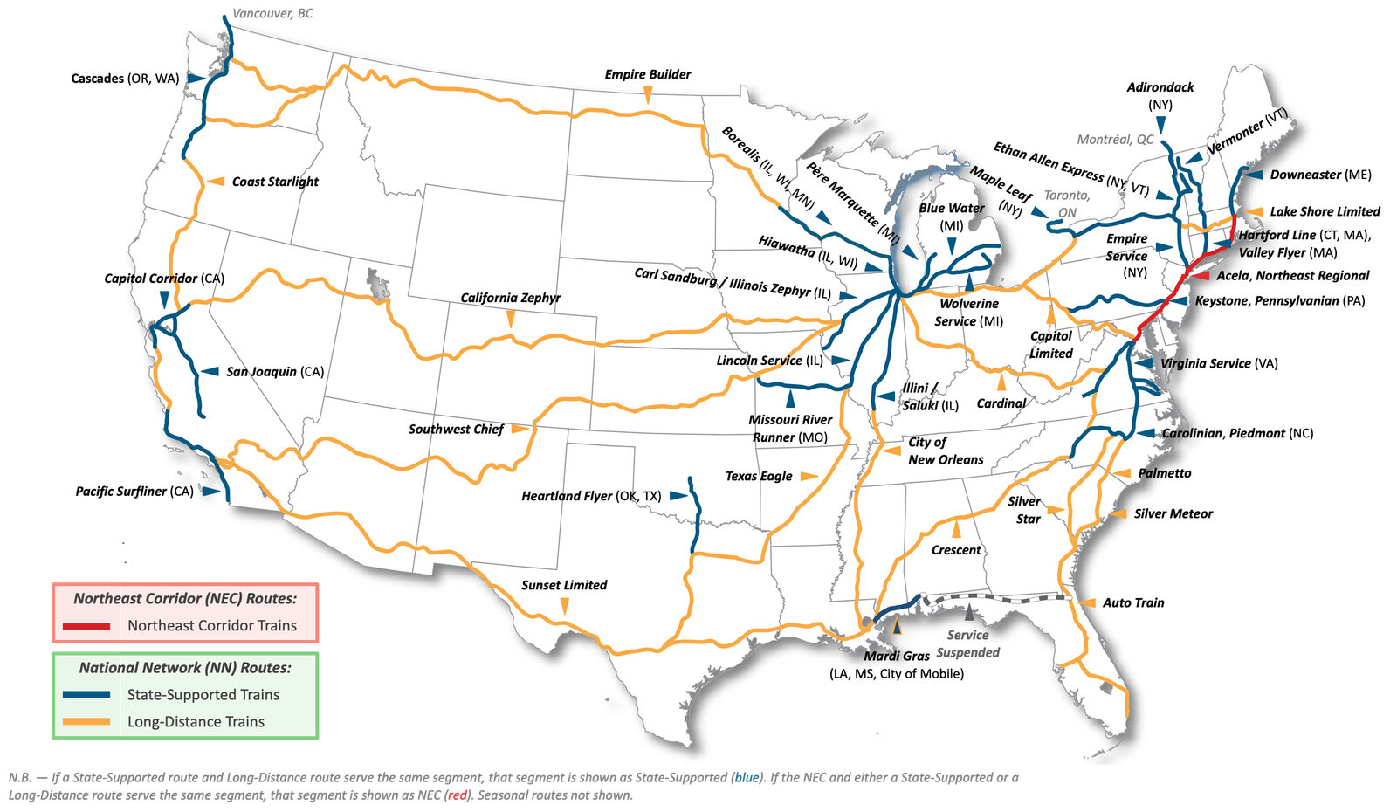

Slide 6
Amtrak in Louisiana
5 daily trains over 4 routes serving 8 communities:
  State-supported Mardi Gras Service
  Long-distance Crescent, City of New Orleans, & Sunset Limited routes
Maintenance facility and crew base in New Orleans
216k ons & offs at Louisiana stations.
262 employees, with total direct payroll of approximately $22.7 million.
Mardi Gras Service began on August 18, 2025 and has significantly outperformed projections.

Slide 7
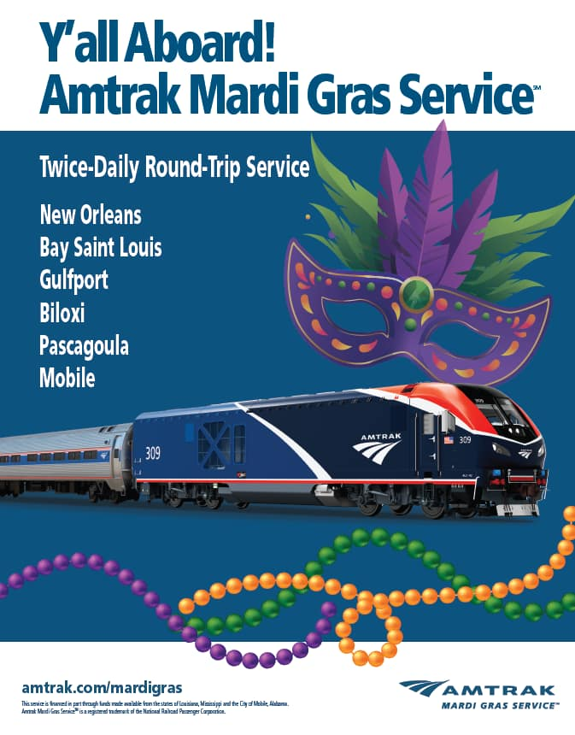
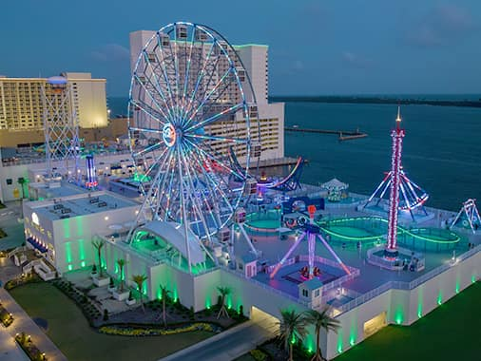

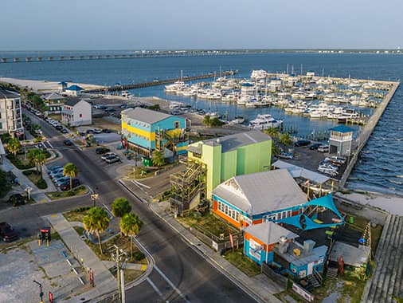
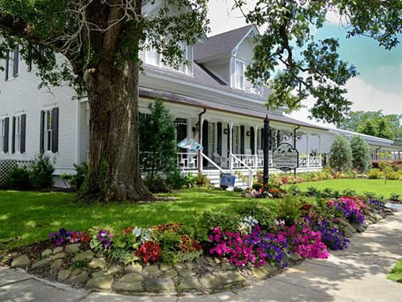
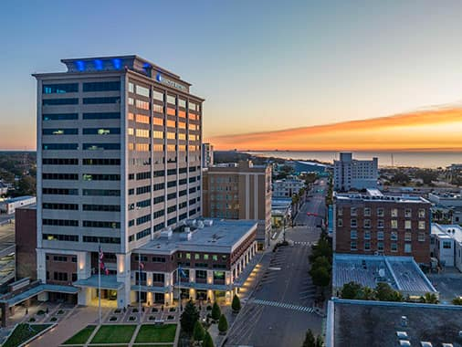
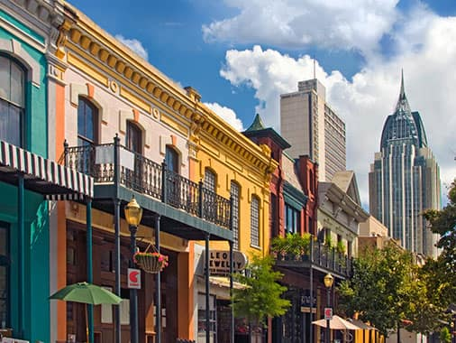
New Orleans, LA
Biloxi, MS
Bay Saint Louis, MS
Pascagoula, MS
Gulfport, MS
Mobile, AL

Slide 8


Amtrak Mardi Gras Service Schedule
Eastbound | NOL | BAS | GUF | BIX | PAG | MOE
Amtrak Mardi Gras Service Train 24 Originates in NOL | 7:35 AM | 8:57 AM | 9:29 AM | 9:53 AM | 10:27 AM | 11:18 AM
Amtrak Mardi Gras Service Train 26 Originates in NOL | 5:31 PM | 6:58 PM | 7:30 PM | 7:54 PM | 8:26 PM | 9:14 PM
Westbound | MOE | PAG | BIX | GUF | BAS | NOL
Amtrak Mardi Gras Service Train 23 Originates in MOE | 6:30 AM | 7:13 AM | 7:48 AM | 8:11 AM | 8:42 AM | 10:13 AM
Amtrak Mardi Gras Service Train 25 Originates in MOE | 4:30 PM | 5:13 PM | 5:48 PM | 6:11 PM | 6:42 PM | 8:13 PM

Slide 9
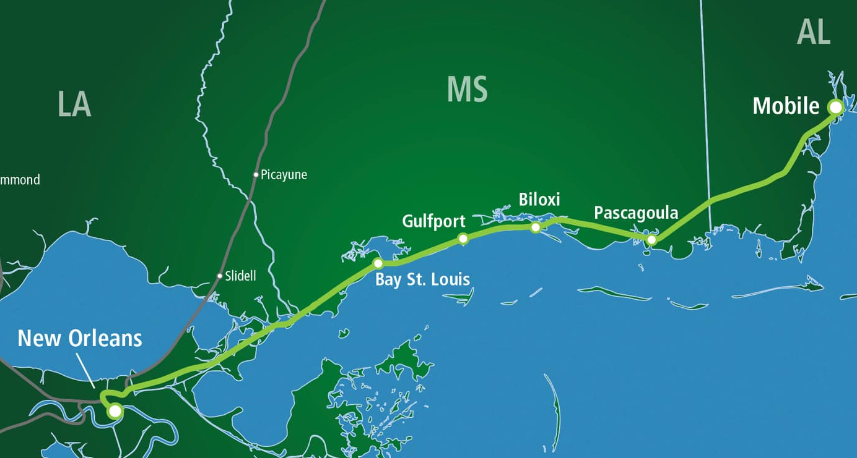
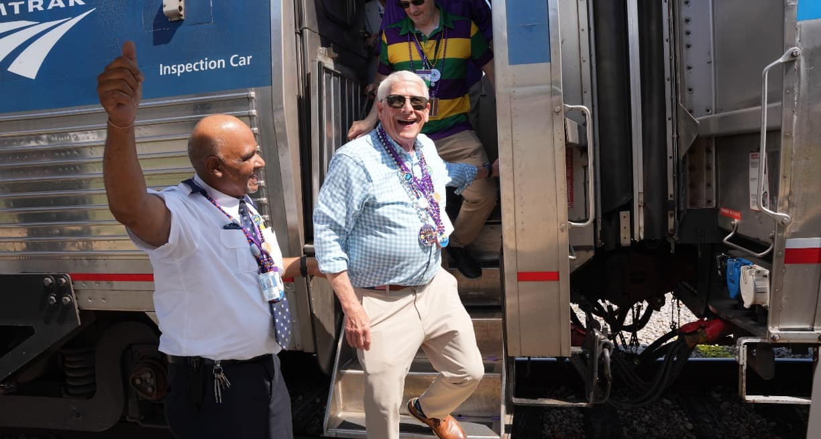
Amtrak Mardi Gras Service Overview
Twice-daily round trips between New Orleans and Mobile
Convenient connections to other trains:
  City of New Orleans to Chicago
  Crescent to Atlanta, Washington and NYC
  Sunset Limited to Houston and Los Angeles
Amenities: Coach & Business Class; free WiFi, café service with local products, & no middle seat.
Operated by Amtrak and supported by Louisiana, Mississippi and the City of Mobile.

Slide 10
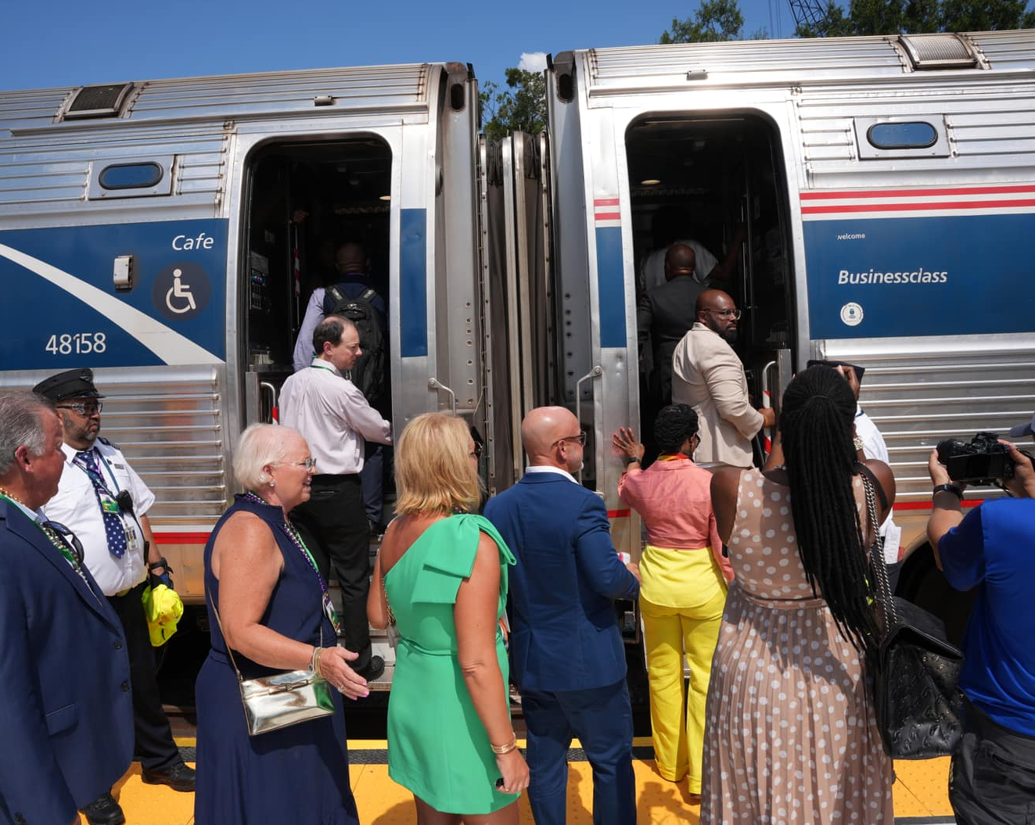
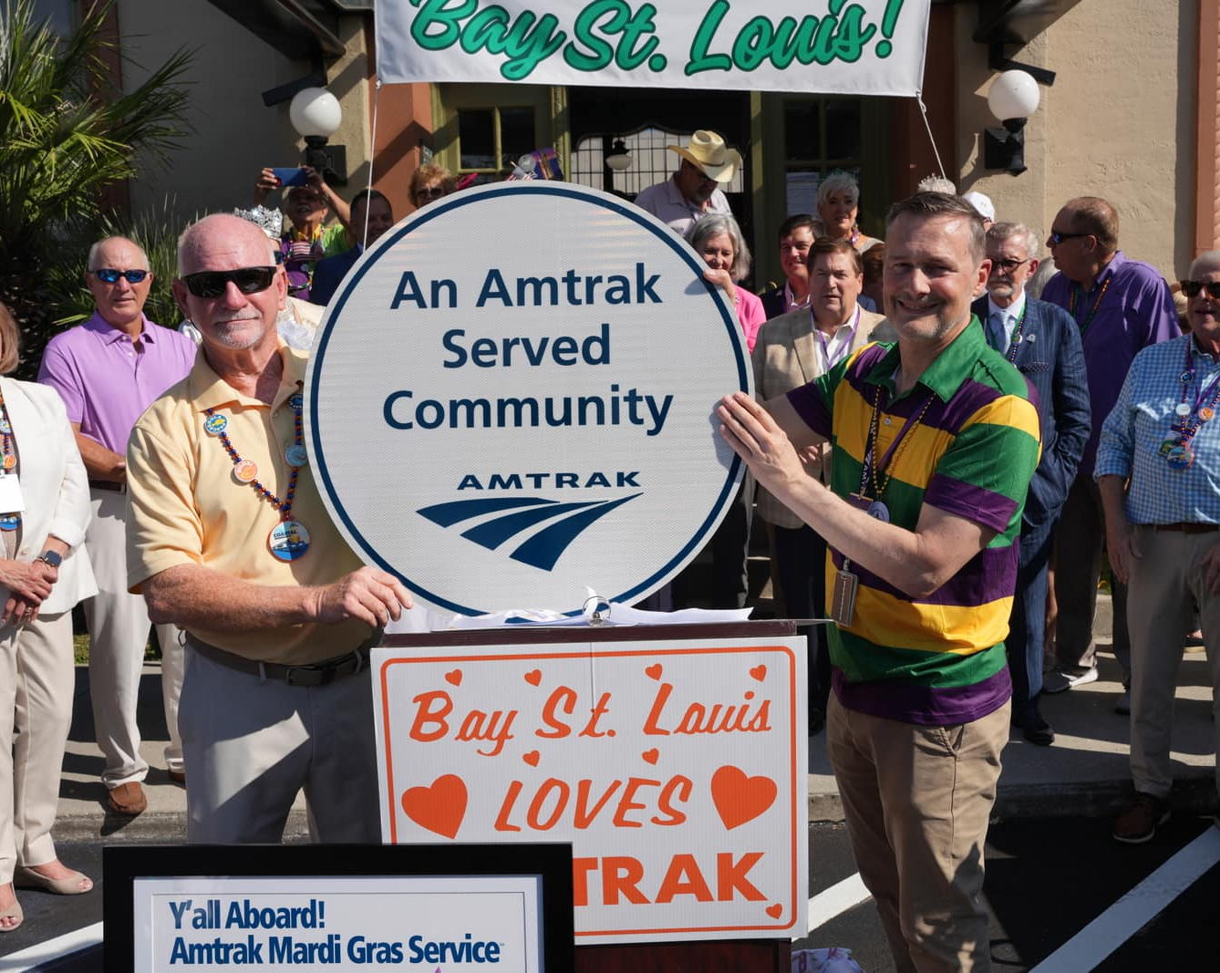
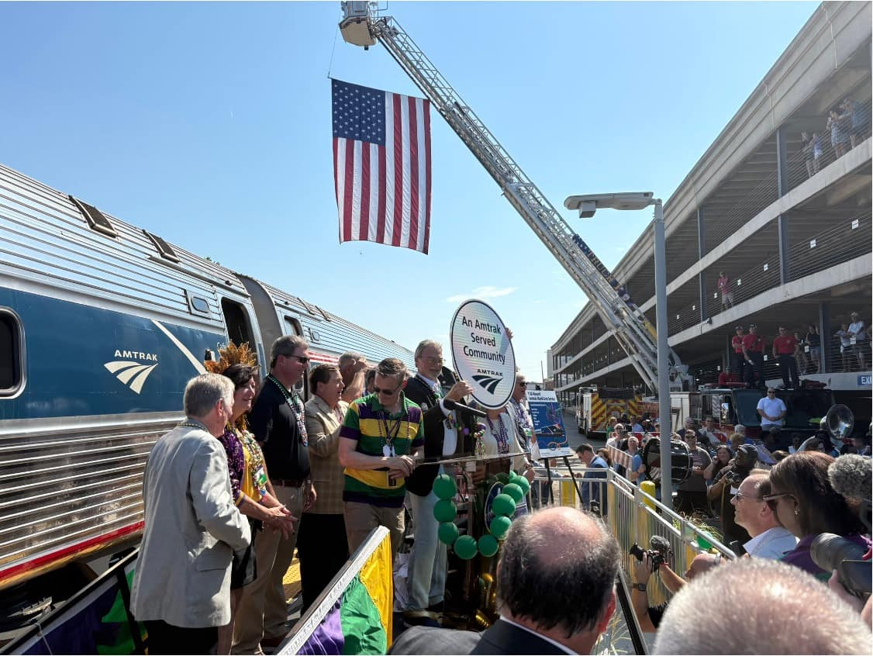
92,000+ Mardi Gras trips since launch

Slide 11
AMTRAK MARDI GRAS SERVICE
Ridership Snapshot
92,000 Total Ridership (as of March 29th)
412 Average Daily Ridership
Average Load Factor
Average occupancy of the train throughout the trip
  61.3% Premium Seat
  68.8% Regular Seat
Average Peak Load Factor
Maximum occupancy of the train between any two stations
  69.8% Premium Seat
  77.0% Regular Seat
After the endpoints, Biloxi is the busiest station
Preliminary Data. Subject to Change.
Sample Period: 8/18/25 – 3/29/26

Slide 12
AMTRAK MARDI GRAS SERVICE
Operational Snapshot
86% Customer On-Time Performance (Goal: 80%)
97% On-Time Initial Terminal Departure
85% On-Time Endpoint Arrival
Preliminary Data. Subject to Change.
Sample Period: 8/18/25 – 3/29/26

Slide 13
AMTRAK MARDI GRAS SERVICE
Sales Snapshot
Most popular travel day is Saturday
High utilization of the Share Fares discount (for parties of 3-8 people)
Average Fares Paid:
  Coach: $29.57
  Business: $69.25
Preliminary Data. Subject to Change.
Sample Period: 8/18/25 – 2/25/26

Slide 14
AMTRAK MARDI GRAS SERVICE
Riders On/Off
New Orleans and Mobile have the highest ridership, followed by Biloxi
Pascagoula has the lowest ridership
55% of passengers travel the full route length between New Orleans and Mobile
Preliminary Data. Subject to Change.
Sample Period: 8/18/25 – 3/29/26

Slide 15
AMTRAK MARDI GRAS SERVICE
Customer Service Snapshot
As of March 31, 2026 Blue Sky Customer Satisfaction Index (CSI) Score: 96.32 vs. 91.9 goal
  Blue Sky focuses on customer feedback when trains are on-time
Highest score of any Amtrak route across the country!
Highest scoring categories:
  Quality of Staff Interactions on Train
  Quality of Staff Interactions at Boarding Station
Great staff, very helpful and friendly. Trains are spacious and clean. Everything on time or slightly early. Pleasant experience all around.
I was able to relax and enjoy the ride to New Orleans. I've driven to NOLA thousands of times, but this time I could leave the driving to you! Thank you for reactivating this route. I'll be taking the train from now on at least four times a month!
Preliminary Data. Subject to Change.
Sample Period: 8/18/25 – 3/31/26

Slide 16
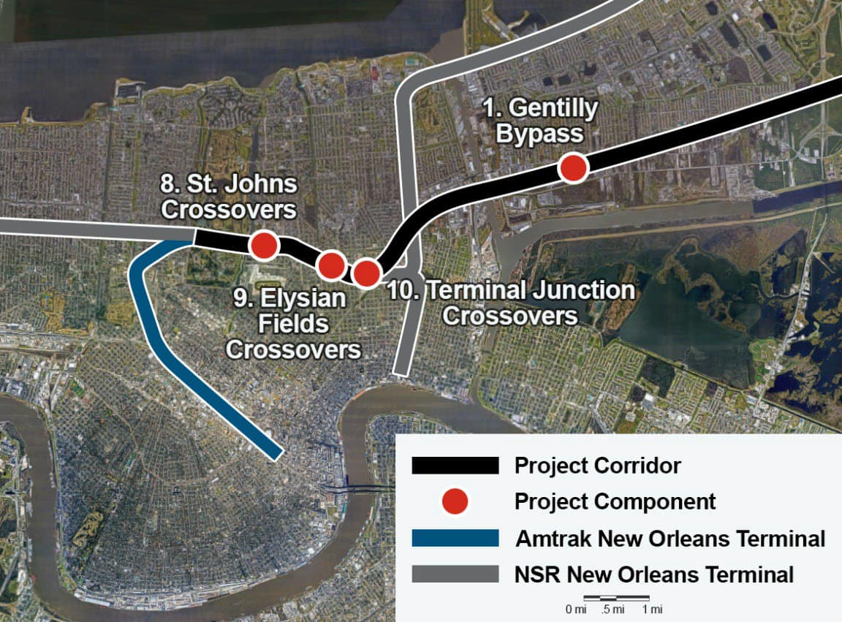
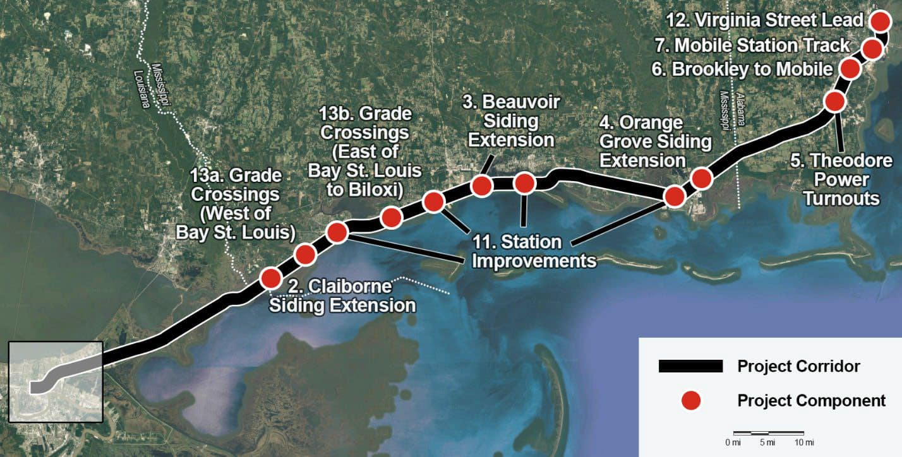
AMTRAK MARDI GRAS SERVICE
Corridor Improvement Program (CRISI) Update
Notes:
Station Improvement Projects at Pascagoula, Biloxi, Gulfport, and Bay Saint Louis.
Status: Award expected in January; Construction to begin Summer 2026
Preliminary engineering efforts are progressing for six CSX-sponsored projects:
Gentilly Bypass, Claiborne Siding Extension, Beauvoir Siding Extension, Orange Grove Siding Extension, Theodore Power Turnouts and the Brookley to Mobile Siding Extension.
Agreement negotiations are actively advancing for Port of Mobile, Norfolk Southern, and Mississippi DOT sponsored projects.

Slide 17
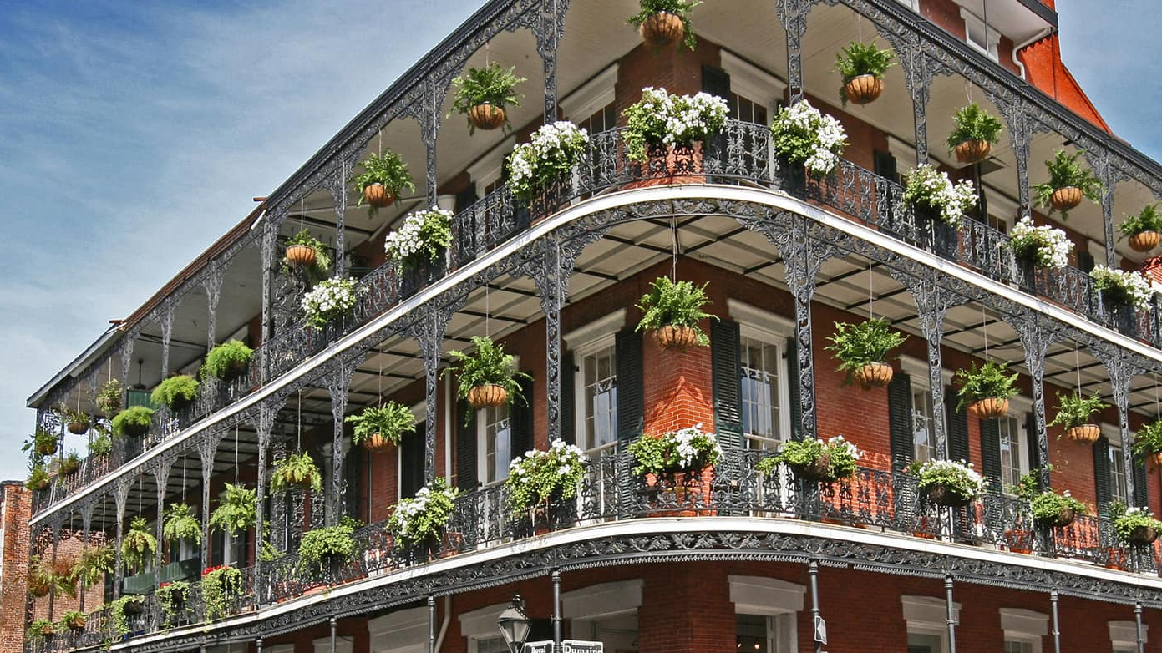
Ride the Mardi Gras!
Book online:
amtrak.com/mardigras or amtrak.com/tickets/grouptravel
Book via Amtrak mobile app:
Download from App Store / Google Play
Book via phone call:
1-800-USA-RAIL or 1-800-USA-1GRP (for groups)
Or purchase tickets in person at New Orleans Union Passenger Terminal

Slide 18
ENS Signs
In case of emergency at grade crossings, use ENS signs to get help

Slide 19
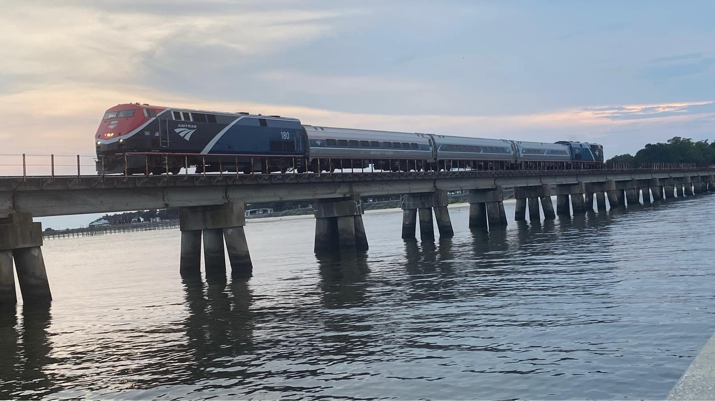

Questions?
Thank you!
Continue the conversation:
T. L. Stennis III, Director, Government Affairs - South
TL.Stennis@amtrak.com I 504-579-4550

