Slide 1
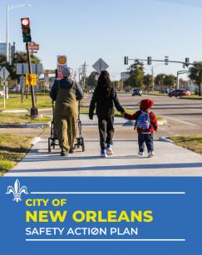


City of New Orleans Safety Action Plan
City Council Transportation Committee Meeting
April 2, 2026
Notes:
DRAFT

Slide 2
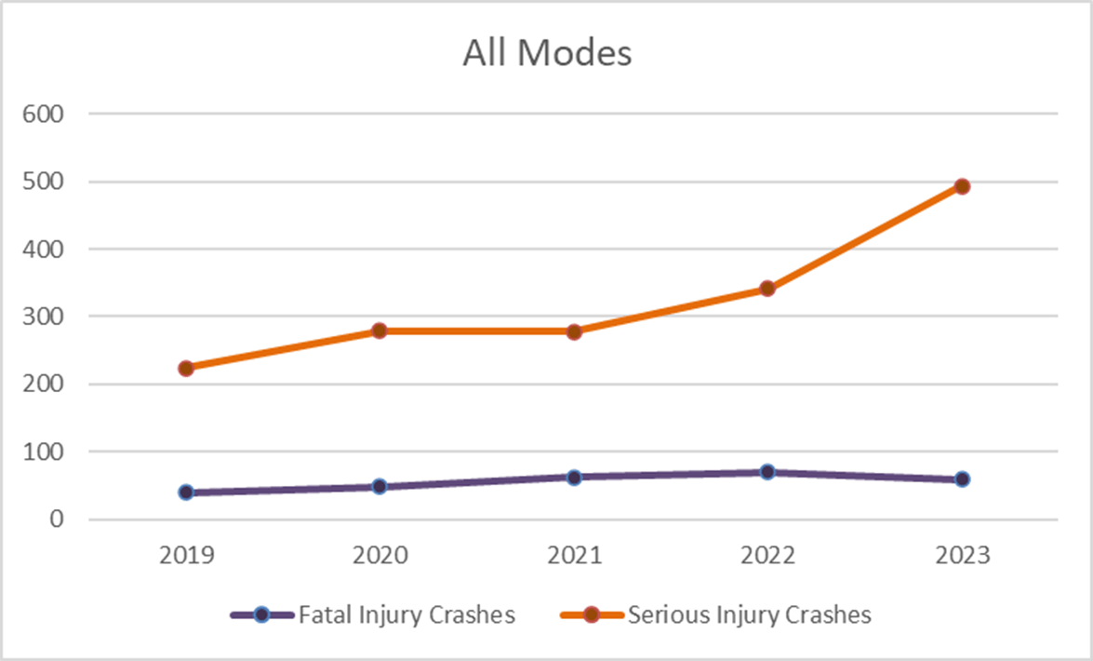
What is the problem?
On average, 60 people die in traffic every year in New Orleans.*
Annual Fatal and Serious Injury Crashes
On average, 373 people are severely injured in traffic every year in New Orleans.*
* Based on 5 years of crash data (2019-2023)
This information shall not be subject to discovery or admitted into evidence in Federal or State court pursuant to 23 U.S.C. 407.
Notes:
What is a serious injury? A serious injury is one that is life-altering, referring to injuries involving broken or fractured bones, dislocated limbs, severe lacerations, unconsciousness, severe burns, or injuries to the skull, spinal cord, or abdomen.
Stark upward trend in fatal and serious injury, or ‘FSI,’ crashes across all modes in the five-year period
Fatal and serious injury (FSI) crashes rose 109% over the five-year period
Crash severity rose across all types of roadway users
Pedestrian FSIs rose 62%
All other mode (auto, moto, and bike) FSIs grew by over 100% each
2024 update: CARTS crash data for 2024 was released after this analysis was completed, and showed that while fatal crashes remained flat between 2023 ad 2024, and serious injury crashes fell 8%, overall crashes (any severity) rose 11%

Slide 3
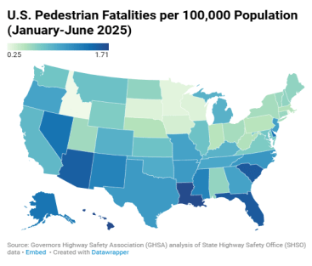

Crash Comparisons
Locations | Total Traffic Fatalities | Total Serious Injuries
East Baton Rouge | 85 | 304
Orleans | 63 | 403
Caddo | 43 | 170
Calcasieu | 38 | 93
St. Tammany | 35 | 75
Jefferson | 34 | 102
Tangipahoa | 33 | 69
Lafayette | 32 | 145
Ouachita | 32 | 69
(Using five-year average of data from 2020-2024)-Source: The Louisiana Highway Safety Commission
Notes:
New Orleans has consistently ranked near the top of these crash categories year after year.
Reducing these negative roadway outcomes is the entire focus of this program.
It is our objective to achieve a sustained drop in these crash categories year after year until we reach our goal of zero.

Slide 4
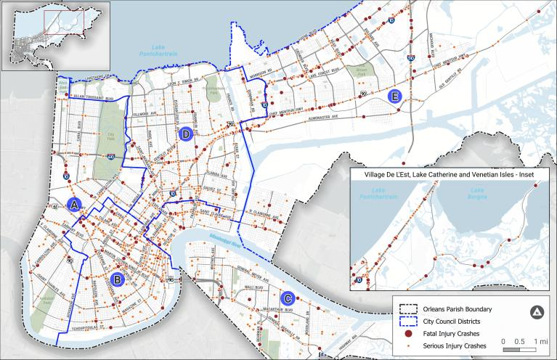
Fatal & Serious Injury Crashes 2019 - 2023
Replace with slide showing this map and City Council Districts once we receive
Notes:
The project team analyzed state crash data from CARTS for the most recent five-year period available at the time – 2019 to 2023
Of the more than 84,000 total crashes over that period, this map shows the location of fatal and serious injury crashes, which are the focus of this SAP
While not shown here, minor injury and property damage only crashes were considered in the safety analyses

Slide 5
Overall Crash Severity by Mode, 2019-2023
All Crashes
Fatal & Serious Injury Crashes
This information shall not be subject to discovery or admitted into evidence in Federal or State court pursuant to 23 U.S.C. 407.
Notes:
Motor vehicles are the greater volume of FSI crashes
However, nearly one third of FSIs involved people walking and bicycling
While motorcycles and VRUs (people walking, rolling, and bicycling) were involved in just 4% of overall crashes, they comprise 41% of fatal and serious injury crashes
Of 1,895 FSI crashes between 2019 – 2023:
59% were motor-vehicle only
29% involved people walking or bicycling—vulnerable road users (VRUs)
12% involved motorcycles

Slide 6
68% of fatal and serious injury crashes occurred on just 130 miles (7%) of New Orleans roads.
This information shall not be subject to discovery or admitted into evidence in Federal or State court pursuant to 23 U.S.C. 407.

Slide 7
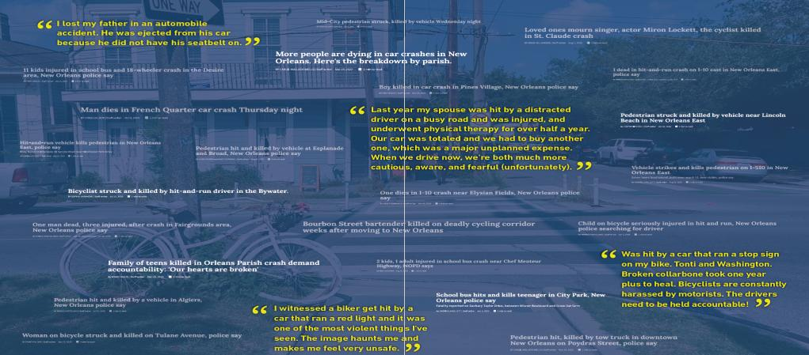
What do we hear from friends and families?
This information shall not be subject to discovery or admitted into evidence in Federal or State court pursuant to 23 U.S.C. 407.
Notes:
DESCRIPTION
Stark upward trend in fatal and serious injury, or ‘FSI,’ crashes across all modes in the five-year period
Fatal and serious injury (FSI) crashes rose 109% over the five-year period
Crash severity rose across all types of roadway users
Pedestrian FSIs rose 62%
All other mode (auto, moto, and bike) FSIs grew by over 100% each
2024 update: CARTS crash data for 2024 was released after this analysis was completed, and showed that while fatal crashes remained flat between 2023 ad 2024, and serious injury crashes fell 8%, overall crashes (any severity) rose 11%

Slide 8
Vision and Goals
The Safety Action Plan Vision is that:
All New Orleans streets are safe for users of all ages and abilities.
The plan’s goal is:
15 YEARS TO ZERO: By 2041 the City and its transportation partners will eliminate death and serious injuries on New Orleans streets.
Interim target: Achieve a 50% reduction in deaths and serious injuries by 2031.
This information shall not be subject to discovery or admitted into evidence in Federal or State court pursuant to 23 U.S.C. 407.
Notes:
Bold and visionary

Slide 9
SS4A Safety Action Plan (SAP) Process
Bipartisan Infrastructure Law set up $5 billion in SS4A funds for planning and implementation of safety projects
SAP involves detailed crash and risk analysis, developing infrastructure projects, policies, and programs eligible for SS4A and other funding
Kickoff
Crash analysis
Plan reviews
Final Plan
Project locations
Next Steps
Mayor and Council approval
Systemic actions
SS4A implementation funding
Crash and risk analysis
Safety Analysis
Community input
Safety Summit
Priority corridors
Safety design toolkit
January – May 2025
March – December 2025
January – March 2026
April - May 2026
Source: FHWA
This information shall not be subject to discovery or admitted into evidence in Federal or State court pursuant to 23 U.S.C. 407.
Notes:
Not just about funding but about building a culture of safety, partnerships that support safe streets, and baking transportation safety holistically into city decision-making and investments
Project Advisory Committee—city staff from across departments, external stakeholders, advocates, etc. have been directly informing the process
Draft Plan elements will be shared in December and followed by a public review in January—this webinar will cover what will be in the plan with examples of projects, policies, and program recommendations
SS4A’s last authorized year in the BIL is 2026 – has broad bipartisan support and signs are good that it will not only be reauthorized but significantly expanded
Timeline – implementation and supplemental planning work – including two supplemental SS4A awards for lighting study and Downtown Development District work on CBD-focused safety study

Slide 10
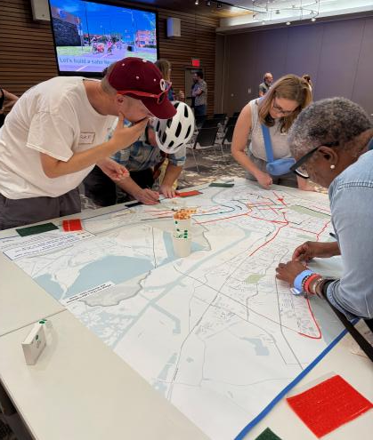
What we heard from transportation safety surveys?
2500+ survey and online map responses
Infrastructure Priorities Identified
Sidewalk and roadway conditions
Dangerous crossings and poor visibility
Lack of safe facilities
Behavioral Priorities Identified
Risky driver behavior
Disregard for traffic laws
Aggressive driving
This information shall not be subject to discovery or admitted into evidence in Federal or State court pursuant to 23 U.S.C. 407.

Slide 11
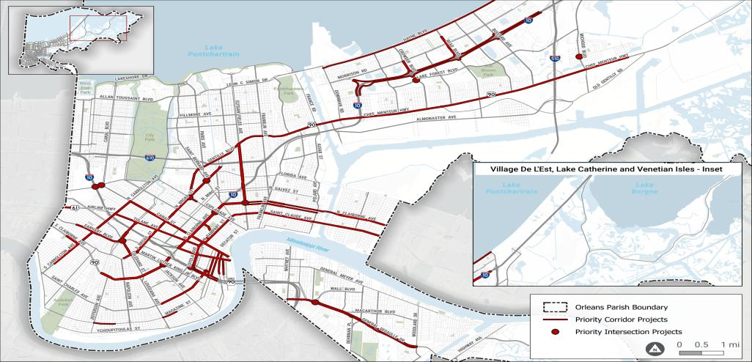
Priority Safety Network
Provides a focus for roadway safety improvements and safety action strategies
This information shall not be subject to discovery or admitted into evidence in Federal or State court pursuant to 23 U.S.C. 407.
Notes:
The Priority Safety Network was identified based on various inputs including highest frequency of fatal and severe crash data, risk, and community priorities. It does not include the Interstate system – but focuses primarily on local and state roadways that are not controlled-access.

Slide 12
Priority Safety Network
All projects total $171.7M
Corridors
40 corridors totaling 66 miles
19 routes (42 miles) are state roadways
Estimated construction cost in 2026 dollars is $161.8M
$92.3M state
$69.5M local
Intersections
12 intersections (half are on state roadways)
Estimated construction cost in 2026 dollars is $9.9M
A few overlap with priority corridors
This information shall not be subject to discovery or admitted into evidence in Federal or State court pursuant to 23 U.S.C. 407.

Slide 13
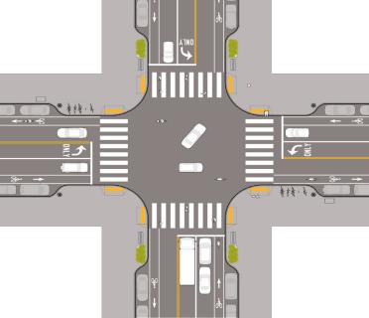
Safe Street Design-Improving Visibility
Roadway and sidewalk lighting
Curb extensions and corner parking restrictions
High-visibility crosswalks
Bus stop improvements
Use of curb extensions for daylighting
This information shall not be subject to discovery or admitted into evidence in Federal or State court pursuant to 23 U.S.C. 407.

Slide 14
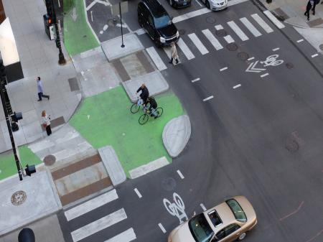
Safe Street Design - Reducing Exposure and Conflicts
Signalization safety improvements
Protected intersections
Turn restrictions
Safe and continuous access for Vulnerable Road Users
Pedestrian crosswalk design policy
Protected intersection in Chicago, IL
This information shall not be subject to discovery or admitted into evidence in Federal or State court pursuant to 23 U.S.C. 407.
Notes:
Support Multimodal Projects
Access management policy
DPW Roadway Design Guide updates

Slide 15
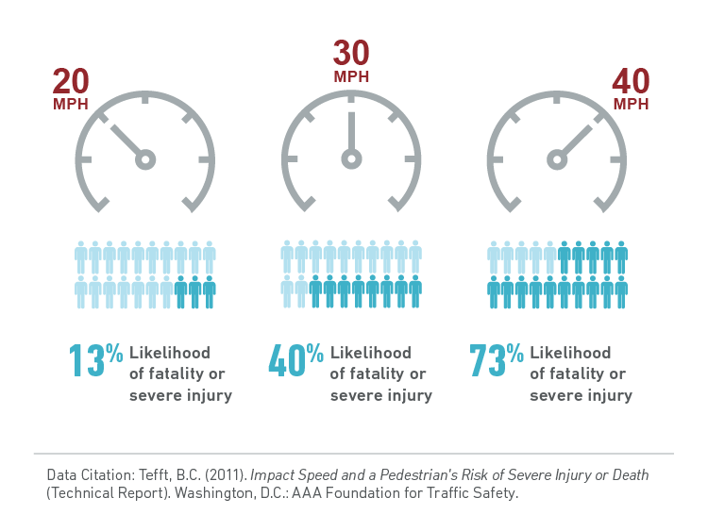
Plan and Design for Safe Speeds - Managing Speeds
Lane configuration and narrowing
Tightening intersections
Traffic calming
Speed limit reduction
Strategic speed enforcement
This information shall not be subject to discovery or admitted into evidence in Federal or State court pursuant to 23 U.S.C. 407.

Slide 16
Build a Culture of Safety
Create Community Awareness
Establish the New Orleans Safety Partnership
Comprehensive safety communications and awareness campaign
Partner with community-based organizations and NOPD to host safety-focused trainings and events
Focus on Progress and Transparency
Safety infrastructure demonstration projects
Upgrade the City Transportation Safety Dashboard
Improve Complete Streets Policy Implementation
This information shall not be subject to discovery or admitted into evidence in Federal or State court pursuant to 23 U.S.C. 407.

Slide 17
Measure Progress and Share Updates
Output examples:
Number and/or miles of projects
Average travel speeds in the city
Safety campaign engagement & participation
Outcome examples:
Number of Fatal and Serious Injury (FSI) crashes
FSI crashes by mode
Overall investment in safety initiatives
This information shall not be subject to discovery or admitted into evidence in Federal or State court pursuant to 23 U.S.C. 407.
Notes:
Important to track progress on the infrastructure, policies, and programs – in particular number of projects, people reached, etc. – ultimately if the goal is zero deaths and incapacitating injuries, those are the most important metrics
More detail on what metrics are proposed on the boards

Slide 18
Next steps
Resolution supporting adoption of Safety Action Plan
Plan adoption via Executive Order
Federal Safe Streets for All funding opportunity

