Slide 1


NEW ORLEANS POLICE DEPARTMENT Criminal Justice Committee City Council Presentation
Anne E. Kirkpatrick, Superintendent of Police
March 30, 2026

Slide 2


Departmental Overview
FQ Security & DPW Update
Crime Statistics 2026 YTD
Violent Crime Reduction Plan Update
Technology Update
Recruitment Efforts
Current Strength and Separations
NOPD HQ & Infrastructure Update
Overtime 2026

Slide 3
FQ Security Update
Bourbon Street Terrorist Incident on January 1, 2025, has continued to impact NOPD’s approach and coverage of all special events, Mardi Gras 2026, SEAR 1 alert for the second weekend of parades
NOPD has met with stakeholders to determine next steps for FQ barriers, a proposal of 18 permanent barriers for Bourbon Street and Jackson Square was recommended
The use of bond funds are being discussed to begin procurement process

Slide 4
DPW Transition Update
DPW employees have been vetted 77 of the 88 are eligible for transfer to NOPD
Ordinance request to transfer scheduled April/May
Anticipate official transfer May 2026

Slide 8
Violent Crime Reduction Strategies
Violent Crime Strategies in Progress
Continue with weekly GRIP meetings using Data Analytics and wholistic approach to violent crime.
Continue to work with DA’s Office on N.O.D.I.C.E. (recent shutdown of carwash being used for illegal narcotics & drug dealing)
Continued collaboration with federal, local and State law enforcement partners and in task forces with occasional focus surges to apprehend violent criminals.
Will be partnering with Thomas Abt and the Violence Reduction Center with Commissioner Daniel Shanks to expand upon the GRIP and NODICE strategies with more evidence-based strategies that would best fit New Orleans.

Slide 9
Technology Update
Mark 43- Records Management System, fully implemented November 2025- Crime Statistics for reporting UCRs still being modified to conform to new federal and state reporting requirements
Peregrine- Real-time decision and operations management platform which provides public safety agencies data to solve most difficult problems; fully implemented June 2025
ShotSpotter- Pilot Program discontinued
Sigma Square – create pilot to work on solving more cold cases

Slide 10
Recruitment Effort Updates
Leadership changes: Captain Nolan and Dr. Green
Launched updated recruitment website (NOPD.org) March 2026
New branding recruitment campaign launch April 2026
Tik Tok videos
Launched Indeed – increased application by 77%
72% increase in test takers
Part-Time Police Officers

Slide 11
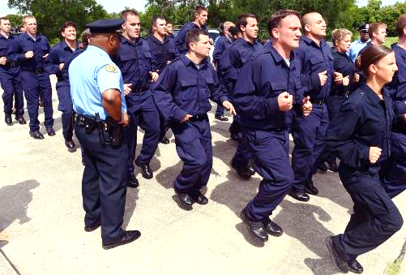
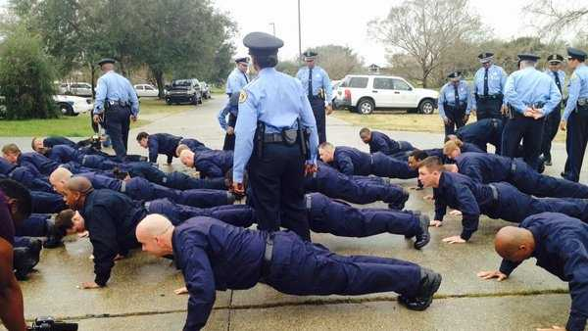
Results
Class 206 –32 Recruits - Graduated 27 last week
Class 207—28 Recruits Graduation July 2026
Class 208 – 15 hired, 1 scheduled onboarding, 19 psych/med- Launch date April 2026
Lateral Class – 1 in Academy

Slide 12
Current Strength - Separations
2026 STAFFING LEVELS YTD
Current 2025 Comm strength 895
Current 2025 Civilian strength 315
Current 2025 Recruit strength 64
Total 1,274
2026 SEPARATIONS YTD
Current Comm Separations 14
Current Civilian Separations 7
Total 21

Slide 13
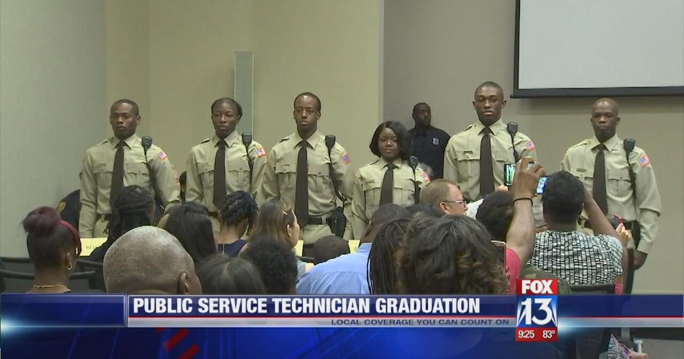
Pipeline Police Support Technicians/Transport
Working towards implementing Police Support Technician program
(Traffic Enforcement Support) candidates hired as potential future police officers

Slide 14

Facility Needs
Property and Evidence Building – critical
Academy needs – out-grown and cost to maintain – AC alone is $450,000 – no restroom facilities on driving course
6th and 1st District – restroom problems
Opportunity to move into MLK School
Police/Fire/EMS
Possible Regionalization with Feds and other jurisdictions

Slide 15

DXC HQ & Infrastructure Update
IT & Sex Offenders only operations at 715 S Broad-plans to move to Perdido Street (Old VA Building)
April/May 2026
Crime Lab 4th Floor Renovation for DNA requested in recent 2026 Capital Budget Hearing
(must happen to ensure accreditation)
HVAC issues are improving
6th District- A/C fully operational
3rd District- Rental a/c, new unit on order
7th District- A/C fully operational
Academy – 50% operational, new compressor and coils needed
CE&P- A/C fully operational
Crime Lab- Temporary unit installed, original 2 new chiller had 4 factory defects, DPM in process of replacing warranty expired

Slide 16
2026 LAB HIRE REQUEST
JOB TITLE | ASSIGNMENT | TOTAL
CODIS ADMIN | ISB/Crime Lab | 1
CODIS SPECIALIST | ISB/Crime Lab | 1
CODIS SUPPORT | ISB/Crime Lab | 1
TOTAL |  | 3
Department has requested to hire 3 CODIS positions to satisfy requirement for DNA Lab accreditation
Request pending budget funding & Council approval
Comptroller offer extended waiting on start date

Slide 17
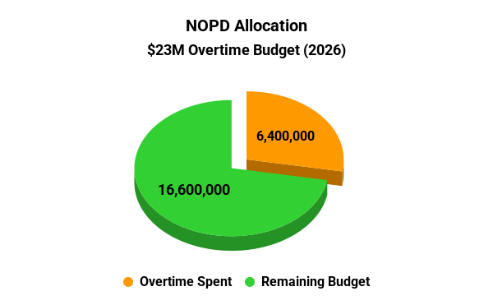
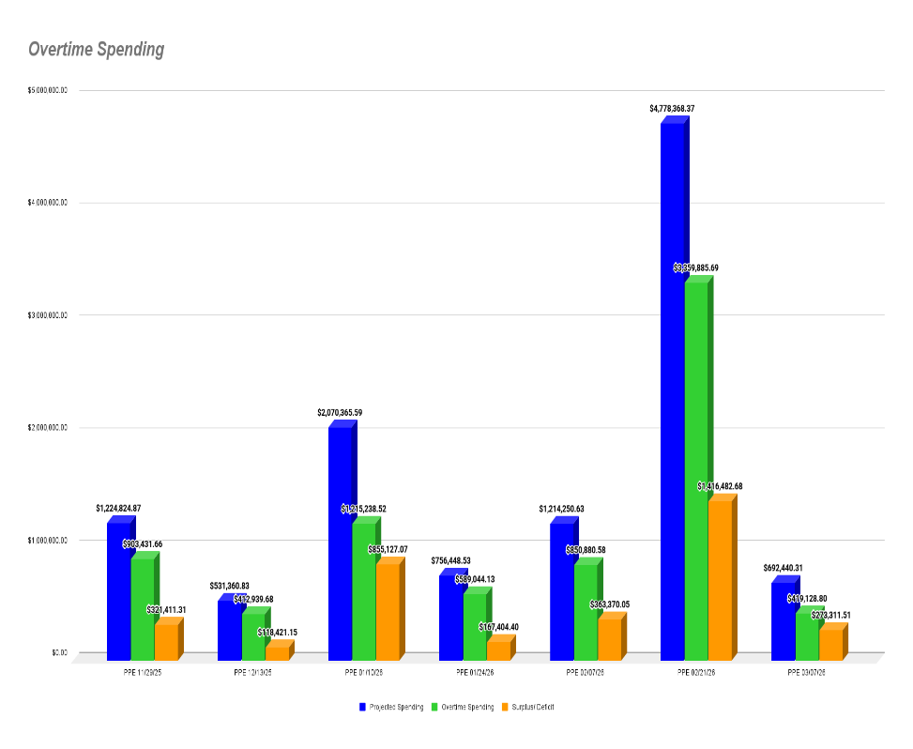
NOPD Overtime
2026 Overtime Spending
Projections vs Spending

Slide 18


