Slide 1
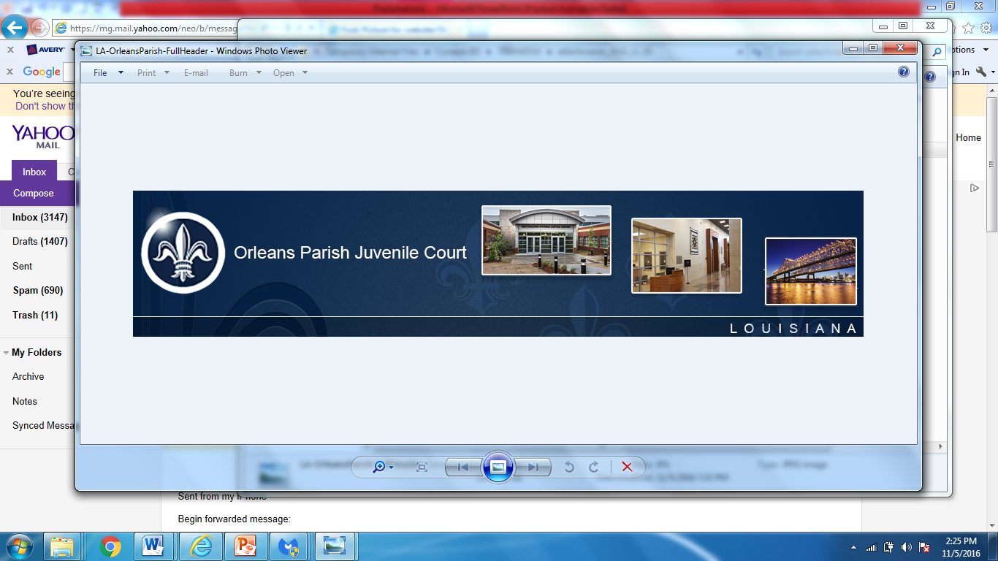
Fulfilling Our Purpose:
“Strengthening Public Safety for our Community”
Quarterly Law Enforcement Check In @ Criminal Justice Committee
March 30, 2026

Slide 2



The Judges of Orleans Parish Juvenile Court believe that, through a unified voice and collaboration, the New Orleans Juvenile Justice System can be a leader in administering fair and equal justice, provide individualized comprehensive and effective programs for delinquent and neglected youth, and ensure accountability that builds safe, resilient families and communities.
To provide a court of excellence for children, youth, and families by enforcing the Louisiana Children’s Code.

Slide 3

CURRENT BUDGET/STAFFING

Slide 4
ORLEANS PARISH JUVENILE COURT
2026 CURRENT STAFFING AND APPROVED BUDGET
Org | Description | FTE | PT | Budget | Vacancies*
8302 | Administrative Services | 15 |  | $1,261,307 | 3*
8302 | Other Operating - Contractors | 10 | 1 | $775,989
8303 | Clerk's Services | 4 |  | $292,011
8308 | Judges Personnel | 10 |  | $677,711.0
 | Total | 39 | 1 | $3,007,018 | 3*
**Recent resignation will result in a total of 4 vacancies.

Slide 5

2025 Positions Eliminated
HR/Executive Assistant
ODAP Sr. Youth Advisor
ODAP Youth Advisor
ODAP Youth Advisor
Teen Court Coordinator
PT MELOW Facilitator
PT Teen Court Facilitator
PT GROWW Facilitator
TOTAL REDUCTION = $342,437.00

Slide 6
Update on Legislative Initiatives
Senate Bill 217
House Bill 911

Slide 7
OVERVIEW OF SB 217
Louisiana Senate Bill 217 propose structural changes to the court system in Orleans Parish, specifically:
Reduction in the number of judges
Addresses the overall administration of courts in Orleans Parish
Is part of a broader push to reconfigure judicial resources and court structure
Currently pending in Senate Judiciary A Committee

Slide 8
OVERVIEW OF HB 911
A sweeping judicial reform proposal that would:
Completely restructure the Orleans Parish court system
Consolidate multiple courts into a single unified district court
Reduce the number of judges
Merge administrative functions (including clerks of court)
Potentially eliminate or absorb Orleans Parish Juvenile Court

Slide 9
OPJC POSITION
In Theory……..
What the Numbers Don’t Show
An Uneven Playing Field
What if we move forward with SB 217 and HB 911?
How Do We Move Forward?

Slide 10

2026 CHALLENGES

Slide 11

1. Staff Vacancies
2. Legislative Initiatives
3. Staff Security Gate

Slide 12
