Slide 1
Downtown Development District
Annual Presentation to New Orleans City Council
Seth Knudsen
President & CEO
Downtown Development District of New Orleans
March 19, 2026

Slide 2
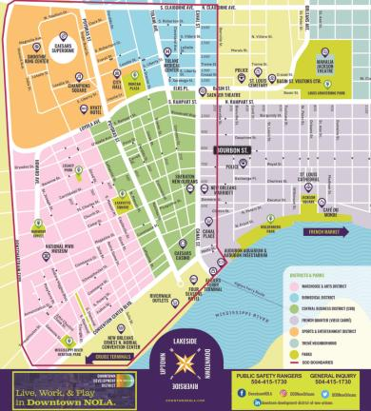
DDD Governance
Organization Structure: Independent State Agency
Date of Founding: 1974
Governance: 11-member Board
Staff: 27 staff
Management Area: 160 city blocks

Slide 3
DDD Core Services
CLEANER
Litter pickup
Pressure washing
Graffiti removal
SAFER
24/7 NOPD Police Details
24/7 Armed Private Security Patrols
DDD Public Safety Rangers
STRONGER
Economic Development
Public Policy Advocacy
Marketing
CLEANER
STRONGER
SAFER

Slide 4
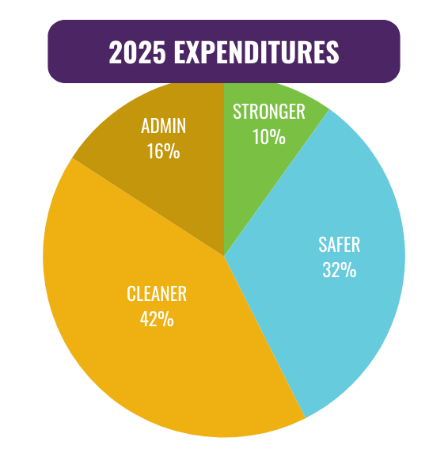
CLEANER - $4.1M
SAFER - $3.2M
STRONGER - $1M
FINANCE & ADMIN - $1.5M
TOTAL - $9.8M

Slide 5

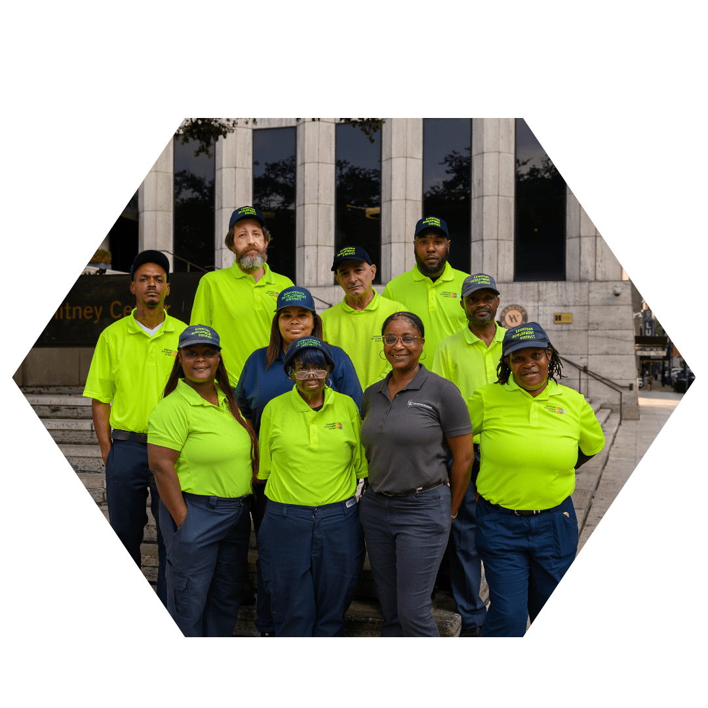
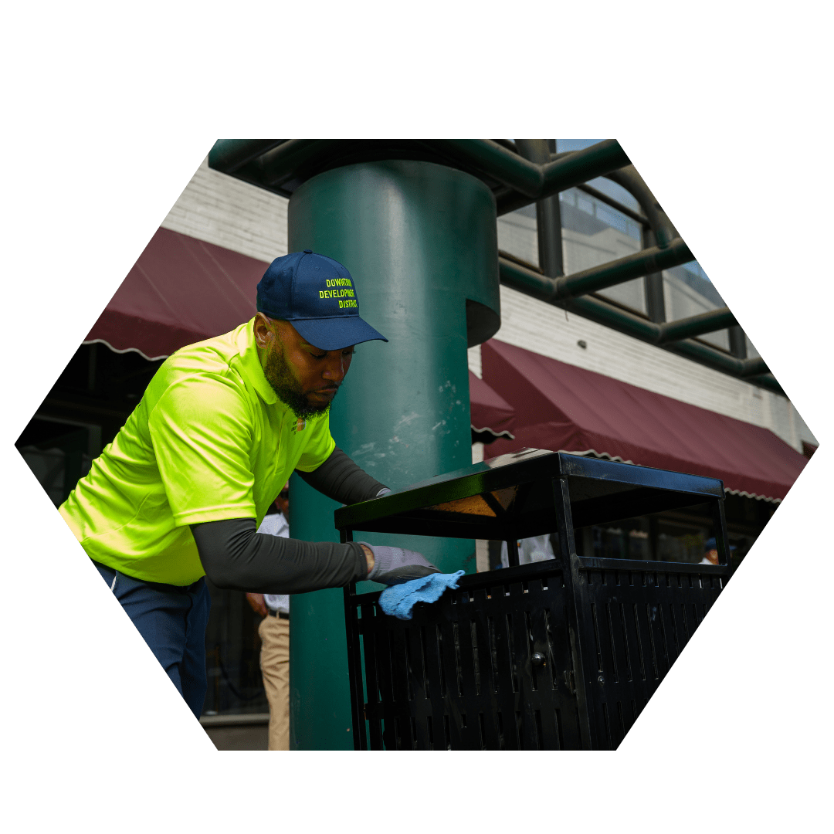
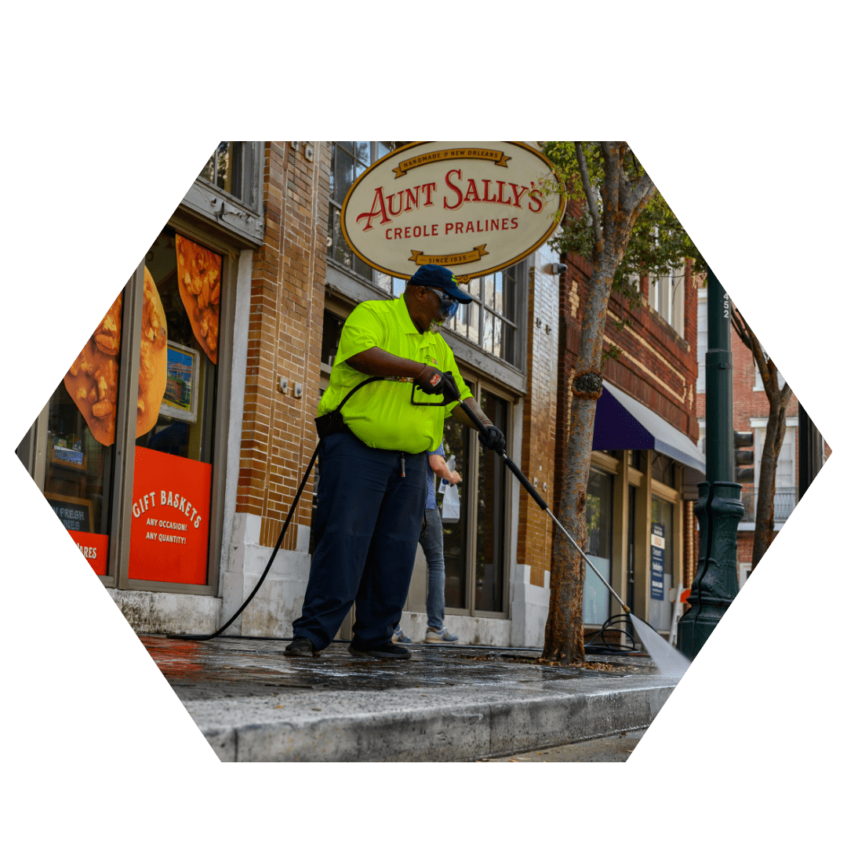
CLEANER
DEBRIS PICKUP
67,000+ tasks completed
GRAFFITI REMOVAL
4,000+ tasks completed
WEED ABATEMENT
67,000+ tasks completed
LEAF ABATEMENT
3,000+ blocks cleaned
TRASH CAN SURVEYS
16,000+ tasks completed
PRESSURE WASHING
15,000+ blocks cleaned
HIGHLIGHT
Conducted more than 12,000 assessments of high-traffic areas to ensure they are consistently maintained and documented for quality assurance.

Slide 6
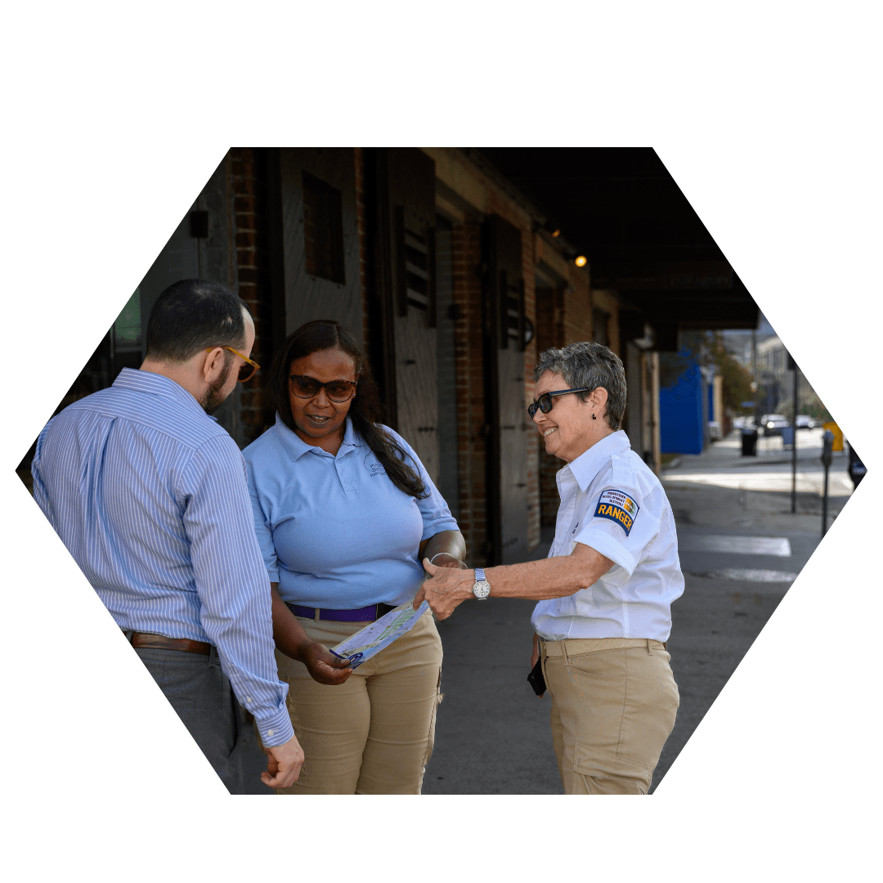
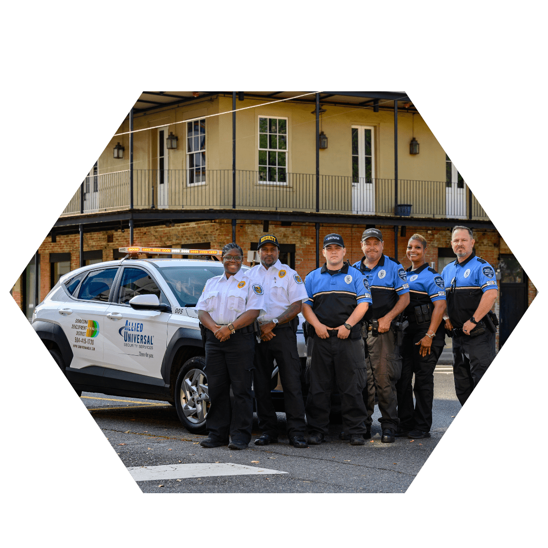
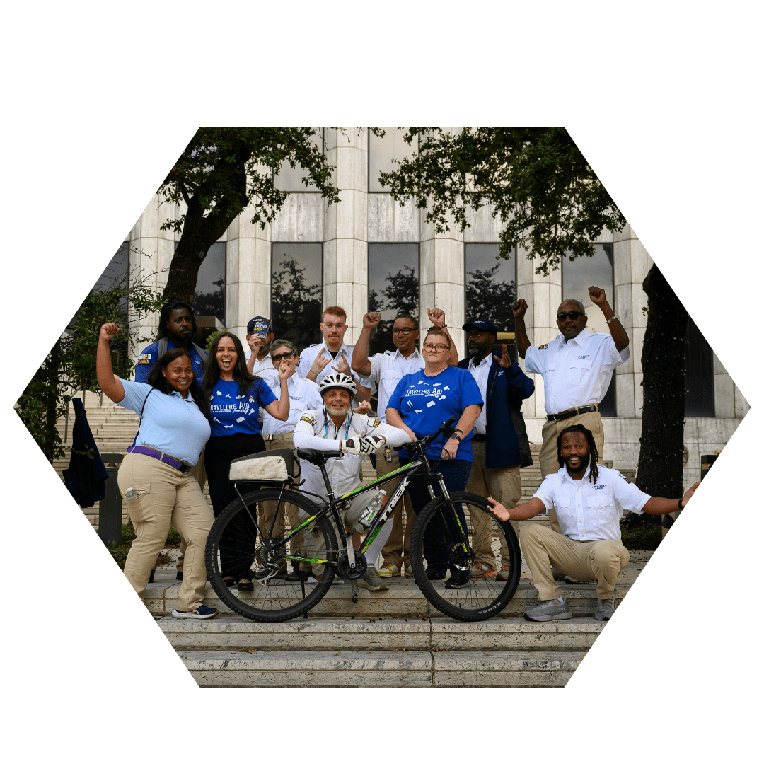
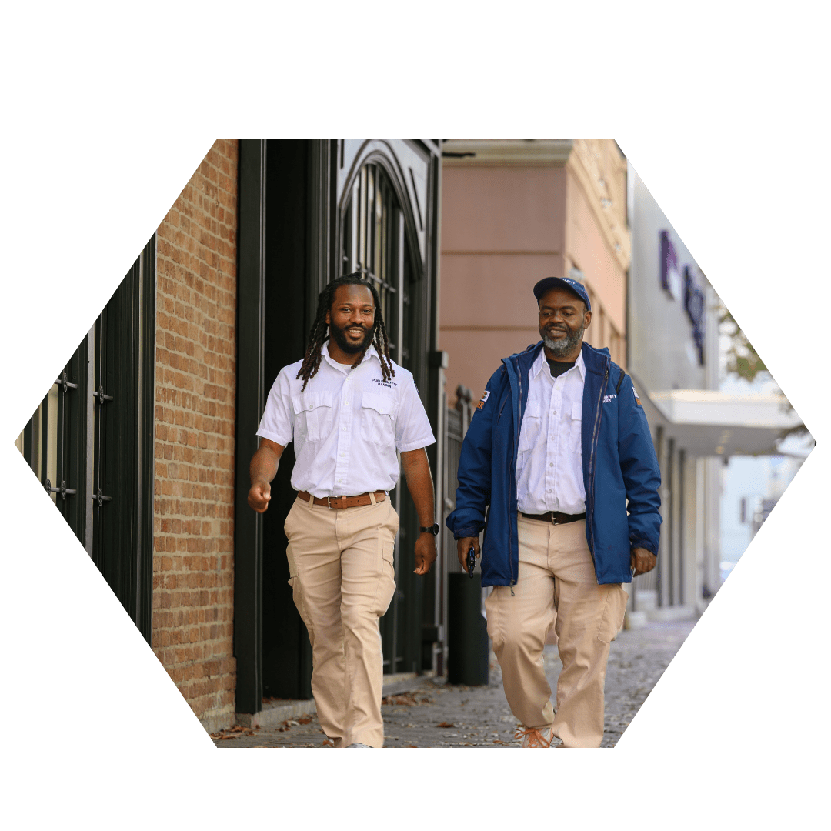
SAFER
ARMED PATROL
11,400+ NOPD off-duty hours contracted
48,680+ private security hours contracted
PUBLIC SAFETY RANGERS
32,000+ hospitality checks
23,000+ business contacts
3,800+ calls for service
81,000+ incidents logged
HOMELESS OUTREACH
172 unique individuals served
16 permanent housing placements
27 healthcare connections
HIGHLIGHT
Opened a DDD Security Alliance Outpost at 119 Royal Street in partnership with Starwood Capital and the Astor Crowne Plaza.

Slide 7
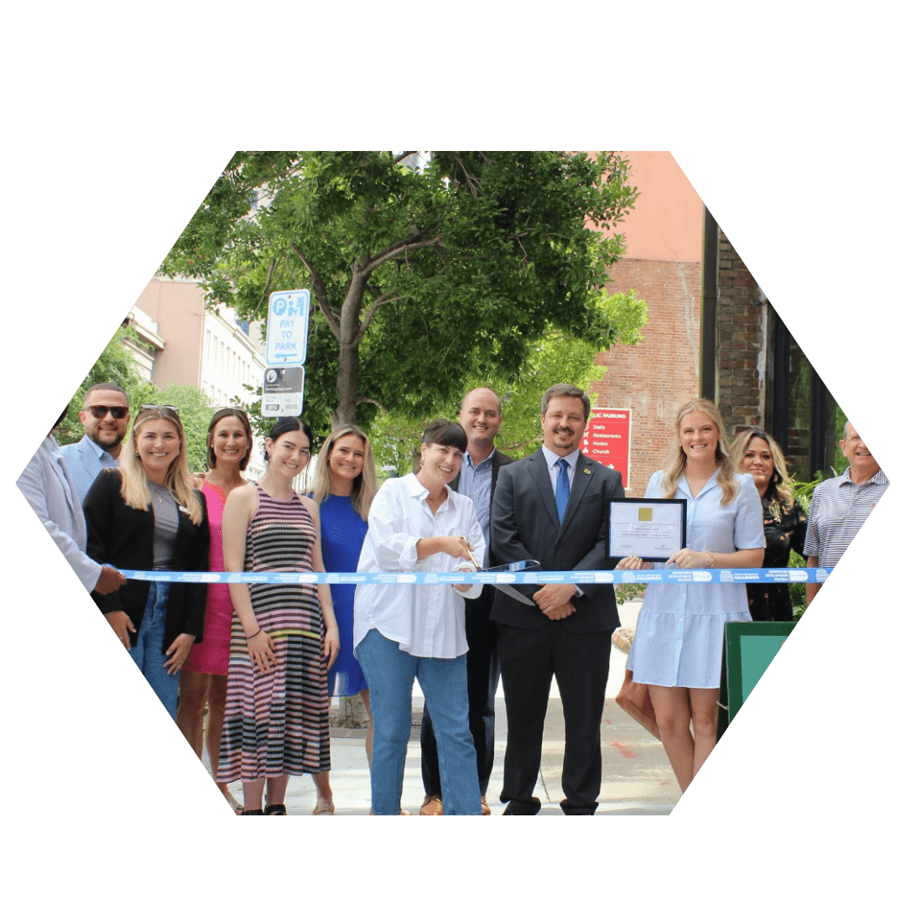
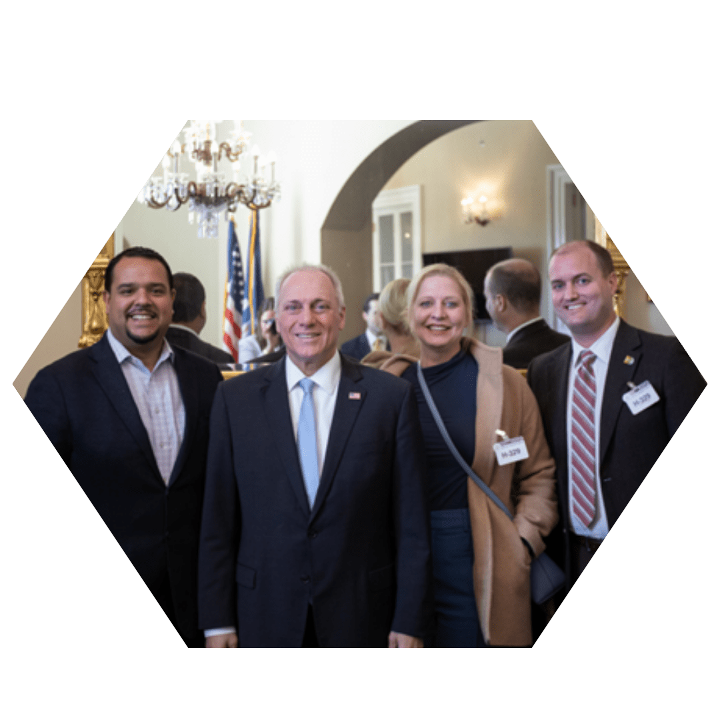
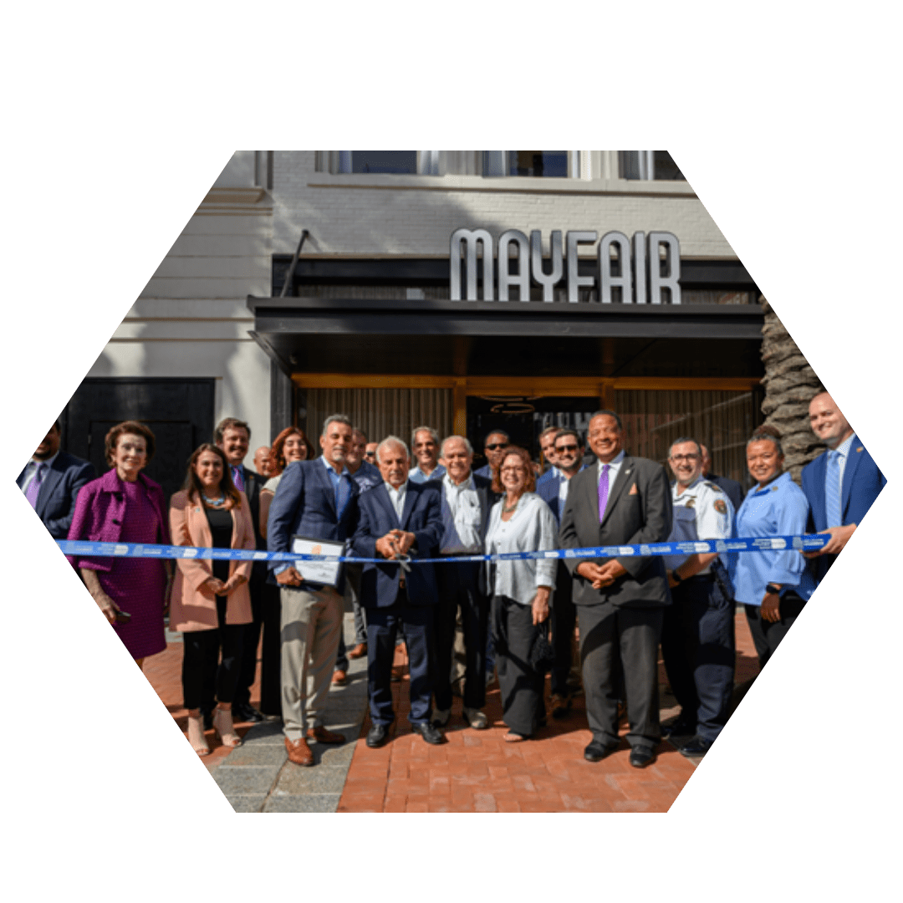
STRONGER
ECONOMIC DEVELOPMENT
$250k+ public funding advanced
100+ stakeholder engagements
60+ meetings held
12 ribbon cuttings
4 major plans / research projects
4 market reports and state of downtown
PUBLIC POLICY
2 new public safety bicycles secured
Upgraded Motorola radios secured
$100k in state funding received
Federal Advocacy with International Downtown Association
MARKETING
928 posts across all platforms
1.67M impressions across all platforms
52 newsletters produced
HIGHLIGHT
Played a key role on the citywide Super Bowl LIX Infrastructure Committee to coordinate and deliver projects across the entire district.

Slide 8
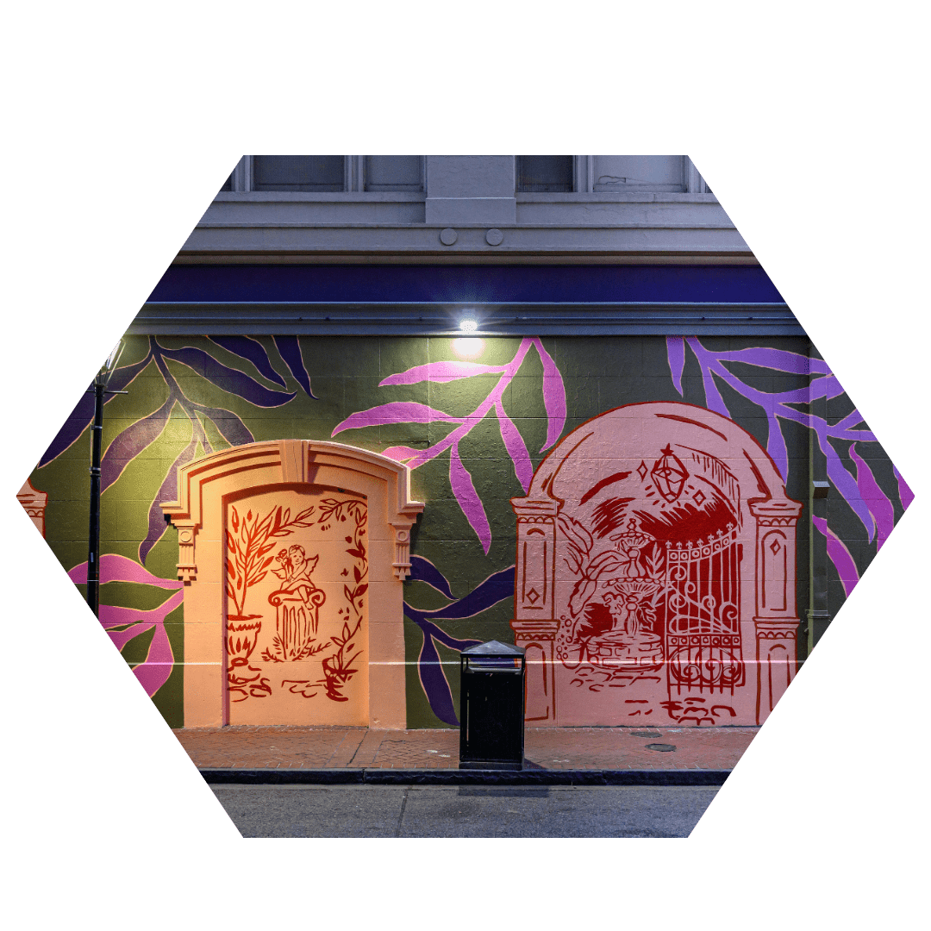
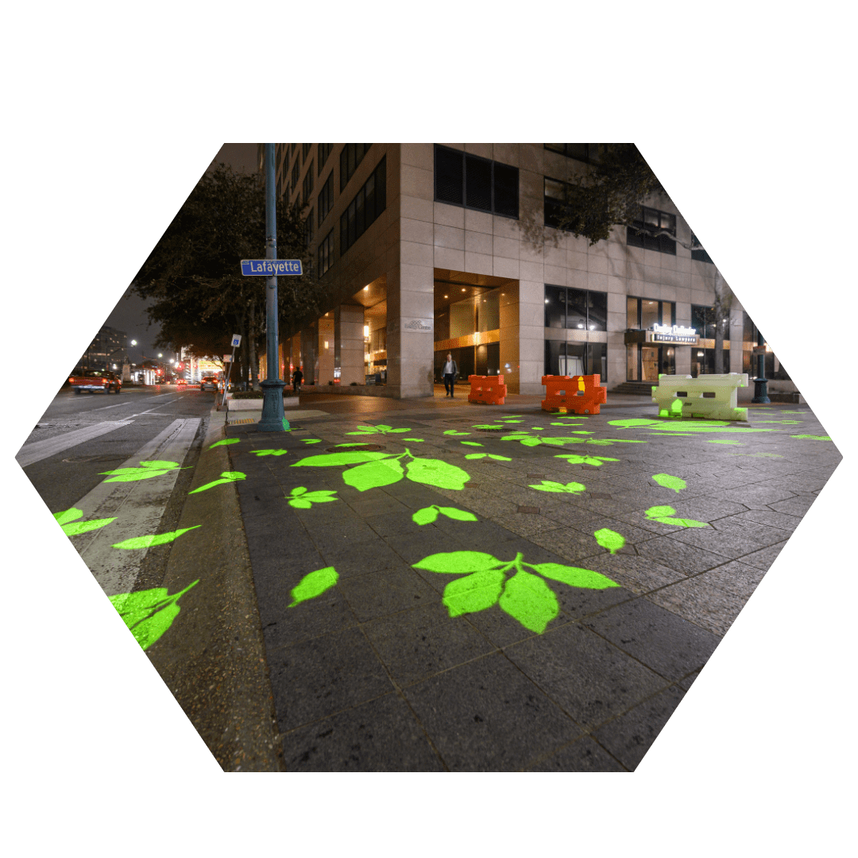
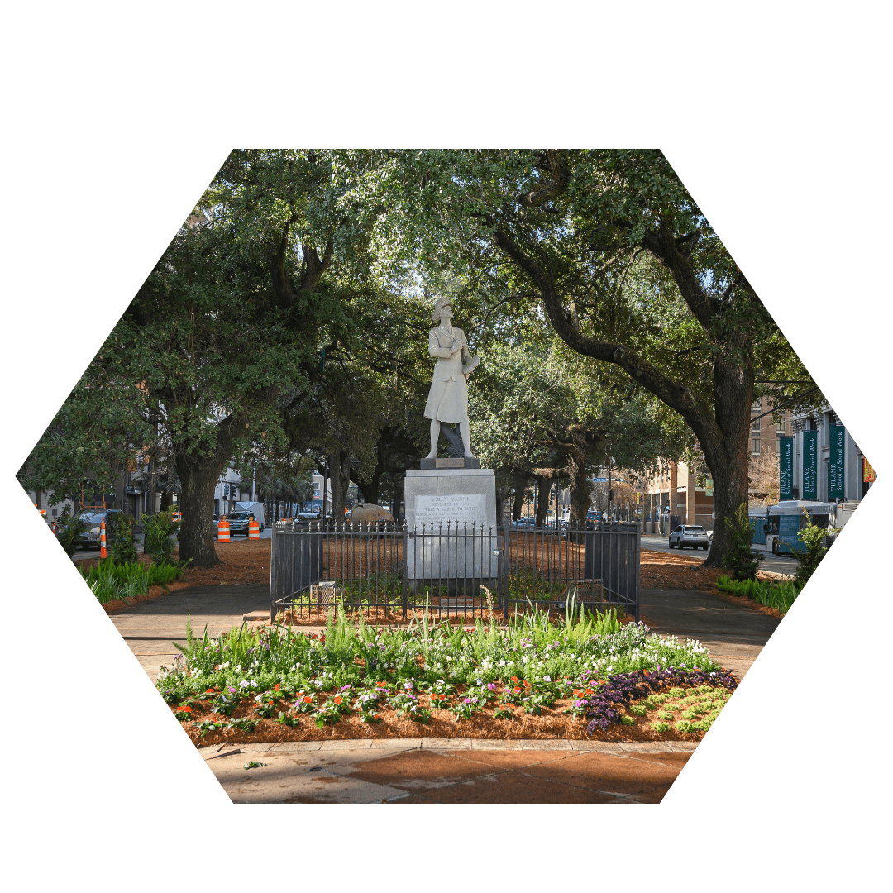
SPECIAL PROJECTS
FRENCH DOORS PROJECT
40+ properties contacted for improvements
3 murals completed
3 street art projects completed
10+ partnerships with local businesses
LIGHT UP LAFAYETTE STREET
7 light poles with creative projectors installed
Enhanced pedestrian safety / engagement on corridor
BIODISTRICT LANDSCAPING
5 key gateways improved
Partnership with BioDistrict New Orleans
Consistent with strategic plan

Slide 9

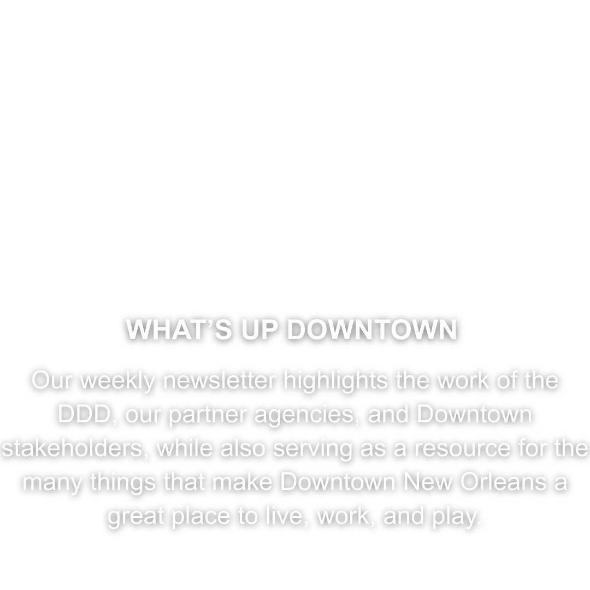

THANK YOU!

