Slide 1
City of New Orleans 2025 Audit Planning Communications with Governance March 19, 2026
Presented by:
Becky Hammond, CPA, CISA, CITP, CGAP

Slide 2
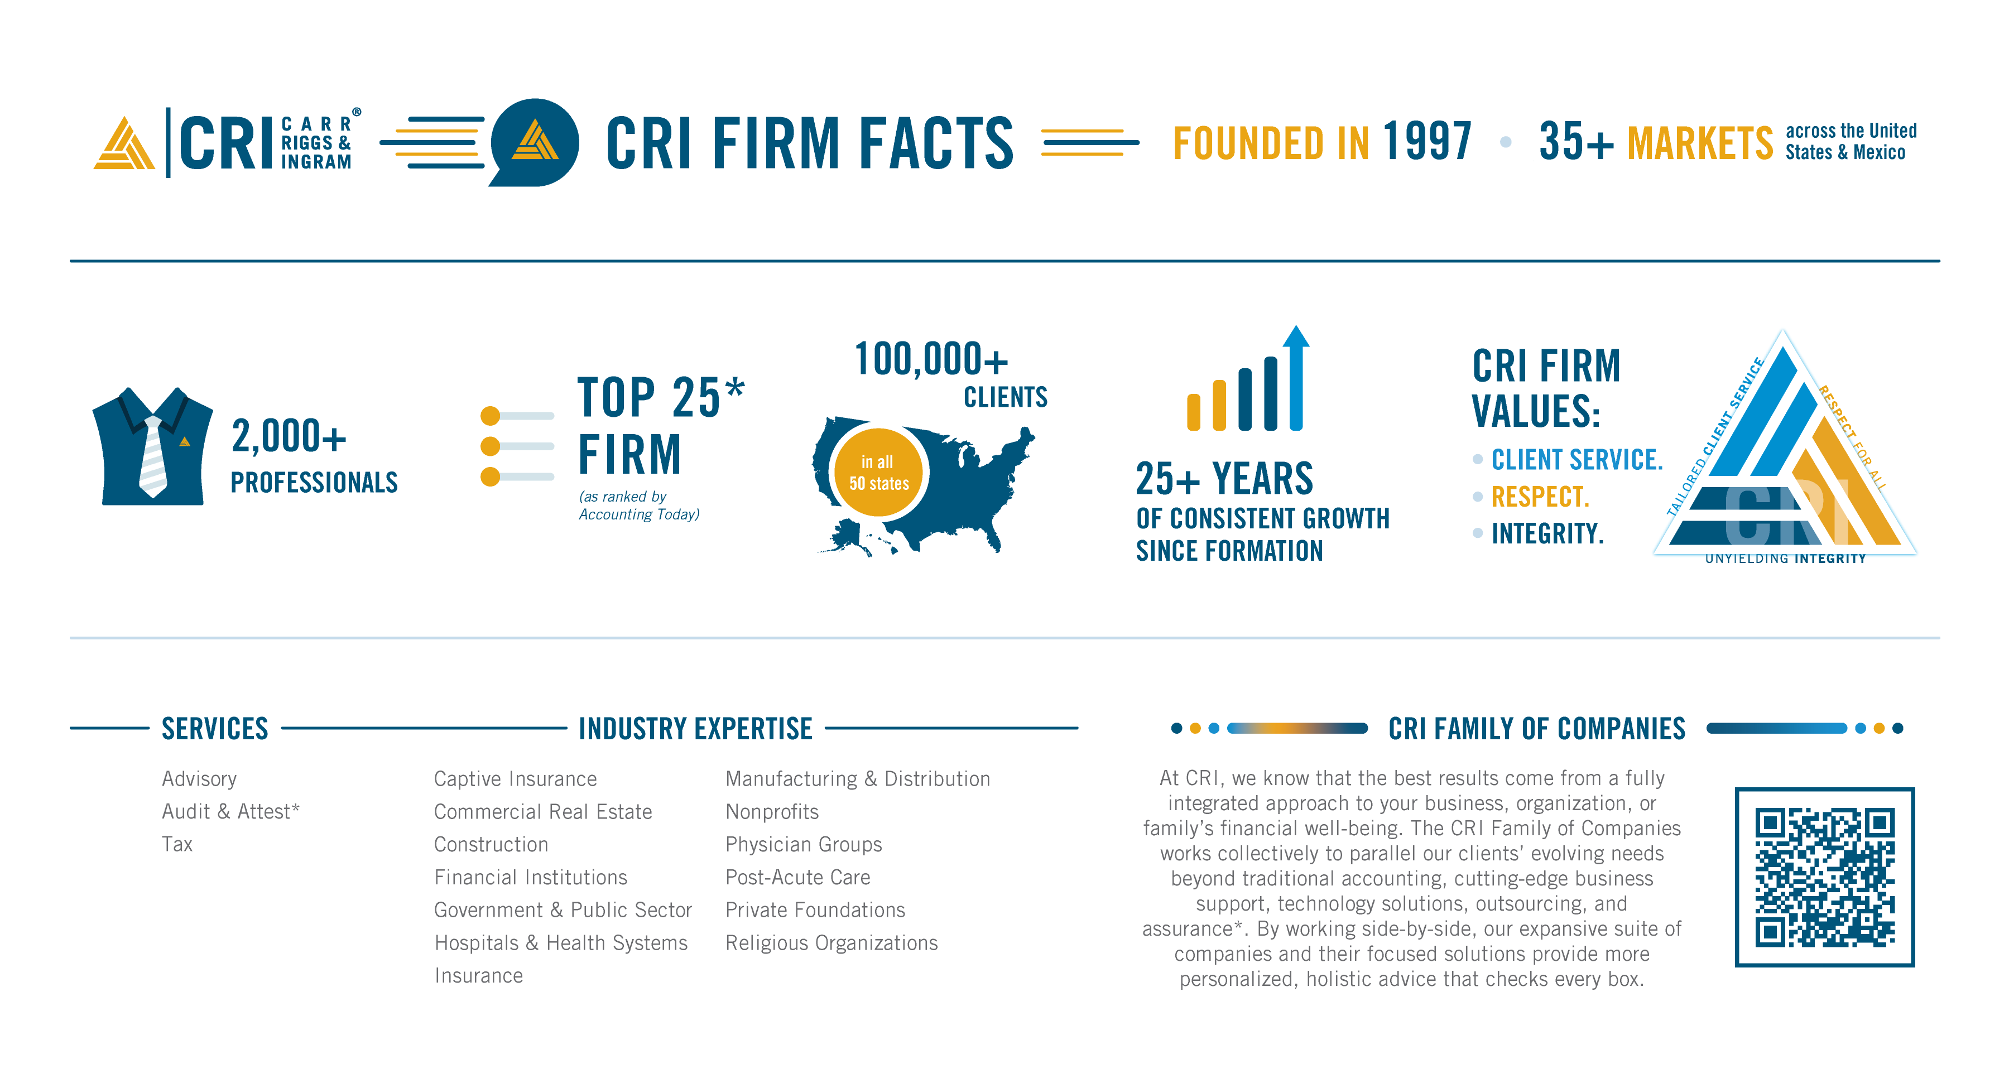
CRI Firm Facts

Slide 3
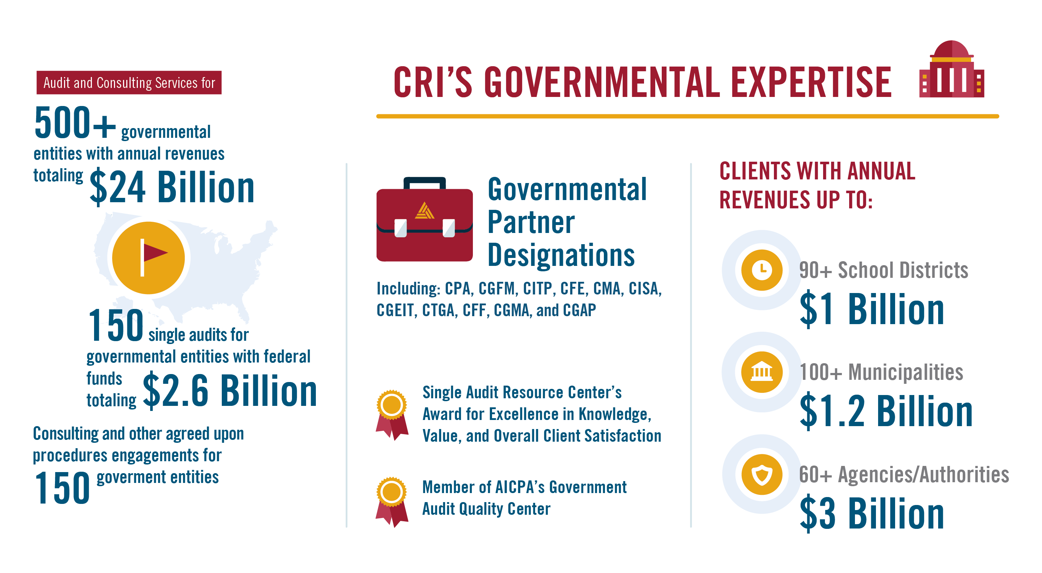
GOVERNMENTAL CREDENTIALS
Notes:
David

Slide 4
Purpose of Communication
Provide helpful context for newly elected council members
Offer a clear, high-level explanation of what an audit is
Describe what auditors do—and do not do—during the audit
Strengthen understanding of oversight responsibilities
Promote transparency and reinforce the value of the audit process

Slide 5
Audit Engagement Overview
The City of New Orleans’ annual audit covers:
Governmental activities
Aggregate discretely presented component units (except for Airport, audited by other auditors)
Each major fund
Aggregate remaining fund information
Audit period: As of and for the year ended December 31, 2025
Engagement includes opportunity for follow-up meetings for discussion and questions.

Slide 6
Auditor Responsibilities
Perform audit under GAAS and Government Auditing Standards
Performance of audit under Uniform Guidance will be handled by Sean M. Bruno, CPAs
Plan and perform audit to obtain reasonable, not absolute assurance
An audit includes looking at material transactions as well as sampling items on a test basis.
We do not test or audit all transactions.

Slide 7
Auditor Responsibilities
Consider internal control only to plan audit procedures, not to issue internal control opinions
Communicate significant matters relevant to oversight of financial reporting
Communicate additional matters required by:
Laws or regulations
Contracts or grant agreements
Communicate independence considerations if relevant

Slide 8
Responsibilities with Respect to Internal Control
Understand internal control as part of risk assessment
Determine nature, timing, and extent of further audit procedures
Identify risk of:
Errors
Fraudulent financial reporting
Misappropriation of assets
Violations of laws/regulations

Slide 9
Responsibilities Related to Compliance
Perform required tests of compliance with laws, regulations, contracts, and grants.
When under Uniform Guidance (as performed by Sean M. Bruno, CPAs):
Test compliance for major federal programs
Evaluate internal control over compliance
Provide an opinion on compliance for major programs

Slide 10
RSI, SI, and OI
Required Supplementary Information (RSI):
Apply limited procedures
No audit opinion or assurance provided
Supplementary Information (SI):
Evaluate presentation in relation to financial statements
Report whether fairly stated in relation to the financial statements as a whole
Other Information (OI):
Apply limited procedures
No audit opinion or assurance provided

Slide 11
Planned Scope and Timing of the Audit
Overview of planned audit approach, including:
Addressing significant risks
Approach to internal control (including whether control testing will be performed)
Materiality considerations
Areas of higher risk
Ongoing weekly status meetings with Finance Dept.
Timing:
Expected start of fieldwork: March 30, 2026
Expected issuance of report: June 30, 2026
Engagement partner: Becky Hammond

Slide 12
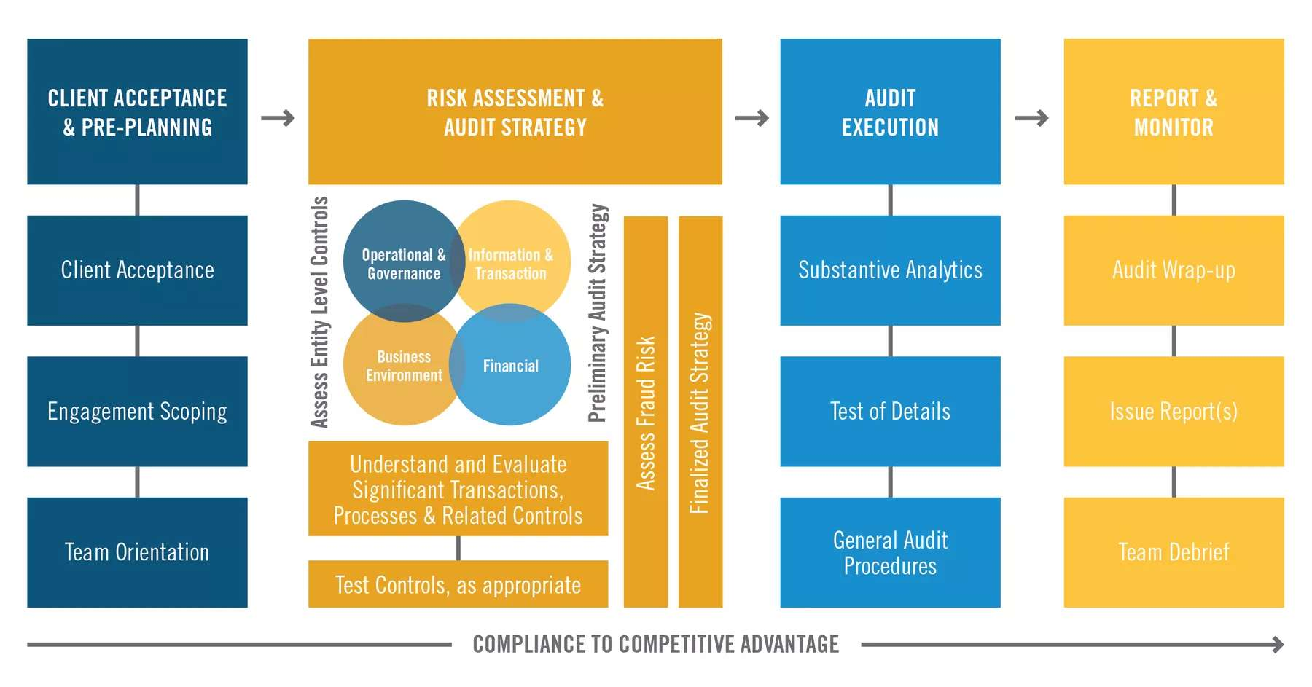
Audit Approach
Notes:
David

Slide 13
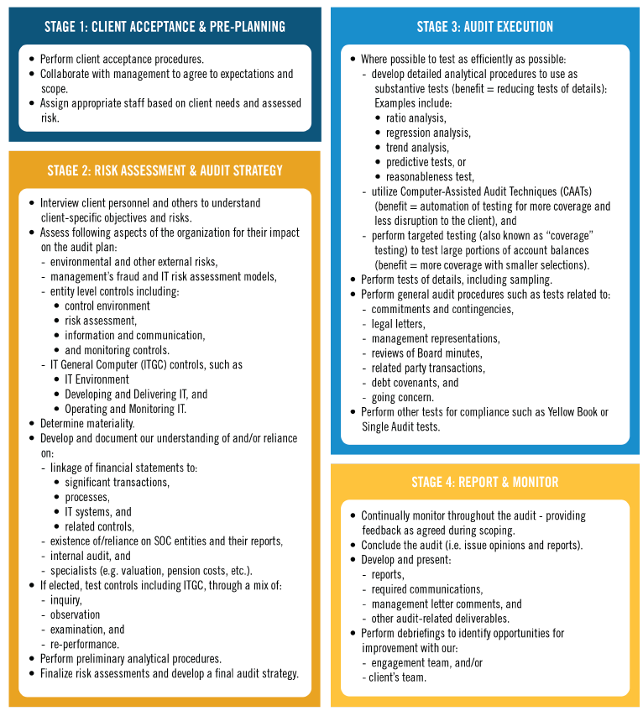
Audit Approach

Slide 14
Significant Risks Identified
GAAS requires identifying certain fraud risks as significant:
Management override of controls
Revenue recognition
Incurred but not report unpaid losses
Pension estimates
OPEB estimates
Municipal solid waste landfill estimates
Significant risks may be updated during the audit as planning evolves.

Slide 15
Communication of Issues During Audit
Significant difficulties encountered will be communicated promptly
Internal control–related matters required by standards will be communicated
Updates may be provided if audit scope or timing changes

Slide 16
- Today’s Presenter -
Becky Hammond
CPA, CISA, CITP, CGAP.
985-629-5558
bhammond@CRIadv.com

