Slide 1
Department of Sanitation Public Works Committee Meeting
March 10, 2026

Slide 2

Department of Sanitation
Organizational Structure and Staffing
Administrative Office
5 FTEs
Enforcement
5 FTEs
Field Operations
51 FTEs 4 Supervisors 16 Equipment Operators 31 Laborers
Field Operations Staffing
 | Sun | Mon | Tue | Wed | Thu | Fri | Sat
Supervisor | 2 | 3 | 4 | 4 | 4 | 2 | 1
Equipment Operator | 9 | 9 | 16 | 16 | 16 | 7 | 7
Laborer | 13 | 13 | 31 | 31 | 31 | 18 | 18

Slide 3
Department of Sanitation
2026 Adopted Budget
Personal Services | Other Operating | Total
$4,192,946 | $66,292,953 | $70,485,899
2026 Adopted Budget
FTE Allocation
Administrative Office | 5
Enforcement | 6
Field Operations | 62
TOTAL | 73
Other Operating Expenditure Categories
Collection Contracts | $55.9M
Disposal | $6.2M
Mardi Gras & Special Events | $1.7M
Miscellaneous (Admin, Supplies, Materials, Tools, Repairs) | $1.6M
City Facilities | $0.3M
Drop-Off, HHW Day, Shred Days | $0.3M
Recycling Carts | $0.2M

Slide 4
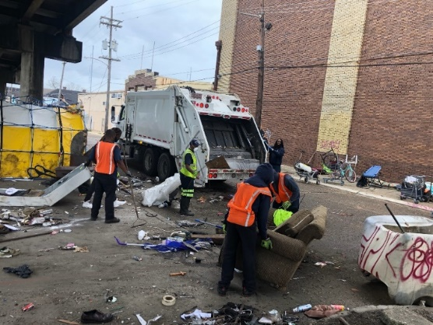
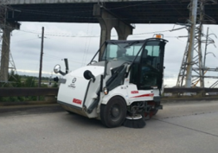
Department of Sanitation
City Services
City Services
Litter Removal (Public ROW) Public Litter Can Collection & Maintenance (~2,500 Receptacles) Mechanical Street Sweeping and Flushing on Major Thoroughfares and Bridges Illegal Dumping & Waste Tire Remediation (Public ROW) Illegal Sign Removal Mardi Gras & Special Event Clean-Up Disaster Event Clean-Up Recycling Cart/Bin Delivery & Repair Recycling Services at City Facilities Drop-Off, HHW Day, Shred Days
Transfer Station Operations Contract Oversight Enforcement of City Ordinances Regulatory Compliance Permit Approval Community Clean-Up Partnerships

Slide 5
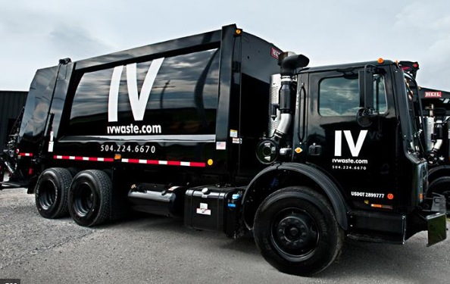
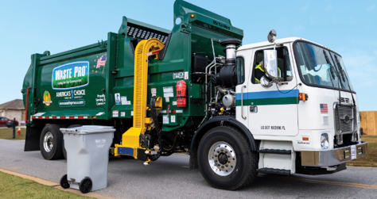
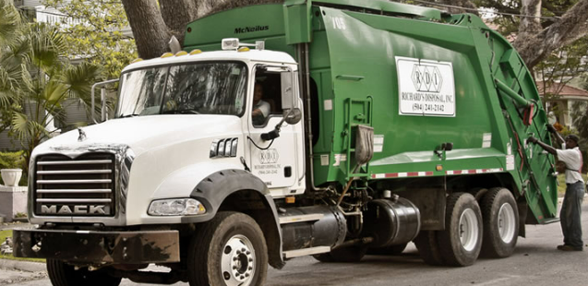
Department of Sanitation
Contractor Services
Contractor Services
Curbside Solid Waste & Recycling Collection Solid Waste Cart Delivery & Repair Dead Animal Removal French Quarter Enhanced Services Litter Removal Public Litter Can Collection Mechanical Street Sweeping & Flushing (FQ & DDD) Pressure Washing Organic Waste Removal Orphan Bag Removal Graffiti & Sticker Removal (Public ROW) Special Event Clean-Up
Landfill Disposal Solid Waste Collection at City Facilities Drop-Off, HHW Day, Shred Day Support Special Event Clean-Up (Supplemental Labor & Heavy Equipment) Disaster Event Debris Removal & Monitoring

Slide 6
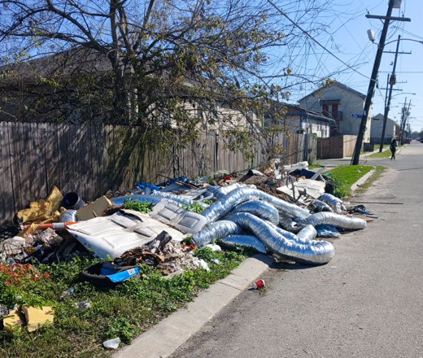
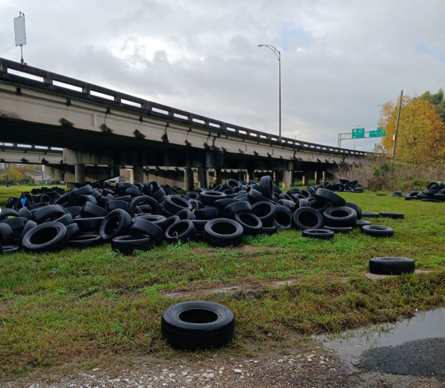
Department of Sanitation
Illegal Dumping
Department of Sanitation clears illegal dumping & waste tires from the public right-of-way.
2026 Illegal Dumping
Closed Requests | 411
Avg Days to Close | 70 days
Pending Requests | 541
Avg Days Pending | 40 days
Illegal Dumping | 2023 | 2024 | 2025
Closed Requests | 4,386 | 3,195 | 3,702

Slide 7
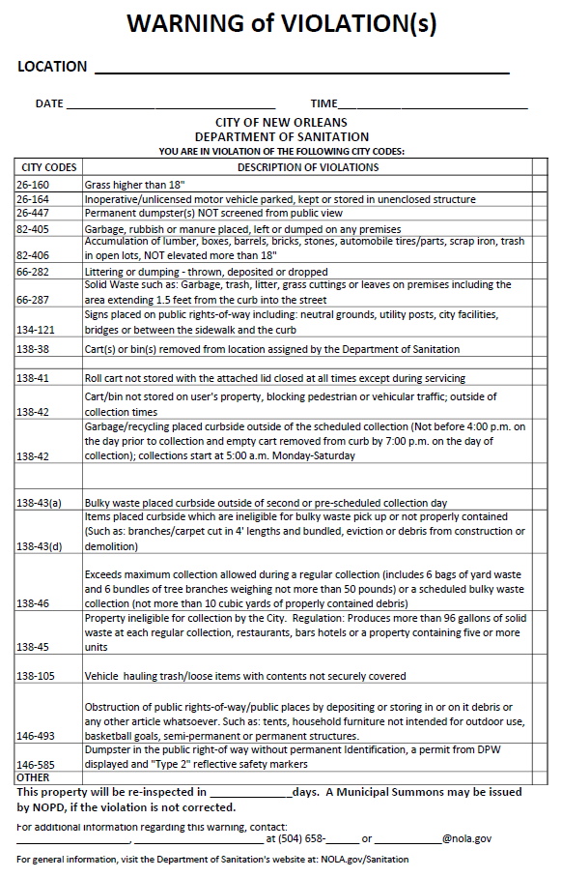
Department of Sanitation
Enforcement
Sanitation Rangers enforce the following municipal codes:
Sec 138: Solid Waste
Sec 26: Dumpsters
Sec 66: Littering & Dumping
Sec 134: Illegal Signs
Sec 30: Waste Tires
2025
Hearings | 111
Assessed Fines | $393,425
Enforcements actions:
Verbal/Written Warning
Certified Letter
Administrative Adjudication Hearing
Municipal Summons (NOPD)

Slide 8
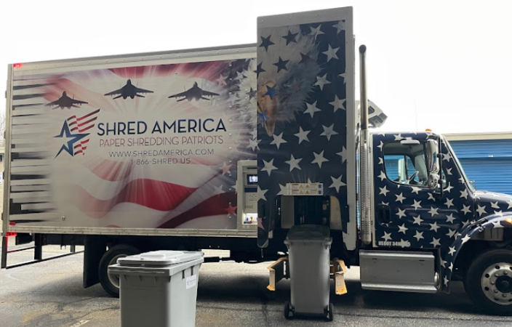
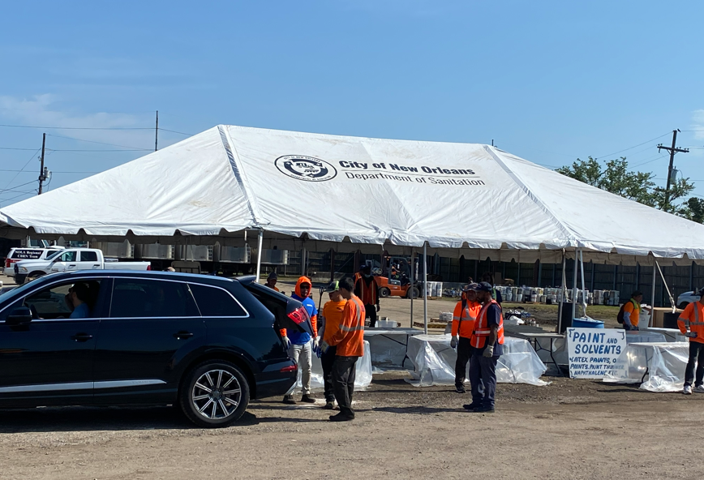
Department of Sanitation
Upcoming Events
Shred Day: Saturday, March 21
HHW Day: Saturday, April 11
2829 Elysian Fields Ave 8:00 AM – 1:00 PM nola.gov/sanitation

