Slide 1
7th Division Crime Summary
10/12/2026

Slide 2
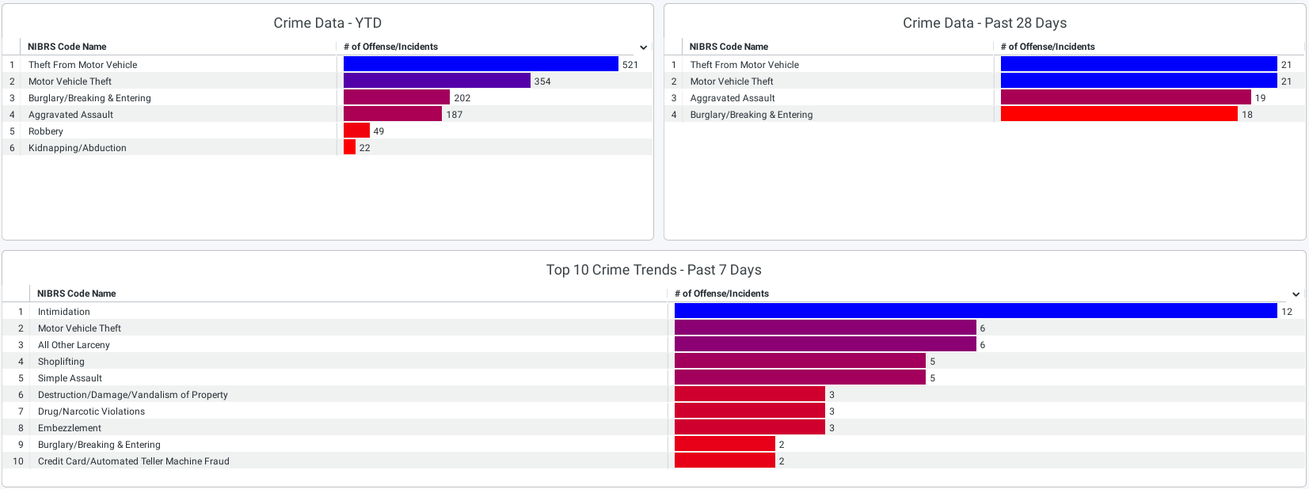
Crime Data for Year to Date / Past 28 days / Past 7 days

Slide 3
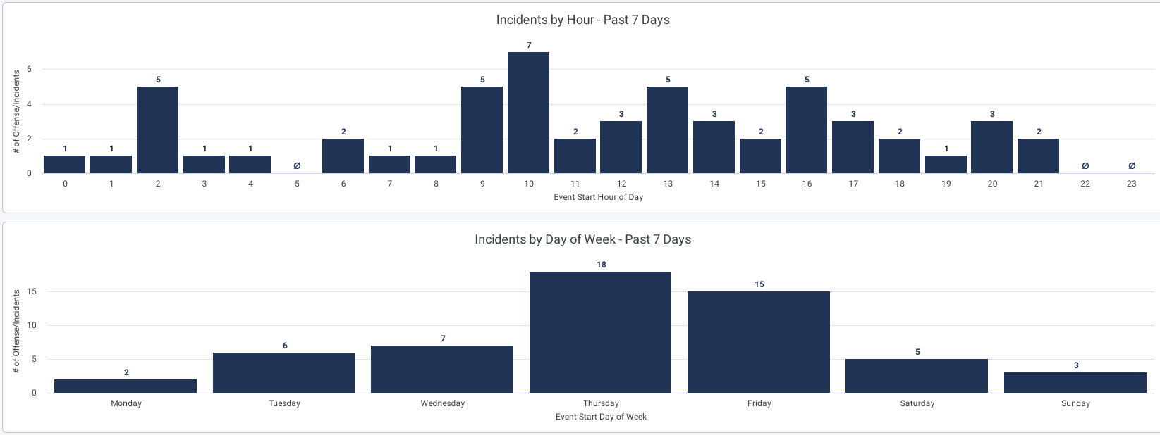
Incidents by Hour and Day of Week – Past 7 Days

Slide 4
Crime Trends – Last 28 days vs. Last 28 days, last year (Crime is currently trending down, some )
Aggravated Assaults -13.04% (-3)
Homicides -100% (-1)
Robbery -100% (-2)
Sexual Abuse and Assault -50%(-2)
Burglary -18%(-4)
Motor Vehicle Thefts -47.73%(-21)
Theft from Vehicle -61.82%(-34)
Even though crime is trending down we have seen an increase in aggravated assaults (partly due to the incident on Cutler), motor vehicle thefts and theft from vehicles (an arrest was made).

