Slide 1
7th Division Crime Summary
9/30/2026

Slide 2
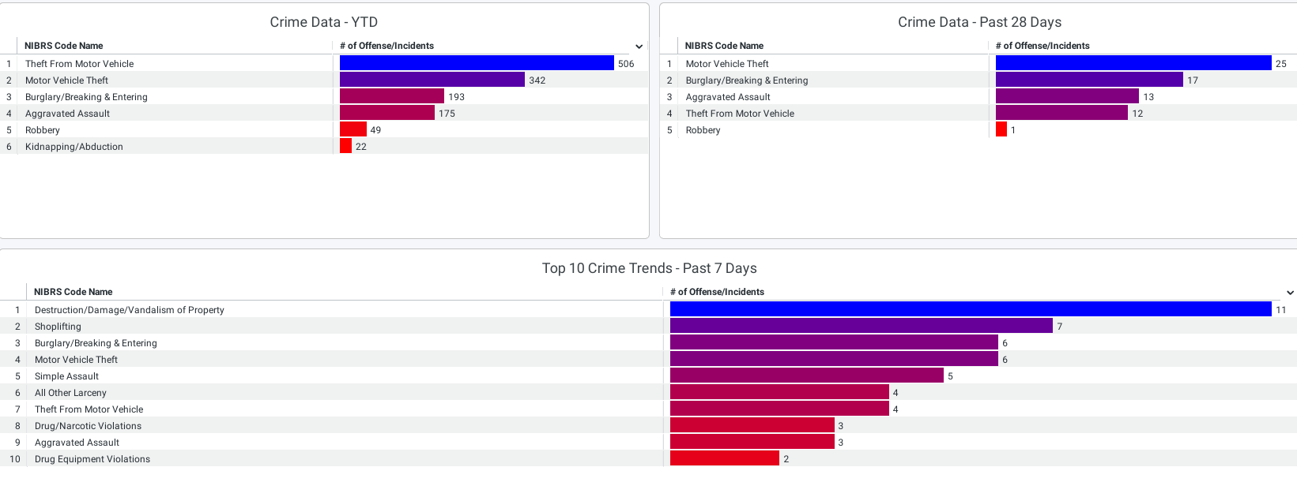
Crime Data for Year to Date / Past 28 days / Past 7 days

Slide 3
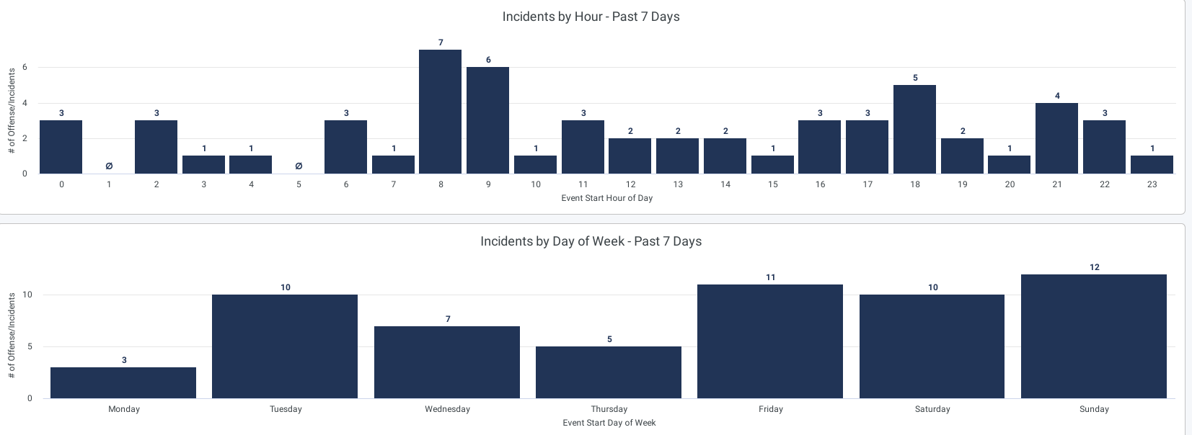
Incidents by Hour and Day of Week – Past 7 Days

Slide 4
Crime Trends – Last 28 days vs. Last 28 days, last year (Crime is currently trending down, some )
Aggravated Assaults -45.83% (-11)
Homicides -100% (-1)
Robbery -75% (-3)
Sexual Abuse and Assault -50%(-2)
Burglary -40%(-12)
Motor Vehicle Thefts -59.32%(-35)
Theft from Vehicle -76.92%(-50)
Out of the 15 theft from vehicles, we had this period 2 of them were left unlocked.

