Slide 1
7th Division Crime Summary
9/23/2026

Slide 2
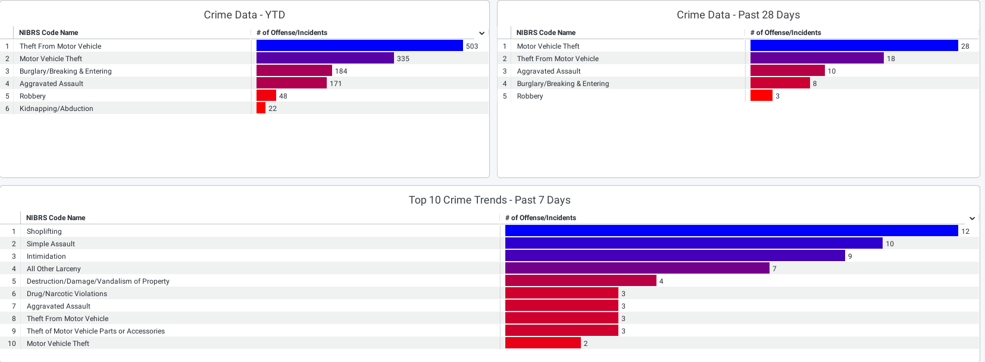
Crime Data for Year to Date / Past 28 days / Past 7 days

Slide 3
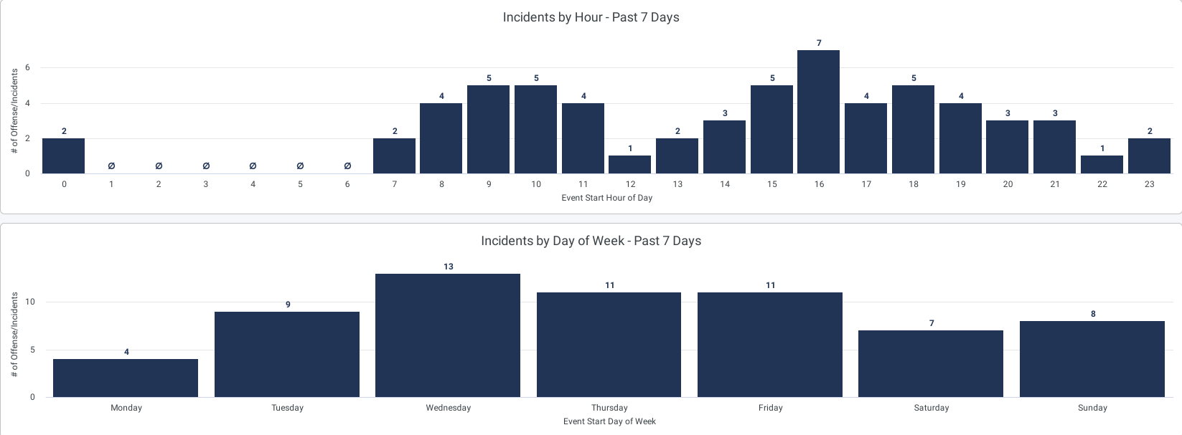
Incidents by Hour and Day of Week – Past 7 Days

Slide 4
Crime Trends – Last 28 days vs. Last 28 days, last year (Crime is currently trending down)
Aggravated Assaults -52.17% (-12)
Homicides +0% (+0)
Robbery -80% (-4)
Sexual Abuse and Assault -40%(-2)
Burglary -71.43%(-25)
Motor Vehicle Thefts -52.73%(-29)
Theft from Vehicle -78.46%(-51)
Out of the 14 theft from vehicles, we had this period 4 of them were left unlocked.

