Slide 1
7th Division Crime Report
8/10/2026

Slide 2
Aggravated Assaults
The last 28 days vs. last 28 days, last year we are down -20% (-4).
A total of 16 aggravated assaults with 6 of those not being domestic violence - 1 theft from auto attempt where the suspect and victim exchanged gun fire. 1- unknown suspect pointed a weapon at the victims during an argument. 1- a known suspect pinned the victim to a pole with a vehicle and fled the scene. 1- the victim was struck by the suspect vehicle (dispute over a dog). 1- victim was struck by the suspect’s vehicle while they were fleeing the scene of an accident. 1- an unknown suspect pointed a firearm at the victim (construction worker) at a construction site on E Manslick.

Slide 3
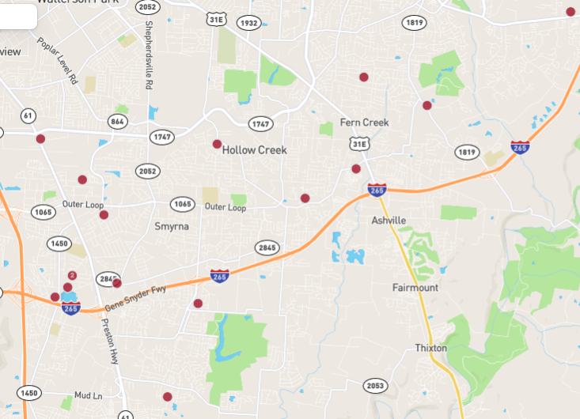
Aggravated Assault Map

Slide 4
Homicides
The last 28 days vs. last 28 days, last year we are breaking even +0% (+0).
The last 28 days vs. Previous 28 days +1. Male victim was found at McNeely Lake Park.

Slide 5
Robbery
The last 28 days vs. last 28 days, last year we are down -25% (-1).
Of the 3 robberies that occurred 1- was a female that was assaulted and robbed while walking in the 9400 block of Smyrna Pkwy around 1:00 AM. 1- shoplifting gone bad when the suspect threatened the use and displayed the handle of a firearm. 1 – suspect was not allowed on the property of McAlister’s and was attempted to take ice when he punched the employee that approached him.

Slide 6
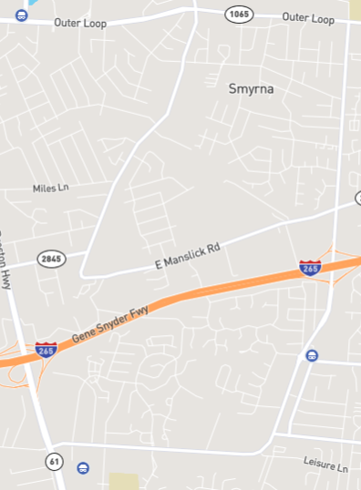
Robbery Map

Slide 7
Sexual Abuse and Assault
The last 28 days vs. last 28 days, last year we are up +66.67% (+2).
All 5 sexual abuse cases that have occurred over the last 28 days are domestic related (a family member).
This category includes everything from inappropriate touching to rape 1st.
At this time, no map will be provided for this category.

Slide 8
Burglary
The last 28 days vs. last 28 days, last year we are down -50% (-15).
Of the 15 burglaries, 6 of them occurred on beat 6 with 2 of those being storage units (Extra Storage and Rental Storage). 3 of the burglaries were domestic related, an ex making unlawful entry. 1- of the burglaries the suspect forced entry into a rear window, stole the owner’s vehicle keys and vehicle. 1- the suspect entered through a garage door that was opened approximately one foot, and they then entered the home.
Of the 15 burglaries 2 occurred in the middle of the night and the remaining 13 either occurred from 6:00 AM to 11:00 AM or 6:00 PM to 10:00 PM.

Slide 9
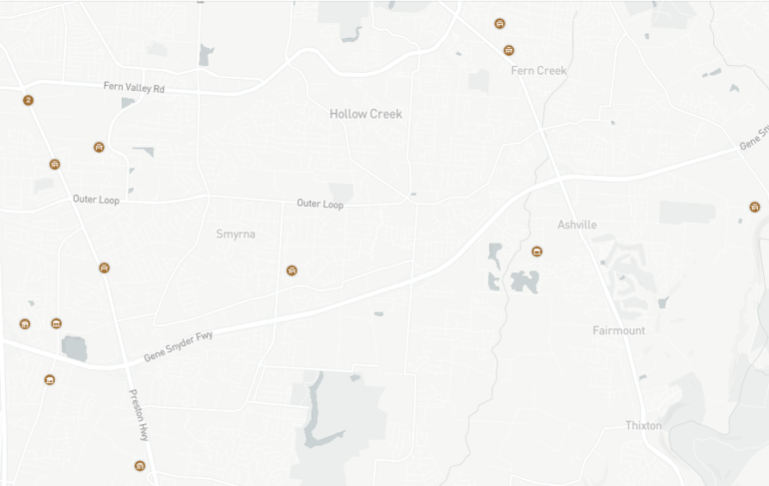
Burglary

Slide 10
Motor Vehicle Thefts
The last 28 days vs. last 28 days, last year we are down -44% (-33).
Of the 42 that occurred 16 were on beat 4 and 10 occurred on beat 3. Approximately 70% of the 42 occurred between the hours of 10:00 PM and 7:00 AM with the remainder between 2:00 PM and 9:00 PM. Only a few were left unlocked and approximately 35% were attempted thefts.

Slide 11
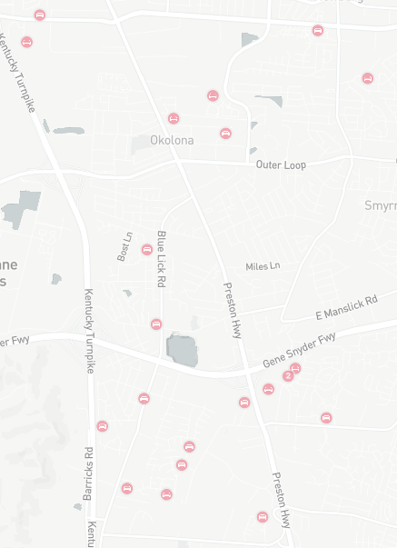
Motor Vehicle Thefts

Slide 12
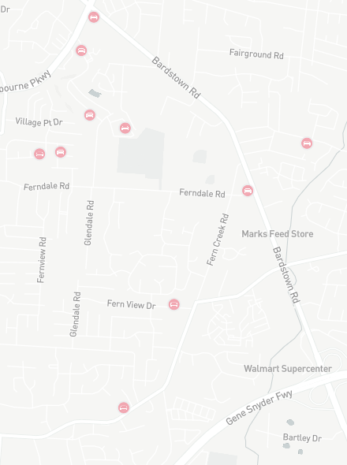
Motor Vehicle Thefts

Slide 13
Theft from Vehicles
The last 28 days vs. last 28 days, last year we are up +3.77% (+2).
Of the 55, 32 were completed and 23 attempted.
The majority occurred on the following beats: 15 on beat 1, 11 on beat 3 and 14 on beat 6.

Slide 14
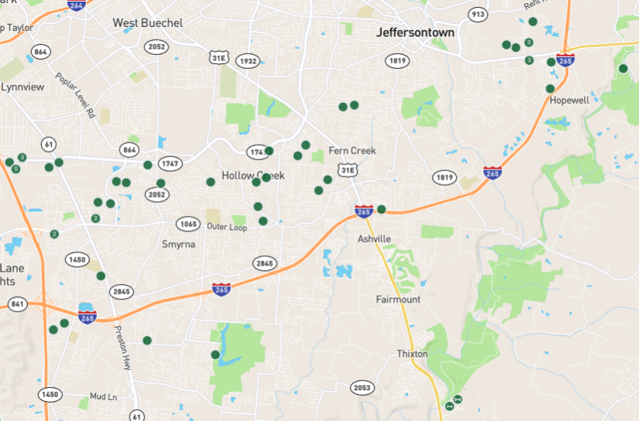
Theft from Vehicles

