Slide 1
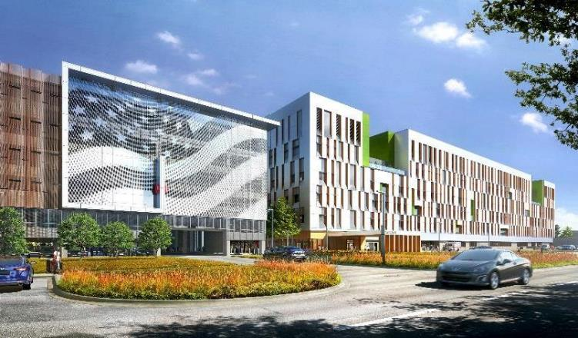
Construction of the New Louisville VA Medical Center COL Eric Crispino Commander Louisville District U.S. Army Corps of Engineers
11 December 2021

Slide 2
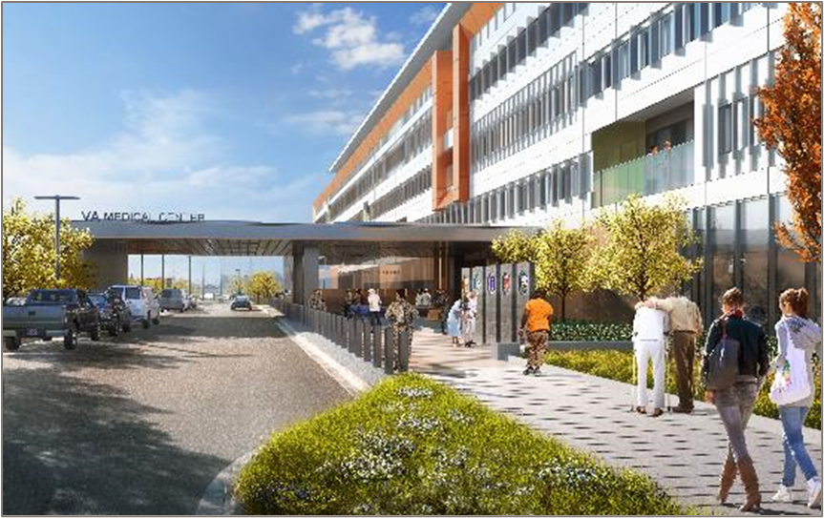
AGENDA
Project Overview
Construction Schedule
Construction Activities
Frequently Asked Questions
Contact Information

Slide 3
stakeholders
USACE
HQ PMO
LRD
Louisville District
MX
Department of Veterans Affairs
Construction and Facilities Management
VISN 9
Robley Rex Medical Center
Construction Contractor
Designer of Record / AE

Slide 4
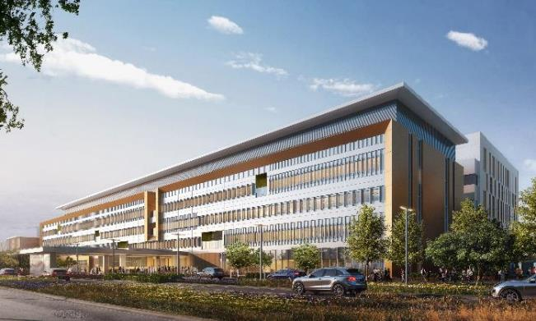
PROJECT OVERVIEW
Scope
$840 million
972,000 square feet
(915k hospital, 42k central utility plant 18k laundry)
104 bed, full-service hospital
2 parking structures
Laundry facility
Central Utility Plant & underground utility distribution
Roadways, sidewalks, perimeter fencing, landscaping and other site improvements
View from East

Slide 5
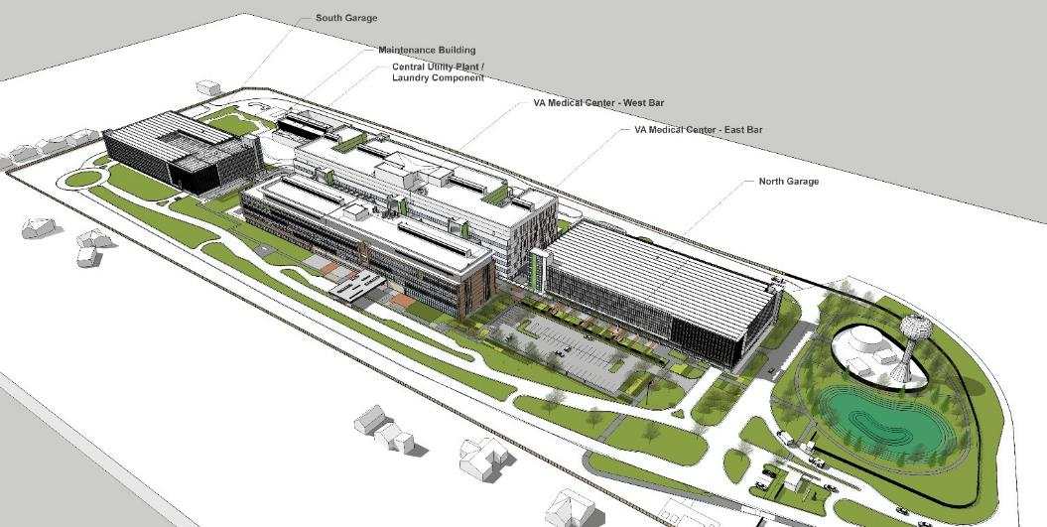
Campus view (looking southwest)

Slide 6
Construction overview
Timothy Hitchcock
Area Engineer
U.S. Army Corps of Engineers Louisville District

Slide 7
Safety
is
Priority #1

Slide 8
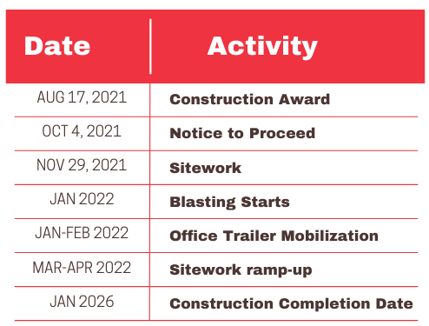
Construction schedule

Slide 9
Construction Activities
Normal Construction Activities 7:00 a.m. to 5:00 p.m.
Louisville Metro Noise Ordinance restricts construction activities to not extend past 9:00 p.m.
Monday - Saturday
Additional days/times will be coordinated/approved by USACE.

Slide 10
Expectations during construction
Noise
Louisville Metro Noise Ordinance restricts construction activities to 7:00 a.m. to 9:00 p.m.
Dust Control
Dust control measures will be monitored/maintained throughout the life of the project. Some typical measures include dust mitigation through application of water/reducing agents, wet saw cutting, and no dry street sweeping.
Utility outages Any expected outages to utilities will be coordinated prior to and affected homeowners will be notified in advance. No outages scheduled in the immediate future.
Construction Vehicle Route
Trucks and equipment will only utilize the access point at KY22 (main entrance) to enter/exit the site. Neighborhood roads will not be used for ingress/egress.

Slide 11
Blasting
Blasting
Necessary to excavate the solid rock
In-ground blasts (inherently less noisy/dusty)
Pre-inspection surveys offered within 500-ft radius
Blast/safety specialists on site
Warning signals (5 min, 1 min, & All Clear)
Test blasts to be performed
Vibration sensors/monitors will be utilized
Tentative Schedule
Starts JAN 2022 through APR 2022
Daily blasts from approx. 2:00-4:00 p.m.
Blast schedule will be made available

Slide 12
Blasting – Frequently Asked QUestions
Eligibility for a pre-blast inspection
Residents and business owners within 500-foot radius of the blast site are eligible for a complimentary pre-blast inspection.
What process do we follow if we believe there has been damage?
For property owners who had a pre-blast survey performed that believe their property has been damaged as a result of blasting please utilize the information provided in the pre-blast survey and contact the field representative identified.

Slide 13
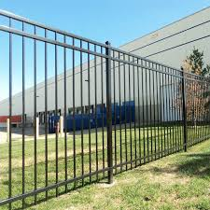
Frequently asked questions
Site Fencing/Privacy
During construction = chain link fence along the perimeter of the construction site.
Permanent perimeter fence = a nine-foot-tall galvanized steel, square picket fence.
There is an extensive landscaping plan for the site, which includes numerous shade and ornamental trees that will be planted along the property boundary.
Permanent Perimeter Fence
Example

Slide 14
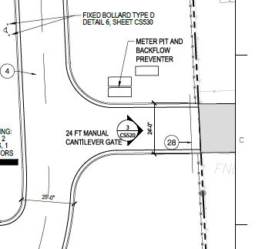
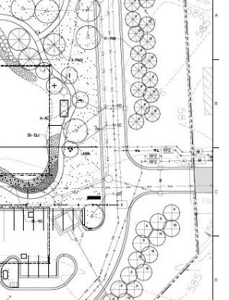
Frequently asked questions
Ingress/Egress on Carlimar Lane
While the VA site does connect to Carlimar Lane, the access point will be gated and will only be used for emergency access both during construction and after construction completion. The construction contractor is not to use this entrance for their work.
Gated access
Perimeter landscaping

Slide 15
Contact info
For project updates:
www.va.gov/louisville-health-care/programs/new- robley-rex-va-medical-center/
Submit construction-related questions here: LOUVAMCconstruction@usace.army.mil
-E-mail us to be added to an e-mail list for weekly construction updates.
-Weekly construction updates will also be posted on the VA webpage.

